Slide 1








Given a hypothesis, what
experiment should we run next?
Helping microbiome researchers test whether a compound inhibits a pathogen
while sparing commensal bacteria.
Aidan
Emmy
Jimmy
Ramith
Zhang
Nguyen
Hsu
Hettiarachchi
Team Zhang et al.
(Biotech Track: Problem #2)
Sanjyot
Seh Na
Xiaochen
Shenoy
Mellick
Zhai
1
Notes:
Open with the researcher’s decision: given a hypothesis, what experiment should we run next? Our motivating user is a microbiome researcher testing whether a supplied compound inhibits a pathogen while sparing commensals. We propose evidence-grounded experiments for researcher review; selective inhibition is the hypothesis, not a demonstrated outcome.
Editable PowerPoint: each click state is a named group in the Selection Pane. Ungroup a state to reuse text, shapes, charts and tables. Photos and web/video previews remain images.

Slide 2
Inhibit the pathogen. Spare the commensals?
Inhibit the pathogen. Spare the commensals?
Inhibit the pathogen. Spare the commensals?
Inhibit the pathogen. Spare the commensals?
X
X
For a microbiome researcher:
For a microbiome researcher:
For a microbiome researcher:
a candidate compound, selected strains.
a candidate compound, selected strains.
a candidate compound, selected strains.
Will
Will
compound X
compound X
inhibit the
inhibit the
pathogen while sparing these
pathogen while sparing these
commensals?
commensals?
What experiment
would answer this?
Measure the effect on the pathogen
Pathogen
Pathogen
Pathogen
Commensals
Commensals
Commensals
and on the commensals.
2
2
2
2
Notes:
0:00–0:50. Step 1: show only the title and a centered neutral bacterial plate. Step 2: introduce a microbiome researcher with a candidate compound and selected strains. Explain that activity against the pathogen alone is not enough: the experiment must also measure the effect on commensals. Color the pathogen and commensals, reveal the labels and move the plate left. Step 3: reveal compound X and the question, draw a T-ended inhibitory connection to the pathogen, then grey it out. This visualizes the hypothesized selective effect, not measured inhibition or survival; keep the spoken framing as a question. Step 4: ask what experiment would answer it, then advance to the missing-link graph. Compound discovery and strain selection are upstream. We support turning a supplied research question into a justified experiment. No clinical or wet-lab outcome is claimed.
Editable PowerPoint: each click state is a named group in the Selection Pane. Ungroup a state to reuse text, shapes, charts and tables. Photos and web/video previews remain images.

Slide 3
A question for our knowledge base
A question for our knowledge base
A question for our knowledge base
A question for our knowledge base
A question for our knowledge base
“Does compound X inhibit strain Y?”
“Does compound X inhibit strain Y?”
“Does compound X inhibit strain Y?”
“Does compound X inhibit strain Y?”
Compounds
Compounds
Strains
Compounds
Strains
Compounds
Compounds
Strains
Strains
Strains
X
X
Y
Y
X
Y
?
This measurement is missing. What experiment would answer it?
3
3
3
3
3
Notes:
Abstract bipartite knowledge base: two compound nodes on the left and three strain nodes on the right. All existing edges cross the partitions. Start unlabeled; reveal the researcher question; identify X and Y; zoom and dim surrounding knowledge; highlight the missing X–Y measurement. The demonstration assumes an up-to-date KB and researcher-supplied identities. Known evidence would be returned with citations; the researcher decides whether another experiment is worthwhile. The missing link here is genuinely unanswered under an up-to-date-KB assumption, not a literature-completeness judgment. Concealing evidence is reserved for benchmark simulation. This is not an actual query trace.
Editable PowerPoint: each click state is a named group in the Selection Pane. Ungroup a state to reuse text, shapes, charts and tables. Photos and web/video previews remain images.

Slide 4
Use what’s known to design what we test next
Use what’s known to design what we test next
Use what’s known to design what we test next
Use what’s known to design what we test next
Related
Related
Related
Related
compounds
compounds
compounds
compounds
A
A
A
A
Proposal
Compound X · supplied
Supporting papers
Supporting papers
Supporting papers
strains
B
B
B
B
Y
Y
Y
Y
Assay & readout
Concentration series
Strain of interest
Strain of interest
Strain of interest
Strain of interest
Controls & replicates
C
C
C
C
Rationale & citations
Known activity
Known activity
Known activity
Known activity
Protocol templates
Protocol templates
4
4
4
4
Notes:
Conceptual bacterial workflow. Related compounds have measured activity on the organism of interest. Papers support those measurements; protocol templates are a separate source of assay structure, controls and defaults, not necessarily the original protocols from those papers. Together they inform a reviewable experiment proposal for compound X and the supplied panel. Species-level evidence does not establish a result for every strain. Current agent retrieval is IC50-based; the bacterial graph and downstream MIC execution exist separately. No end-to-end bacterial run or measured inhibition is claimed. Proposal fields shown here are categories, not populated experimental recommendations.
Editable PowerPoint: each click state is a named group in the Selection Pane. Ungroup a state to reuse text, shapes, charts and tables. Photos and web/video previews remain images.

Slide 5
Propose an experiment—and show why
Propose an experiment—and show why
Propose an experiment—and show why
An assay, concentration range, controls and procedure,
An assay, concentration range, controls and procedure,
An assay, concentration range, controls and procedure,
with supporting evidence for the researcher to review.
with supporting evidence for the researcher to review.
with supporting evidence for the researcher to review.
Hypothesis
Our system · implemented
Our system · implemented
Our system · implemented
refinement
Answer exists
Answer exists
Answer exists
Return result
Return result
Return result
and sources
and sources
and sources
Researcher’s
Researcher’s
Researcher’s
Check the
Check the
Check the
question
question
question
knowledge base
knowledge base
knowledge base
Measurement missing
Measurement missing
Measurement missing
Researcher / lab
Researcher / lab
Researcher / lab
Propose an
Propose an
Propose an
Review
Review
Review
experiment
experiment
experiment
and run
and run
and run
Add measured results
Add measured results
and sources to the KB
and sources to the KB
Q/A backup ↗
Q/A backup ↗
Q/A backup ↗
5
5
5
Notes:
3:00–4:00. The accented region identifies implemented system behavior: both returning an existing answer and proposing an experiment when a measurement is missing. Solid internal connections represent these implemented paths; the distinction is implementation status, not benchmark coverage. The researcher supplies the question and reviews a proposed experiment before the lab runs it. Show both implemented branches and the researcher/lab handoff on arrival; then reveal the result feedback loop, followed by upstream hypothesis refinement. Muted dotted arrows identify proposed connections: hypothesis refinement and measured-result ingestion. Researcher/lab review and execution remain outside the system box; the solid handoff does not claim autonomous experimental execution. The feedback loop adds measured results, assay conditions and provenance, including negative results, to the KB. Hypothesis refinement sharpens an existing idea into a testable question. The current connected agent is IC50-based; this conceptual diagram does not establish an end-to-end bacterial run. Existing evidence does not prevent confirmatory experiments.
Editable PowerPoint: each click state is a named group in the Selection Pane. Ungroup a state to reuse text, shapes, charts and tables. Photos and web/video previews remain images.

Slide 6
Can the model design the missing experiment?
Can the model design the missing experiment?
Can the model design the missing experiment?
Can the model design the missing experiment?
Kimi K3.1 Pro
DeepSeek V4.1 Flash
GLM 5.3
Nemotron 3 Super
Hide a known measurement and its source papers.
Hide a known measurement and its source papers.
Hide a known measurement and its source papers.
GPT-OSS-120B
Astra medium
Supply evidence and protocol steps with unfilled parameters.
Supply evidence and protocol steps with unfilled parameters.
Supply evidence and protocol steps with unfilled parameters.
Ask each model to design the missing experiment.
Ask each model to design the missing experiment.
Ask each model to design the missing experiment.
Experiment choice
Experiment choice
Procedure
Procedure
Numbers
Numbers
Does the assay answer
Does the assay answer
Are the steps sound
Are the steps sound
Are parameters justified
Are parameters justified
the question?
the question?
and complete?
and complete?
and internally consistent?
and internally consistent?
EXAMPLE · KINASE BENCHMARK
Design a concentration–response experiment to measure
haspin inhibition by CHEMBL4278808.
Mean score across 20 cases · 3 criteria, 0–2 each · score out of 6
6
6
6
6
Notes:
4:00–5:15. Four beats: test setup; three assessment criteria; a shortened version of the actual case-1 question; then the results figure. The original case-1 prompt additionally asks for an ordered procedure and justified parameters and forbids remembered potency. In a benchmark simulation, known query-pair evidence and its source documents are excluded from fixed input packets. Six models each produce one response on 20 manually selected, correlated kinase/cell cases (120 responses). Generation uses those fixed packets, with no live graph retrieval. Grade experiment suitability, procedural soundness and numerical soundness, 0–2 each per case. The chart shows mean total scores out of 6 across 20 cases. The original 100 responses were regraded with a frozen rubric by blinded Astra-medium judges; scores are provisional, not expert validation or pass rates. One judge sample per response; no inter-rater agreement estimate. Critical-failure case counts, separate from mean scores: Kimi 0/20, DeepSeek 1/20, GLM 8/20, Nemotron 17/20, GPT-OSS 19/20; Astra medium 0/20. Astra adds 20 proposals scored 4.10/6; it also serves as judge in separate fresh contexts, so same-model preference is possible. Astra generation uses medium reasoning and a different serving interface; prior candidates used low reasoning. Source: benchmark/runs/astra-medium-20/RESULTS.md at aff33ef. No statistical ranking, deterministic baseline, measured KG lift or MIC end-to-end result is established. Models: Kimi K3.1 Pro, GLM 5.3 (not Flash), DeepSeek V4.1 Flash 1017, Nemotron 3 Super, GPT-OSS-120B. Concrete finding, in plain language: one DeepSeek response told the researcher to prepare 11 different concentrations, but the same response listed 10 in its experiment settings. A person would need to resolve that disagreement before using the proposal. Protocol steps here are seven manually generalized benchmark cards with parameter slots and prerequisites, not raw graph nodes or automatically extracted paper protocols. Sources: biohack/data/pilot_results.json and benchmark/judge/RESULTS.md at source commit c1a0e32, plus committed benchmark/runs outputs. Keep detailed axis scores and limitations for Q/A.
Editable PowerPoint: each click state is a named group in the Selection Pane. Ungroup a state to reuse text, shapes, charts and tables. Photos and web/video previews remain images.

Slide 7
How the scores break down
Kimi K3.1 Pro
DeepSeek V4.1 Flash
GLM 5.3
Nemotron 3 Super
GPT-OSS-120B
Astra medium
Mean score per criterion across 20 cases · each criterion is scored 0–2
0 = materially wrong · 1 = plausible but incomplete · 2 = supported
7
Notes:
Each bar is the mean of 20 case scores on one criterion, from 0 to 2. These three means sum to the preceding total out of 6. Zero means materially wrong; one is plausible but incomplete; two is supported for that criterion. Scores are provisional Astra-medium judgments, not pass rates or wet-lab validation. Astra generated its own candidate responses at medium reasoning using a different serving interface and was judged by fresh Astra contexts; same-model preference is possible. Source: biohack/data/pilot_results.json and the linked benchmark reports. A procedure score of 1 can reflect an honest outline with unresolved lab settings.
Editable PowerPoint: each click state is a named group in the Selection Pane. Ungroup a state to reuse text, shapes, charts and tables. Photos and web/video previews remain images.

Slide 8
Can the model write a runnable OT-2 protocol?
Can the model write a runnable OT-2 protocol?
Simulator gate: 1 / 5 passed on the first attempt
Simulator gate: 1 / 5 initially → 4 / 5 after repair; liquid-handling errors remain
Initial answer
Initial answer
After repair (penalty included)
After repair (penalty included)
Score / 100 · one sample per model · up to 3 repairs · −5 points per repair · failed gate = 0
Score / 100 · one sample per model · up to 3 repairs · −5 points per repair · failed gate = 0
Jimmy’s supplied results · simulation ≠ wet-lab validation ·
Jimmy’s supplied results · simulation ≠ wet-lab validation ·
Data ↗
Data ↗
8
8
Notes:
Separate OT-2 MIC protocol benchmark supplied by Jimmy on 2026-11-08; not an end-to-end execution of the preceding kinase/cell proposals. Five models, one initial sample each, high reasoning effort. Same MIC prompt; 16 weighted rubric rows normalized to 100. A failed simulator/hardware gate scores zero. Up to three repairs using simulator feedback, with five points deducted per repair. Gate pass count rises from one to four, but correct liquid handling is not guaranteed: GPT-OSS passes after three repairs while its dilution/control logic is wrong. Nemotron still fails after three repairs. Repair counts in chart order: 0, 1, 2, 3, 3. Reference scores 100. Model labels and scores are as supplied; independent reproduction is pending. Source: benchmark/step3_MIC_benchmark/candidates_step3/benchmark_before_after.md and leaderboard.csv. Source documents simulator API-level adjustments. This small benchmark does not establish statistical superiority or wet-lab success.
Editable PowerPoint: each click state is a named group in the Selection Pane. Ungroup a state to reuse text, shapes, charts and tables. Photos and web/video previews remain images.

Slide 9
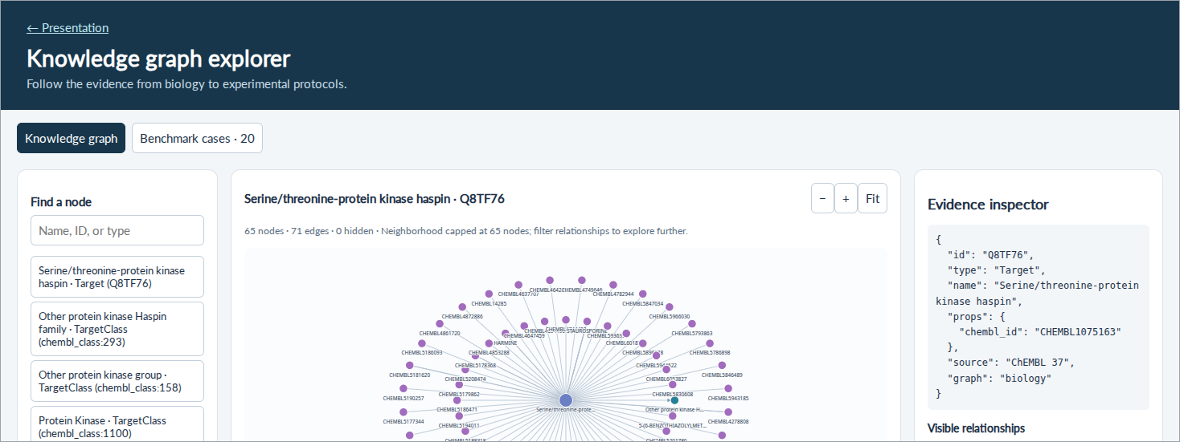
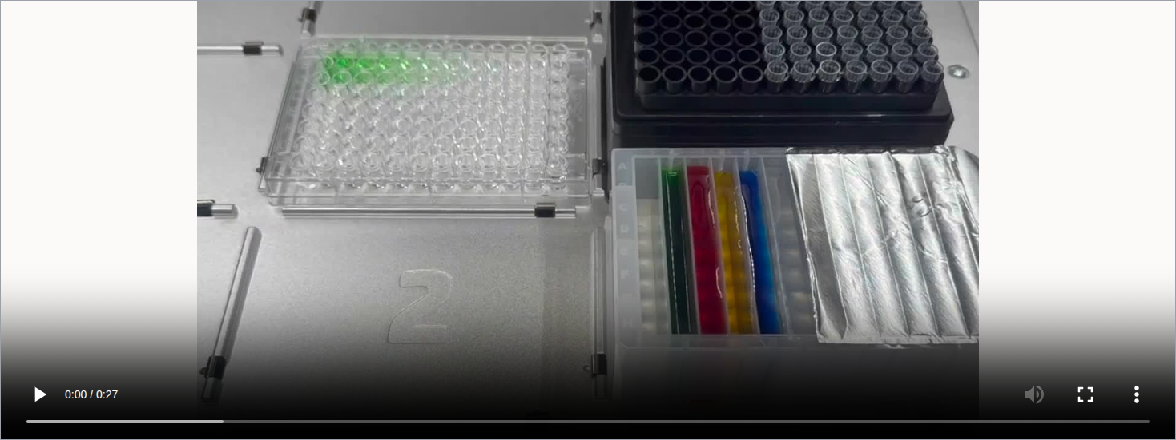
Inspect the evidence, design and checks
OT-2 liquid-handling demonstration
Case viewer ↗
Case viewer ↗
Recorded output ↗
Recorded output ↗
Separate MIC run sheet ↗
Separate MIC run sheet ↗
OT-2 video ↗
OT-2 video ↗
Recorded case review · MIC execution example starts from a separate hand-written proposal · 3-minute demo
27-second hardware demonstration · colored-liquid run
9
9
Notes:
5:15–8:15, strict three-minute evidence walkthrough. 0:00–0:30 establish the question and show the supplied case input. 0:30–1:30 inspect retained evidence and step cards in the benchmark-case tab; the withheld answer is reviewer-only. 1:30–2:15 reveal the held-out record and discuss experiment/steps/numbers; open the recorded model output via the link if useful. 2:15–3:00 advance to the second reveal and play the 27-second OT-2 hardware demonstration. The clip shows the team’s colored-liquid run; it is not established as the execution of the model proposal or the separate generated MIC protocol. The MIC run sheet remains linked for inspection. This last artifact begins from a hand-written four-species proposal; it is NOT the execution of the model output just shown. Say so explicitly. This is a recorded-artifact walkthrough, not a live agent run. If the UI is slow, use the pre-opened pages; do not run paid model calls during the pitch. No wet-lab outcomes claimed.
Editable PowerPoint: each click state is a named group in the Selection Pane. Ungroup a state to reuse text, shapes, charts and tables. Photos and web/video previews remain images.

Slide 10
Backup slides
Original deck · supporting detail and Q/A
10
Notes:
The timed pitch ends after the preceding demo slide. The remaining nineteen slides from the original deck follow for questions and reference.
Editable PowerPoint: each click state is a named group in the Selection Pane. Ungroup a state to reuse text, shapes, charts and tables. Photos and web/video previews remain images.

Slide 11
Which bacteria should survive treatment?
Which bacteria should survive treatment?
Which bacteria should survive treatment?
Antibiotics can disrupt the gut microbes that help protect us, leaving an
Antibiotics can disrupt the gut microbes that help protect us, leaving an
Antibiotics can disrupt the gut microbes that help protect us, leaving an
opening for infections such as
opening for infections such as
opening for infections such as
C. difficile
C. difficile
C. difficile
.
.
.
130+
130+
A published proof of concept
A published proof of concept
Lolamicin treated infections while preserving the gut
Lolamicin treated infections while preserving the gut
drug-resistant clinical isolates
drug-resistant clinical isolates
microbiome and preventing secondary
microbiome and preventing secondary
C. difficile
C. difficile
infection
infection
in
inhibited by lolamicin
in
inhibited by lolamicin
in vitro
in vitro
mice
mice
.
.
Our next experiment must test both sides of selectivity.
A candidate + specified strains + a question → a grounded experiment design.
Muñoz et al., Nature (2024) · doi:10.1038/s41586-024-07502-0 · Published evidence, not our results
Muñoz et al., Nature (2024) · doi:10.1038/s41586-024-07502-0 · Published evidence, not our results
Muñoz et al., Nature (2024) · doi:10.1038/s41586-024-07502-0 · Published evidence, not our results
11
11
11
Notes:
Open with the consequence: an antibiotic can inhibit a pathogen while also disrupting gut bacteria that help resist colonization by opportunistic pathogens. Pathogen potency alone does not establish microbiome preservation. This motivates measuring both sides early in discovery. Published proof of concept: Muñoz et al., A Gram-negative-selective antibiotic that spares the gut microbiome, Nature 630, 429–436 (2024), doi:10.1038/s41586-024-07502-0. https://www.nature.com/articles/s41586-024-07502-0 ; https://pubmed.ncbi.nlm.nih.gov/38811738/ . The authors report activity against more than 130 multidrug-resistant clinical isolates and efficacy in mouse infection models, with microbiome preservation and prevention of secondary C. difficile infection in mice. These are separate in-vitro and animal findings, not human efficacy or results from our system. Our researcher supplies a candidate and specified bacterial strains; selecting either is upstream. The proposed workflow connects available biological evidence to an appropriate concentration series, culture requirements and a lab-feasible MIC plan. A panel MIC assay is an early selectivity screen; it cannot establish whole-microbiome safety, human exposure, clinical benefit or efficacy. The immediate output is a reviewable experiment, and the longer-term motivation is finding candidates with less collateral microbiome damage.
Editable PowerPoint: each click state is a named group in the Selection Pane. Ungroup a state to reuse text, shapes, charts and tables. Photos and web/video previews remain images.

Slide 12
A testable plan for an antimicrobial candidate
A testable plan for an antimicrobial candidate
A testable plan for an antimicrobial candidate
Which experiment will tell us whether a candidate inhibits pathogens while
Which experiment will tell us whether a candidate inhibits pathogens while
Which experiment will tell us whether a candidate inhibits pathogens while
sparing commensals?
sparing commensals?
sparing commensals?
For the researcher
For the researcher
For the researcher
A researcher with compound X, specified strains and a question.
A researcher with compound X, specified strains and a question.
A researcher with compound X, specified strains and a question.
Compound discovery and strain selection happen upstream.
Compound discovery and strain selection happen upstream.
Compound discovery and strain selection happen upstream.
Immediate benefit
Immediate benefit
A cited experiment design grounded in templates and lab
A cited experiment design grounded in templates and lab
constraints.
constraints.
The query guides assay selection; an optional assay preference narrows the
The query guides assay selection; an optional assay preference narrows the
search.
search.
Our contribution
Biological evidence + protocol knowledge + lab constraints.
The proposed distinction is a traceable antimicrobial evidence-to-assay handoff.
Known evidence → citations · unanswered question → grounded design · researcher decides whether to run
12
12
12
Notes:
Grounding agreement: assume the KB is up to date. Known evidence is returned with citations; the researcher decides whether to run another experiment. The demo follows a genuinely unanswered question, not incomplete-literature meta-analysis. An incompatible proposal must stop before compilation or hardware execution, even if its limitations are displayed. This is the required workflow, not proof that current runtime gates implement it. Whether LLM step assembly improves on template selection and parameter filling remains open. Evaluate appropriate experiment, sound steps and reasonable numerical parameters. Hiding known evidence simulates the missing-information case only in evaluation. Our immediate end-user is an antimicrobial discovery researcher moving a candidate from a virtual screen into experimental testing. Given specified bacterial strains, the question is how to measure pathogen inhibition and effects on commensals with an appropriate MIC experiment. The intended immediate benefit is less manual translation from evidence to a reviewable assay plan; time savings and biological selectivity have not been measured. Strain selection is upstream of this workflow, alongside compound discovery. MIC means minimum inhibitory concentration. Our contribution is the combination of biological evidence, protocol knowledge and explicit lab constraints in one traceable workflow. We do not claim a new foundation model or a demonstrated first-in-industry algorithm. Industry context: Benchling offers AI experimental design and instrument-connected automation; Opentrons Protocol Designer creates executable robot protocols. Our proposed distinction is the focused antimicrobial evidence-to-assay handoff, to be evaluated rather than asserted as superior. Sources: https://www.benchling.com/ai/experimental-design ; https://www.benchling.com/automation ; https://docs.opentrons.com/protocol-designer/ . Commensal-sparing is an illustrative goal, not a validated result. Sparse commensal measurements and species-specific culture and oxygen requirements limit what can be inferred or executed. Patient benefit is a longer-term motivation; this prototype supports research decisions.
Editable PowerPoint: each click state is a named group in the Selection Pane. Ungroup a state to reuse text, shapes, charts and tables. Photos and web/video previews remain images.

Slide 13
A source record becomes a graph connection
A source record becomes a graph connection
A source record becomes a graph connection
One recorded experiment
One recorded experiment
One recorded experiment
C. difficile
C. difficile
Organism
J. Med. Chem. · 2000
Organism
J. Med. Chem. · 2000
J. Med. Chem. · 2000
MIC = 50 µg/mL
CHEMBL1133633
MIC = 50 µg/mL
CHEMBL1133633
CHEMBL1133633
CHEMBL420452
CHEMBL420452
ChEMBL assay CHEMBL876060
ChEMBL assay CHEMBL876060
ChEMBL assay CHEMBL876060
Compound
Compound
“Antimicrobial activity was measured
Shared source
“Antimicrobial activity was measured
“Antimicrobial activity was measured
against Clostridium difficile organism.”
CHEMBL1133633
against Clostridium difficile organism.”
against Clostridium difficile organism.”
MIC
MIC
= 50 µg/mL
= 50 µg/mL
Compound, organism, value, unit and
MIC = 50 µg/mL
Compound, organism, value, unit and
source stay linked.
source stay linked.
B. fragilis
A second assay adds B. fragilis.
Organism
This is not a selectivity result.
Actual imported ChEMBL records · small graph excerpt · no PDF extraction claimed
Actual imported ChEMBL records · small graph excerpt · no PDF extraction claimed
Actual imported ChEMBL records · small graph excerpt · no PDF extraction claimed
13
13
13
Notes:
Literal ChEMBL 37 graph_bacteria records for CHEMBL420452. Assay CHEMBL876060 reports MIC = 50 ug.mL-1 against C. difficile, linked to document CHEMBL1133633, J Med Chem (2000). Second assay CHEMBL875007 reports 50 ug.mL-1 against B. fragilis from the same document. Measurement links are real; diagram positions and source connectors are a presentation of edge metadata, not a complete graph neighborhood. ChEMBL import, not demonstrated PDF extraction. Neither comparison establishes selectivity.
Editable PowerPoint: each click state is a named group in the Selection Pane. Ungroup a state to reuse text, shapes, charts and tables. Photos and web/video previews remain images.

Slide 14
A protocol choice keeps its supporting evidence
A protocol choice keeps its supporting evidence
A protocol choice keeps its supporting evidence
A different source: the method
A different source: the method
A different source: the method
2-fold spacing
2-fold spacing
MIC template
MIC template
Parameter
PubChem assay 449774
Parameter
PubChem assay 449774
PubChem assay 449774
“10-point two-fold serial dilutions”
“10-point two-fold serial dilutions”
“10-point two-fold serial dilutions”
HAS_PARAM
HAS_PARAM
Source: AID 449774
Evidence retained in our curated
Source: AID 449774
Evidence retained in our curated
Evidence retained in our curated
bacterial MIC template.
bacterial MIC template.
bacterial MIC template.
1
2
3
4
Prepare dilution series
Add bacteria
Incubate
Read growth
Method summary, not a complete runnable protocol. Culture conditions and source applicability need review.
Evidence supports a choice; the researcher still reviews the proposed design.
Curated template + source-linked parameters · not a claim of autonomous protocol extraction
Curated template + source-linked parameters · not a claim of autonomous protocol extraction
Curated template + source-linked parameters · not a claim of autonomous protocol extraction
14
14
14
Notes:
Source quote and observed dilution factor are from kg/protocols/templates/bacterial_mic_broth.json, parameters.dilution_factor.observed[0], PubChem AID 449774. The template is agent-curated; its source applicability requires domain review. The prepare/inoculate/incubate/read chain summarizes the method, not an exact rendering of all CSV step nodes. Do not imply these conditions were extracted from the ChEMBL document on slide 4. The next plate is a separate hand-written execution example.
Editable PowerPoint: each click state is a named group in the Selection Pane. Ungroup a state to reuse text, shapes, charts and tables. Photos and web/video previews remain images.

Slide 15
Connect the question to an applicable method
Connect the question to an applicable method
Connect the question to an applicable method
“Does compound X inhibit growth of C. difficile?”
“Does compound X inhibit growth of C. difficile?”
“Does compound X inhibit growth of C. difficile?”
Interpret the question
Interpret the question
Interpret the question
ORGANISM
ORGANISM
ORGANISM
Bacterial MIC
Bacterial MIC
Entity type
Entity type
Entity type
Protocol template
Protocol template
Whole-organism growth
Whole-organism growth
Whole-organism growth
We need a bacterial assay, not a purified-
We need a bacterial assay, not a purified-
We need a bacterial assay, not a purified-
APPLICABLE_TO
APPLICABLE_TO
protein assay.
protein assay.
protein assay.
Template → organism type
Template → organism type
Check broth growth
Query interpretation selects the relevant
Query interpretation selects the relevant
Query interpretation selects the relevant
compatibility
entity type and endpoint.
entity type and endpoint.
entity type and endpoint.
Explicit template
requirement
The template offers a method. Lab constraints and biological suitability still need review.
Actual protocol-graph relationship · illustrative query mapping, not a recorded agent run
Actual protocol-graph relationship · illustrative query mapping, not a recorded agent run
Actual protocol-graph relationship · illustrative query mapping, not a recorded agent run
15
15
15
Notes:
Graph relations: kg/protocols/graph/edges.csv includes proto:bacterial_mic_broth APPLICABLE_TO chembl_target_type:ORGANISM and REQUIRES cond:target_is_whole_organism / cond:strain_growth_readable_in_broth. The C. difficile query is an illustrative routing example, not an executed agent trace. Organism type is query interpretation, not a claimed direct CSV edge from that species to the protocol. The current helper described in agent/tools.py defaults to kinase retrieval; this shows MIC compatibility evidence, not proof of an integrated runtime path.
Editable PowerPoint: each click state is a named group in the Selection Pane. Ungroup a state to reuse text, shapes, charts and tables. Photos and web/video previews remain images.

Slide 16
Tools available to the proposal agent
Tools available to the proposal agent
Tools available to the proposal agent
bio_kg_resolve | Resolve entities and target classes
bio_kg_analogs | Similar compounds measured on the same target
bio_kg_similar | Structural neighbors across targets
protocol_kg_templates | Applicable templates, steps and parameters
bio_kg_resolve
bio_kg_resolve
Resolve entities and target classes
Resolve entities and target classes
bio_kg_analogs
Similar compounds measured on the same target
bio_kg_similar
Structural neighbors across targets
Algorithm:
initial lookup, similarity ranking and numeric anchor.
LLM:
tool selection, assay choice and justified proposal.
Pilot:
fixed evidence packets; these retrieval tools were not invoked.
Current agent capabilities are distinct from the 20-case benchmark setup
Current agent capabilities are distinct from the 20-case benchmark setup
Current agent capabilities are distinct from the 20-case benchmark setup
16
16
16
Notes:
Source: agent/tools.py TOOL_SPECS, agent/anchor.py and proposal flow. Four retrieval tools are exposed to the LLM. Initial lookup and numeric anchor are deterministic. The five-model pilot used fixed input packets and no retrieval tool loop.
Editable PowerPoint: each click state is a named group in the Selection Pane. Ungroup a state to reuse text, shapes, charts and tables. Photos and web/video previews remain images.

Slide 17
A measured-data graph, with provenance
42,240
Every measurement retains its assay, document,
unit and relation.
MIC measurements
5,386 censored results preserved.
593 compounds · 12 species
>128
means the threshold was not reached; it is not
an exact MIC.
Built from the local ChEMBL 37 database.
Commensal-first retrieval creates paired evidence. Species-
level records can still hide resistant strains.
Inspect MIC source records ↗
25,632 nodes · 21,640 assays · 3,387 documents · counts recomputed from committed CSVs
17
Notes:
Repository audit: main 30886d3 (2026-11-08). Sources: kg/biology/build_bacteria.py, chembl_bacteria_db.py, graph_bacteria/{nodes,edges}.csv. No benchmark hold-out applied to this MIC graph. Traits are hand-curated. A high MIC in one resistant isolate does not prove commensal sparing. The separate explorer contains kinase/protocol data, not the bacterial MIC graph.
Editable PowerPoint: each click state is a named group in the Selection Pane. Ungroup a state to reuse text, shapes, charts and tables. Photos and web/video previews remain images.

Slide 18
Protocol choices have inspectable sources
19
3 curated templates
carry steps, parameters,
controls and source evidence.
sourced design rules
Defaults retain their observations and derivation;
7 have executable checks
disagreements are flagged.
The graph spans 8 assay archetypes. Much of the rule set is
enzyme-focused; MIC applicability needs review.
The researcher can inspect
why a parameter was chosen
, then accept or revise it.
Sources: Assay Guidance Manual, PubChem BioAssay and the team’s MIC reference protocol
18
Notes:
Repository audit: main 30886d3 (2026-11-08). kg/protocols/rules.yaml, templates/*.json, defaults.py and build_db.py. Curated content has not received full human review. extract.py is tested with a stubbed client, not evidence of completed bulk LLM extraction. Keep routing mechanics high-level; show source-linked values when challenged.
Editable PowerPoint: each click state is a named group in the Selection Pane. Ungroup a state to reuse text, shapes, charts and tables. Photos and web/video previews remain images.

Slide 19
The plate is computed—and independently audited
Hand-written MIC example · 4 species × 2 replicates · final concentrations in µg/mL
Row / species | 1 | 2 | 3 | 4 | 5 | 6 | 7 | 8 | 9 | 10 | GC | SC
A–B · C. difficile | 256 | 128 | 64 | 32 | 16 | 8 | 4 | 2 | 1 | 0.5 | GC | SC
C–D · E. faecalis | 256 | 128 | 64 | 32 | 16 | 8 | 4 | 2 | 1 | 0.5 | GC | SC
E–F · B. fragilis | 256 | 128 | 64 | 32 | 16 | 8 | 4 | 2 | 1 | 0.5 | GC | SC
G–H · B. longum | 256 | 128 | 64 | 32 | 16 | 8 | 4 | 2 | 1 | 0.5 | GC | SC
512 µg/mL prepared → 256 µg/mL after inoculum.
The audit replays transfers to catch a plausible-looking 2× error. GC: growth control; SC: sterility control.
Generated from execution/examples/mic_selectivity.jsonl · audit: 0 disagreements for this two-fold example
19
Notes:
Repository audit: main 30886d3 (2026-11-08). execution/plate.py: plate_design and audit use separate arithmetic. The example is hand-written, not agent-generated. Internal historical field names say uM, but design.unit supplies ug/mL. Non-two-fold transfers are not implemented correctly; an audit warning is not yet a hard stop. Species/media compatibility still needs expert review.
Editable PowerPoint: each click state is a named group in the Selection Pane. Ungroup a state to reuse text, shapes, charts and tables. Photos and web/video previews remain images.

Slide 20
Three auditable evaluation cases
Existing case packet | What it probes
Haspin biochemical inhibition · case 1 | Low-concentration coverage
Haspin biochemical inhibition · case 2 | Parameter choice for a different reference potency
Rec-1 cell viability · case 3 | Cellular effect ≠ target-specific inhibition
Input evidence and reviewer-only answers are separate. The packet builder excludes the
query pair and its documents.
These are kinase/cell cases. The following slides show provisional model scores; a validated MIC benchmark
remains open.
Inspect the cases and answer toggles ↗
Three manually selected diagnostic cases · reviewer calibration and source-leakage review still required
20
Notes:
Repository audit: main 30886d3 (2026-11-08). slides/talks/biohack/graph/BENCHMARK.md and slides/tools/prep_benchmark_cases.py. Cases are not independent samples for a generalization claim. Runtime graph masking is not wired into the agent. Structured step output extends the current agent contract. Completed fixed-packet pilot: DeepSeek V4.1 Flash 1017, Kimi K3.1 Pro, GLM 5.3 (not Flash), Nemotron 3 Super, and GPT-OSS-120B. The following slides show provisional Astra-medium grades; this is not an agent retrieval comparison.
Editable PowerPoint: each click state is a named group in the Selection Pane. Ungroup a state to reuse text, shapes, charts and tables. Photos and web/video previews remain images.

Slide 21
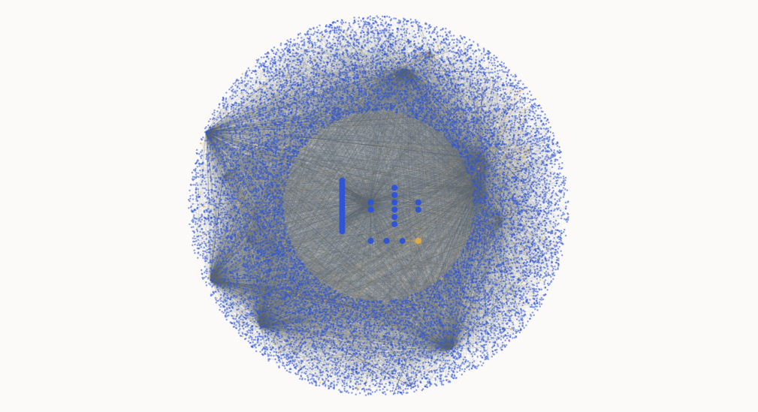
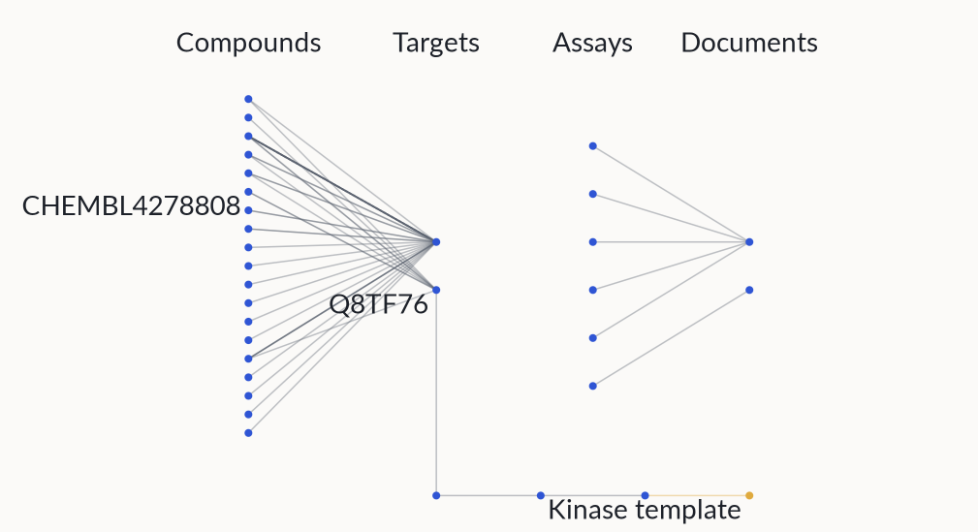
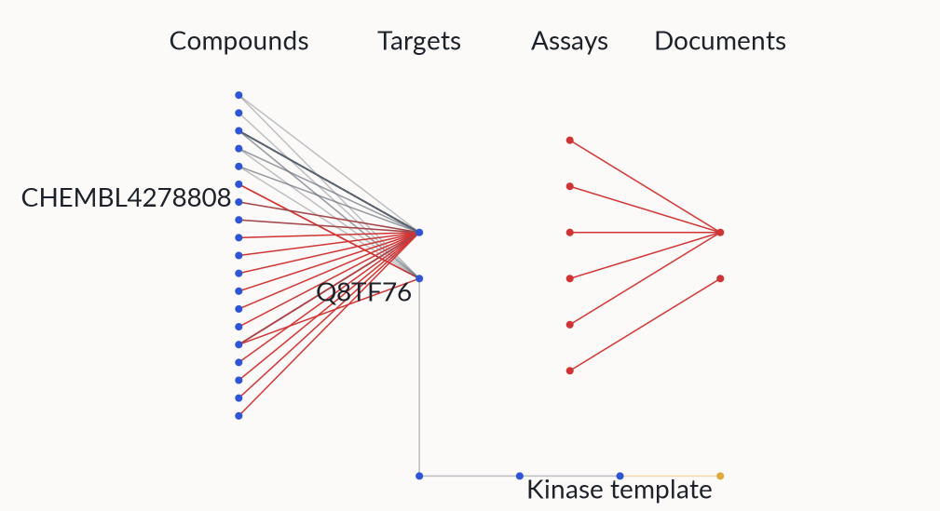
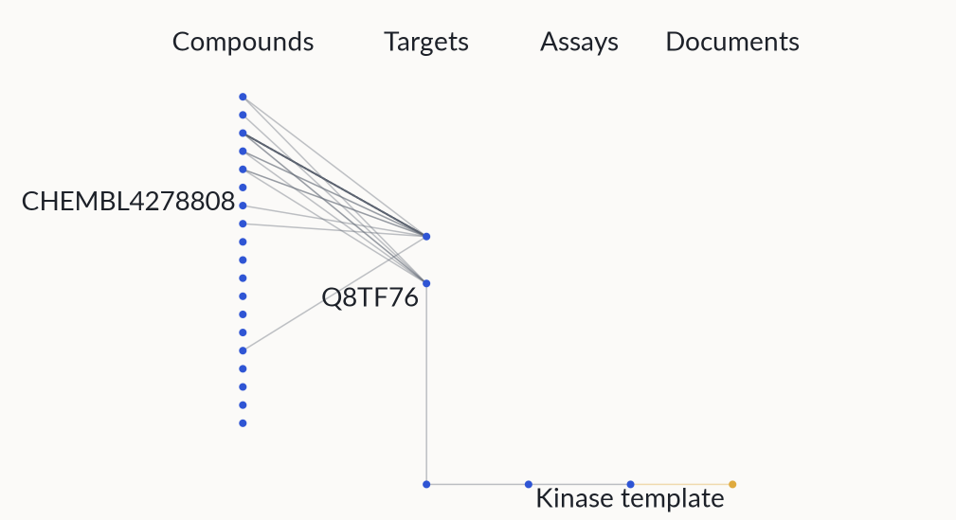
Concealing evidence in the actual graph
Concealing evidence in the actual graph
Concealing evidence in the actual graph
Concealing evidence in the actual graph
Reveal / conceal case 1
Reveal / conceal case 1
Reveal / conceal case 1
Reveal / conceal case 1
Full source graph
Case 1 neighborhood
24 excluded edges
Model context concealed
15,452 nodes; 19,478 CSV edges
Zoom to the excluded evidence,
Includes both query-pair
Removed evidence is absent
across both KBs.
retained examples and protocol
measurements, 2 documents and
from the packet; reusable assay
class link.
6 assays.
structure remains.
Biology:
exclude pair
measurements, source
Biology:
Biology:
Biology:
exclude pair
exclude pair
exclude pair
documents and associated
measurements, source
measurements, source
measurements, source
assays.
documents and associated
documents and associated
documents and associated
assays.
assays.
assays.
Protocols:
withhold raw text and
numbers. Supply 7 generalized
Protocols:
Protocols:
Protocols:
withhold raw text and
withhold raw text and
withhold raw text and
cards.
numbers. Supply 7 generalized
numbers. Supply 7 generalized
numbers. Supply 7 generalized
cards.
cards.
cards.
Model sees only the case packet.
This graph is for reviewers.
Model sees only the case packet.
Model sees only the case packet.
Model sees only the case packet.
This graph is for reviewers.
This graph is for reviewers.
This graph is for reviewers.
● Biology
● Biology
● Biology
● Biology
● Protocols
● Protocols
● Protocols
● Protocols
● Excluded connections
● Excluded connections
● Excluded connections
● Excluded connections
Kinase + protocol snapshot · illustrative layout · 5 dangling edges omitted · source graphs stay intact
Kinase + protocol snapshot · illustrative layout · 5 dangling edges omitted · source graphs stay intact
Kinase + protocol snapshot · illustrative layout · 5 dangling edges omitted · source graphs stay intact
Kinase + protocol snapshot · illustrative layout · 5 dangling edges omitted · source graphs stay intact
21
21
21
21
Notes:
Actual combined kinase biology and protocol CSV snapshot, not the bacterial MIC graph. Coordinates are an illustrative layout with case-1 endpoints grouped centrally. All 15452 nodes and 19473 edges with existing endpoints are drawn; five dangling CSV edges are counted but cannot be drawn. Case-1 source hashes match the case audit. Highlighted 24 edges are precisely the packet builder exclusion predicate. Two documents and six assays are omitted from context, not deleted from the shared KG. The model only receives its isolated JSON packet. Raw protocol nodes remain in the source graph; raw text, exact defaults and quotes are withheld and replaced by seven manually generalized cards. Cross-source leakage review remains incomplete. Source and exclusions downloadable in data/kb_story.json.
Editable PowerPoint: each click state is a named group in the Selection Pane. Ungroup a state to reuse text, shapes, charts and tables. Photos and web/video previews remain images.

Slide 22
Then grade the proposal on three axes
Then grade the proposal on three axes
Then grade the proposal on three axes
Model input
Model input
Model input
Model output
Model output
Model output
Reviewer context
Reviewer context
Reviewer context
→
→
→
→
→
→
Filtered packet only
Filtered packet only
Filtered packet only
Assay + steps + parameters + citations
Assay + steps + parameters + citations
Assay + steps + parameters + citations
Input + output + endpoint guidance + rubric
Input + output + endpoint guidance + rubric
Input + output + endpoint guidance + rubric
1 · Right experiment
1 · Right experiment
1 · Right experiment
2 · Sound steps
2 · Sound steps
3 · Sound numbers
Does this assay answer the
Does this assay answer the
Does this assay answer the
Are stages, controls and
Are stages, controls and
Are values justified and
biological question?
biological question?
biological question?
analysis complete and
analysis complete and
consistent? Is uncertainty
ordered?
Viability ≠ direct BTK
ordered?
explicit?
Viability ≠ direct BTK
Viability ≠ direct BTK
inhibition.
inhibition.
inhibition.
Accept supported alternatives;
Accept supported alternatives;
Check arithmetic; report
flag invented details.
flag invented details.
reference coverage separately.
0 = unsuitable / invalid · 1 = partial · 2 = supported and coherent
0 = unsuitable / invalid · 1 = partial · 2 = supported and coherent
0 = unsuitable / invalid · 1 = partial · 2 = supported and coherent
20 cases · 3 axes · report
20 cases · 3 axes · report
20 cases · 3 axes · report
mean score out of 6
mean score out of 6
mean score out of 6
. Report failures and abstentions too.
. Report failures and abstentions too.
. Report failures and abstentions too.
Blinded Astra medium · frozen rubric · provisional scores · expert review pending
Blinded Astra medium · frozen rubric · provisional scores · expert review pending
Blinded Astra medium · frozen rubric · provisional scores · expert review pending
22
22
22
Notes:
The evaluated model sees only the input packet and returns assay/system/readout, ordered step-card instructions, numeric parameters or null, controls, rationale, citations and limitations. Isolated Astra-medium agents review final outputs against the frozen rubric after generation; answers are not included in model requests. Each axis is 0–2 per case. Twenty cases × three axes × two points = 120 possible points/model; plots show means out of 6. Scores are provisional and blinded to model identity. Four synthetic rubric anchors passed; expert validation remains pending. Hidden IC50 values are excluded from judge packets. Numerical coverage against held-out IC50 is an offline diagnostic, conditional on assay comparability, not proof of protocol validity. Missing values and unsupported claims remain explicit; no post-generation repair was scored.
Editable PowerPoint: each click state is a named group in the Selection Pane. Ungroup a state to reuse text, shapes, charts and tables. Photos and web/video previews remain images.

Slide 23
Six models, twenty diagnostic cases
Kimi K3.1
DeepSeek V4.1
GLM
Nemotron 3
GPT-OSS-
Astra
Pro
Flash
5.3
Super
120B
medium*
Mean rubric total · 20 cases · maximum 6 per case · score out of 6
Blinded Astra medium · provisional scores · one response per case
*Astra: same-model judging; different serving settings and reasoning effort
23
Notes:
20 purposively selected cases: 15 biochemical, 5 cellular; six models, one response per case. 85 new completions plus 15 reused outputs with identical inputs/settings. Original 100 freshly reviewed by isolated Astra-medium judges blinded to model identity under a frozen rubric. Four synthetic anchor checks do not establish expert calibration. Each axis 0–2, mean total 0–6. No measured retrieval lift, statistical superiority, MIC or wet-lab validation. Critical failures are reported separately. Source: benchmark/judge/RESULTS.md at c1a0e32. Generation used temperature 0 and low reasoning; judging used medium reasoning. Astra adds 20 proposals and 20 fresh blinded reviews, scoring 4.10/6 with zero critical-failure flags. Its medium generation reasoning and Codex transport differ from prior candidates. Same-model judge preference is possible. Source: benchmark/runs/astra-medium-20/RESULTS.md at aff33ef.
Editable PowerPoint: each click state is a named group in the Selection Pane. Ungroup a state to reuse text, shapes, charts and tables. Photos and web/video previews remain images.

Slide 24
Where the rubric points come from
Kimi K3.1
DeepSeek V4.1
GLM
Nemotron 3
GPT-OSS-
Astra
Pro
Flash
5.3
Super
120B
medium*
Mean score per axis: 0–2 · 20 cases per model · expert review pending
*Astra: same-model judging; different serving settings and reasoning effort
24
Notes:
20 purposively selected cases: 15 biochemical, 5 cellular; six models, one response per case. 85 new completions plus 15 reused outputs with identical inputs/settings. Original 100 freshly reviewed by isolated Astra-medium judges blinded to model identity under a frozen rubric. Four synthetic anchor checks do not establish expert calibration. Each axis 0–2, mean total 0–6. No measured retrieval lift, statistical superiority, MIC or wet-lab validation. Critical failures are reported separately. Source: benchmark/judge/RESULTS.md at c1a0e32. Generation used temperature 0 and low reasoning; judging used medium reasoning. Astra adds 20 proposals and 20 fresh blinded reviews, scoring 4.10/6 with zero critical-failure flags. Its medium generation reasoning and Codex transport differ from prior candidates. Same-model judge preference is possible. Source: benchmark/runs/astra-medium-20/RESULTS.md at aff33ef.
Editable PowerPoint: each click state is a named group in the Selection Pane. Ungroup a state to reuse text, shapes, charts and tables. Photos and web/video previews remain images.

Slide 25
Useful designs still need evidence checks
What the outputs revealed
Cases with critical failures
Uncertainty matters.
Kimi left the unsupported
Kimi K3.1 Pro | 0 / 20
DeepSeek V4.1 Flash | 1 / 20
GLM 5.3 | 8 / 20
Nemotron 3 Super | 17 / 20
GPT-OSS-120B | 19 / 20
Astra medium* | 0 / 20
cellular series unresolved.
Check internal consistency.
DeepSeek specified
both 11 and 10 points for one series.
Require source support.
GPT-OSS claimed pilot
verification that was never supplied.
Nebius batch: 310,831 tokens
*Astra uses the same model for generation and judging,
$0.675 est. + $0.306 reserved
with different run settings. All grades need domain review.
Astra generation + judging: usage unavailable
Inspect chart data ↗
·
Outputs, grading evidence and usage ledger ↗
25
Notes:
20 purposively selected cases: 15 biochemical, 5 cellular; six models, one response per case. 85 new completions plus 15 reused outputs with identical inputs/settings. Original 100 freshly reviewed by isolated Astra-medium judges blinded to model identity under a frozen rubric. Four synthetic anchor checks do not establish expert calibration. Each axis 0–2, mean total 0–6. No measured retrieval lift, statistical superiority, MIC or wet-lab validation. Critical failures are reported separately. Source: benchmark/judge/RESULTS.md at c1a0e32. Generation used temperature 0 and low reasoning; judging used medium reasoning. Astra adds 20 proposals and 20 fresh blinded reviews, scoring 4.10/6 with zero critical-failure flags. Its medium generation reasoning and Codex transport differ from prior candidates. Same-model judge preference is possible. Source: benchmark/runs/astra-medium-20/RESULTS.md at aff33ef. New generation: 310831 receipted tokens, estimated $0.674688 plus $0.305636 allowance for three uncertain attempts. Astra token and billing receipts unavailable. Critical failure counts are cases with at least one judge flag, not validated failure rates.
Editable PowerPoint: each click state is a named group in the Selection Pane. Ungroup a state to reuse text, shapes, charts and tables. Photos and web/video previews remain images.

Slide 26
A protocol that passes the simulator
Check run for this review | Observed result
Repository test suite at main 30886d3 | 340 passed · 3 skipped
Four-species example → OT-2 protocol | Simulation passed · Opentrons 8.8.2 · API 2.27
Independent transfer replay | 0 plate-audit disagreements for this example
Two outputs:
robot code + human run sheet
.
Incubation, readout and MIC calling remain off-robot steps.
Generated protocol ↓
Run sheet ↗
Result + warnings ↗
Software verification, not wet-lab validation · pipette installation and anaerobic incubation remain unconfirmed
26
Notes:
Repository audit: main 30886d3 (2026-11-08). Reproduced 2026-11-08. pytest: 340 passed, 3 skipped, with no LLM calls. Separate execution.generate --simulate run used the committed hand-written example, opentrons==8.8.2 and numpy<2. Simulation validates executable robot operations, not biological efficacy. Exact input and warnings are downloadable under evidence/.
Editable PowerPoint: each click state is a named group in the Selection Pane. Ungroup a state to reuse text, shapes, charts and tables. Photos and web/video previews remain images.

Slide 27
What is built, and what still needs connecting
Implemented and inspectable | Still to establish
MIC graph with provenance and censored measurements | MIC-aware agent retrieval; current helper defaults to kinase IC50
Protocol templates, sourced rules and parameter derivations | Domain review of MIC routing and culture conditions
Computed plate map, independent audit, simulated OT-2 example | Hard audit gates, non-two-fold support and confirmed hardware
Five-model diagnostic pilot and extensive software tests | Independent grading, measured time savings and biological validation
Claim today: inspectable components and a verified execution example · not an autonomous MIC discovery loop
27
Notes:
Repository audit: main 30886d3 (2026-11-08). Audit of agent/README.md, kg/biology/README.md, execution/README.md, benchmark/README.md and graph/BENCHMARK.md at main 30886d3. Unknown oxygen tolerance currently passes optimistically. The earlier animated trace includes mock execution/validation and is deliberately not the central proof in this deck.
Editable PowerPoint: each click state is a named group in the Selection Pane. Ungroup a state to reuse text, shapes, charts and tables. Photos and web/video previews remain images.

Slide 28
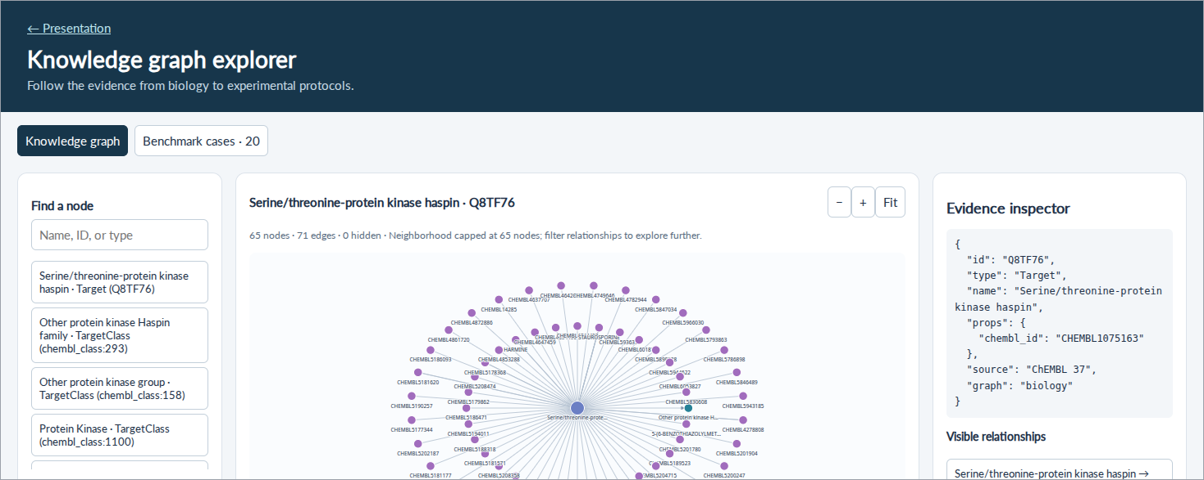
Inspect the evidence behind a decision
Open graph explorer and case packets ↗
· committed data, not a live agent run
28
Notes:
Open the graph viewer and inspect a measurement, its source and the case input/review split. This is a view of committed data and diagnostic cases, not a live agent or a benchmark result. The viewer has its own dataset controls.
Editable PowerPoint: each click state is a named group in the Selection Pane. Ungroup a state to reuse text, shapes, charts and tables. Photos and web/video previews remain images.

Slide 29
The next proof is one connected MIC experiment
Take a candidate and a researcher-selected panel through the full chain.
Connect | MIC-aware retrieval → sourced assay design → audited protocol
Challenge | Withheld measurements, wrong endpoints, bad units and infeasible conditions
Measure | Researcher review time, design correctness and reproducibility
Our proposed contribution:
a traceable link between biological evidence and an experiment
the lab can review and run.
Patient benefit motivates the work; the immediate deliverable supports a research decision.
29
Notes:
Repository audit: main 30886d3 (2026-11-08). Proposed next experiments, not completed results. Keep architecture high-level; foreground the auditable artifacts and measured checks. Industry alternatives already provide experimental design and automation; superiority of this combination remains to be tested.
Editable PowerPoint: each click state is a named group in the Selection Pane. Ungroup a state to reuse text, shapes, charts and tables. Photos and web/video previews remain images.

