Slide 1
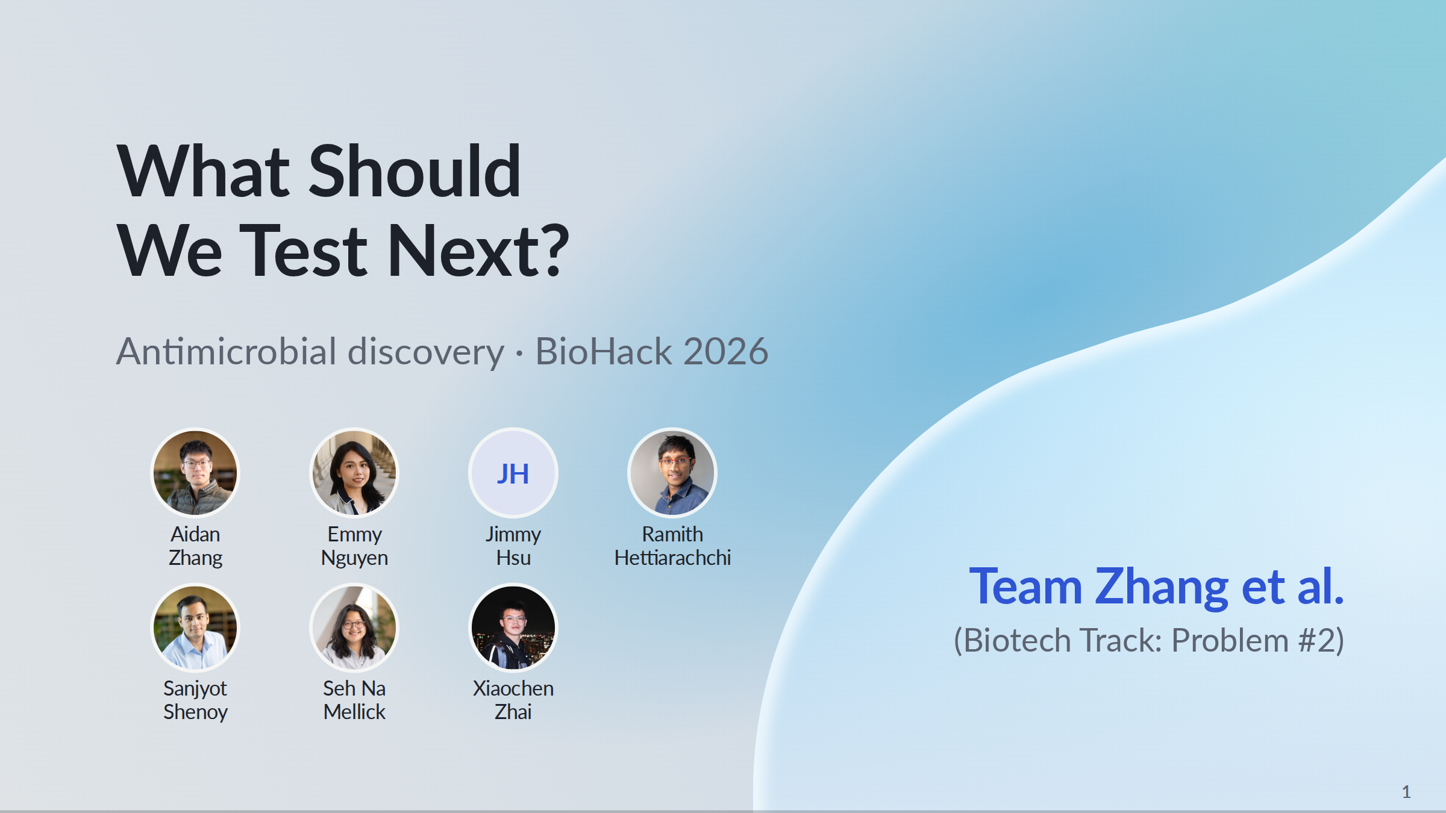
Notes:
Title slide.
PowerPoint: click to reveal successive captured states; smooth HTML motion is represented by discrete reveals. Demo: https://zhang-etal-biohack.pages.dev/talks/biohack/graph/

Slide 2
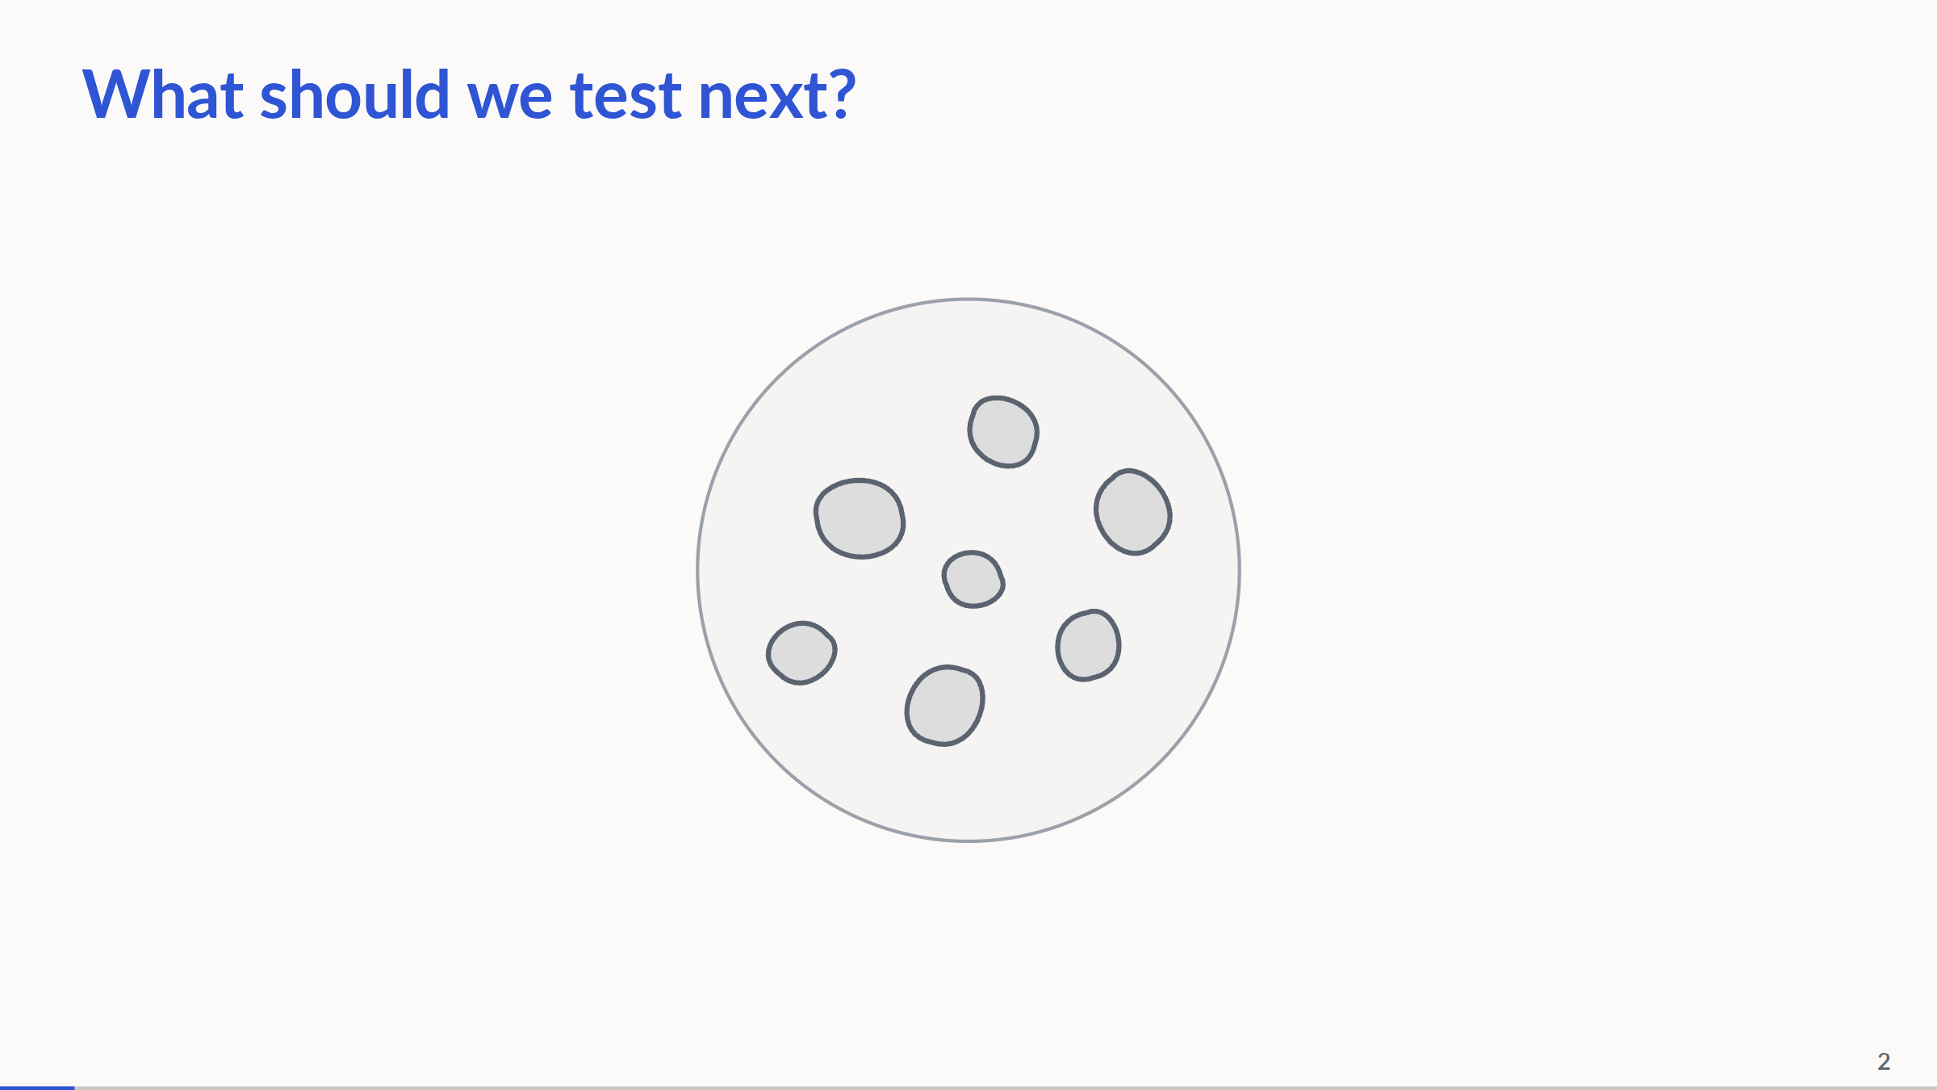
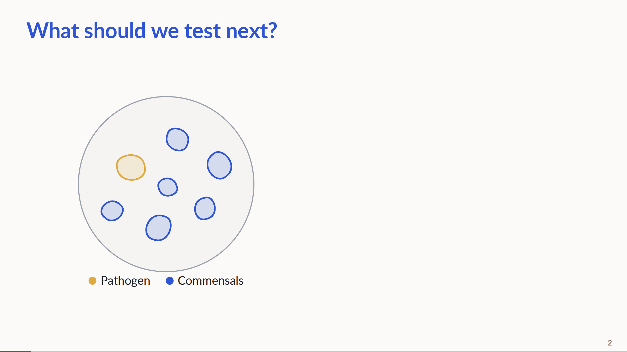
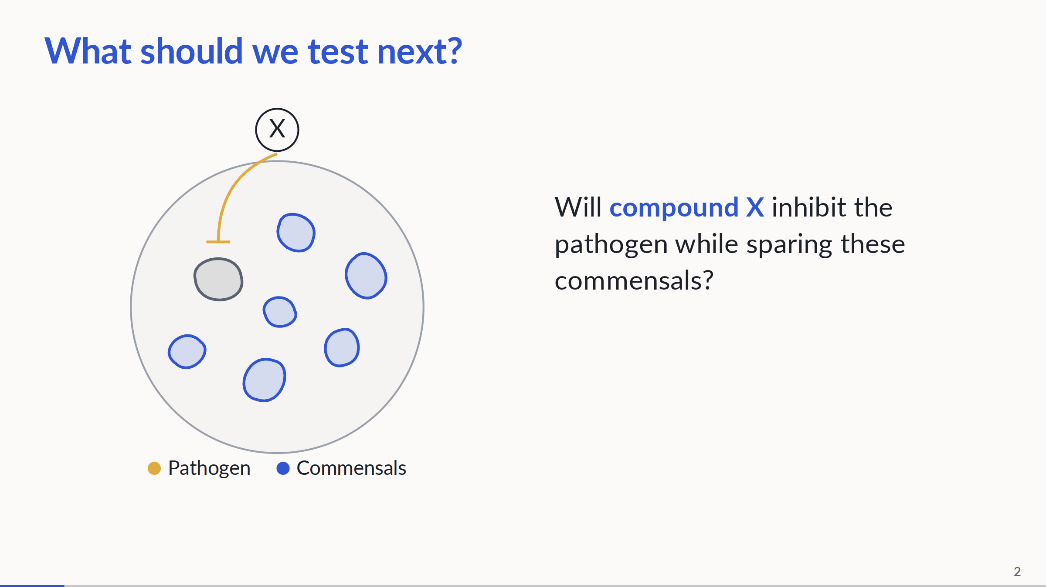
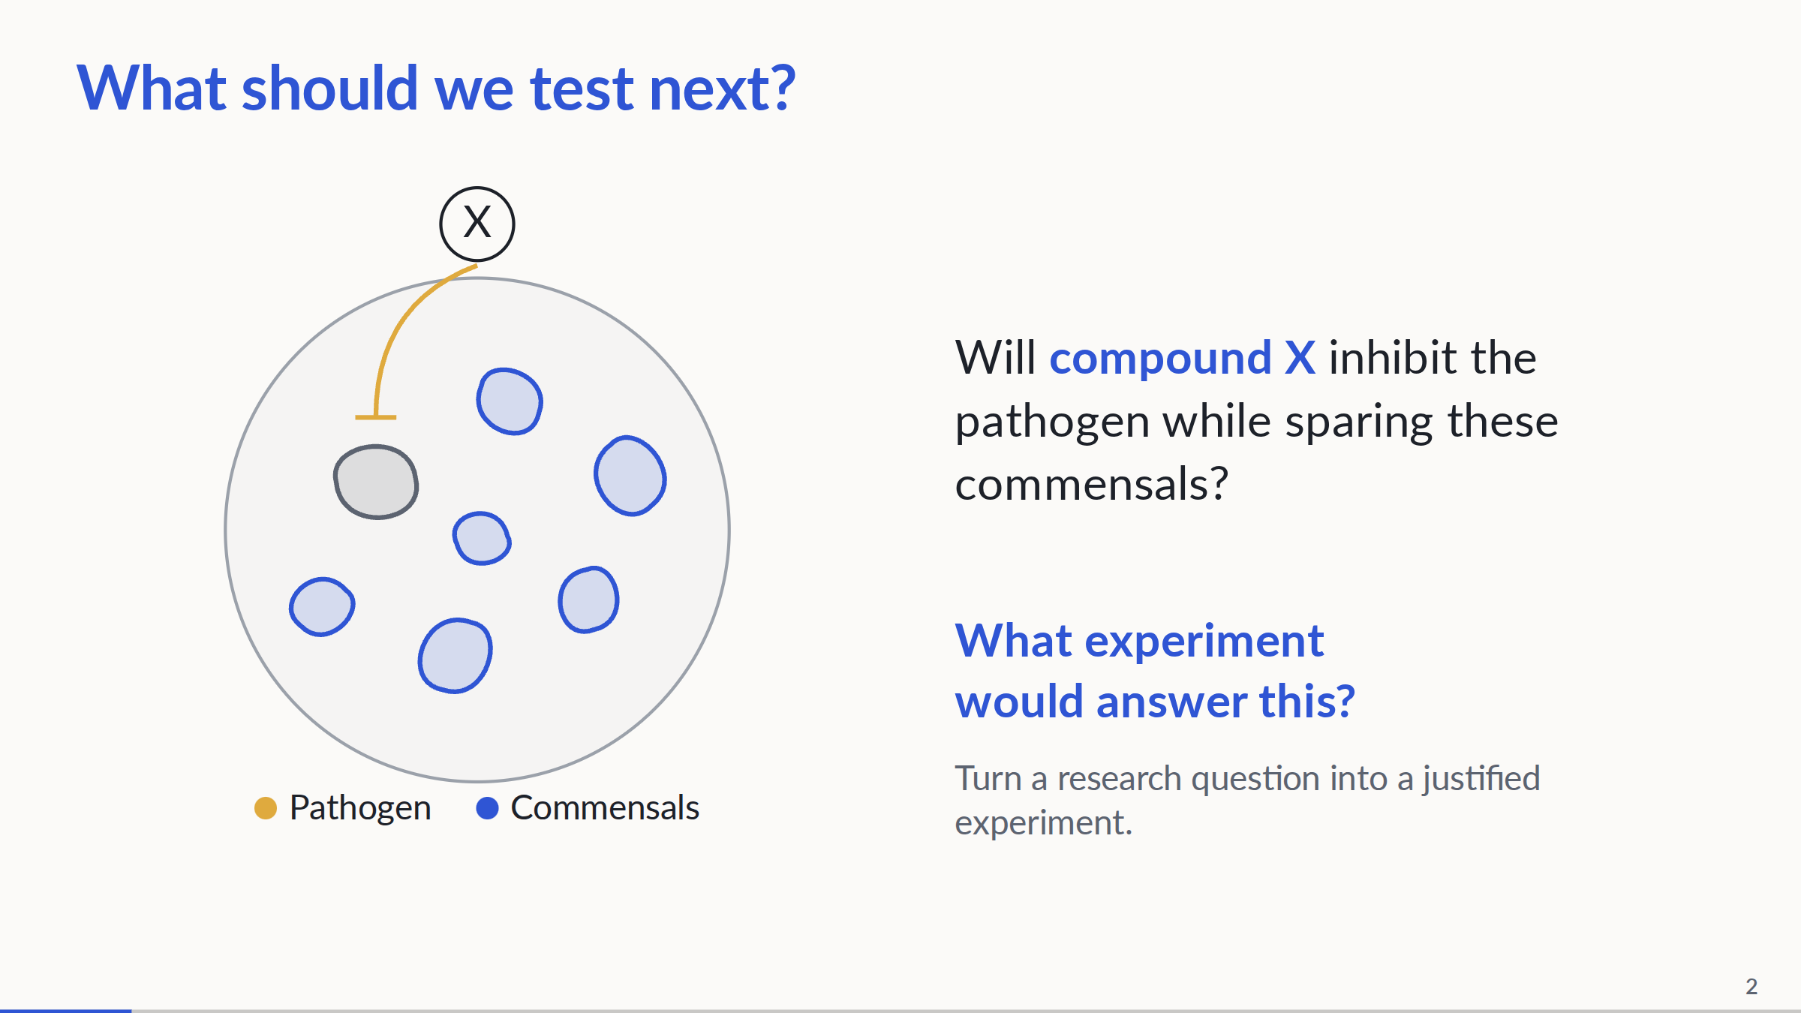
Notes:
0:00–0:50. Step 1: show only the title and a centered neutral bacterial plate. Step 2: color the pathogen and commensals, reveal the labels and move the plate left. Step 3: reveal compound X and the question, draw a T-ended inhibitory connection to the pathogen, then grey it out. This visualizes the hypothesized selective effect, not measured inhibition or survival; keep the spoken framing as a question. Step 4: ask what experiment would answer it, then advance to the missing-link graph. Compound discovery and strain selection are upstream. We support turning a supplied research question into a justified experiment. No clinical or wet-lab outcome is claimed.
PowerPoint: click to reveal successive captured states; smooth HTML motion is represented by discrete reveals. Demo: https://zhang-etal-biohack.pages.dev/talks/biohack/graph/

Slide 3
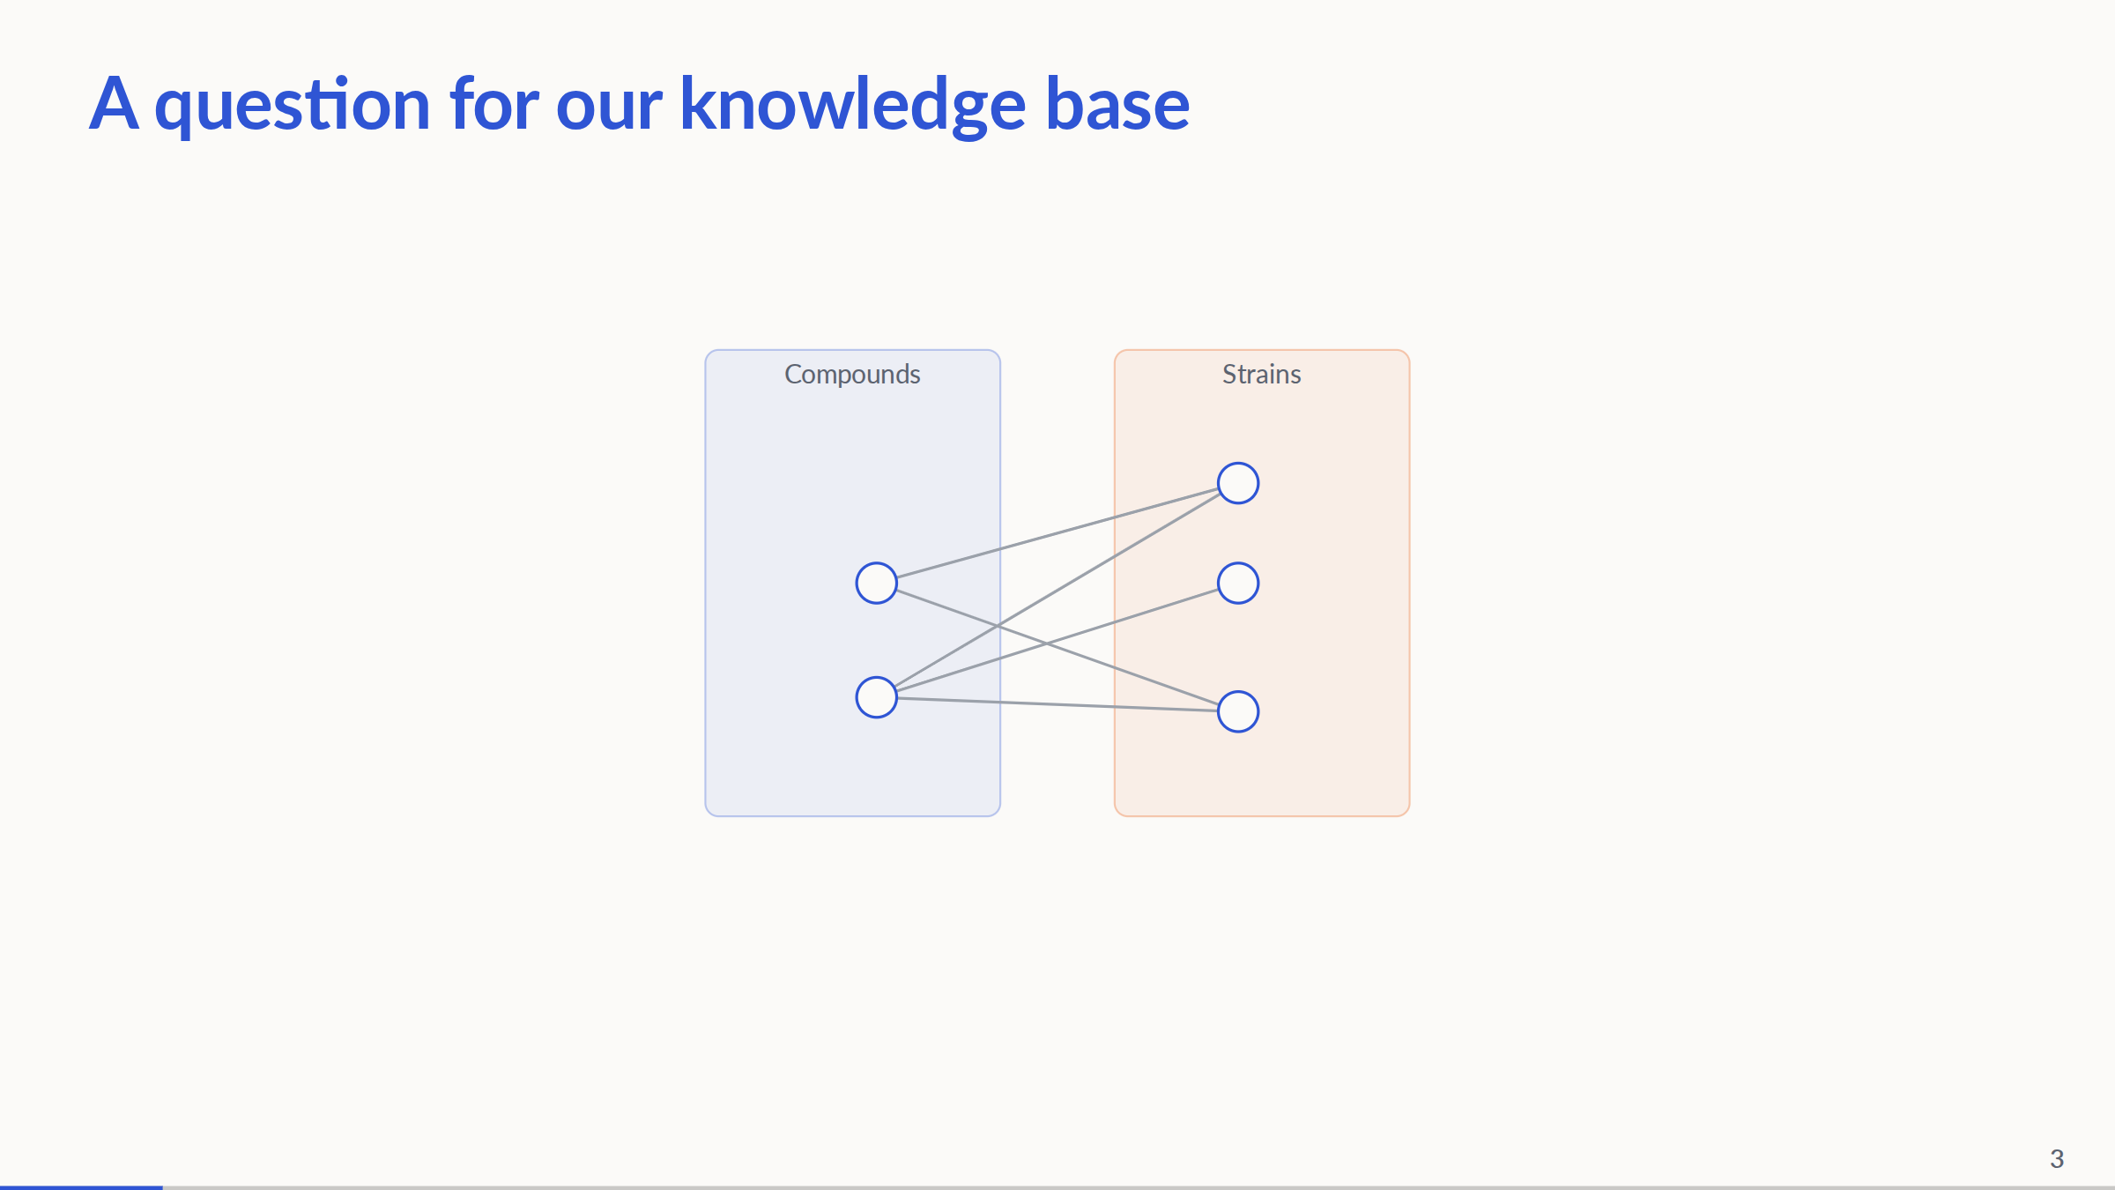
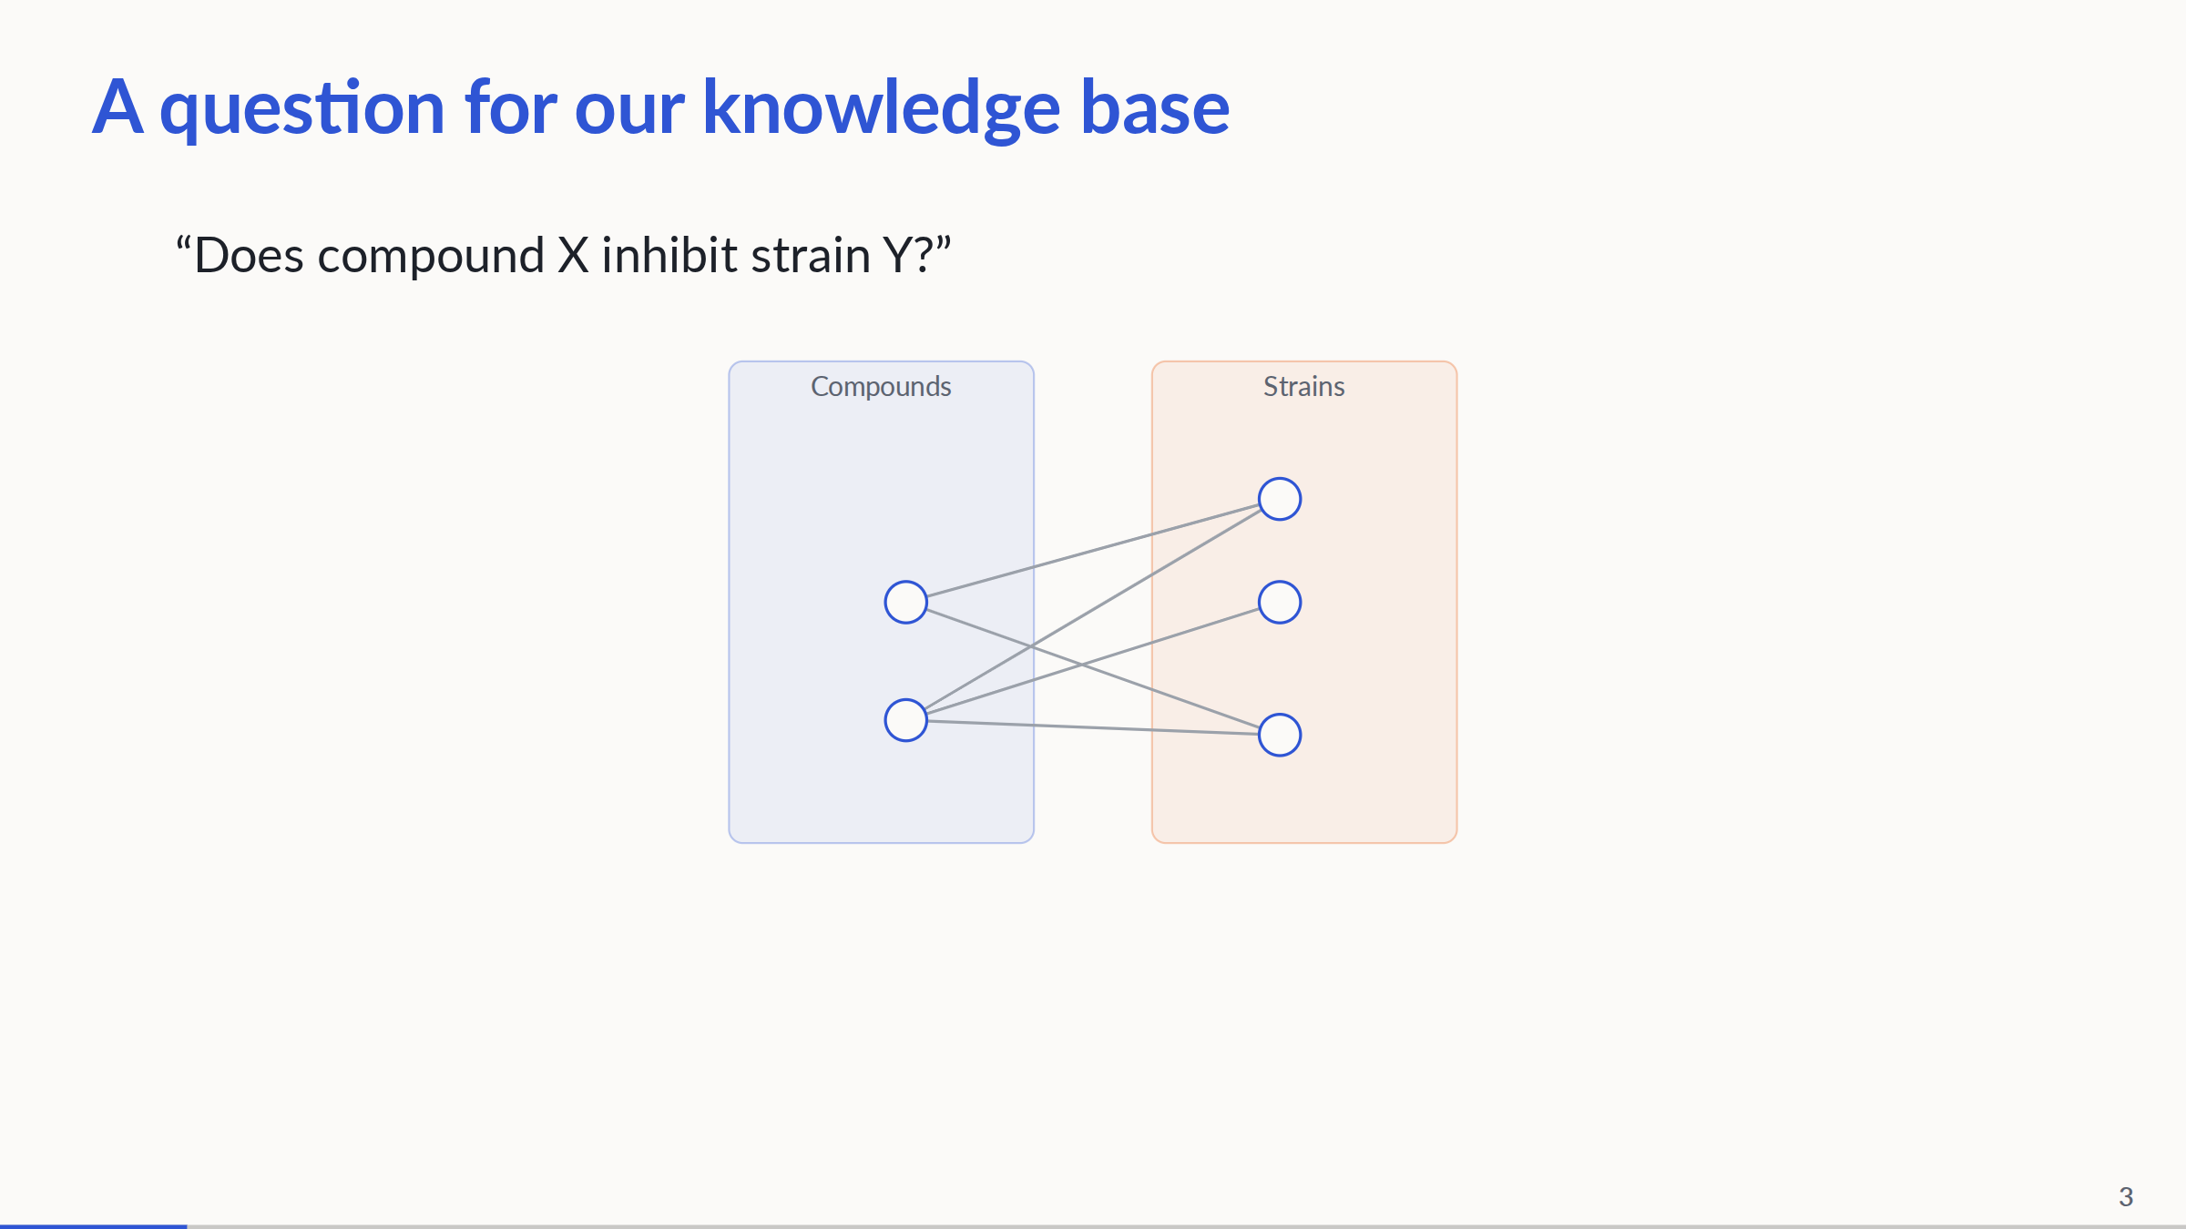
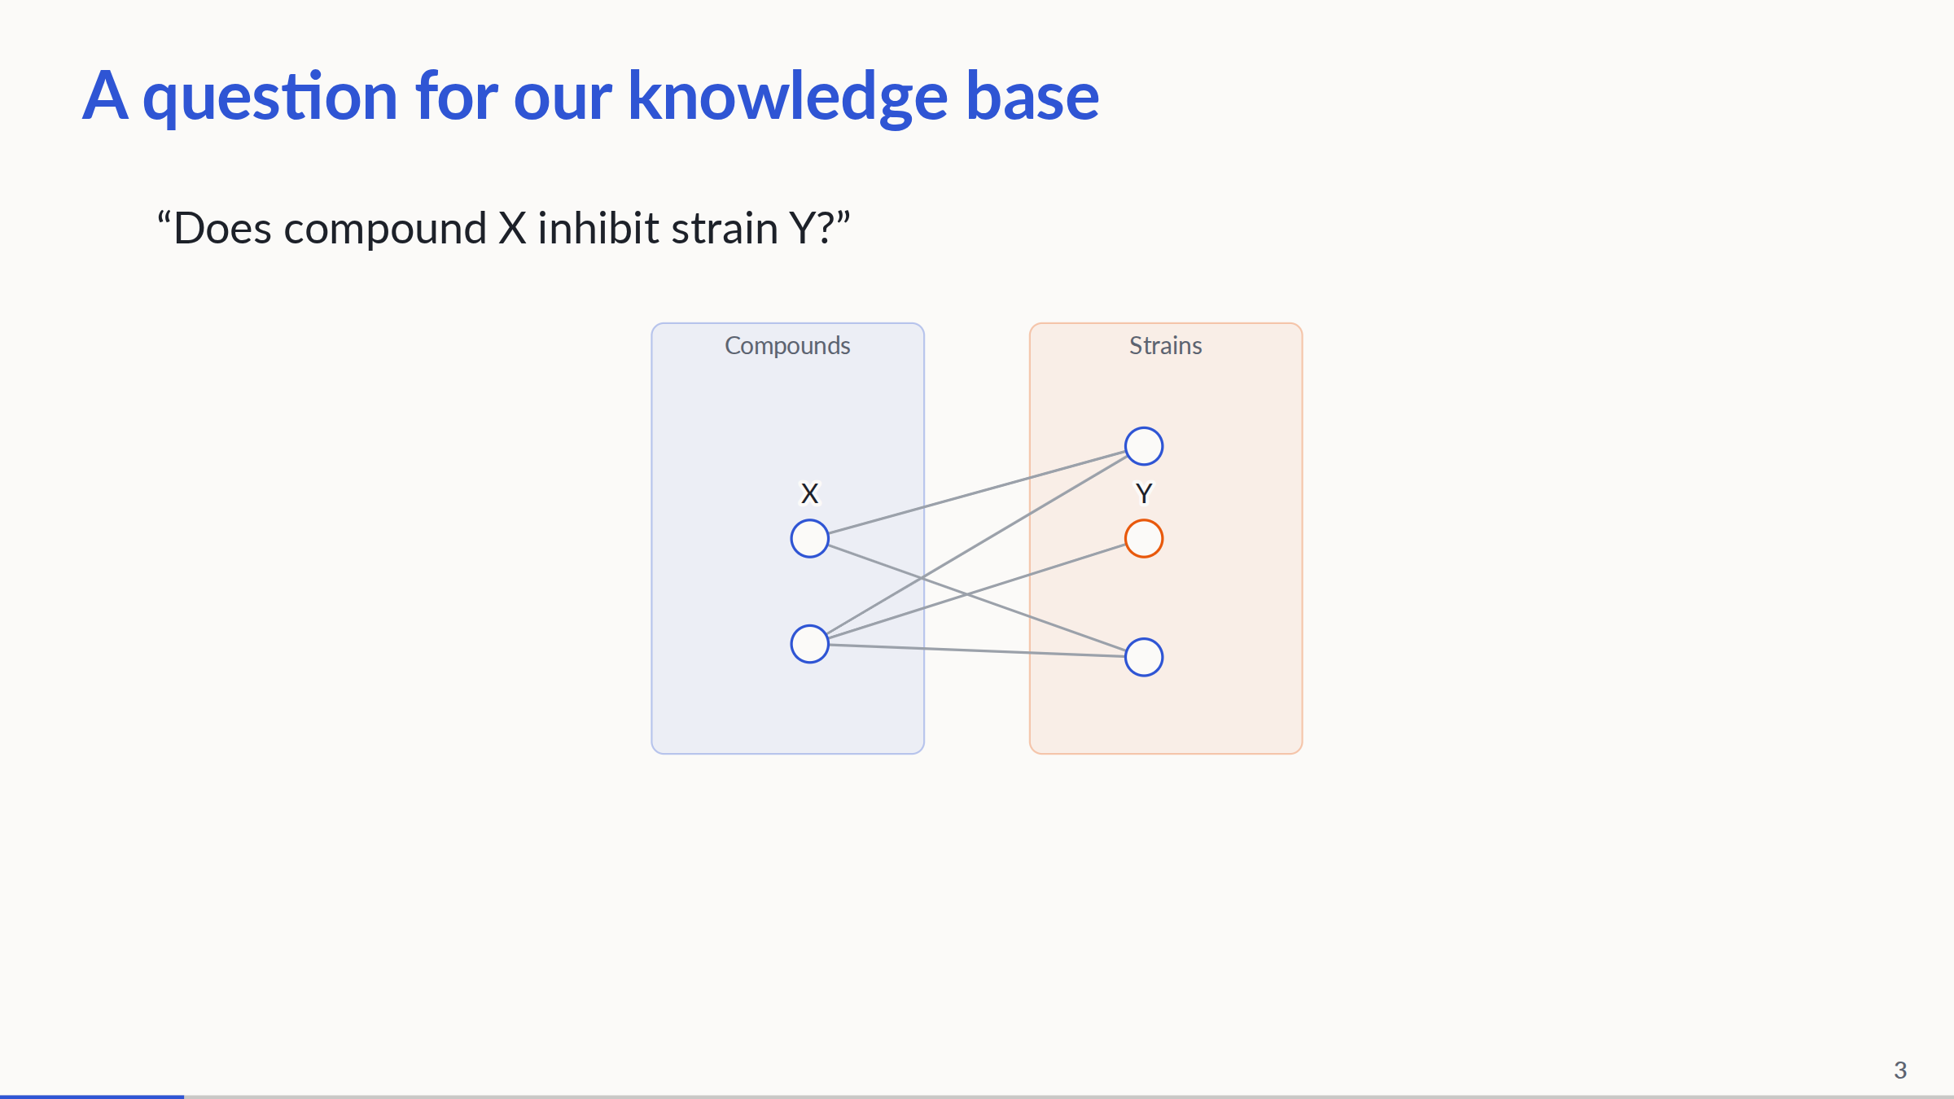
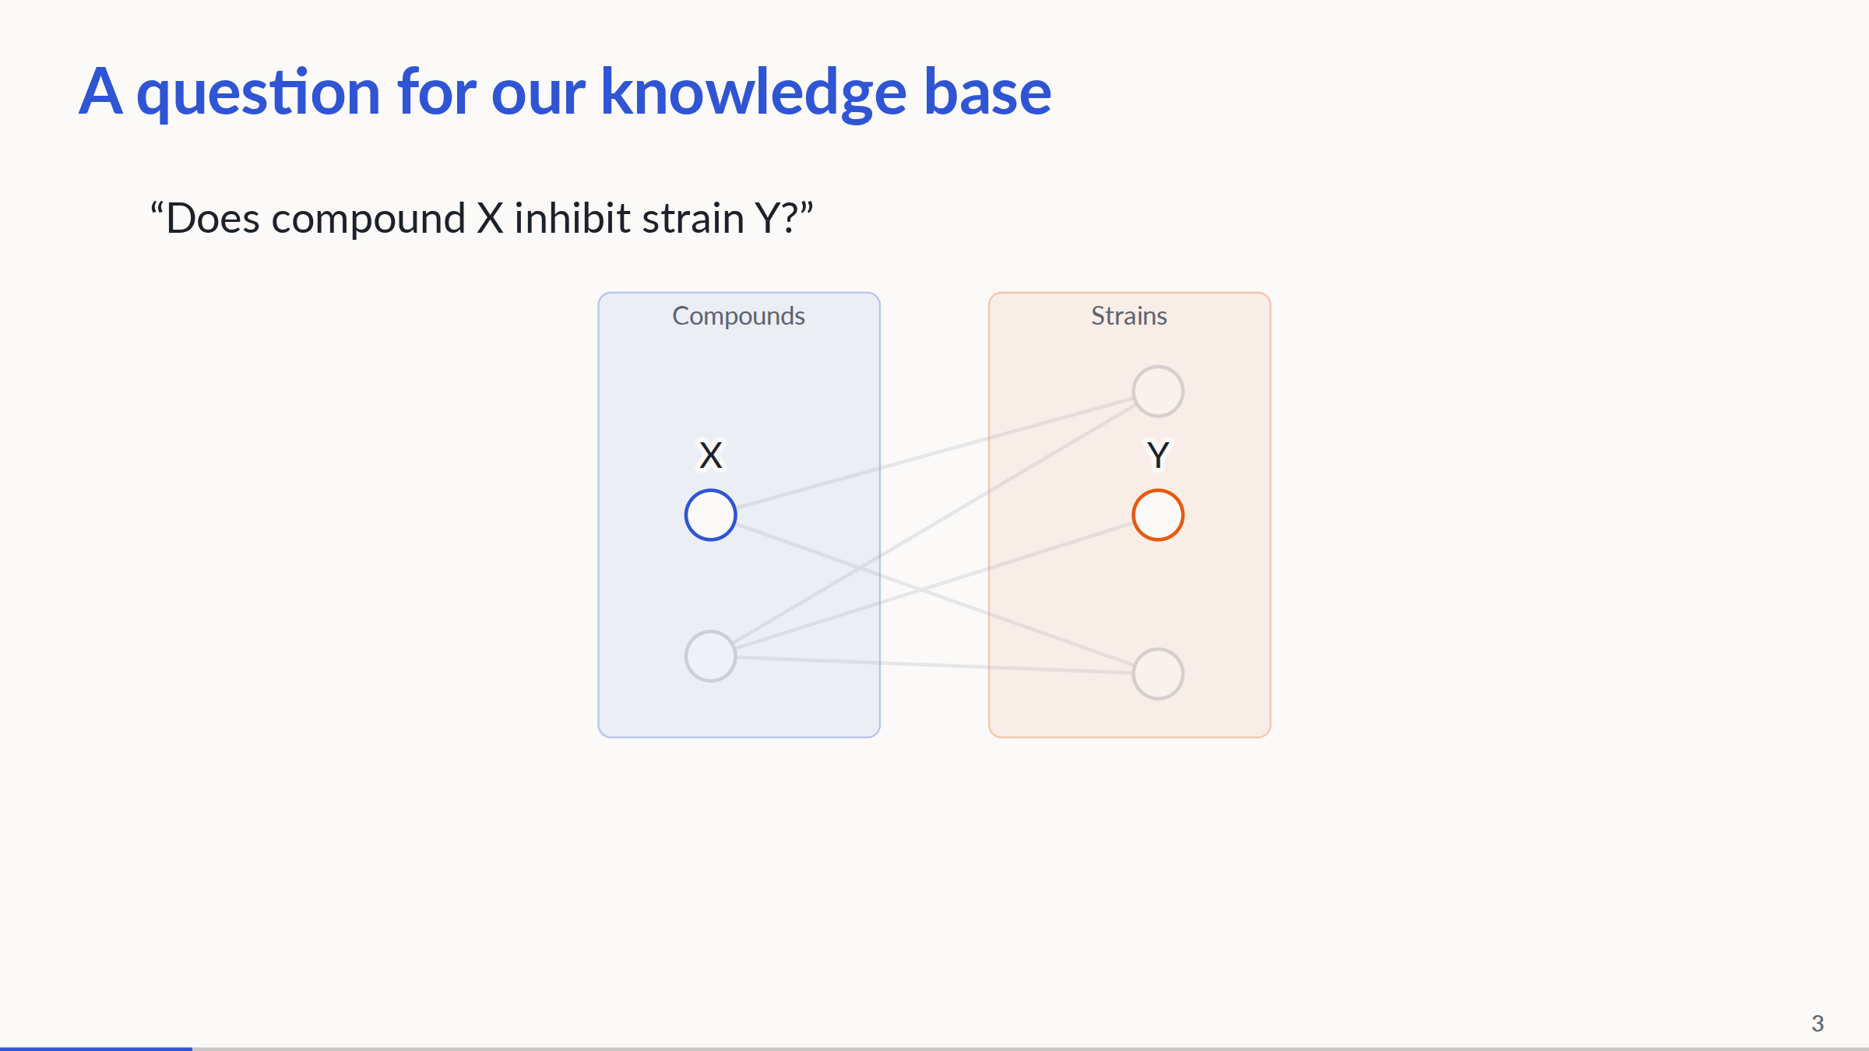
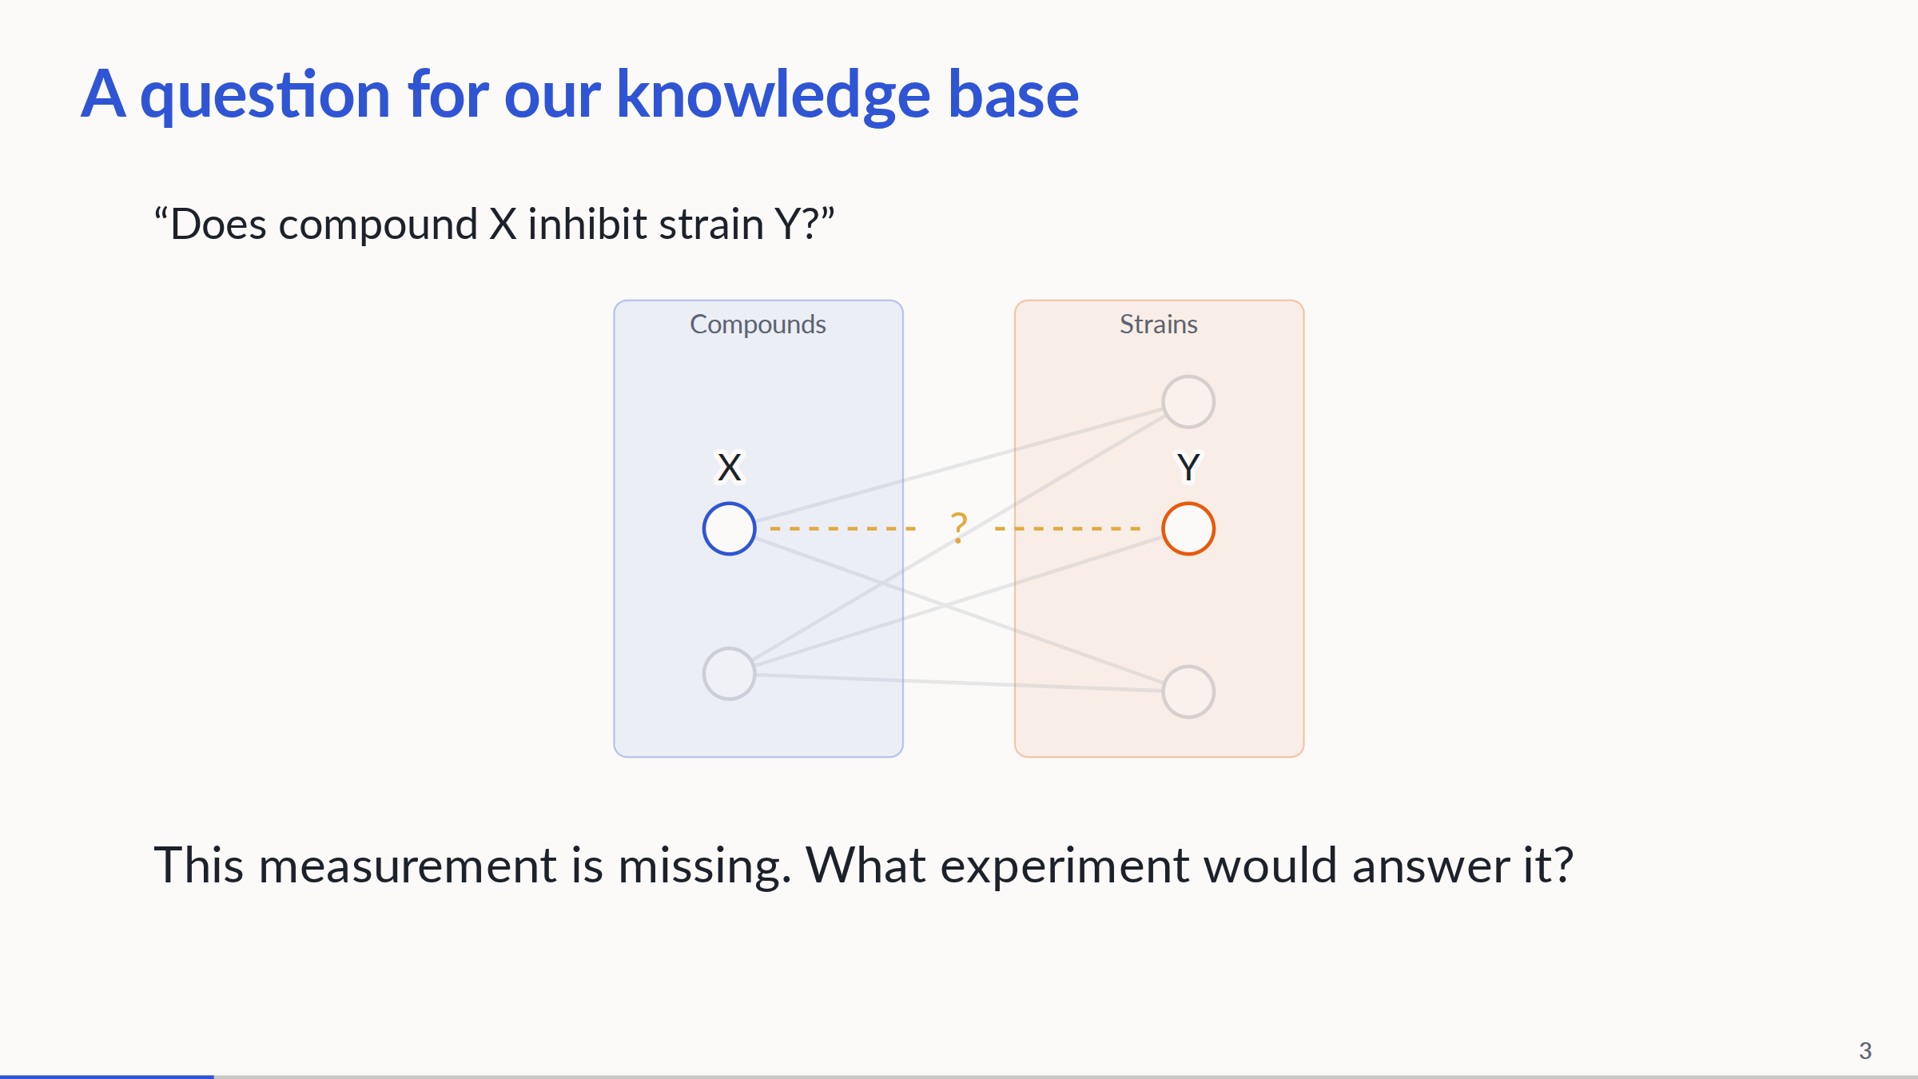
Notes:
Abstract bipartite knowledge base: two compound nodes on the left and three strain nodes on the right. All existing edges cross the partitions. Start unlabeled; reveal the researcher question; identify X and Y; zoom and dim surrounding knowledge; highlight the missing X–Y measurement. The demonstration assumes an up-to-date KB and researcher-supplied identities. Known evidence would be returned with citations; the researcher decides whether another experiment is worthwhile. The missing link here is genuinely unanswered under an up-to-date-KB assumption, not a literature-completeness judgment. Concealing evidence is reserved for benchmark simulation. This is not an actual query trace.
PowerPoint: click to reveal successive captured states; smooth HTML motion is represented by discrete reveals. Demo: https://zhang-etal-biohack.pages.dev/talks/biohack/graph/

Slide 4
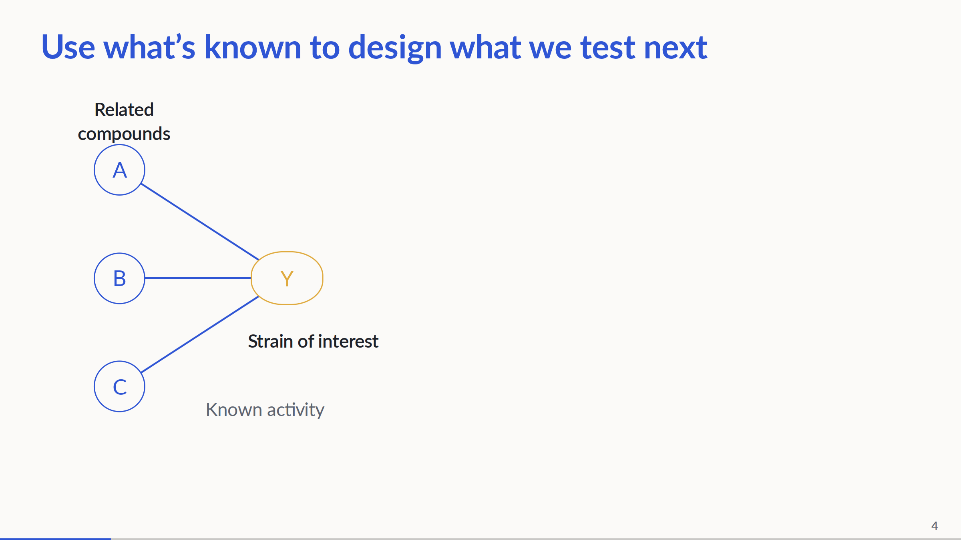
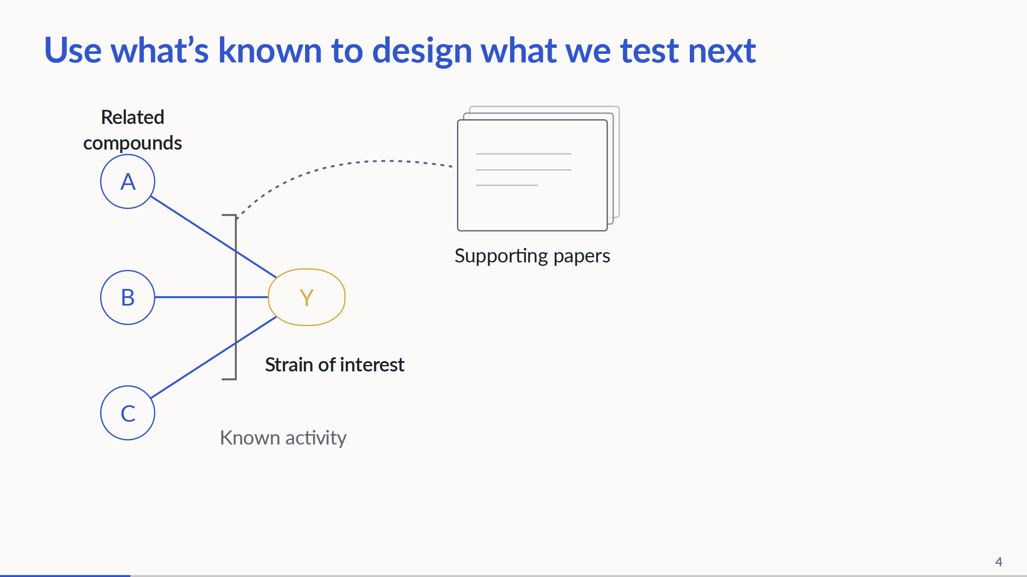
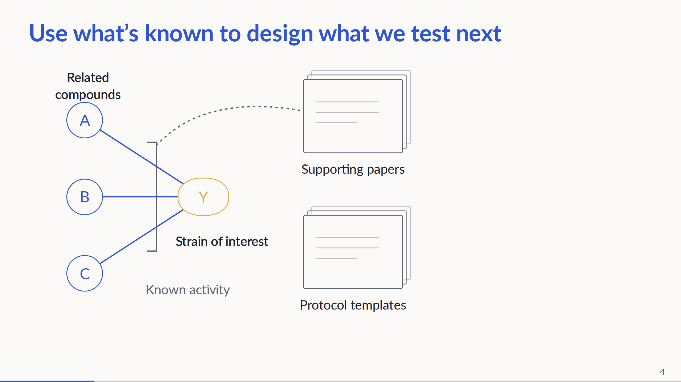
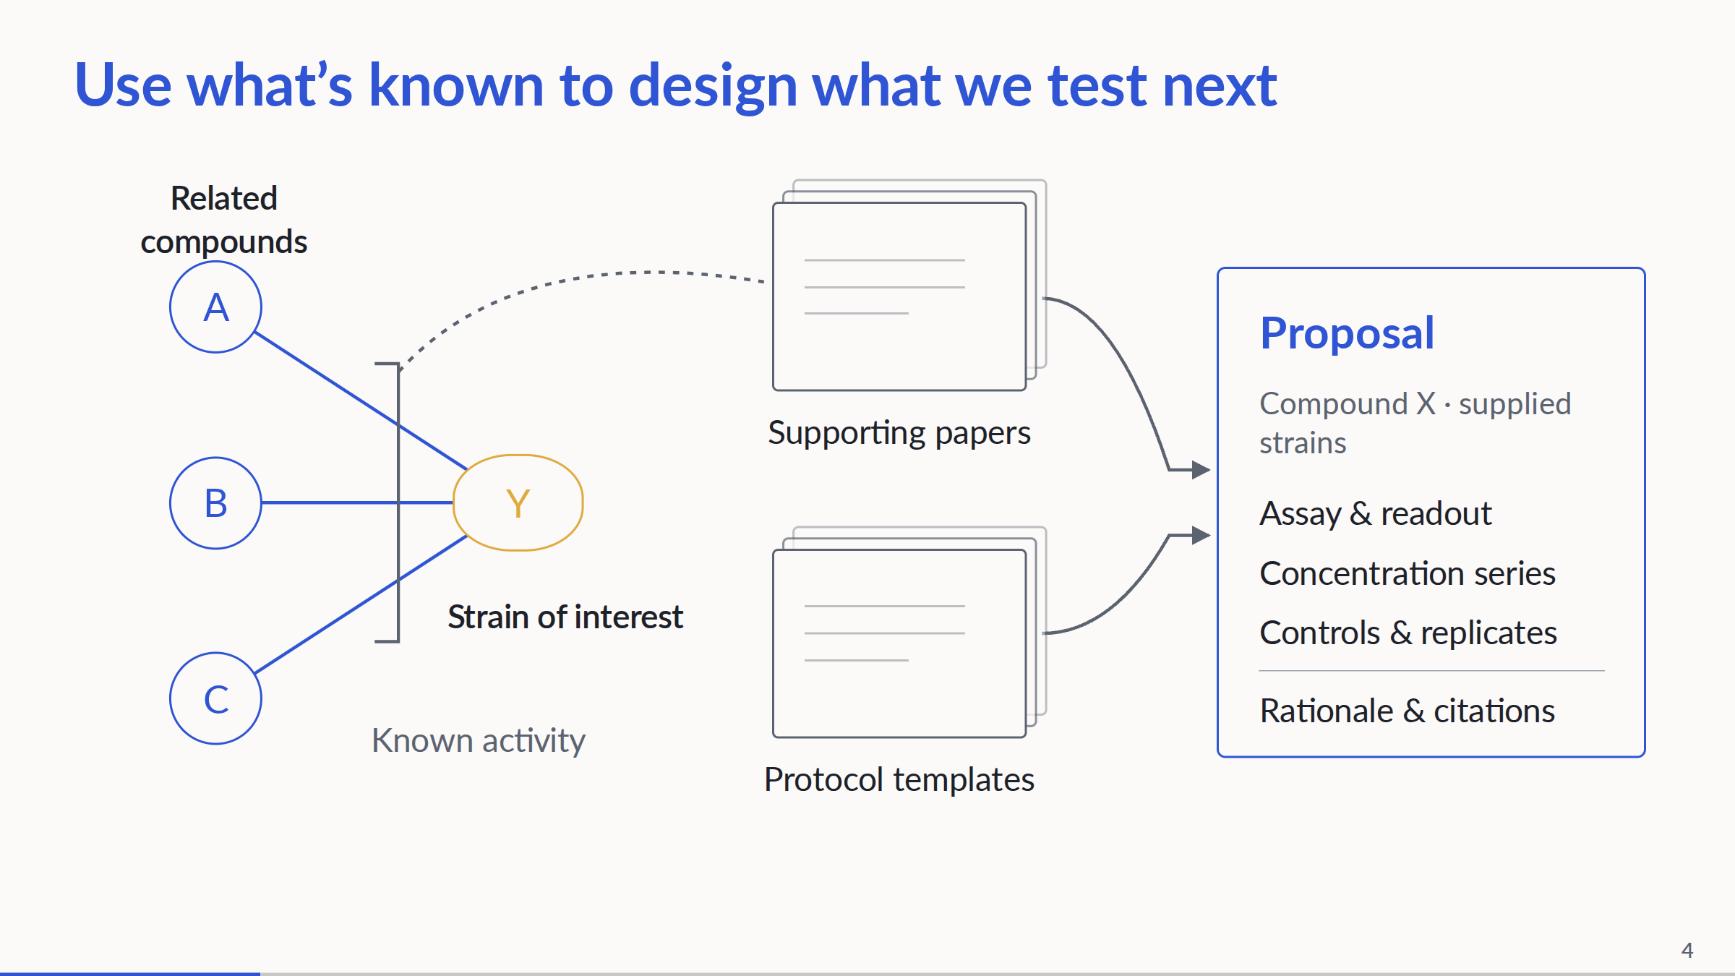
Notes:
Conceptual bacterial workflow. Related compounds have measured activity on the organism of interest. Papers support those measurements; protocol templates are a separate source of assay structure, controls and defaults, not necessarily the original protocols from those papers. Together they inform a reviewable experiment proposal for compound X and the supplied panel. Species-level evidence does not establish a result for every strain. Current agent retrieval is IC50-based; the bacterial graph and downstream MIC execution exist separately. No end-to-end bacterial run or measured inhibition is claimed. Proposal fields shown here are categories, not populated experimental recommendations.
PowerPoint: click to reveal successive captured states; smooth HTML motion is represented by discrete reveals. Demo: https://zhang-etal-biohack.pages.dev/talks/biohack/graph/

Slide 5
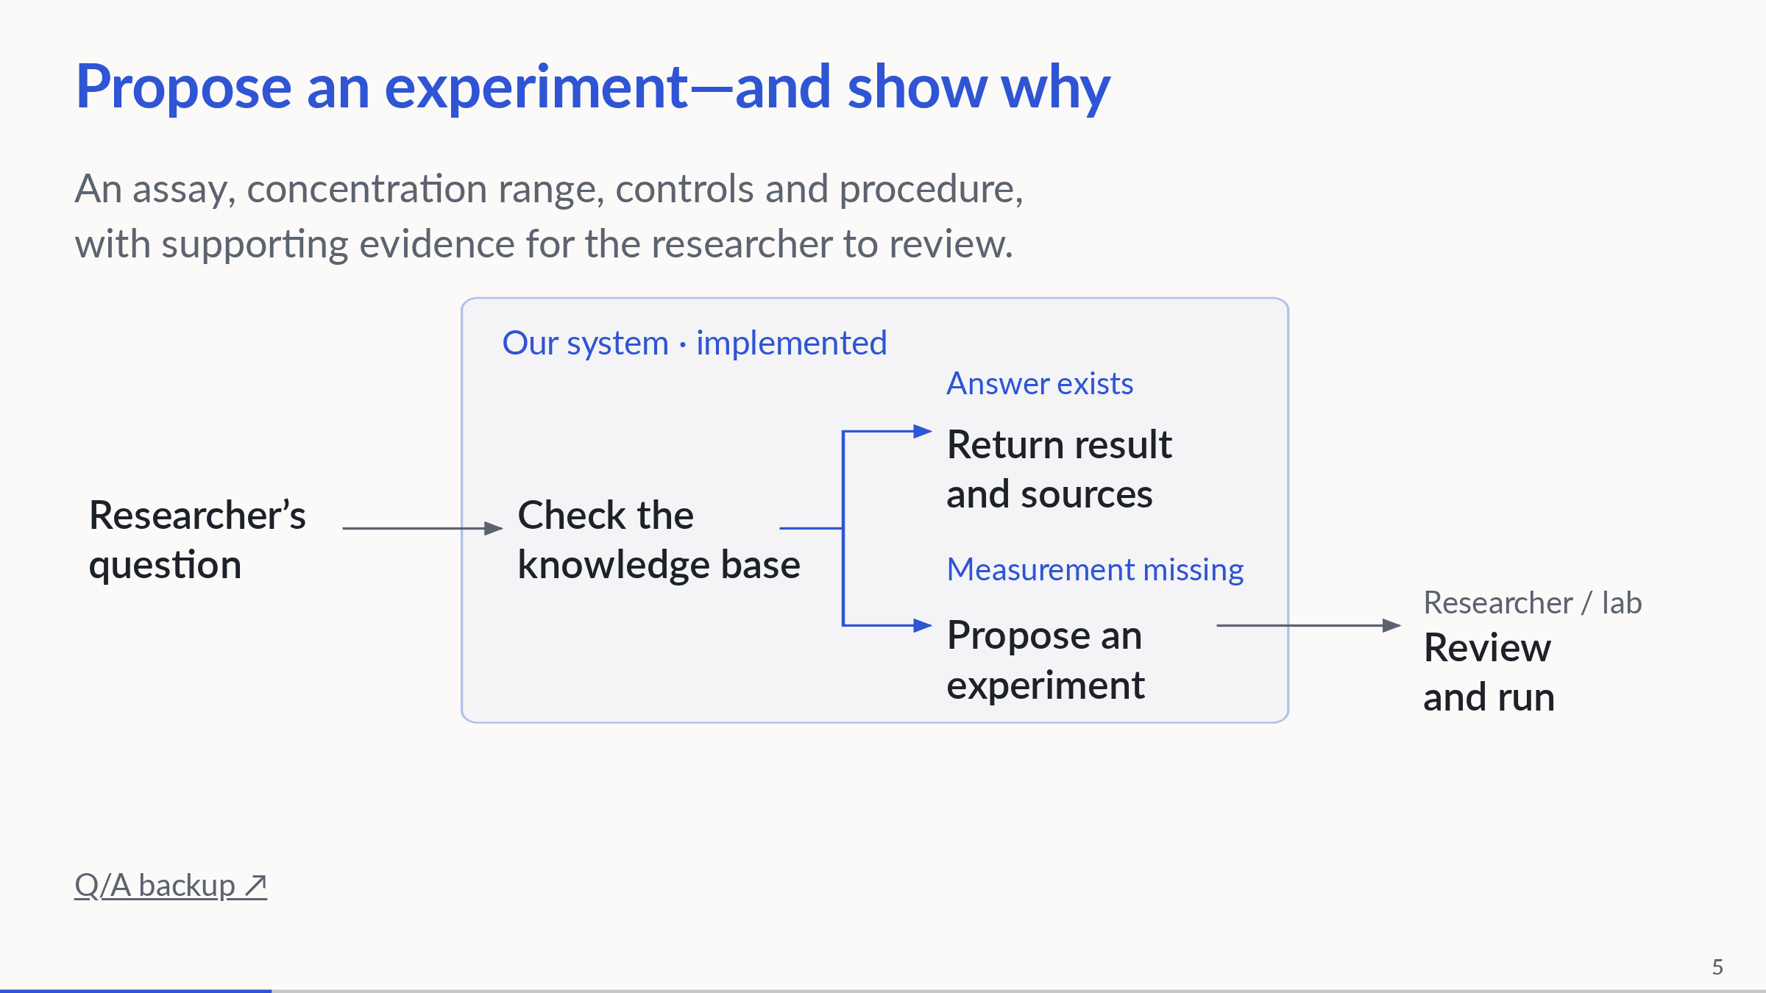
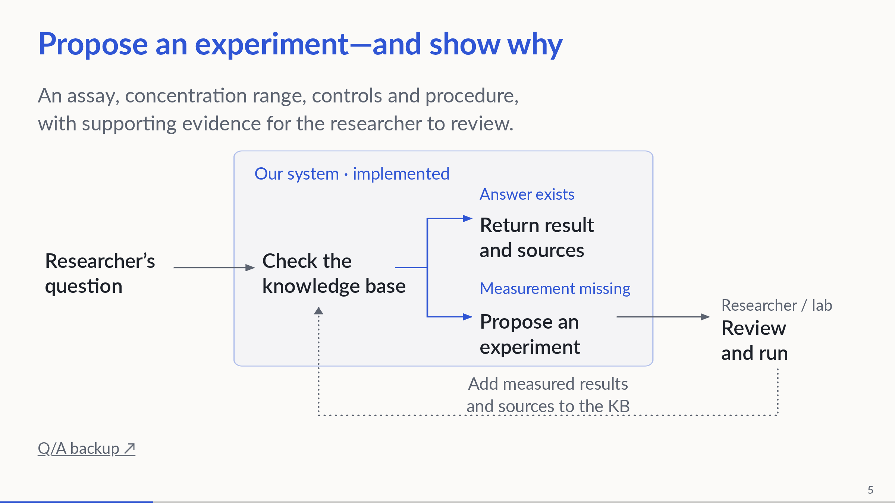
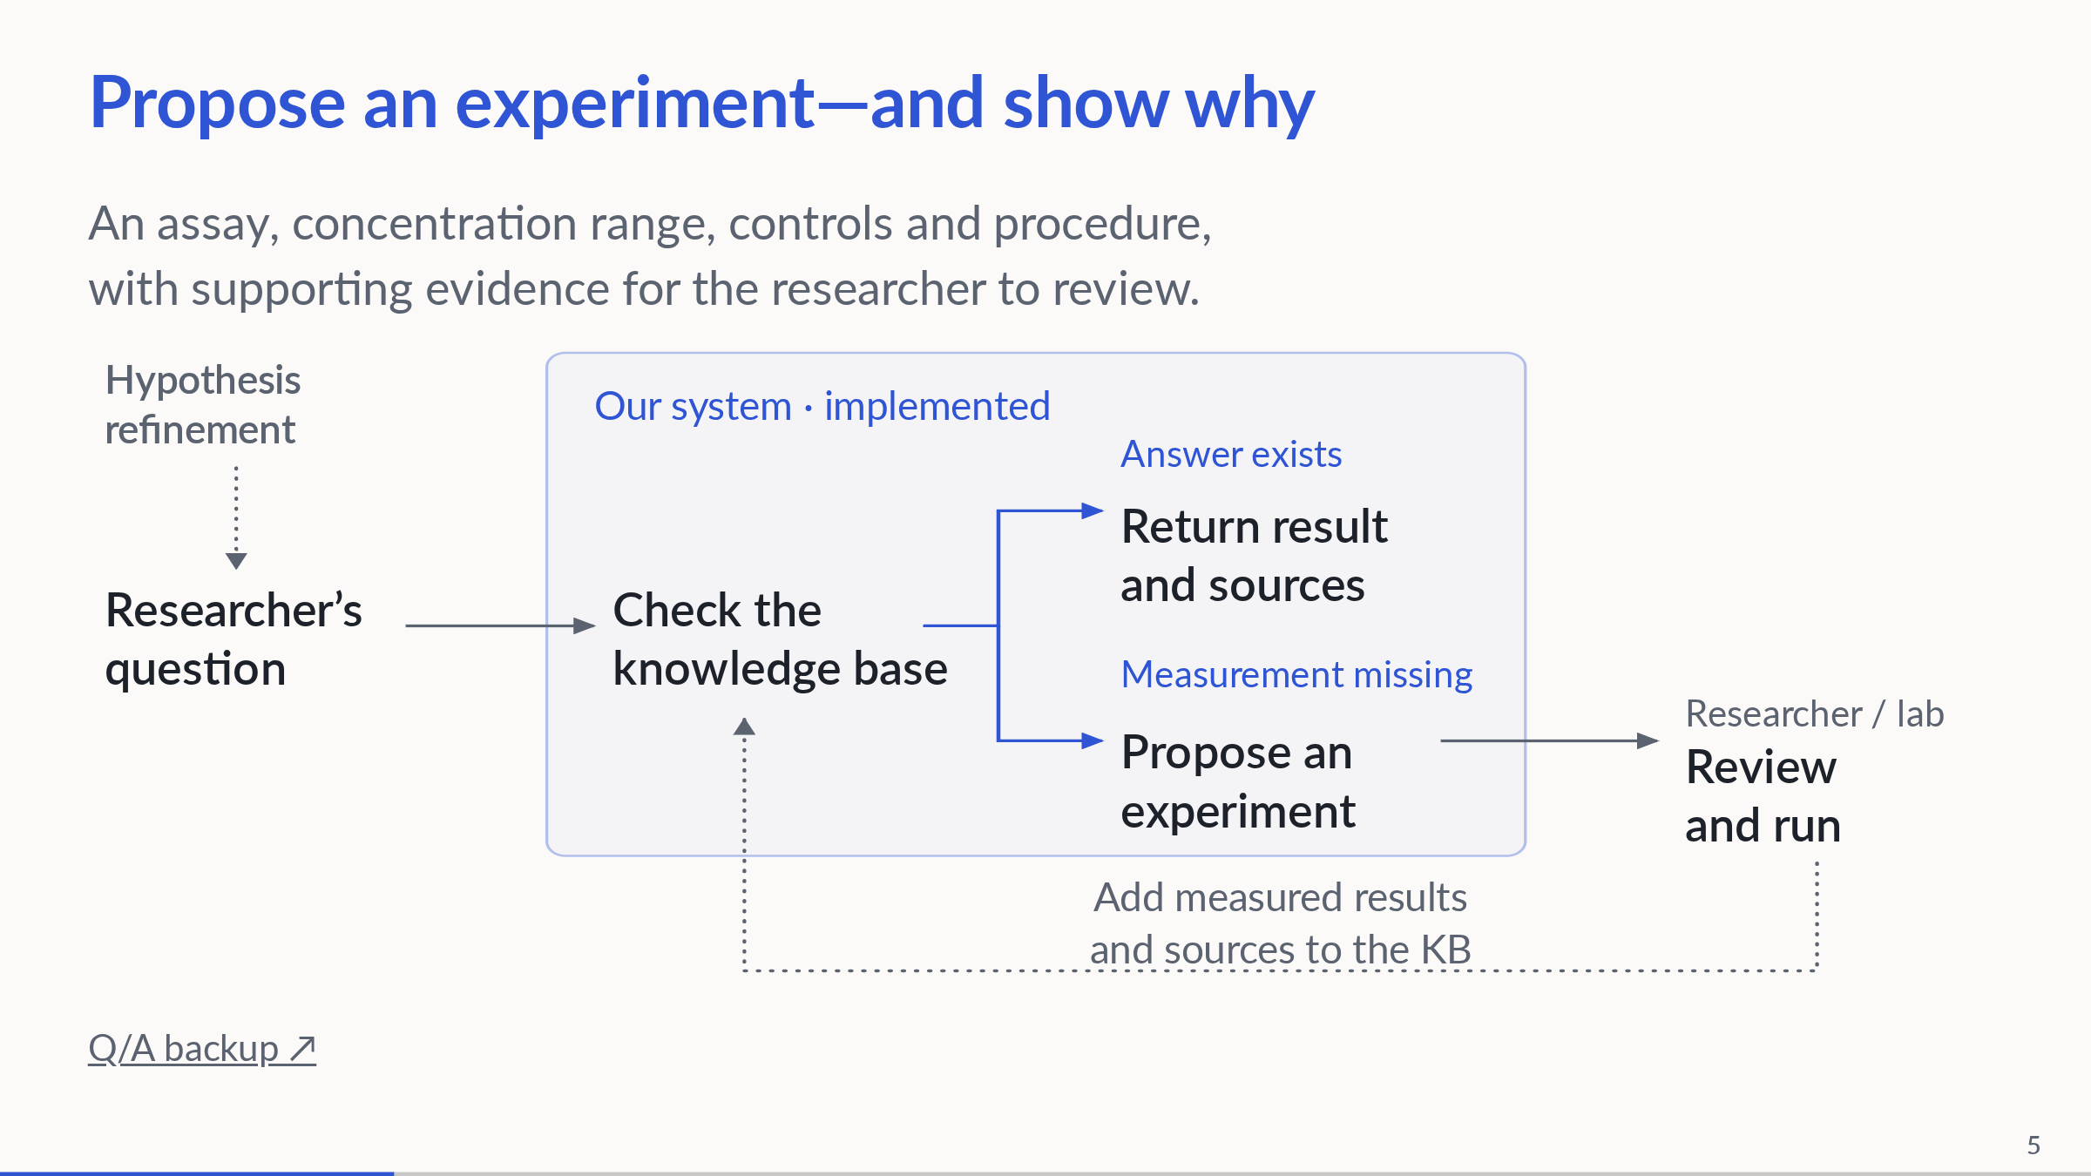
Notes:
3:00–4:00. The accented region identifies implemented system behavior: both returning an existing answer and proposing an experiment when a measurement is missing. Solid internal connections represent these implemented paths; the distinction is implementation status, not benchmark coverage. The researcher supplies the question and reviews a proposed experiment before the lab runs it. Show both implemented branches and the researcher/lab handoff on arrival; then reveal the result feedback loop, followed by upstream hypothesis refinement. Muted dotted arrows identify proposed connections: hypothesis refinement and measured-result ingestion. Researcher/lab review and execution remain outside the system box; the solid handoff does not claim autonomous experimental execution. The feedback loop adds measured results, assay conditions and provenance, including negative results, to the KB. Hypothesis refinement sharpens an existing idea into a testable question. The current connected agent is IC50-based; this conceptual diagram does not establish an end-to-end bacterial run. Existing evidence does not prevent confirmatory experiments.
PowerPoint: click to reveal successive captured states; smooth HTML motion is represented by discrete reveals. Demo: https://zhang-etal-biohack.pages.dev/talks/biohack/graph/

Slide 6
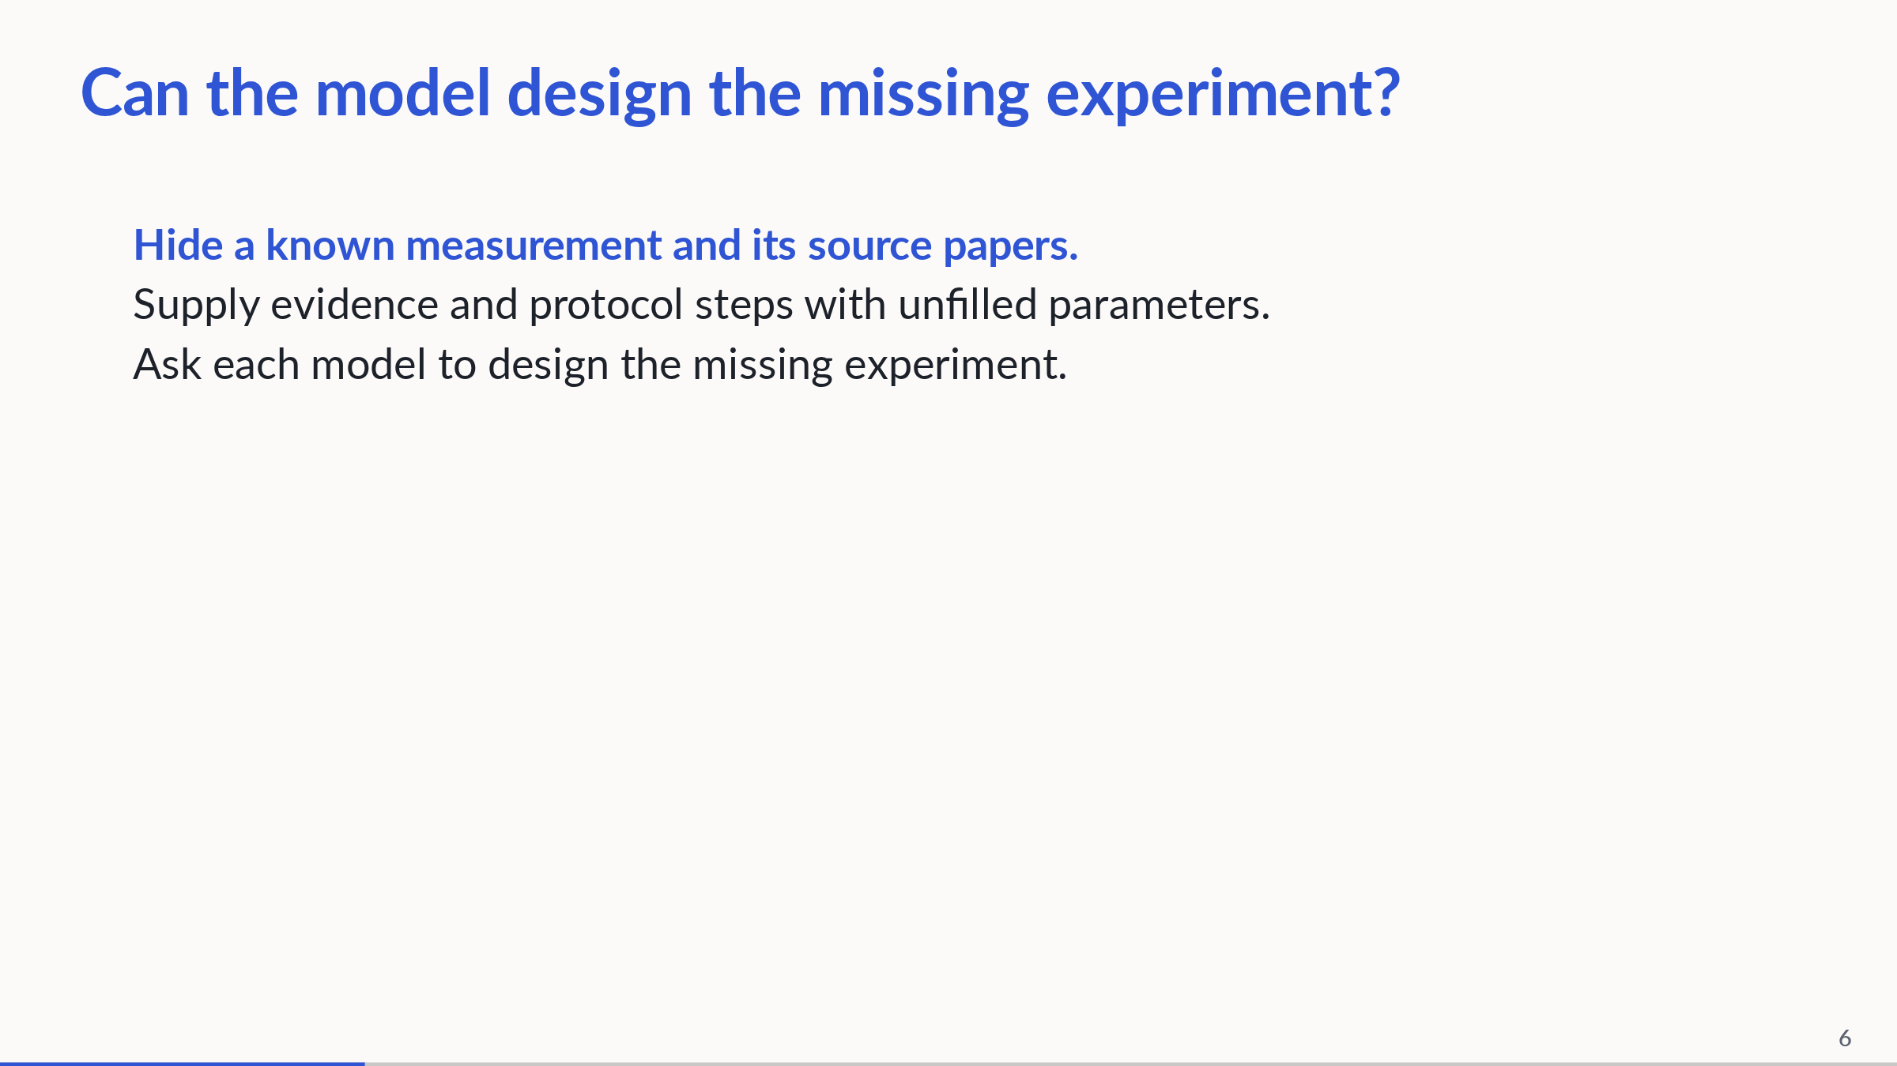
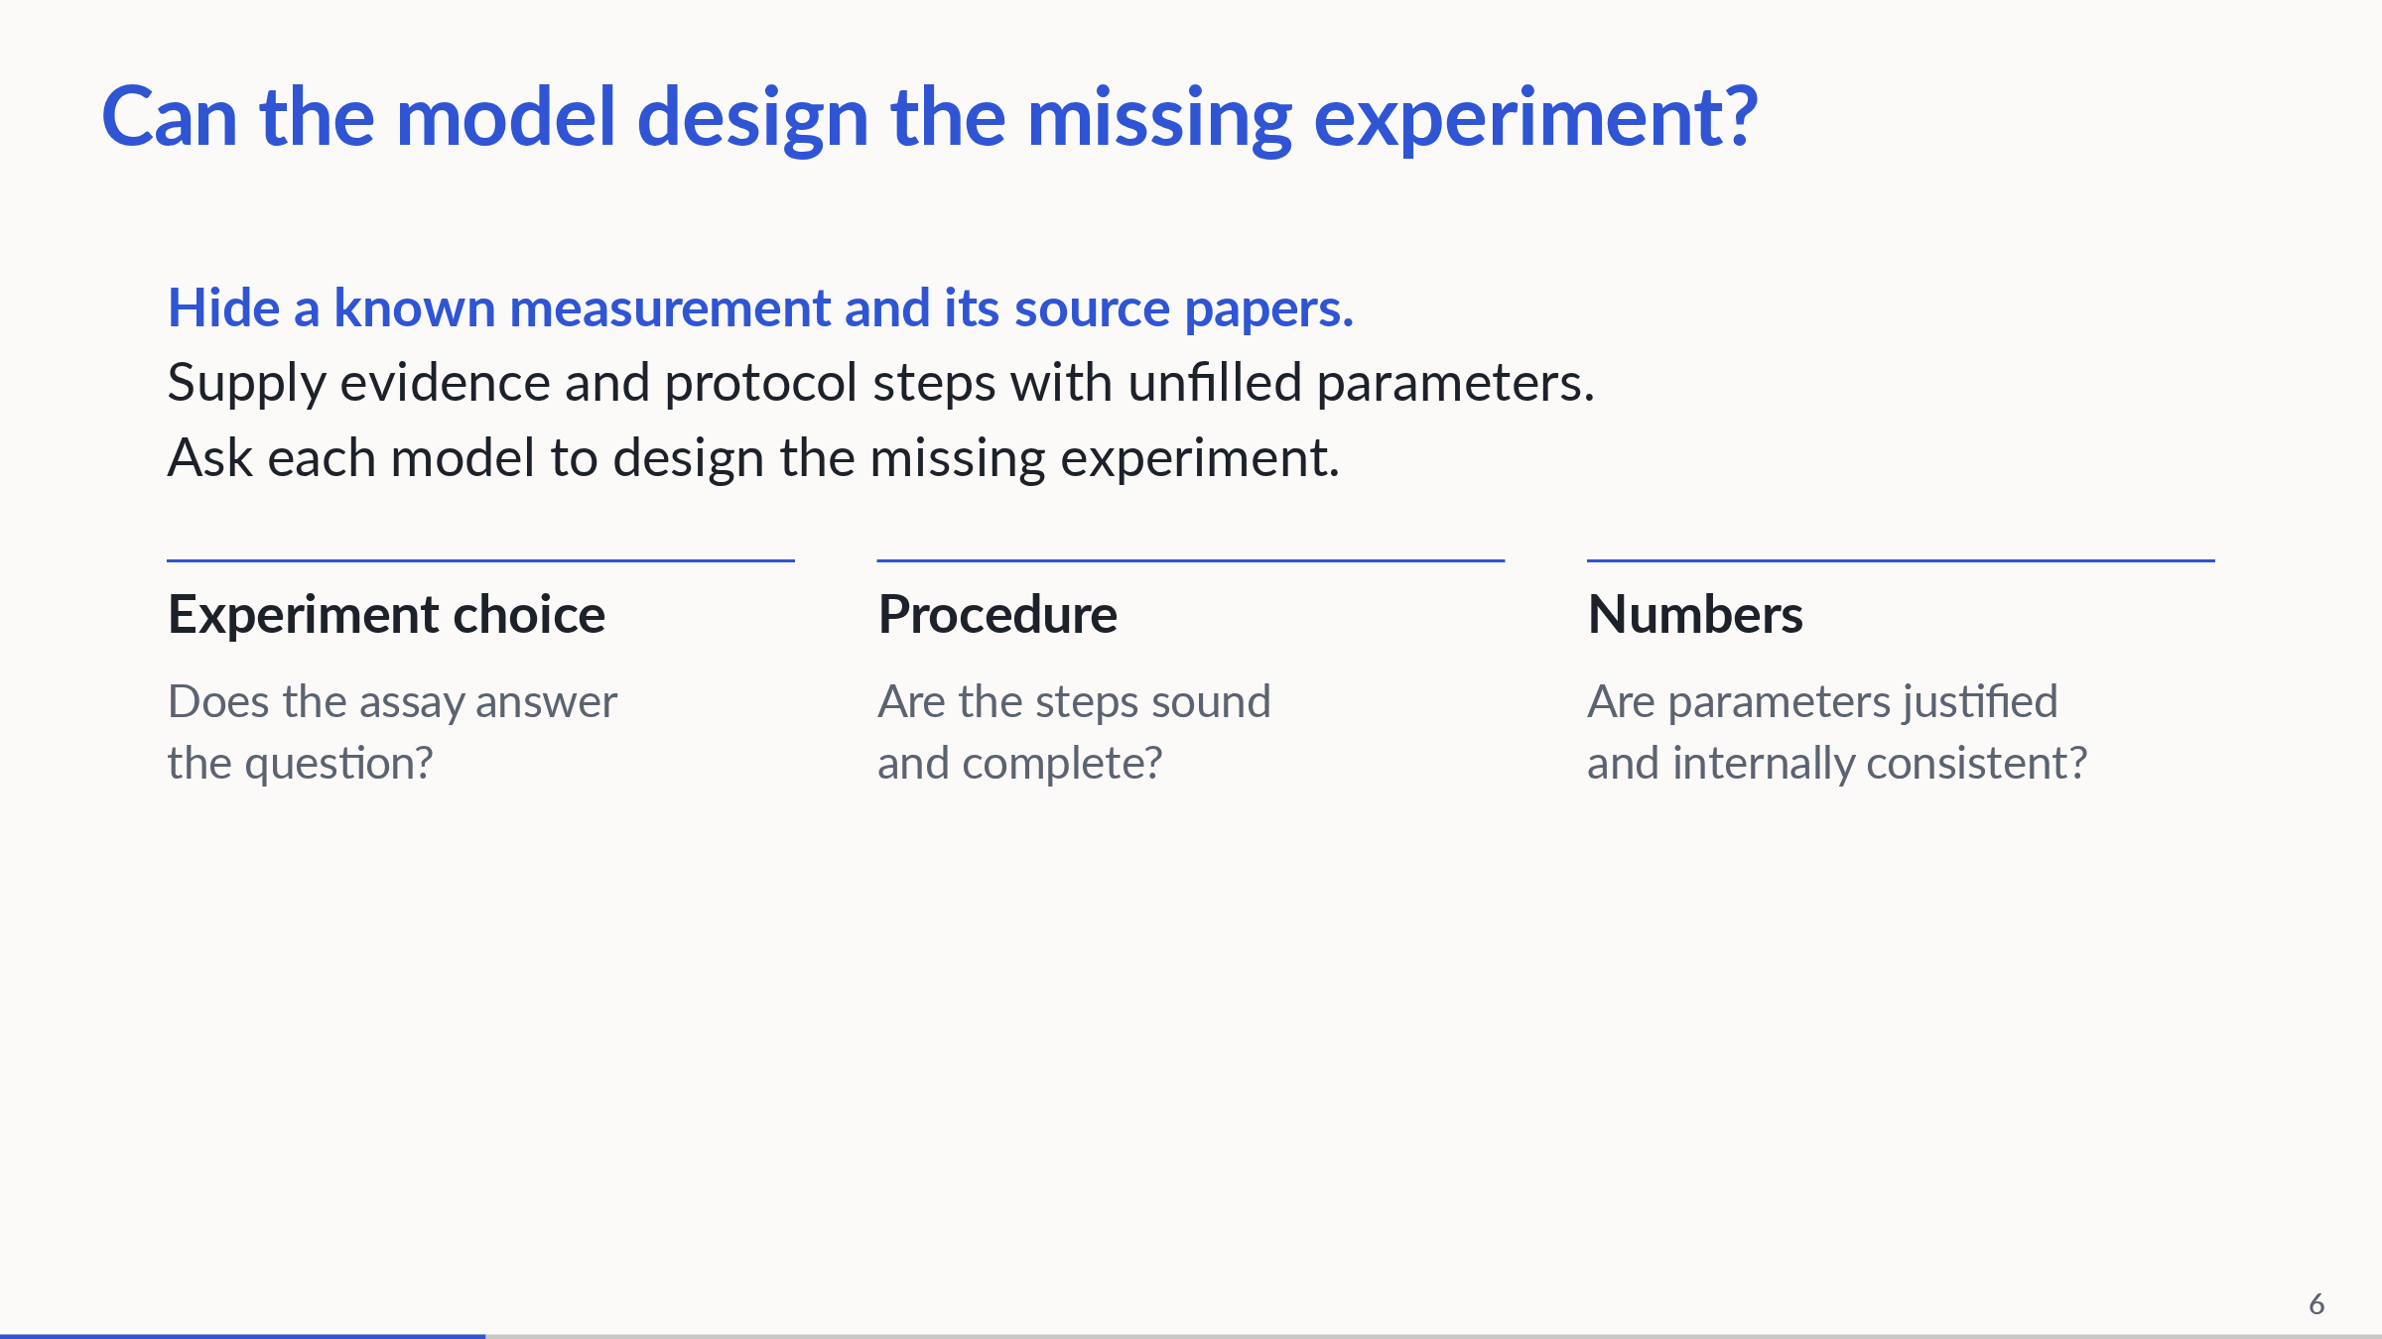
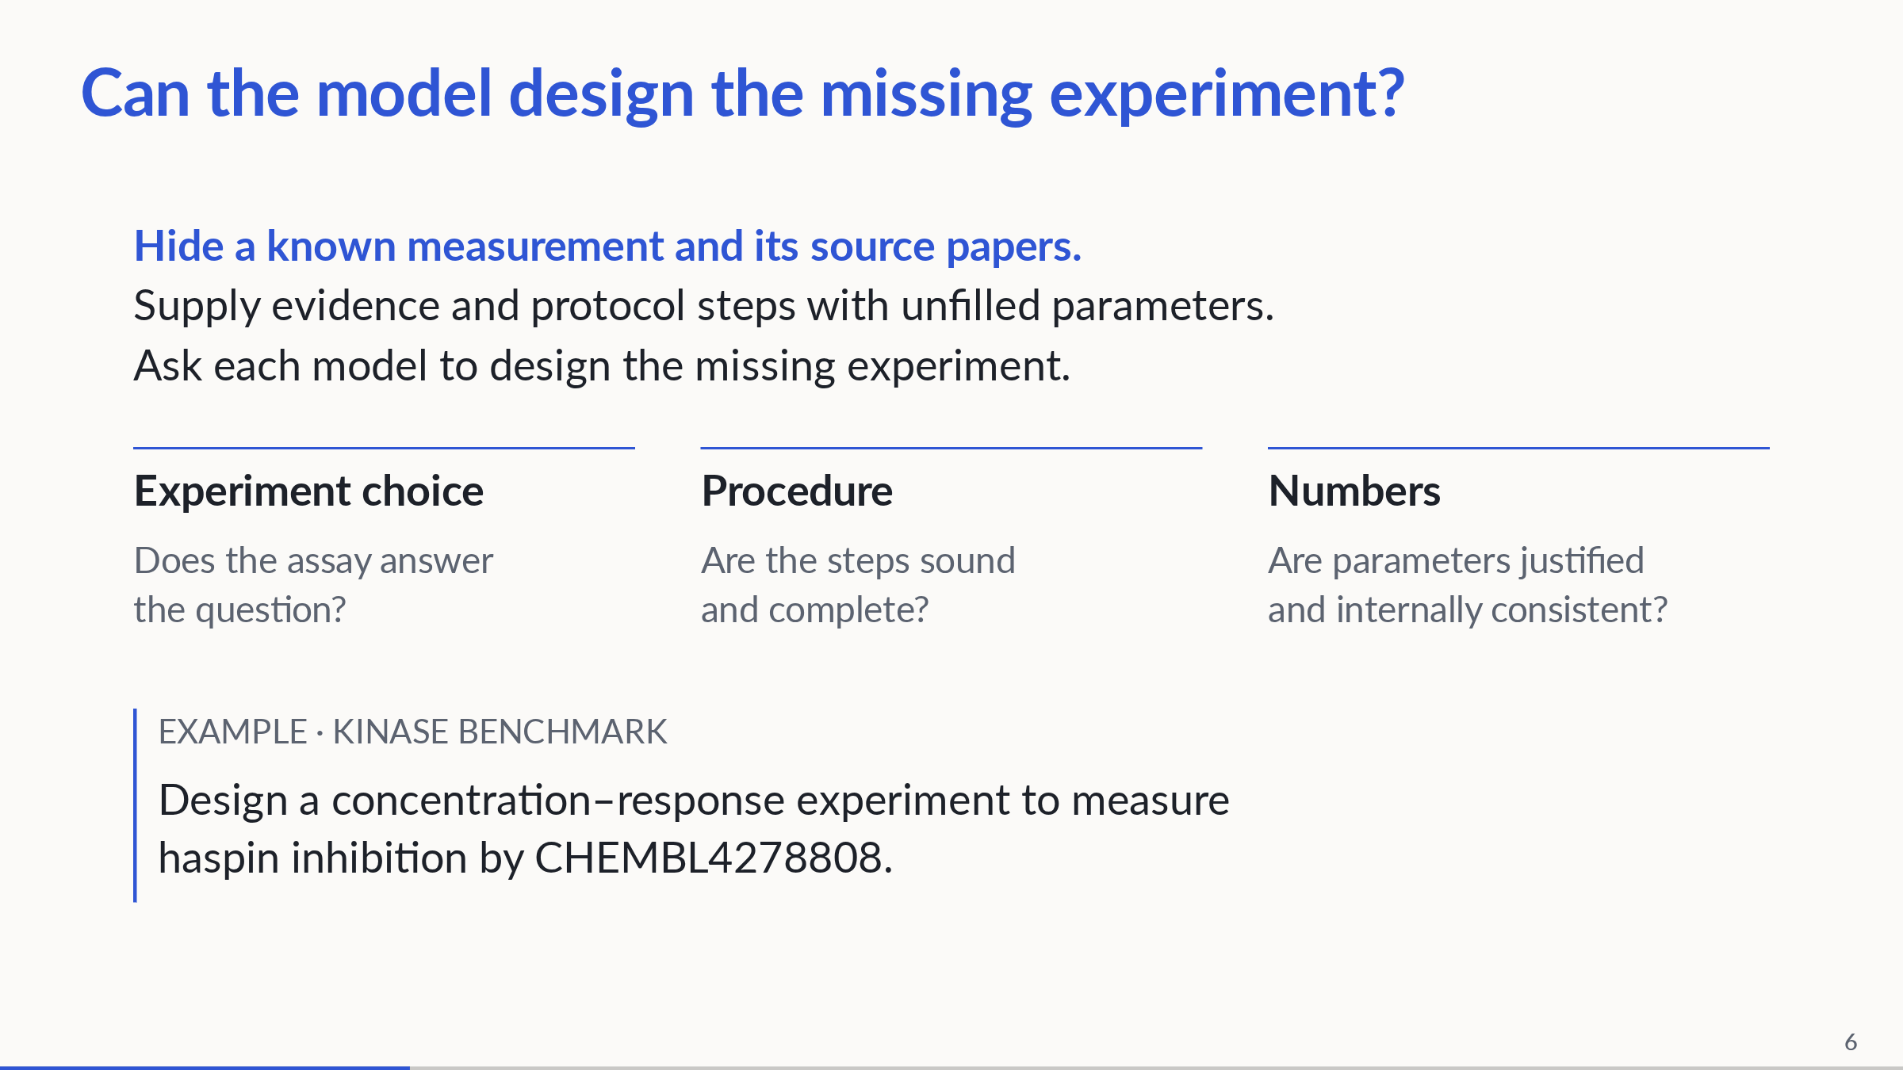
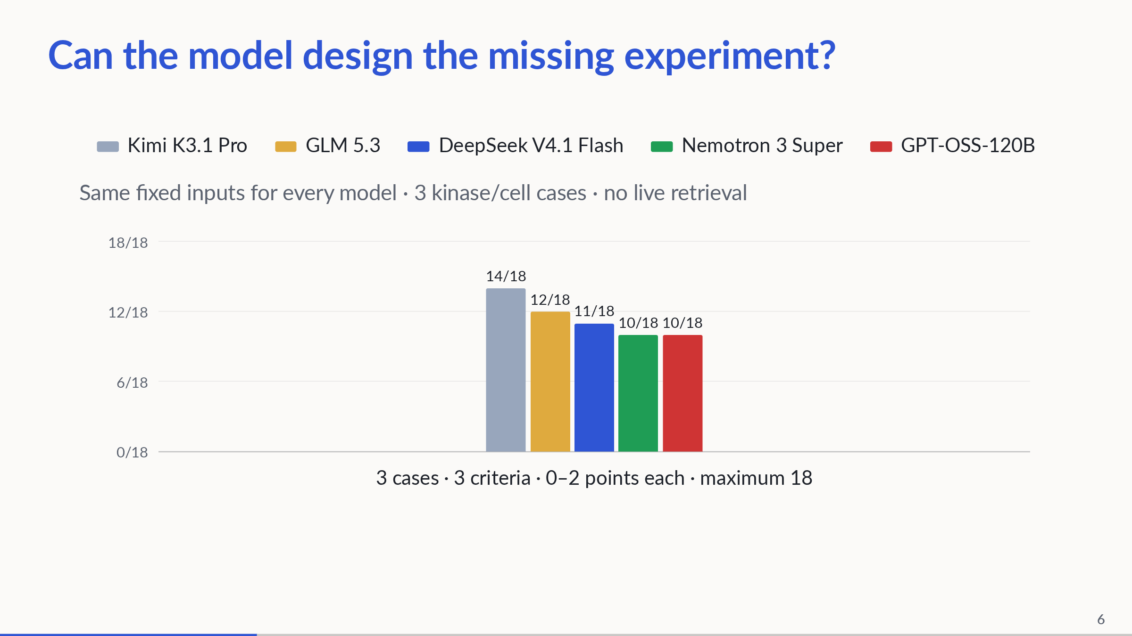
Notes:
4:00–5:15. Four beats: test setup; three assessment criteria; a shortened version of the actual case-1 question; then the results figure. The original case-1 prompt additionally asks for an ordered procedure and justified parameters and forbids remembered potency. In a benchmark simulation, known query-pair evidence and its source documents are excluded from fixed input packets. Five models each produce one response on three manually selected, correlated kinase/cell cases. Generation uses those fixed packets, with no live graph retrieval. Grade experiment suitability, procedural soundness and numerical soundness, 0–2 each per case. Scores are provisional, unblinded, uncalibrated Codex judgments, not expert validation or pass rates. No statistical ranking, deterministic baseline, measured KG lift or MIC end-to-end result is established. Models: Kimi K3.1 Pro, GLM 5.3 (not Flash), DeepSeek V4.1 Flash 1017, Nemotron 3 Super, GPT-OSS-120B. Concrete finding, in plain language: one DeepSeek response told the researcher to prepare 11 different concentrations, but the same response listed 10 in its experiment settings. A person would need to resolve that disagreement before using the proposal. Protocol steps here are seven manually generalized benchmark cards with parameter slots and prerequisites, not raw graph nodes or automatically extracted paper protocols. Sources: biohack/data/pilot_results.json and committed benchmark/runs outputs. Keep detailed axis scores and limitations for Q/A.
PowerPoint: click to reveal successive captured states; smooth HTML motion is represented by discrete reveals. Demo: https://zhang-etal-biohack.pages.dev/talks/biohack/graph/

Slide 7
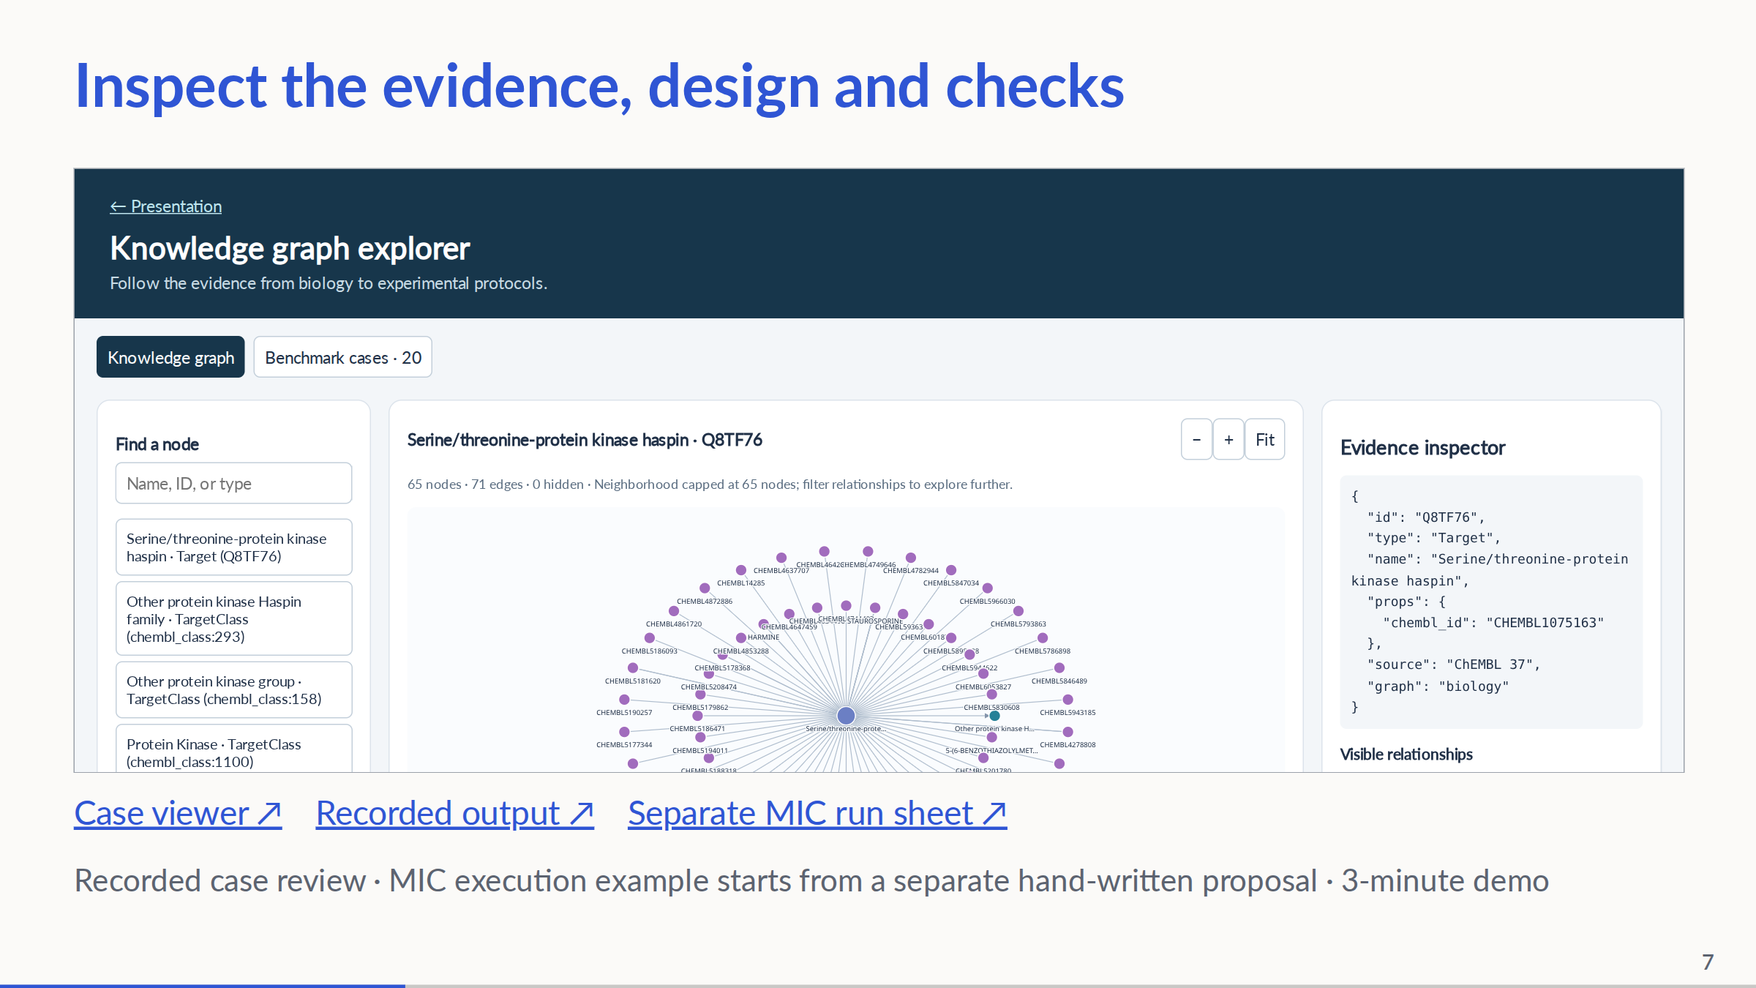
Notes:
5:15–8:15, strict three-minute evidence walkthrough. 0:00–0:30 establish the question and show the supplied case input. 0:30–1:30 inspect retained evidence and step cards in the benchmark-case tab; the withheld answer is reviewer-only. 1:30–2:15 reveal the held-out record and discuss experiment/steps/numbers; open the recorded model output via the link if useful. 2:15–3:00 show the separately generated MIC run sheet/protocol and simulation warnings. This last artifact begins from a hand-written four-species proposal; it is NOT the execution of the model output just shown. Say so explicitly. This is a recorded-artifact walkthrough, not a live agent run. If the UI is slow, use the pre-opened pages; do not run paid model calls during the pitch. No wet-lab outcomes claimed.
PowerPoint: click to reveal successive captured states; smooth HTML motion is represented by discrete reveals. Demo: https://zhang-etal-biohack.pages.dev/talks/biohack/graph/

