Slide 1
Angular
Team Crystals
Anuja Ajay-245235
Nimisha Reghuvaran-245212
Sankari Suresh-245108

Slide 2

What is Angular ?
Angular is a platform that helps you create advanced web applications in HTML using Typescript (Dart or ES5).
It helps you to structure your code, separate your concerns and remove trivial code.

Slide 3
Key Features of Angular
Two-way data binding: Provides automatic synchronization of data between the model and view.
Dependency Injection: Allows efficient management of application components and services.
Directives: Extends HTML with custom attributes and elements, enabling powerful declarative programming.
Templating: Supports a rich set of tools and syntax for creating dynamic views.
Routing: Enables navigation and management of application states.
Testing: Angular provides built-in testing utilities for easy unit testing and end-to-end testing.

Slide 4
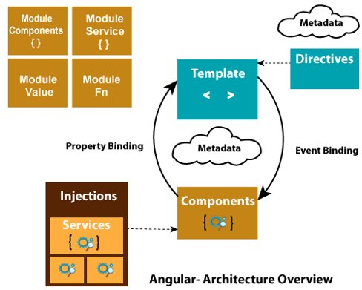
Architecture
Angular Architecture is divided into different parts like Component, Template, Directive, Service, and Module.

Slide 5
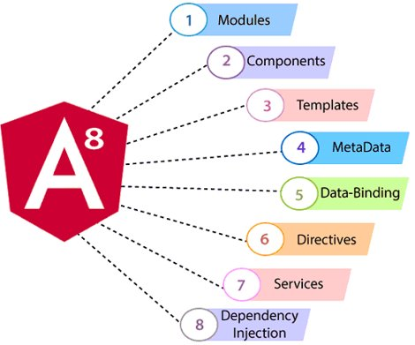
Architecture
Modules: Containers for related components, services, and other Angular artifacts.
Components: Building blocks of Angular applications that encapsulate templates, logic, and styling.
Templates: HTML-based files that define the structure and appearance of the user interface.
Metadata in Angular provides additional information about classes, components, and other Angular artifacts.It is used to configure and customize the behavior of these artifacts.Metadata is defined using decorators, such as @Component, @Directive, or @NgModule.

Slide 6
Data Binding: Establishes a connection between the UI and the application's data model.
Directives: Directives are a powerful feature in Angular that allow you to extend HTML and create reusable components.They are markers on DOM elements that instruct Angular to attach specific behavior or modify the appearance of those elements.
Services: Reusable and shareable code to handle business logic, data fetching, and other application-wide tasks.
Dependency Injection: A design pattern that promotes loose coupling and modular development.

Slide 7
Angular Modularity
Angular applications are based on Modules.
Angular Modules helps organizing the application into cohesive blocks of functionality.
A module is implemented as a class.
Declares which components, services etc that belongs together.

Slide 8
Angular App Module
The App Module is a core module in Angular that acts as the root module of an Angular application.
It provides a container for organizing and bootstrapping the components, services, and other Angular artifacts.
The App Module is responsible for defining the application's main components and configuring various aspects of the application.

Slide 9
App Module Structure
The App Module typically consists of the following components:
NgModule Decorator: A TypeScript decorator used to define the metadata for the module.
It specifies the module's imports, exports, providers, and bootstrap components.
Imports:
The "imports" property lists other modules that the App Module depends on.
These can include built-in Angular modules, third-party modules, and custom modules.

Slide 10
Declarations:
The "declarations" property contains the components, directives, and pipes used within the App Module.
These declarations make the components and other artifacts available for use within the module.
Providers:
The "providers" property defines the services or dependencies required by the module and its components.
Services registered here can be shared across the entire application.
Bootstrap Component:
The "bootstrap" property specifies the root component of the application.
This component is responsible for initializing and rendering the application's initial view.

Slide 11
AppModule Decorator Configuration
Imports:
Angular modules that need to be imported by the App Module, such as FormsModule, ReactiveFormsModule, RouterModule, etc.
Declarations:
Custom components, directives, and pipes declared within the App Module.
Providers:
Services or dependencies required by the App Module and its components.
Bootstrap:
The root component that will be bootstrapped when the application is launched.

Slide 12
Angular Component Structure
Template:
The template defines the structure and layout of the component's view.
It uses HTML combined with Angular's template syntax to display data and interact with the user.
Class:
The class contains the component's logic and behavior.
It handles data manipulation, event handling, and interactions with other components or services.
Metadata:
The metadata for a component is defined using the @Component decorator.
It provides information about the component, such as its selector, template, styles, and more.

Slide 13
Data Binding
Creating dynamic and interactive user interfaces
Data binding allows Internet users to manipulate web page elements.
The incremental display of a webpage makes data binding convenient.
Angular uses the concept of two-way binding.
UI element-related change is reflected in the corresponding and specific model state. Conversely, any model state changes reflect in the UI state.

Slide 14
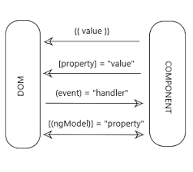
Without a framework it responsible for pushing data values into the HTML controls and turning user responses into actions and value updates.
Angular supports databinding, a mechanism for
Coordinating parts of a template with parts of a
component

Slide 15
Types of Data Binding
Data binding
Interpolation
Property binding
Event binding

Slide 16

Interpolation Binding
Interpolation is a procedure that allows the user to bind a value to the user interface element.
Interpolation binds the data one-way, which means that data moves in one direction from the components to HTML elements.

Slide 17
The code for the same below.
In the app.component.ts file, we’ve created two properties called name and topic.
export class AppComponent {
title = 'binding';
public name = "Sample"
public topic = "Data Binding"
To interpolate and bind them in the HTML file, type the following code
<h1 style="text-align: center;">Welcome to {{name}}</h1>
<h2 style="text-align: center;">Welcome to the {{topic}} tutorial</h2>

Slide 18
2.Property Binding
Property binding is a one-way data binding mechanism that allows you to set the properties for HTML elements.
It involves updating a property value in the component and binding the value to an HTML element in the same view.
Use property binding for toggle functionality and sharing data between components. It uses the "[]" syntax for data binding.

Slide 19
In the app.component.ts file, create another property called image and provided the path to the Logo in the assets folder.
public image = "/assets/Logo.png"
In the app.component.html file.
<img [src] = "image" alt="" style="height: 100px; width: 250px" class="center">

Slide 20

3.Event Binding
Event binding type is when information flows from the view to the component when an event is triggered.
The event could be a mouse click or keypress. The view sends the data to update the component.
It is the exact opposite of property binding, where the data goes from the component to the view.

Slide 21
created a Subscribe button that displays a “Thank you” message when clicked on.
<br><button (click)="onClick()">Subscribe to Simplilearn</button></div>
To display the message on the console, we’ve created a function called onClick() in the app.component.ts file.
onClick(){
console.log("Thanks for subscribing")
}
Every time the user clicks on the button, the message is displayed on the console.

Slide 22

Two-way Data Binding
Two-way binding is a mechanism where data flows from the component to the view and back.
This binding ensures that the component and view are always in sync. Any changes made on either end are immediately reflected on both.
The general syntax to denote two-way data binding is a combination of Square brackets and parentheses "[()]".

Slide 23
To illustrate two-way data binding, create a property with an empty string and an input box for the user to type.
Whatever the user provides is displayed on the screen with the help of the property.
In the .ts file,
public random = ""
In the .html file, we’ve created an input field
<input [(ngModel)]="random" type="text"> <br>
{{random}}

Slide 24
Angular Directives
Structural Directives
Structural directives modify the structure of the DOM by adding, removing, or replacing elements.
*ngIf:
The *ngIf directive conditionally adds or removes an element based on a specified expression.
*ngFor:
The *ngFor directive iterates over a collection and generates a set of elements for each item in the collection.
*ngSwitch:
The *ngSwitch directive is used in conjunction with *ngSwitchCase and *ngSwitchDefault to conditionally display elements based on a specific value.

Slide 25
Attribute Directives
Attribute directives modify the behavior or appearance of an element, component, or template.
ngClass:
The ngClass directive dynamically adds or removes CSS classes to an element based on certain conditions.
ngStyle:
The ngStyle directive dynamically sets inline styles for an element based on specified expressions.
ngModel:
The ngModel directive provides two-way data binding between an input element and a component's property.

Slide 26
Services
Angular services are objects that get instantiated just once during the lifetime of an application.
They contain methods that maintain data throughout the life of an application, i.e., data is available all the time.
The main objective of a service is to organize and share business logic, models, or data and functions with different components of an Angular application.
They are usually implemented through dependency injection.

Slide 27
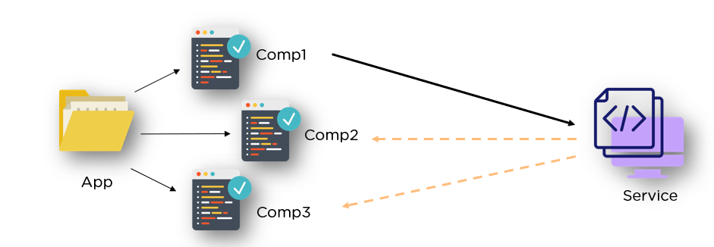

Slide 28
Features of Services
Services in Angular are simply typescript classes with the @injectible decorator.
This decorator tells angular that the class is a service and can be injected into components that need that service.
They can also inject other services as dependencies.
These services are used to hold business logic.

Slide 29
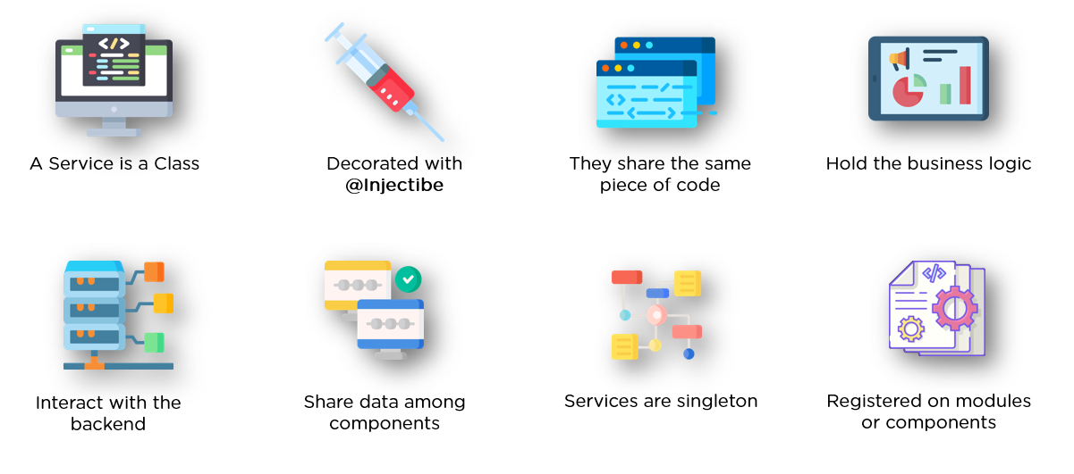

Slide 30
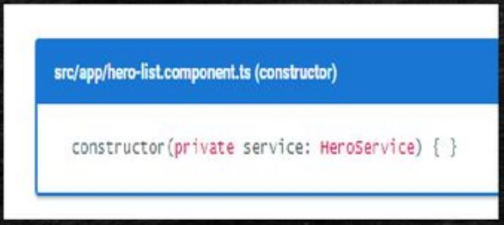
Dependency Injection
Dependency injection is a way to supply a new instance of a class with the dependencies it requires.
Most dependencies are services.
Angular uses dependency injection to provide a new component with the services they need
Angular can tell which services a component needs by looking at the types of its constructor parameters.

Slide 31
Dependency Injection Cont...
DI in Angular is achieved through the use of decorators, such as @Injectable() for services and @Component() for components, which allow dependencies to be specified.
Angular's DI system uses a hierarchical injection system, where dependencies are resolved based on the structure of the application's component tree.
DI in Angular is also useful for creating mock objects and facilitating unit testing by allowing the injection of test doubles or stubs

Slide 32
Dependency Injection Cont...
The DI system in Angular supports both explicit and implicit dependency injection. Explicit DI allows you to specify the dependencies directly, while implicit DI relies on TypeScript's type inference capabilities.
Angular's DI system can also manage the lifecycle of injected dependencies, ensuring that they are created and destroyed as needed.
Angular provides a hierarchical injector tree that allows different levels of dependency scopes, such as application-wide singletons, module-level instances, or component-specific instances.

Slide 33
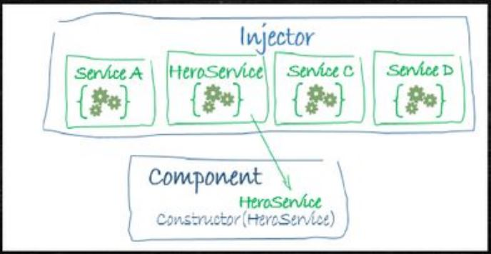
Dependency Injection Cont...
When Angular creates a component, it first asks an injector for the services that the component requires.
An injector maintains a container of service instances that it has previously created.
If a requested service instance is not in the container, the injector makes one and adds it to the container before returning the service to Angular.
When all requested services have been resolved and returned, Angular can call the component's constructor with those services as arguments. This is dependency injection.

Slide 34
Injectors and Providers
In Angular, an injector is responsible for creating and managing the instances of dependencies that are required by components, services, and other objects within an application.
The injector is part of Angular's dependency injection (DI) system and is responsible for resolving dependencies and injecting them into the appropriate objects.
Angular uses a hierarchical injection system, where each component has its own injector that can access dependencies from its parent component's injector.

Slide 35
Injectors and Providers Cont...
Providers in Angular are responsible for registering dependencies with the injector. They define how instances of dependencies are created and managed.
Providers can be registered at different levels within an Angular application, such as at the module level or component level, using the providers property in the module or component metadata.
Angular provides several types of providers, including value providers, class providers, factory providers, and existing providers, which allow for different ways of creating and managing dependencies.

Slide 36
Injectors and Providers Cont...
Value providers allow you to directly provide a value or object instance as a dependency.
Class providers allow you to specify a class that will be instantiated to provide the dependency. This class can have its own dependencies, which will be resolved by the injector.
Factory providers allow you to define a factory function that will be called by the injector to create the dependency instance.

Slide 37
Injectors and Providers Cont...
Existing providers allow you to provide an existing instance of a dependency, rather than creating a new instance.
Providers can also be configured with additional metadata, such as specifying the scope of the dependency (singleton, module-level, or component-level) using the 'providedIn' property.
Angular's DI system automatically resolves and provides the required dependencies based on the registered providers, allowing components and services to access their dependencies without explicitly creating or managing them.

Slide 38
Injectors and Providers Cont...
We must register a service provider with the injector, otherwise it don't know how to create the service.
A provider is something that can create or return a service, typically the service class itself.
You can register providers in modules or in components.

Slide 39
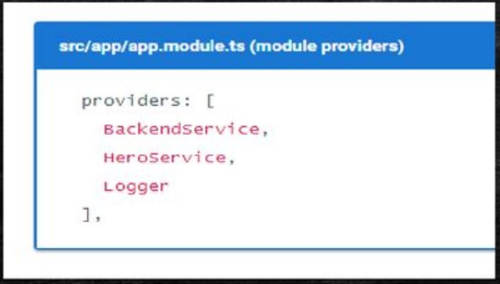
Injectors and Providers Cont...
In general, add providers to the AppModule (root module) so that the same instance of a service is available everywhere.

Slide 40
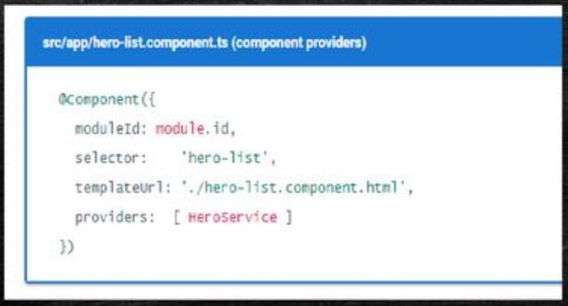
Injectors and Providers Cont...
Alternatively, register at a component level in the providers property of the @Component metadata:
Registering at a component level means you get a new instance of the service with each new instance of that component, and you hides the provider from other components and modules

Slide 41
Angular Material
Angular Material is a UI component library for Angular JS developers.
Angular Material components help in constructing attractive, consistent, and functional web pages and web applications while adhering to modern web design principles like browser portability, device independence, and graceful degradation.
It helps in creating faster, beautiful, and responsive websites.
It is inspired by the Google Material Design.

Slide 42
Features of Angular Material
In-built responsive designing.
Standard CSS with minimal footprint.
Includes new versions of common user interface controls such as buttons, check boxes, and text fields which are adapted to follow Material Design concepts.
Includes enhanced and specialized features like cards, toolbar, speed dial, side nav, swipe, and so on.
Cross-browser, and can be used to create reusable web components.

Slide 43
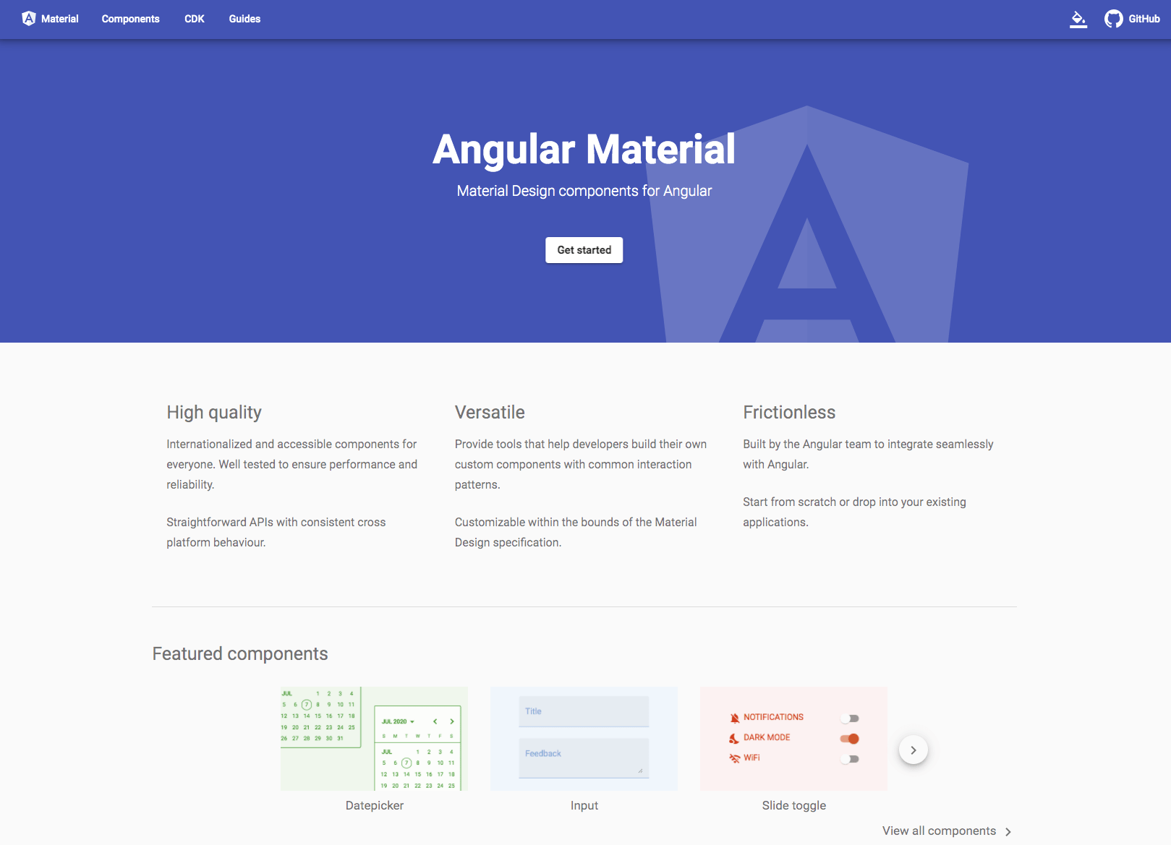
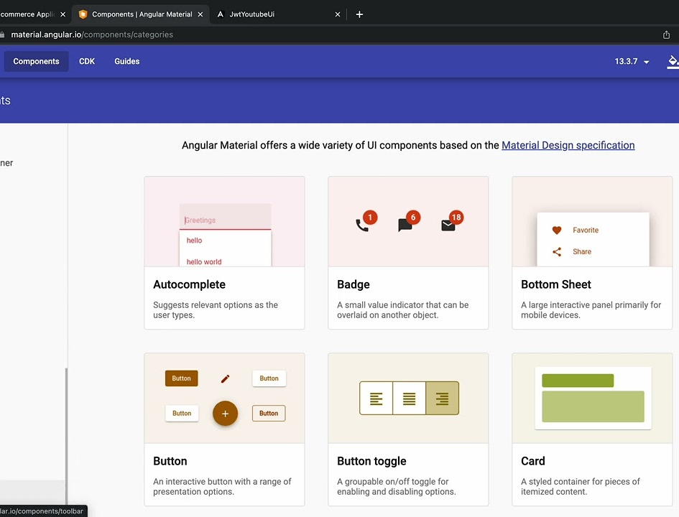
Angular Material UI

Slide 44
Install Angular Material
Use the Angular CLI's install schematic to set up your Angular Material project by running the following command:
ng add @angular/material

Slide 45
Conclusion
Angular offers a robust and comprehensive framework for building modern web applications.
1
Its features, architecture, and rich ecosystem make it a popular choice among developers.
2
With Angular, you can create scalable and maintainable applications that provide a seamless user experience.
3
The powerful MVC architecture promotes modularity, reusability, and separation of concerns in application development.
4
Two-way data binding simplifies data synchronization and reduces boilerplate code.
5
Dependency injection facilitates component communication, code reusability, and unit testing.
6
Reactive programming with RxJS allows for efficient handling of asynchronous operations and event-based programming.
7
Angular CLI provides a comprehensive set of tools for project scaffolding, building, testing, and deployment.
8
Angular's cross-platform capabilities enable the development of web, mobile, and desktop applications from a single codebase.
9

