Slide 1
CampusClaim
Receipt Information Extraction with Gemma 4 Vision
A detailed walkthrough of notebooks/campusclaim_3b.ipynb
Hacktoberfest Hack Day · Theme 3B · Unsloth LoRA on Colab T4

Slide 2
Agenda
What this deck covers from the working notebook
Problem & Theme 3B scope — why CampusClaim exists
Notebook architecture — seven steps from install to adapter zip
Dataset — ICDAR 2019 SROIE, frozen eval sample, domain shift
Memory-safe Colab design — why the first runs crashed
Baseline → LoRA fine-tune → comparison on the same 100 receipts
Scoring, exports, Gradio demo, and optional policy RAG bonus
Honest limits, cut lines, and what to say in the live showcase
CampusClaim · Theme 3B · notebooks/campusclaim_3b.ipynb
2 / 28

Slide 3
The problem
Student clubs retype receipts and hunt for reimbursement rules
Today
Photograph a receipt
Retype merchant, date,
address, and total
Search finance PDFs
Draft a claim by hand
Wait on human approval
CampusClaim
Upload the image
Extract four fields as JSON
Edit mistakes in the form
Draft a claim summary
Optional: cited policy Q&A
Still human
Approval stays with the
college reviewer
The model prepares the
claim — it does not
sanction the expense
CampusClaim · Theme 3B · notebooks/campusclaim_3b.ipynb
3 / 28

Slide 4
Theme selection — 3B only
Confirmed 24 October 2026 · one theme per team
Primary: Theme 3B — Receipt Information Extraction (required)
Bonus only: Theme 2A-style policy RAG as the 3B “combined approach”
Out of scope for hack day: Theme 1 four-model scorecard · Laya decision layer
Model: unsloth/gemma-4-E2B-it (4-bit) with Unsloth FastVisionModel
Hardware: free Colab T4 · GPU cells are not runnable in the local checkout
Source of truth for the run: shared Colab notebook; repo holds the versioned copy
CampusClaim · Theme 3B · notebooks/campusclaim_3b.ipynb
4 / 28

Slide 5
Notebook map — seven steps
campusclaim_3b.ipynb run order (T4 GPU required)
1
2
3
4
5
6
7
Load model
FastVisionModel
4-bit · chat template
Load data
SROIE train/test
lazy indices
Baseline
Smoke → 100
plain Gemma
LoRA
Vision + language
120 steps
Evaluate
Same 100 keys
comparison table
App
Gradio upload
edit · claim draft
Save
Adapter zip
before disconnect
CampusClaim · Theme 3B · notebooks/campusclaim_3b.ipynb
5 / 28

Slide 6
Runtime budget on a free T4
Plan the showcase around these ranges from the notebook header
Install Unsloth + deps — about 2–4 minutes
Model download (gemma-4-E2B-it) — about 5 minutes first time
SROIE download — about 2 minutes
Baseline on 100 receipts — about 3–5 minutes
120 LoRA steps — about 20–30 minutes
Fine-tuned eval on the same 100 — about 3–5 minutes
Critical: stop after the one-receipt smoke test before spending GPU on the full baseline
Gemma 4 is forced to float32 on T4 (float16 → NaN gradients) — expected; image side capped at 1024 px
CampusClaim · Theme 3B · notebooks/campusclaim_3b.ipynb
6 / 28

Slide 7
Dataset — ICDAR 2019 SROIE
jsdnrs/ICDAR2019-SROIE · CC-BY-4.0 · Malaysian receipts
987 rows: 626 train · 361 test
Entities used: company, date, address, total
words / bboxes unused — those would be an OCR baseline, not vision fine-tuning
One train row has empty total → 625 usable train receipts
All 361 test rows usable; evaluation uses a frozen 100-key sample (seed 0)
Frozen keys live in data/eval_keys_seed0.json and are embedded in the notebook
Never resample mid-run — baseline and fine-tuned must share the exact same receipts
Domain shift: SROIE score ≠ campus-receipt score; local receipts are a separate, labelled test
CampusClaim · Theme 3B · notebooks/campusclaim_3b.ipynb
7 / 28

Slide 8
Colab memory design (the hard part)
“Session crashed after using all available RAM” — system RAM, not GPU
Free Colab ≈ 12.7 GB system RAM · T4 ≈ 15 GB VRAM
First crash cause: iterating the image column and decoding ~1,000 PILs into Python lists
Fix 1 — filter on key/entities only via select_columns (metadata views)
Fix 2 — LazyRows for evaluation (decode one receipt per access)
Fix 3 — training Dataset of row indices + with_transform (messages + images)
TRL SFTTrainer accepts datasets.Dataset / IterableDataset — not torch.utils.data.Dataset
Do not Dataset.from_list(all conversations) — that reintroduces the RAM spike
MAX_IMAGE_SIDE = 1024 · dataloader_num_workers = 0 · gc + empty_cache around heavy cells
CampusClaim · Theme 3B · notebooks/campusclaim_3b.ipynb
8 / 28

Slide 9
Step 1 — Load the vision model
FastVisionModel.from_pretrained + Gemma 4 chat template
MODEL_NAME = unsloth/gemma-4-E2B-it (E4B is stronger but tighter on a T4)
load_in_4bit=True — fits inside free T4 VRAM
use_gradient_checkpointing = "unsloth"
Returns a processor, not a tokenizer — use get_chat_template(processor, "gemma-4")
INSTRUCTION: Extract company, date, address, total · reply with JSON only
Print device + allocated/reserved GPU memory after load
Common pitfall: calling processor.tokenizer → TypeError on Gemma 4
CampusClaim · Theme 3B · notebooks/campusclaim_3b.ipynb
9 / 28

Slide 10
Step 2 — Conversation format
What each training example looks like for UnslothVisionDataCollator
messages[user]: text instruction + {"type": "image"} placeholder
messages[assistant]: JSON string of the four gold entities
images: [prepared PIL] — separate column matching generate_from_image
prepare_image: RGB convert + thumbnail to MAX_IMAGE_SIDE
INSTRUCTION is redefined in the conversation cell so partial re-runs after a restart do not NameError
Preview prints the assistant JSON for row 0 to confirm the pipeline before training
CampusClaim · Theme 3B · notebooks/campusclaim_3b.ipynb
10 / 28

Slide 11
Step 3 — Generation & scoring
Same instruction for baseline and fine-tuned · normalised field match
generate_from_image: chat template → processor(images=…) → greedy decode new tokens only
parse_json: first JSON object in the reply (handles fences / prose wrappers)
Normalisers: case/punctuation for text · date formats · currency/comma totals
Metrics: valid JSON · exact company/date/address/total · address token-F1
Formatting differences are not counted as wrong extractions after normalisation
Report valid JSON separately — a prose reply scores 0 on every field
CampusClaim · Theme 3B · notebooks/campusclaim_3b.ipynb
11 / 28

Slide 12
Smoke test — gate before the long run
One frozen receipt · if this fails, do not start the 100-receipt baseline
smoke = eval_rows[0]
Print key, expected entities, and prediction JSON
Success criterion: valid JSON with the four fields (accuracy can still be wrong)
Failure: fix generation / processor / OOM before spending 30+ minutes of GPU
This is the checkpoint the Colab handoff asks M1 to paste back to the team
CampusClaim · Theme 3B · notebooks/campusclaim_3b.ipynb
12 / 28

Slide 13
Baseline — plain Gemma on 100 receipts
evaluate_vision(eval_rows, "plain_model")
Runs the frozen 100 keys with adapters off (or before LoRA is attached)
Produces baseline_df + baseline_metrics
This is the control group every fine-tuned result must beat
Export later: baseline_predictions.csv · baseline_metrics.json
Do not change EVAL_KEYS between baseline and fine-tuned runs
CampusClaim · Theme 3B · notebooks/campusclaim_3b.ipynb
13 / 28

Slide 14
Step 4 — LoRA fine-tuning
Vision layers are trained because the task is reading the receipt
FastVisionModel.get_peft_model · r = alpha = 16 · dropout 0 · all-linear targets
finetune_vision_layers = True (and language / attention / MLP)
SFTTrainer + UnslothVisionDataCollator · processing_class = processor
120 steps ≈ 0.75 epoch over 625 usable train receipts
LR 2e-4 · batch 1 · grad accum 4 · max_length 2048 · adamw_8bit · cosine schedule
skip_prepare_dataset=True · remove_unused_columns=False
OOM fallbacks: LORA_RANK=8 · finetune_vision_layers=False · MAX_IMAGE_SIDE=800
CampusClaim · Theme 3B · notebooks/campusclaim_3b.ipynb
14 / 28

Slide 15
Step 5 — Fine-tuned eval & comparison
Same receipts · same instruction · same scorers
tuned_records = evaluate_vision(eval_rows, "fine_tuned_model")
comparison table: Plain % · Fine-tuned % · Change (points)
Failure table: receipts with any wrong field among company/date/address/total
Show where fine-tuning helped and where it did not — no invented wins
Exact address is strict; always show token-F1 beside it
CampusClaim · Theme 3B · notebooks/campusclaim_3b.ipynb
15 / 28

Slide 16
Metrics slide (fill from results/)
Numbers come only from comparison.csv after the Colab run — never invent them
Metric | Plain Gemma | Fine-tuned | Change
Valid JSON | — | — | —
Company exact | — | — | —
Date exact | — | — | —
Address exact | — | — | —
Total exact | — | — | —
Address token-F1 | — | — | —
After export: copy from results/comparison.csv. M2 owns verification before the deck goes final.
CampusClaim · Theme 3B · notebooks/campusclaim_3b.ipynb
16 / 28

Slide 17
Exports for M2 / M5
results/ folder written by the notebook export cell
baseline_metrics.json · tuned_metrics.json
comparison.csv · failures.csv
baseline_predictions.csv · tuned_predictions.csv
settings.json — model, instruction, eval size/seed, image side, LoRA, steps, LR, batch
Download the whole results/ folder from the Colab file browser
Also download campusclaim_gemma4_lora.zip immediately after training
CampusClaim · Theme 3B · notebooks/campusclaim_3b.ipynb
17 / 28

Slide 18
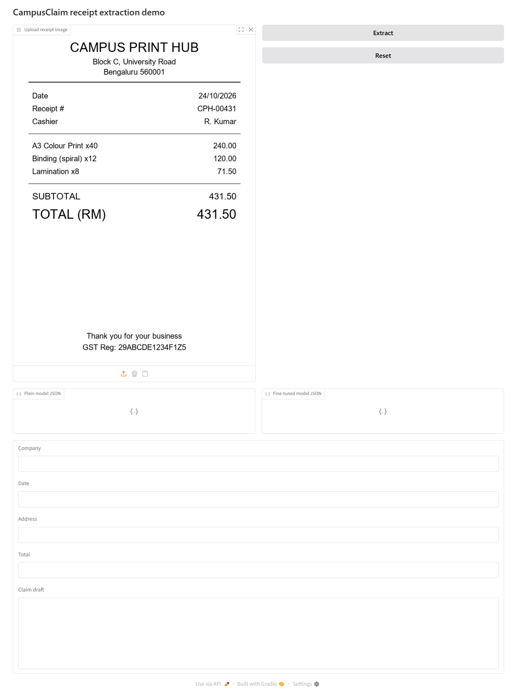
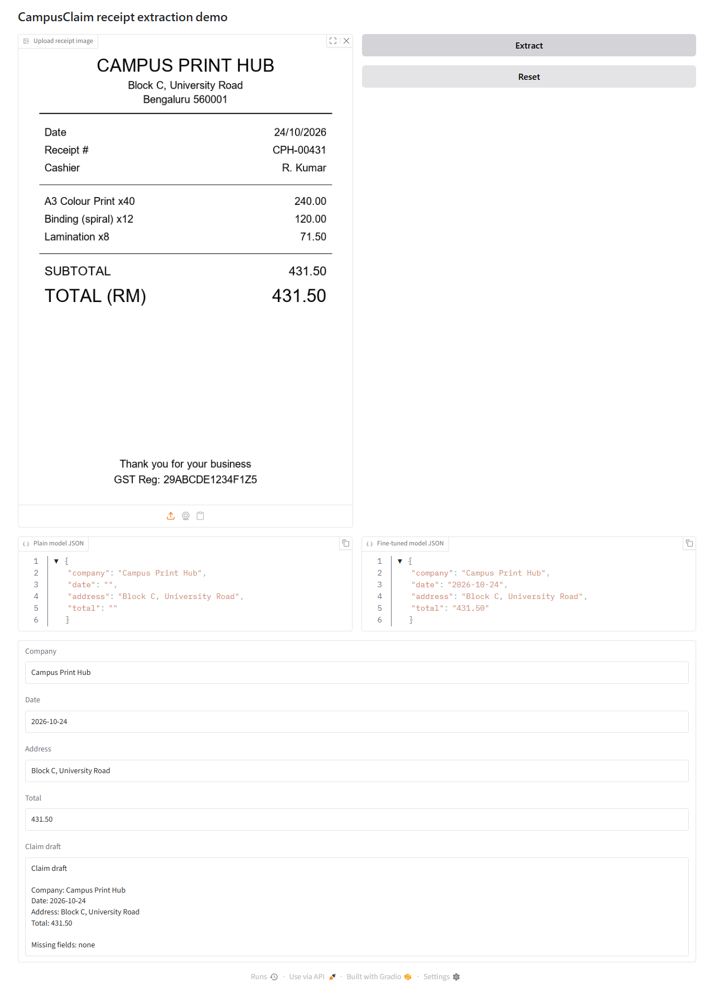
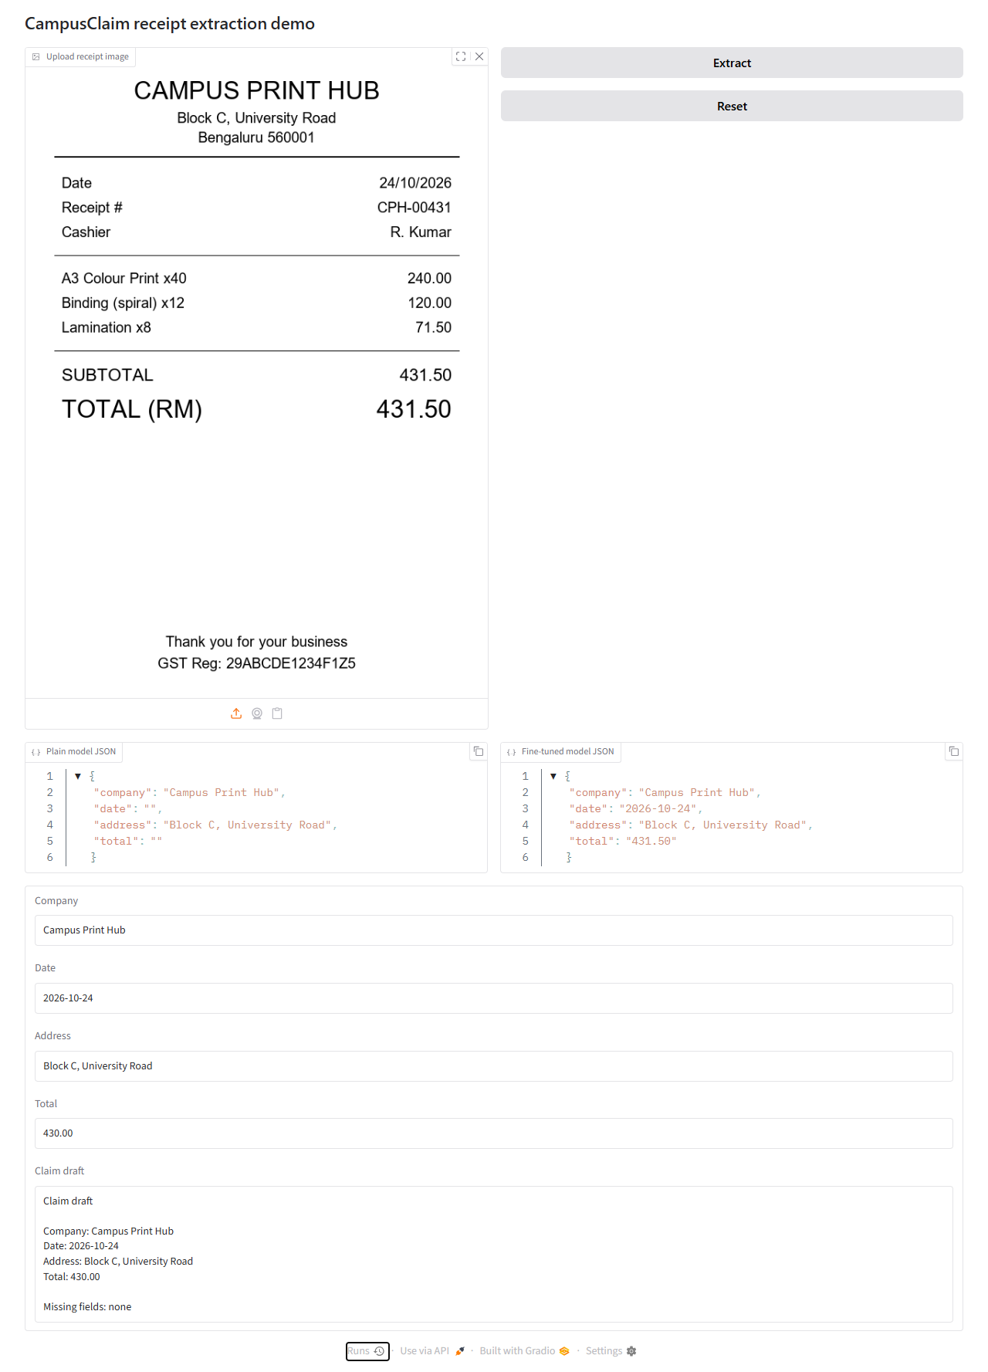
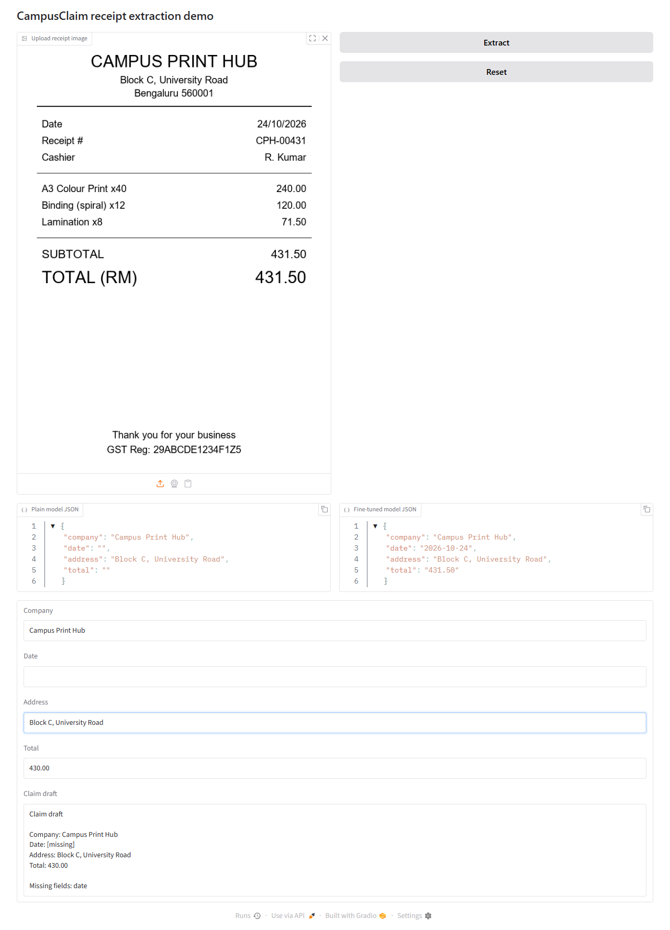
Step 6 — Gradio application
Upload → extract (plain vs tuned) → edit → claim draft
In-notebook demo (primary)
extract_both: disable_adapter for plain,
then tuned with adapters on
Editable fields: company, date,
address, total + purpose
build_summary marks missing fields
and reminds that approval is human
Standalone app/gradio_app.py is the
CPU fallback (dummy or --no-dummy)
Upload
Extract
Edit
Claim
CampusClaim · Theme 3B · notebooks/campusclaim_3b.ipynb
18 / 28

Slide 19
5-minute demo script
From docs/demo-script.md / team plan
0:30 — Problem: clubs retype receipts and hunt rules
1:30 — Extraction: upload held-out receipt · plain vs fine-tuned side by side · fix one field
1:00 — Claim draft from corrected fields · show missing information
1:00 — Evidence: metrics table + two failures (include a wrong total)
1:00 — Policy (if CP1 green): covered question with citation · uncovered refusal
0:30 — Limits: SROIE is Malaysian · local receipts separate · approval stays human
CampusClaim · Theme 3B · notebooks/campusclaim_3b.ipynb
19 / 28

Slide 20
Step 7 — Save adapters before disconnect
Free Colab can die without warning
model.save_pretrained("campusclaim_gemma4_lora")
processor.save_pretrained(...)
zip the folder → campusclaim_gemma4_lora.zip
Copy to Google Drive immediately after training
On reconnect: reload base model → load adapters → re-run eval/app only
Optional: push_to_hub with a Hugging Face token
CampusClaim · Theme 3B · notebooks/campusclaim_3b.ipynb
20 / 28

Slide 21
Optional bonus — policy RAG
Only after Checkpoint 1 (baseline + fine-tune + app green)
Separate notebook — do not mix RAG into the GPU extraction notebook
Proxy docs shortlisted: SNU student reimbursement policy · IIIT Una SAC policy
15-question test: 10 covered · 5 must refuse
Every answer cites document + page; never invent policy
If RAG is not green by CP2 — hide the tab; do not demo a broken feature
Deck must say policy docs are institutional proxies unless college PDFs arrive
CampusClaim · Theme 3B · notebooks/campusclaim_3b.ipynb
21 / 28

Slide 22
Honest reporting notes
From the notebook’s closing markdown — judges reward clarity over hype
SROIE is Malaysian (RM, dd/mm/yyyy) — campus receipts are a domain shift
Report valid JSON separately from field accuracy
Exact address match is strict — always pair with token-F1
State eval subset size and seed (100 · seed 0)
Never compare a 100-receipt baseline with a 361-receipt fine-tuned run
If fine-tuning loses on a field — show it; the problem statement asks for that analysis
CampusClaim · Theme 3B · notebooks/campusclaim_3b.ipynb
22 / 28

Slide 23
Cut lines & fallbacks
From docs/team-plan.md — decide early, record what you did
CUDA OOM → keep 4-bit · freeze vision layers · lower image side / max_length
Training > 30 min → stop, save, evaluate actual step count
Colab disconnect → reload base + adapters from Drive · eval/app only
GPU quota gone → switch Google account (notebook is account-agnostic)
Fine-tuned worse → report honestly · use prompted baseline as comparison
RAG scanned PDFs → replace or drop bonus
CampusClaim · Theme 3B · notebooks/campusclaim_3b.ipynb
23 / 28

Slide 24
Repo companion pieces
What lives outside the notebook but supports the same story
app/inference.py — mirrors generate_from_image for the standalone Gradio app
app/gradio_app.py — dummy by default · --no-dummy with adapter path
scripts/score.py · validate_notebook.py · demo_pipeline.py · freeze_eval_sample.py
tests/ — 40 standard-library tests · bash scripts/check.sh = CI
dev = integration branch · main = submitted baseline
GPU work stays in Colab; local checks stay CPU-only
CampusClaim · Theme 3B · notebooks/campusclaim_3b.ipynb
24 / 28

Slide 25
Team ownership (Hack Day 3B)
Only M1 edits the shared notebook; others use SCRATCH
M1
Notebook + fine-tune
Colab run, adapters, smoke gate
M2
Eval + metrics
Frozen keys, comparison, failures
M3
App + demo
Gradio, screenshots, backup clip
M4
Policy RAG
PDFs + 15Q after CP1
M5
Deck + rehearsal
Slides, rubric checklist
CampusClaim · Theme 3B · notebooks/campusclaim_3b.ipynb
25 / 28

Slide 26
Definition of done (rubric checklist)
Tick these before the final rehearsal
Fine-tuned model with settings documented (steps, LR, rank, image size, subset)
Dataset description: source, 626/361, fields, filtering, frozen eval sample
Comparative analysis on the same receipts (JSON + four fields + address F1)
Working app demonstrated live (upload → extract → edit → claim draft)
Discussion of where fine-tuning helped / did not / why
Backup video + screenshots if live demo fails
Bonus only if green: policy RAG with citations, refusal, 15-question test
CampusClaim · Theme 3B · notebooks/campusclaim_3b.ipynb
26 / 28

Slide 27
Immediate next steps for M1
Where the notebook run stands operationally
Disconnect and delete the Colab runtime after any RAM crash
Upload the patched notebooks/campusclaim_3b.ipynb
Run install → GPU check → model → data → conversations → smoke test
Paste smoke output before starting the 100-receipt baseline
After training: save zip to Drive · run fine-tuned eval · export results/
Hand results/ to M2 · fill metrics slide · rehearse the 5-minute script
CampusClaim · Theme 3B · notebooks/campusclaim_3b.ipynb
27 / 28

Slide 28
Questions
CampusClaim · Theme 3B · Gemma 4 E2B + LoRA on SROIE
Notebook: notebooks/campusclaim_3b.ipynb · Repo: sank8-2/campusclaim

