Slide 1
Bono Delizioso
Keep that food complexion

Slide 2
About BonoDZ
‘Bono delizioso’ aka ‘BonoDZ’ is a food blog website which makes people’s mouth watering from food all around the world.

Slide 3
Team memebrs
Shashank H S
Shashank M M
1BM21CS198
1BM21CS199
Shravanth J
Skanda M Shastry
1BM21CS206
1BM21CS212

Slide 4
Ui interface
This slide shows us the UI interface of the website

Slide 5
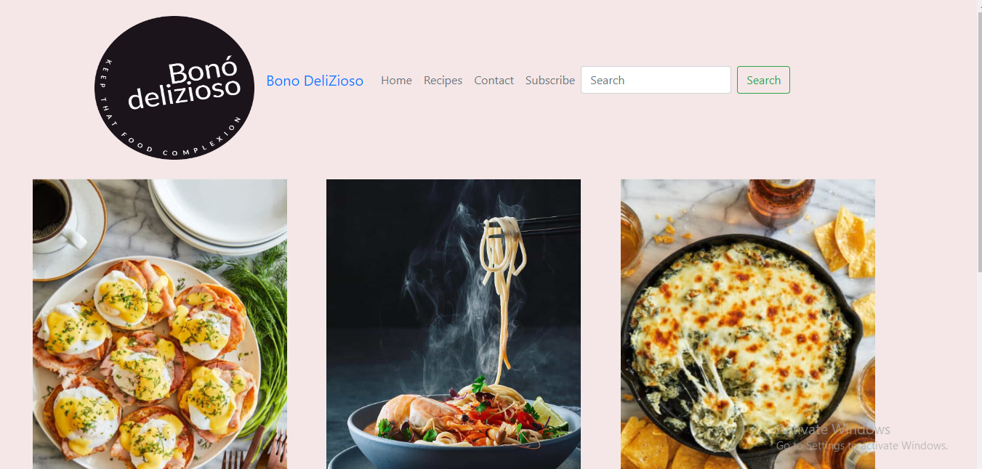

Slide 6
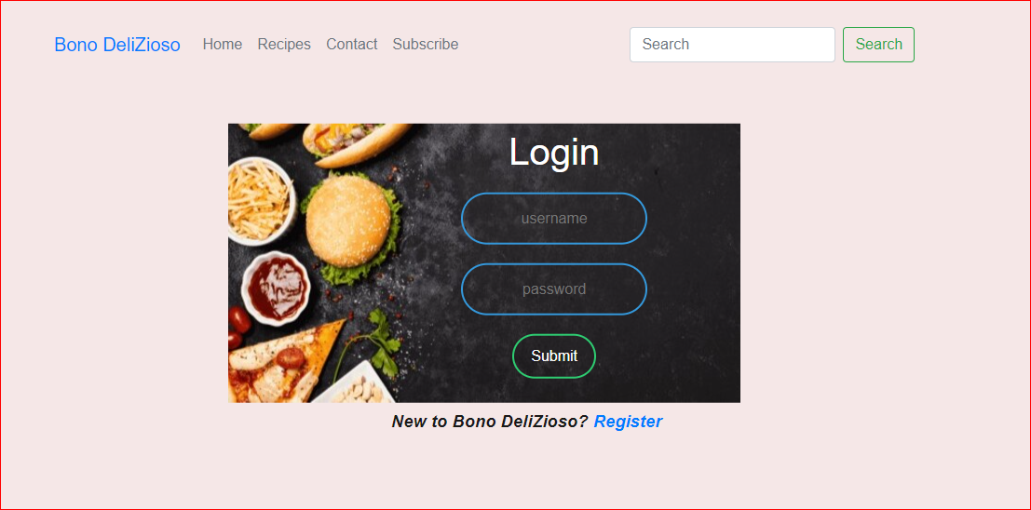

Slide 7
Tools used
HTML
CSS
JS
Hyper text markup language
Cascading styles sheets
Javascript

Slide 8
Problems faced
Most of the people love the food but could not find the best and hygiene place to have it.
Most of the times the recipes would not be found on web to cook at home.
Many people might not know the varieties of food available.
Most of the food blogs are not very informative.
All these problems are solved and made user-friendly in BonoDZ.

Slide 9
Solutions
The problem of not finding a proper and hygiene places to dine is been solved in BonoDZ
Our website picks the top most hygiene places and foods and blog about it to maintain proper user-friendly website.
The recipes of all the food is posted under the food post to make it easy for people to cook it at home with comfort.
Our food blog covers all the vital and important information about a food , place and varities.

Slide 10
Summary
Our motto is always to please people .
We shall provide the best possible information about the food content and make people never go home hungry.

Slide 11
Thank you

