Slide 1
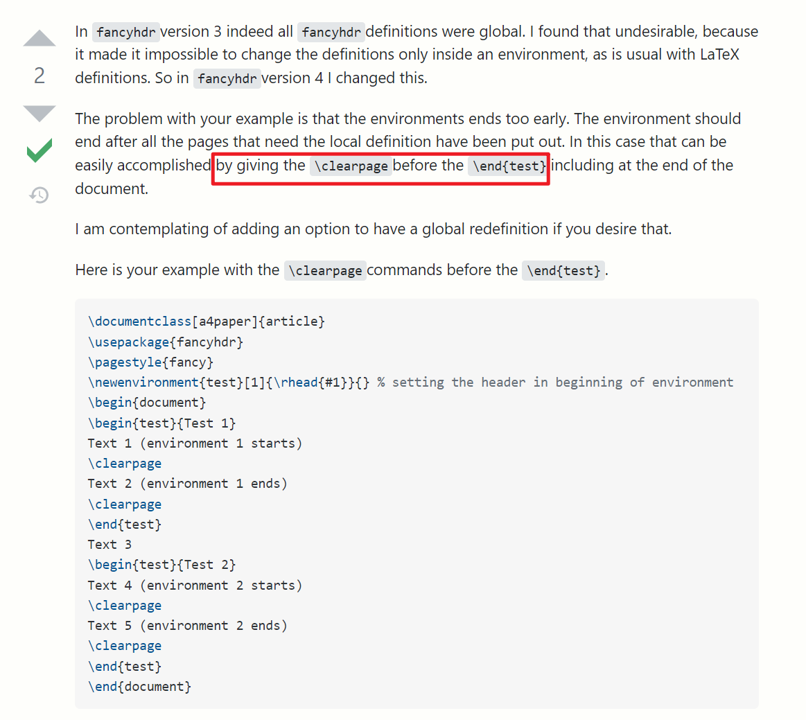
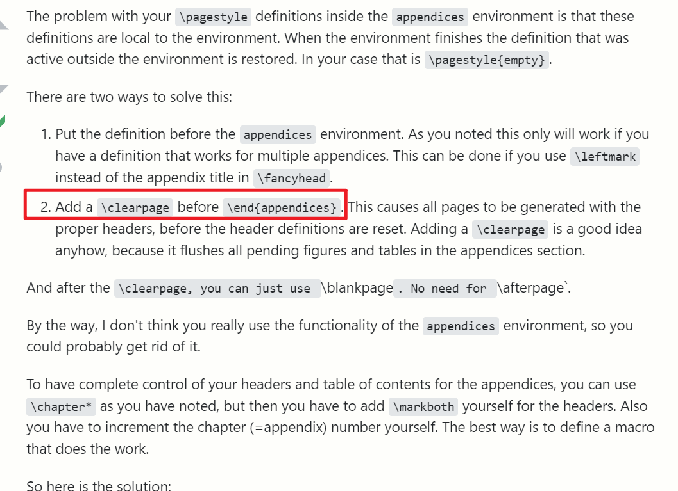
Fancyhdr setting not work for the last page in an environment
https://tex.stackexchange.com/questions/601020/setting-fancy-headers-and-footers-in-an-environment
https://tex.stackexchange.com/questions/629292/fancyhdr-not-showing-up-on-all-pages-of-appendix

Slide 2
Fancyhdr Even Odd not work for the Roman alphabet page numbering
\fancyhead[LE,RO]{List of Publication} not work for x, xi
\fancyhead[L]{\ifthenelse{\isodd{\value{page}}}{}{LIST OF ABBREVIATIONS}}
\fancyhead[R]{\ifthenelse{\isodd{\value{page}}}{LIST OF ABBREVIATIONS}{}}
works
Default pagestyle: plain, fancy
Recommand:
\fancypagestyle{definemyself}{
\renewcommand{\headrulewidth}{0.5pt}
\renewcommand{\footrulewidth}{0pt}
\addtolength{\headheight}{0.5pt}
\fancyhead[LE,RO]{\leftmark}
\fancyhead[RE,LO]{WHAT I WANT TO SEE}}
}
\pagestyle{definemyself}

Slide 3
Manually set the header
\chapter{Deep Learning-derived Spatial Organization Features on Histopathology Images Predicts Prognosis in Colorectal Liver Metastasis Patients after Hepatectomy}
\chaptermark{SOFs Predicts Prognosis in CRLM}
% Style 1: Chapter/Section Name on LO/RE with head rule
\fancypagestyle{PageStyleI}{
\renewcommand{\chaptermark}[1]{\markboth{\@chapapp\ \thechapter\ ##1}{}} % \chaptermark in each chapter.tex to set the short title
\renewcommand{\sectionmark}[1]{\markright{\thesection\ ##1}}
\fancyhf{}
\if@twoside
\fancyhead[RO]{\small \nouppercase \rightmark} %\bfseries chapter name was long.
\fancyhead[LE]{\small \nouppercase \leftmark} %\bfseries
\else
% \fancyhead[L]{\ifthenelse{\isodd{\value{page}}}{}{\bfseries \nouppercase \leftmark}} %\bfseries 粗体
\fancyhead[L]{\ifthenelse{\isodd{\value{page}}}{}{\small \nouppercase \leftmark}}
\fancyhead[R]{\ifthenelse{\isodd{\value{page}}}{\small \nouppercase \rightmark}{}} %\bfseries
\fi
\fancyfoot[C]{\thepage}
}
\MakeUppercase to get upper

Slide 4
Set figure caption in bold:
\usepackage[singlelinecheck=false, labelfont=bf]{caption}
Set title of table above:
Put caption before centering or others.
\begin{table}[htbp!]
\caption[Clinicopathologic characteristics of patients with colorectal cancer liver metastases Part 2]{Clinicopathologic characteristics of patients with colorectal cancer liver metastases Part 2}
\centering
\includegraphics[width=1\textwidth]{Table 3.3}
\end{table}

Slide 5
there is one page which begins with a new section where the header is not correct (so it seems that the \sectionmark is not working in this case)
\section{Profiling of microenvironmental spatial heterogeneity through computer vision and deep learning}
\sectionmark{Profiling of SOFs in the TME}
\section[Profiling of microenvironmental spatial heterogeneity through computer vision and deep learning]{Profiling of microenvironmental spatial heterogeneity through computer vision and deep learning%
\sectionmark{Profiling of SOFs in the TME}}
\sectionmark{Profiling of SOFs in the TME}
section[shown in toc]{shown as section title% \sectionmark{shown as header }}

