Slide 1
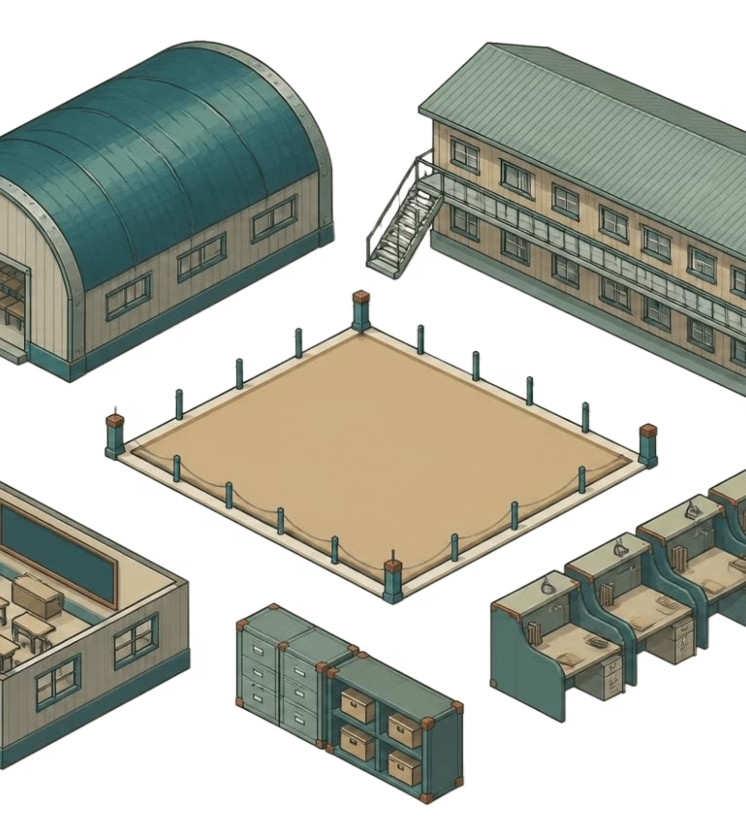
SLAF · TRADE TRAINING SCHOOL
TRADE TRAINING
SCHOOL
MANAGEMENT
PORTAL
PORTAL PURPOSE
One school-wide view
A controlled environment for the full training cycle.
Management information system · Conceptual operating view
Connect Trainee records, accountability, academic activity, accommodation, occurrences, and reporting.
Notes:
Introduce the portal as a single management environment for SLAF Trade Training School. The illustration is conceptual: it represents the school’s connected operating picture, not a screenshot or a finished interface.

Slide 2



THE CASE FOR CONTROL
01 / NEED
Why the portal is needed
Training-school operations depend on timely, accurate information.
CURRENT CONDITION
Disconnected operational records
Information is distributed.
Academic, discipline, accommodation, and reporting records are difficult to view together.
Records spread across paper files, ledgers, and isolated spreadsheets.
Manual compilation
Repeated data entry slows the consolidation of daily strength.
Delayed management picture
Repeated data entry · slow consolidation of daily strength
Management needs a current operational picture without waiting for manual compilation.
Notes:
This slide frames the operational problem without adding performance claims. The issue is not a lack of effort; it is that important information is spread across records and takes time to consolidate before management can see it together.

Slide 3
THE PORTAL MODEL
02 / CONTROL
One controlled environment for the full training cycle
A centralized management information system for Trainees, courses, accountability, academic activity, accommodation, occurrences, and reporting.
01
02
03
One authoritative Trainee record
Connected operational workflows
Formal, role-controlled access
Information starts from a controlled source.
Daily activities support one school-wide view.
Responsibilities and access remain governed.
Notes:
Position the portal as a controlled environment rather than a collection of separate tools. The three principles are the foundation: one authoritative Trainee record, connected workflows, and formal role-controlled access.

Slide 4





PEOPLE AND RESPONSIBILITY
03 / USERS
Designed around the people who run the school
Commanding Officer
Academic Section / OCT
Discipline Section
Executive visibility, strength, approvals, and reports
Courses, calendars, syllabus, exams, and results
Trainee records, Parade State, and occurrences
Accommodation Officer
Instructors
Administrators
Billets, beds, allocations, and vacancies
Classroom attendance, lesson plans, assessments, and approvals
User accounts, permissions, audit, and system operations
Notes:
Emphasize that the portal is organized around the people who operate the school. Each role sees and supports the responsibilities assigned to it, while the system preserves a connected management picture.

Slide 5
OPERATING RHYTHM
04 / CYCLE
The operating rhythm, from intake to Passed Out
The portal follows the school’s work in sequence.
01
02
03
04
05
06
Create the Trade, Course, and Batch
Assign the Classroom and Instructor
Register and enroll Trainees
Run daily accountability and academic activity
Monitor attendance, progress, and assessments
Complete the course and retain the historical record
Notes:
Walk from setup to completion. The point is continuity: the same environment supports creation of the Trade, Course, and Batch; daily operations; monitoring; and the retained historical record after course completion.

Slide 6




PORTAL SCOPE
05 / MODULES
Core modules, connected by one Trainee record
Visibility and control
Training structure
Executive Dashboard · User & Role Management · Trainee Management
Trade, Course & Batch Management · Academic Activities · Course Calendar
Daily accountability
Records and reporting
Parade State · Night Roll Call · Classroom Attendance
Personal Occurrence Reporting · Accommodation · Formal Reports
CONNECTIVE PRINCIPLE
Each area supports a clear operational responsibility; together they form one school-wide view.
Notes:
Use this as the scope slide. The modules are grouped by the responsibility they support, but they are connected through the Trainee record rather than operating as isolated registers.

Slide 7
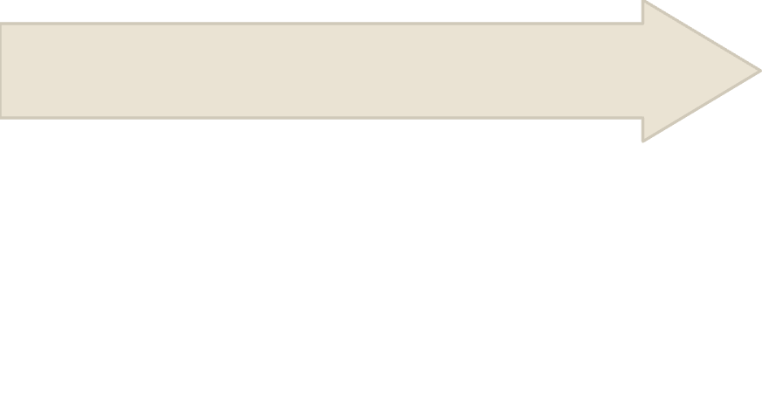
THE AUTHORITATIVE RECORD
06 / JOURNEY
The Trainee journey is visible end to end
Information entered once can support multiple operational functions where appropriate.
Daily accountability recorded
Trainee registered and enrolled
Classroom and Instructor assigned
Course and Batch created
Course completion and Passed Out status recorded
Training, attendance, and assessments completed
START
DAILY RECORD
HISTORICAL RECORD
Course and Batch
Accountability and academic activity
Completion and Passed Out status
Notes:
This slide makes the Trainee record the narrative spine. It shows how information follows the Trainee from course setup and enrollment through daily activity, assessment, completion, and Passed Out status.

Slide 8
DAILY ACCOUNTABILITY · MORNING
07 / PARADE STATE
Parade State turns morning accountability into a governed workflow
STATUS OPTIONS
Present
Sick Report
Hospital
Leave
Temporary Duty
Course Visit
Detached Duty
AWOL
1
2
3
4
Record the status
Save a working draft
Instructor review
Approved Daily Strength
Capture the morning position.
Route to the designated Instructor.
Prepare before formal submission.
Only approved Parade States contribute to official Daily Strength.
Critical cases can alert authorized leadership. Approval updates Trainee status and attendance.
Notes:
Explain the distinction between recording a status and governing the official result. Parade State can be drafted, reviewed, and approved; only approved Parade States contribute to official Daily Strength, while critical cases can alert authorized leadership.

Slide 9
DAILY ACCOUNTABILITY · EVENING
08 / NIGHT ROLL CALL
Night Roll Call preserves the evening picture
The evening record is reviewed separately, without rewriting the morning history.
Morning Parade State
Changed status
Original record remains intact.
Change is recorded without rewriting history.
ILLUSTRATIVE EXAMPLE
IN HOSPITAL
→ ON PARADE
1
2
3
4
Evening review
Day closed
Morning status · Night status
Status is reviewed separately.
Night Roll Call preserves accountability.
Notes:
Stress that Night Roll Call complements the morning Parade State. It gives the school a distinct evening picture and preserves the history of what was recorded in the morning. The status change shown is the illustrative example provided in the brief.

Slide 10



ACADEMIC DELIVERY
09 / ACTIVITIES
Academic activities stay aligned to the course
Course structure, teaching activity, assessment, and progress remain connected.
Build the course
Organize delivery
Retain teaching material
Manage Trades, Courses, Batches, Classrooms, Subjects, and Lessons.
Assign instructors and organize course phases.
Store lesson-plan documents and references.
Assess and record
Track progress
Schedule assessments and maintain marksheets.
Track academic progress chronologically.
ALIGNMENT
Academic activity stays connected to the Trade, Course, Batch, Classroom, Instructor, and Trainee record.
Notes:
Close this section by showing how academic activity fits into the same operating environment. The portal connects course structure and teaching delivery with lesson plans, assessments, marksheets, and chronological academic progress.

