Slide 1
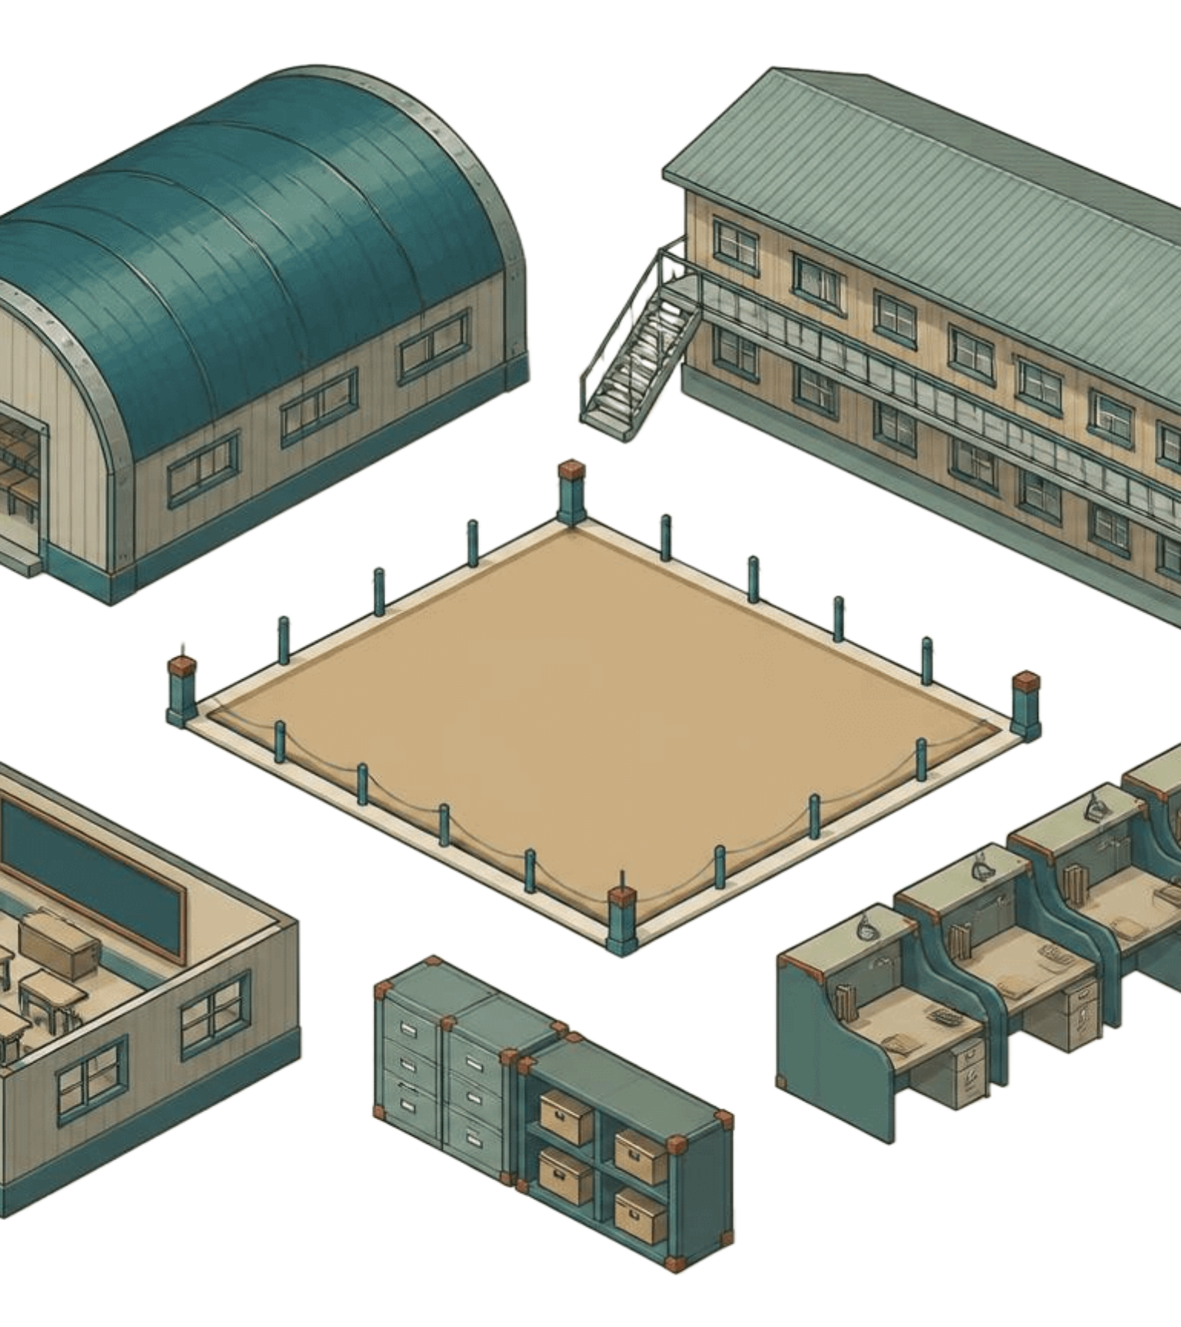
SLAF · TRADE TRAINING SCHOOL
TRADE TRAINING
SCHOOL
MANAGEMENT
PORTAL
PORTAL PURPOSE
One school-wide view
A controlled environment for the full training cycle.
Management information system · Conceptual operating view
Connect Trainee records, accountability, academic activity, accommodation, occurrences, and reporting.
Notes:
Introduce the portal as a single management environment for SLAF Trade Training School. The illustration is conceptual: it represents the school’s connected operating picture, not a screenshot or a finished interface.

