Slide 1
Playing Card Detection and Identification
Mentor : Eshan Gupta
Team sbh
Laksh Balani - 2020102019
Aryan Singhal - 2020102032
Sankalp Bhat - 2020112018
Ishanya Sethi - 2020102014
Repository

Slide 2
Acknowledgements
We would like to express our sincere gratitude to a number of people, without whom this project would not have been completed.
I would like to acknowledge Prof. Ravikiran Sarvadevabhatla for their extensive help in helping us with the methodologies and suggestions. I extend sincere thanks for their guidance, constant interest, suggestions, and encouragement throughout the course of this project.
I would also like to thank our Teaching Assistant and mentor for this project, Eshan Gupta, for correcting us and providing valuable feedback whenever needed, helping us when we came across stumbles.

Slide 3
Motivation
Playing cards are often used in a variety of games such as poker, blackjack which make a major leisure activity in our lives. Detecting playing cards from an image algorithmically can be very helpful. We are asked to find and implement the most efficient method for the same.

Slide 4
Introduction
Over the course of the project our main task is to implement an algorithm which takes in an image as input and correctly identifies and locates the standard playing cards. The algorithm will be able to work under the following cases:
Images of a single card on various backgrounds.
Images where the card(s) are neither centered nor aligned.
If multiple non-overlapping cards are present.
At the end of the project, we will be able to process most ideal images with a high accuracy rate.

Slide 5
Approach
There are two popular approaches for playing cards identification and detection.
SIFT (Scale Invariant Feature Transform)
Template Matching

Slide 6
SIFT
This approach is designed around the Scale Invariant Feature Transform (SIFT) algorithm. The idea is to match SIFT descriptors in the target image with SIFT descriptors that have been precomputed for each type of card. We apply SIFT keypoint detection to all the 52 training images to obtain the precomputed descriptors. If for a given card, more than n of the features are found in the target image, the card is considered to be in the image.

Slide 7
Template Matching
In this approach template matching is used to score how similar each card in the target image is to each of the 52 cards in a standard deck of cards using pre-trained data. Apart from template matching, the approach also uses thresholding and edge detection for the matching of cards. For each template image, a transform is found to map the template onto the card in the target image, and each pixel of the template is mapped onto the target image. The sum squared difference between the mapped template and the target image is then taken as the score of the match. The lowest score of all the templates is selected as the best match.

Slide 8
Failure of SIFT Method
The SIFT method fails to identify the cards accurately as it mapped the features inaccurately. The problem was that multiple features in the training image were getting matched to the same feature in the target image. This leads to an incorrect number of matching features and therefore incorrect detections. Due to this reason we decided to drop the SIFT method and work ahead with the template matching method. The reason SIFT failed was due to the rotation invariant features

Slide 9
Card Detection
For detecting the cards the methods we use are : thresholding and the use of regionprops function. For applying threshold to the image, we add up the r,g and b channels. Then we use a hand-picked threshold value to binarize the image. After that we use the regionprops function to get the region statistics of an image. Areas of a small size are removed to prevent spurious bright regions from causing false positives. This creates one region for each card in the image. The properties of the regionprops function which we use in our project mostly are : centroid, area and bounding box.

Slide 10
Firstly, we have thresholded the image, and taken the conjugate of the thresholded image.
Then, we have applied regions props on the conjugate image in order to get connected areas larger than a minimum threshold, and this represents our cards. We have taken the bbox of the cards as an initial estimate of the area of the image.
Then we take the convex hull of the image, to get a smaller area representing the image so as to get less noise for further steps involving line detection.

Slide 11
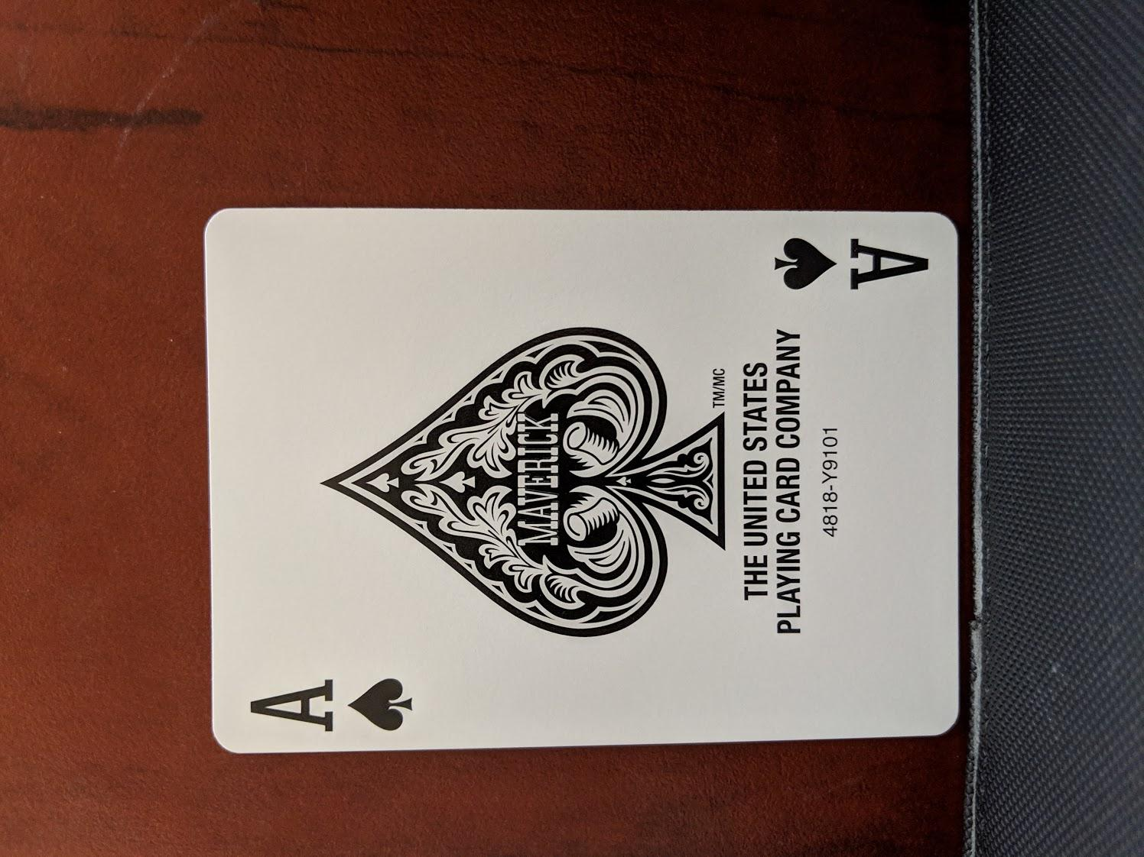
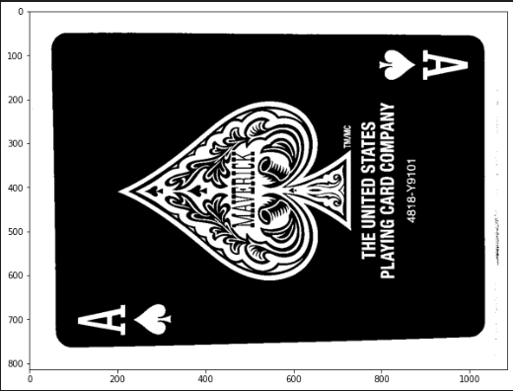
Extracting card area by taking regionprops

Slide 12
Corner Finding
We find the outside corners for every region. Then to find the outside edges, canny edge detector is used. In order to find the four dominant edges in the image we use Hough Transform. These four edges are the outside of a card. Then in order to get the line equation, we perform transform of the parameters. Then we find the intersection points of these four lines and these points are stored as the corner.

Slide 13
Here, we take the convex hull of the individual cards we have detected earlier, and apply canny edge detection on it to get edges.
Then, we apply hough transform on the image to get significant lines, which are going to be the border of the cards since we have removed internal lines using convex hull.
We then take strong lines greedily, taking the first line that is acceptable, and taking future lines ensuring they are a permissible distance or angle away from any previously selected lines. This way, we only end up with four lines representing the corners edges of the card.

Slide 14
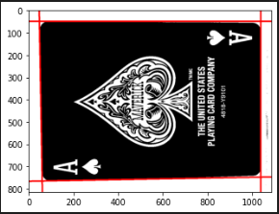
Strong Lines using Hough Transform

Slide 15
We take the intersection of the strong lines to be the corners, given that they are within the individual size constraints of the card.

Slide 16
Corner Arrangement
We now need to arrange the corners in a standardized way in order to prevent the card to be distorted while calculating the transform. This increases the accuracy of the method.
The predefined order makes the first corner one with a number in it, and then goes along the short edge to the second corner, continuing along the edges marking the third and fourth corners. The corner with the number was identified by finding the dark region inside of the card, whose centroid was closest to a corner. Here the regionprops centroid property is used.

Slide 17
The corners in the image that we have detected in previous steps are now numbered, so that the lowest numbered corner goes to the top left of the image, and the rest of the corners go in cyclic order according to their number.
We number the corners in the following manner :
We find the corner which is the closest to a centroid detected using region props within the card itself.
We mark that corner as 1st
We mark the other corners going cyclically along the image.

Slide 18
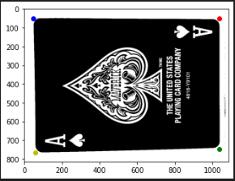
Corners arranged in clockwise order

Slide 19
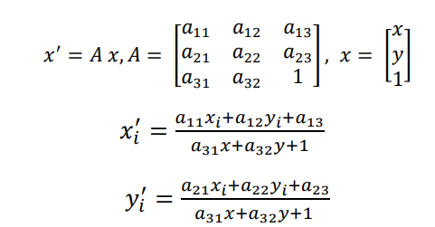
Transform Creation
With the four ordered corners we obtained from previous methods in both the template and target image, we now map the corners of template onto the corners of the target. The equations given below are used to find the linear system with the help of transform matrix.

Slide 20
We already know 4 points in the original image, and their corresponding points in the warped image.
So, we make a matrix from these 4 points in the original image, and the four points in the warped image respectively, and use these two matrices to generate a transfer matrix from the warped image to the original image using numpy’s linear algebra toolbox.
We use this matrix to perform inverse mapping and get the required warped image. The dimensions of this warped image is constant throughout all processed cards.

Slide 21
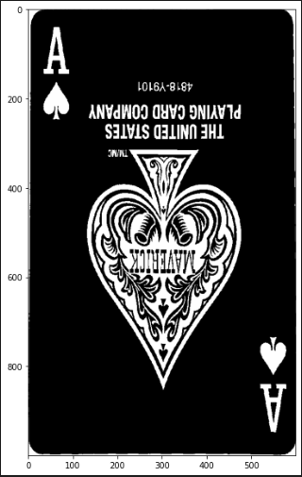
Card extracted

Slide 22
Scoring
Using the transform found in the previous step, we map the area of the template image containing the card onto the target image. Then we compute the sum squared difference for all pixels within the card to get the score of the match.
Each template needs to be scored twice since it is not necessary that all the cards are rotationally symmetric (One time with no rotation and a second time with a 180-degree rotation). With this, our corner detection algorithm can select either of the two numbered corners as the first corner.
After the two scores are calculated, the lesser of the two is reported as the match score for the card and the template

Slide 23
We make a database of the processed training data.
We process any test images to extract cards, and convert it to our specified dimensions.
We calculate the Square Difference between the processed test card image, and all training cards dataset. We also calculate the Minimum Square Difference between the test image and the training image rotated by 180°, since warping doesn’t account for complete rotations. We take the minimum of the above two, and map the card corresponding to the minimum error.

Slide 24
Repetition
he transform creation and scoring are repeated for each of the 52 pre-trained templates. The lowest score is selected as the best match and the template with the lowest score is then considered to be the correct identification.

Slide 25
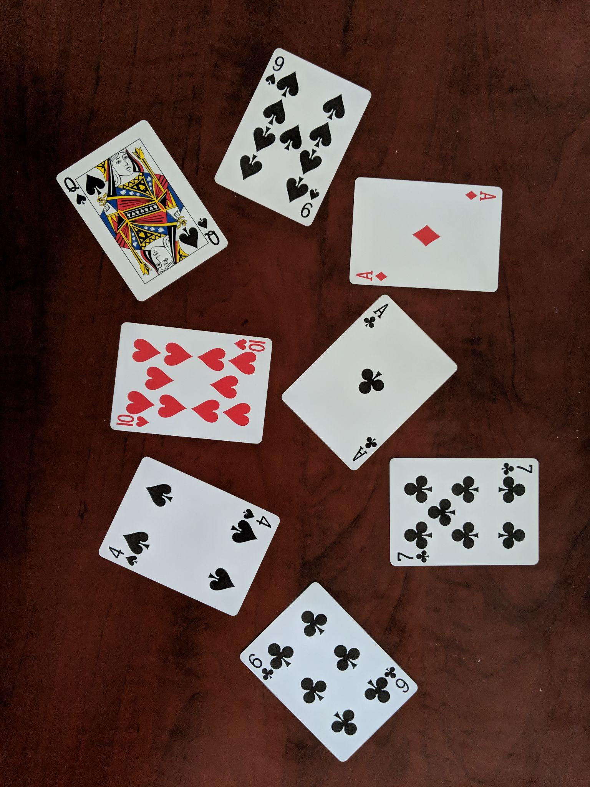

Slide 26
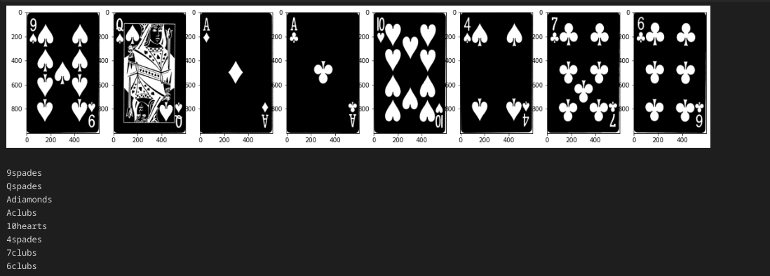

Slide 27
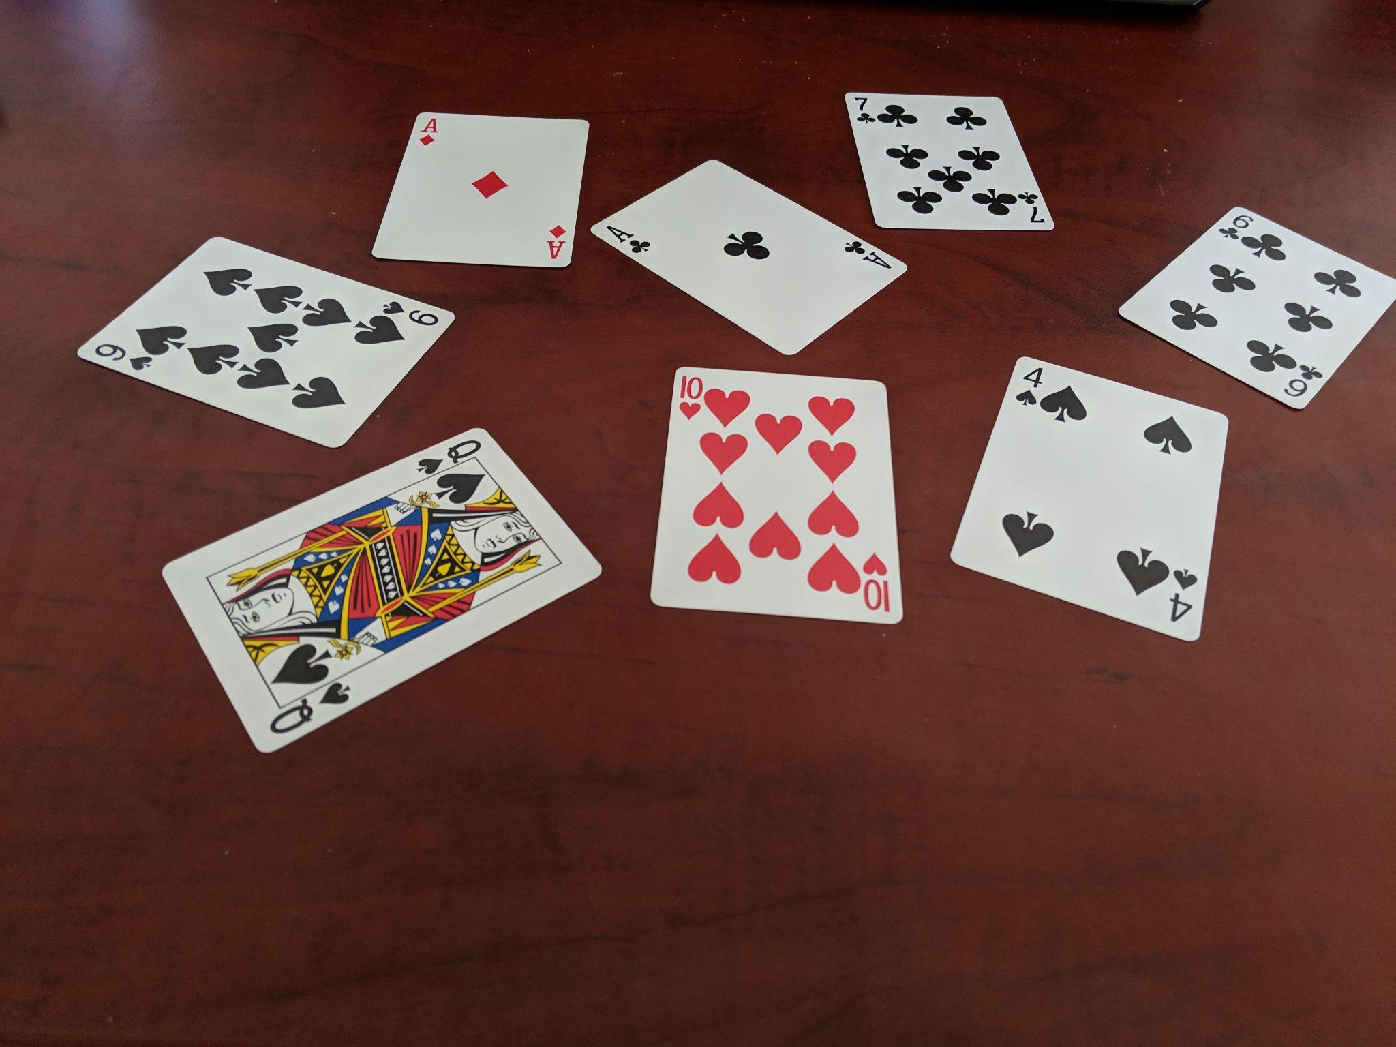

Slide 28
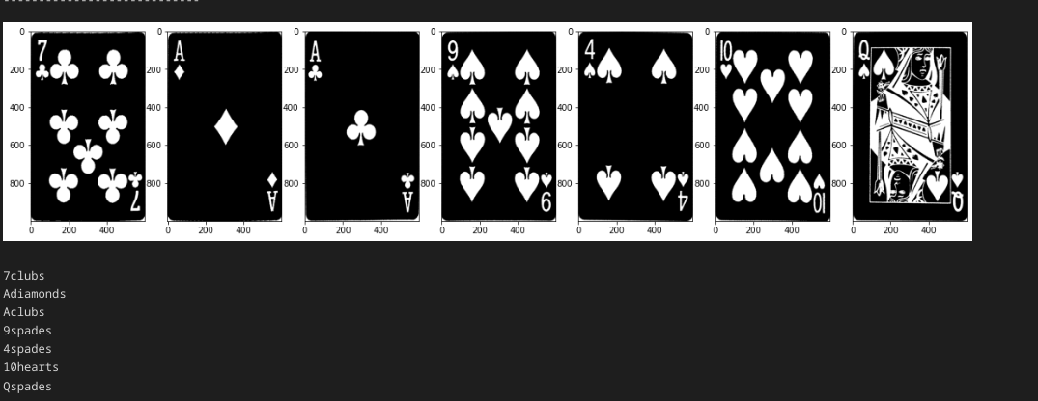

Slide 29
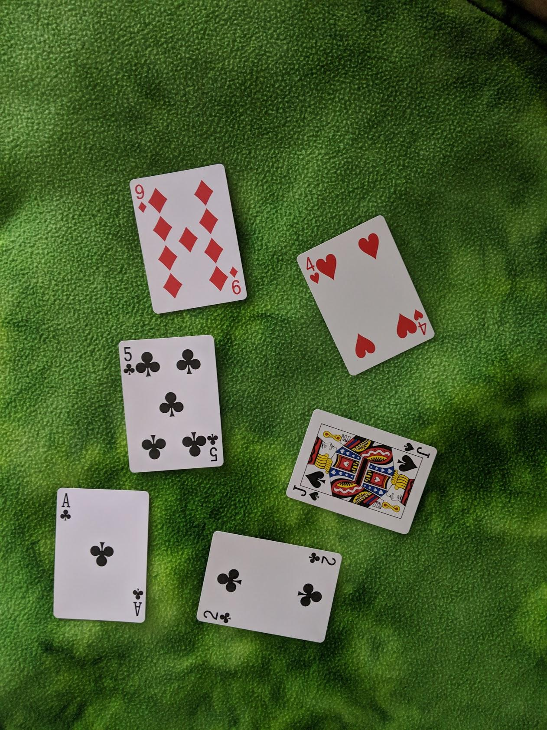

Slide 30
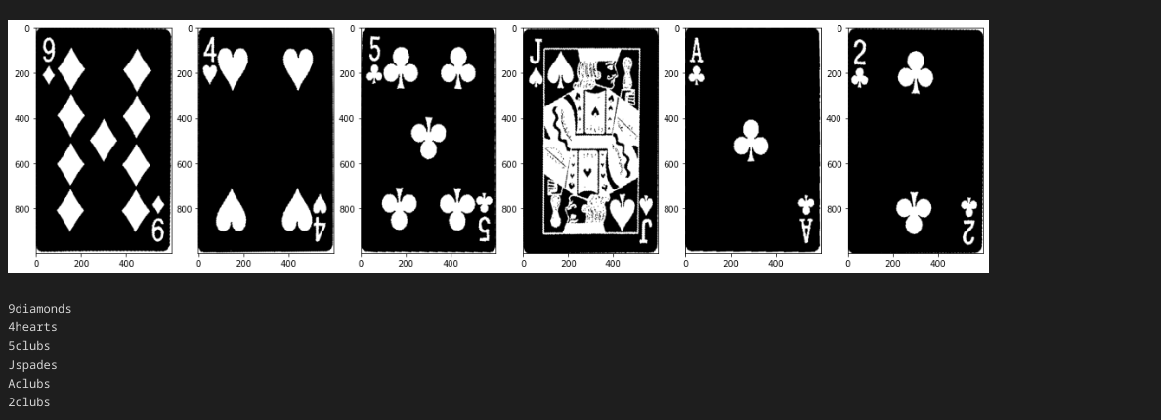

Slide 31
Training
The Card Detection, Corner Finding and Corner Arrangement steps are performed on the training images, similarly to as they are performed on the target image. We store the resulting corners and image in a database for further use in identifying cards. This process is repeated for each of the 52 cards in a standard deck of cards to get a template image for each of them.

Slide 32
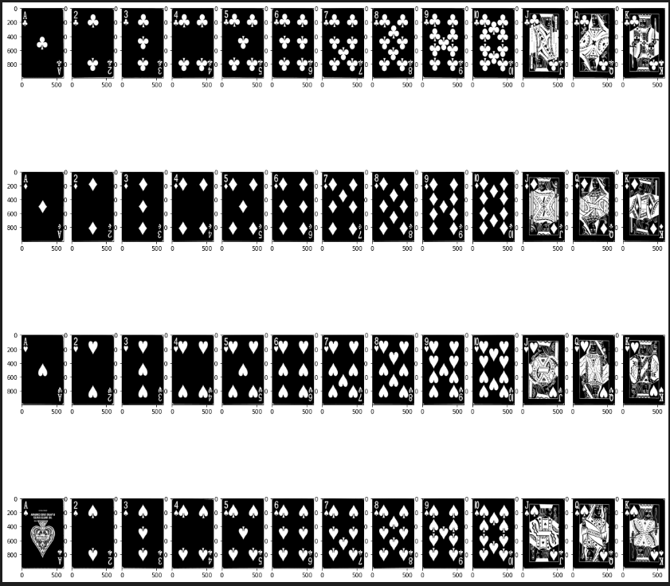

Slide 33
Results
Template matching worked exceedingly well to detect and identify the cards. However,these results are in the ideal case.
Template matching proved to be a time consuming algorithm roughly taking above a minute to identify a single card. The algorithm has to compute scores for which it runs 52 times (one for each card).

Slide 34
Despite the high accuracy of the algorithm it is not without its flaws. This is an area for further improvement and techniques such as subsampling can reduce this time, possibly at the expense of accuracy.

Slide 35
Non-Ideal Cases
This algorithm fails in the case of perspective distortion. We analysed for the images which have had a top down perspective where the cards are not distorted. This might occur due to errors in isolating the card region properly, as the constants chosen for things such as minimum region size and thresholding may need to be changed for perspective distortion.

Slide 36
Contributions
Laksh Balani - Corner finding and Arrangement
Aryan Singhal - Perspective transform and warp
Ishanya Sethi - Locating all cards using regionprops
Sankalp Bhat - Template matching

Slide 37
Thank You

