Slide 1
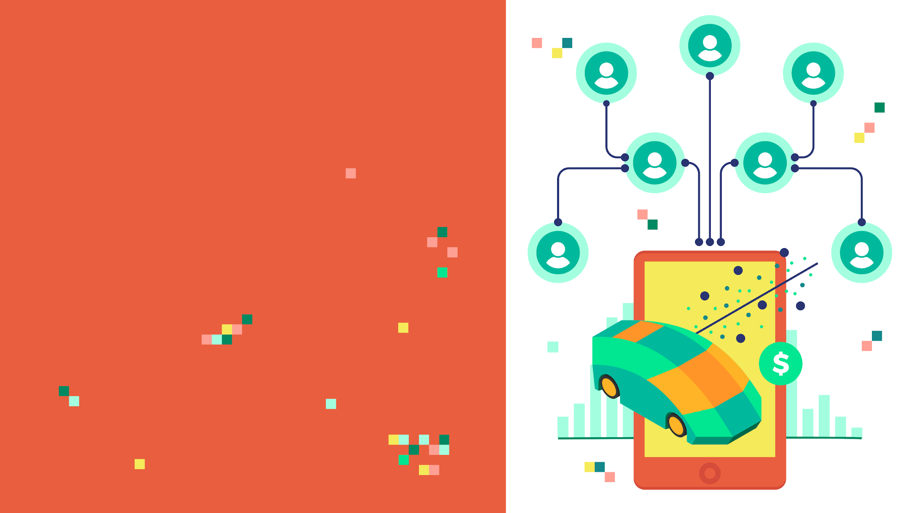
ARTIFICIAL NEURAL
NETWORKS
CAR SALES
PREDICTION

Slide 2
PROBLEM STATEMENT & REGRESSION BASICS

Slide 3
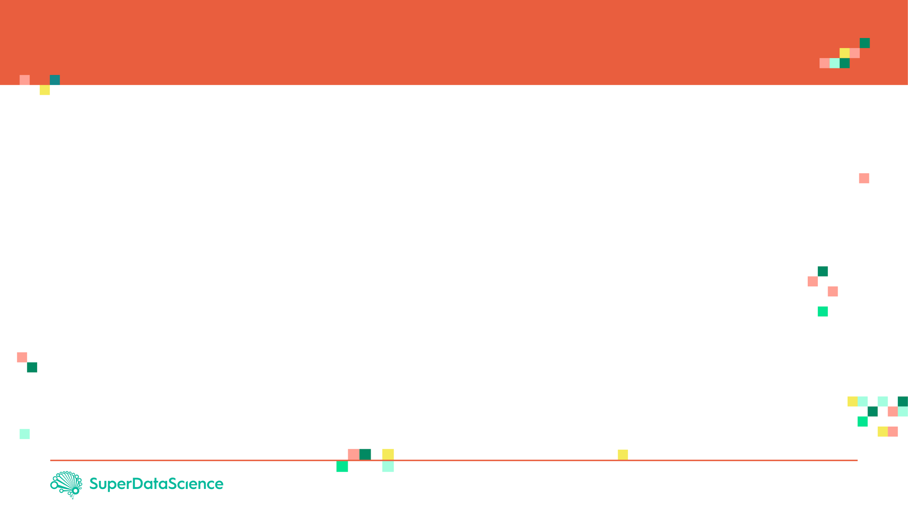
PROJECT OVERVIEW
You are working as a car salesman and you would like to develop a model to predict the total dollar amount that customers are willing to pay given the following attributes:
Customer Name
Customer e-mail
Country
Gender
Age
Annual Salary
Credit Card Debt
Net Worth
The model should predict:
Car Purchase Amount
REGRESSION TASK!
DEEP AND MACHINE LEARNING PRACTICAL

Slide 4
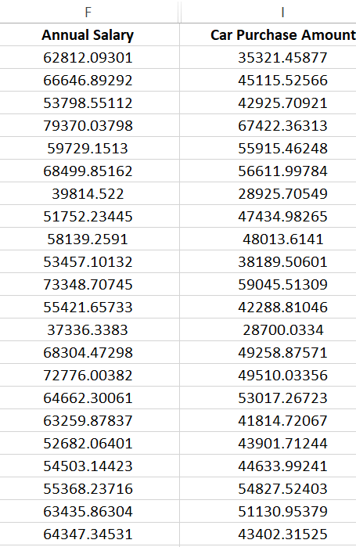
WHAT IS REGRESSION? INTUITION
Regression works by predicting value of one variable Y based on another variable X.
X is called the independent variable and Y is called the dependant variable.
CAR PURCHASE AMOUNT
ANNUAL SALARY

Slide 5

REGRESSION MATH!
Goal is to obtain a relationship (model) between the Annual salary and car purchasing amount.
MODEL! (GOAL)
$2K
CAR PURCHASING AMOUNT
DEPENDANT VARIABLE
CAR PURCHASING AMOUNT ($)
INDEPENDENT VARIABLE
ANNUAL SALARY ($)
+10K
ANNUAL SALARY

Slide 6
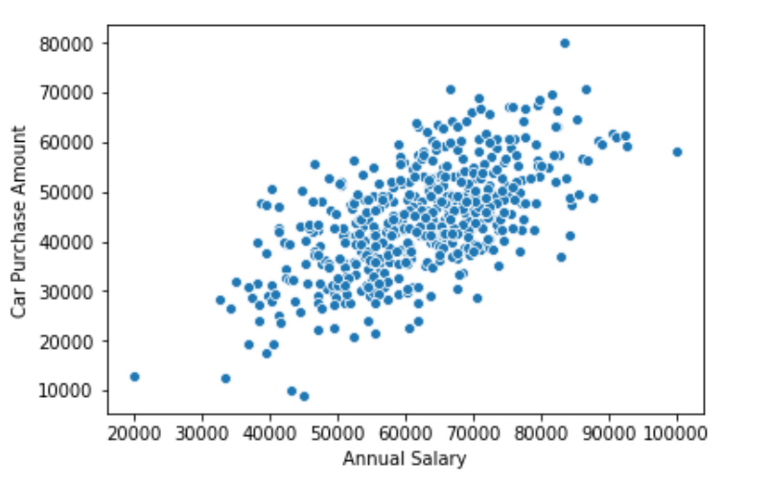

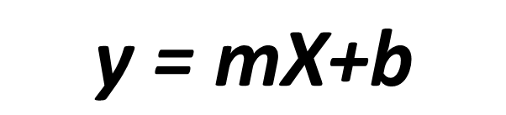
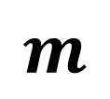



HOW ARE WE GOING TO USE THE MODEL?
Once the coefficients ‘m’ and ‘b’ are obtained, you have obtained a regression model!
This “trained” model can be later used to predict car purchase amount (dollars) based on the annual salary.
DEPENDANT
VARIABLE
INDEPENDANT
VARIABLE

Slide 7






REGRESSION QUIZ
Match the equations to the figures:

Slide 8
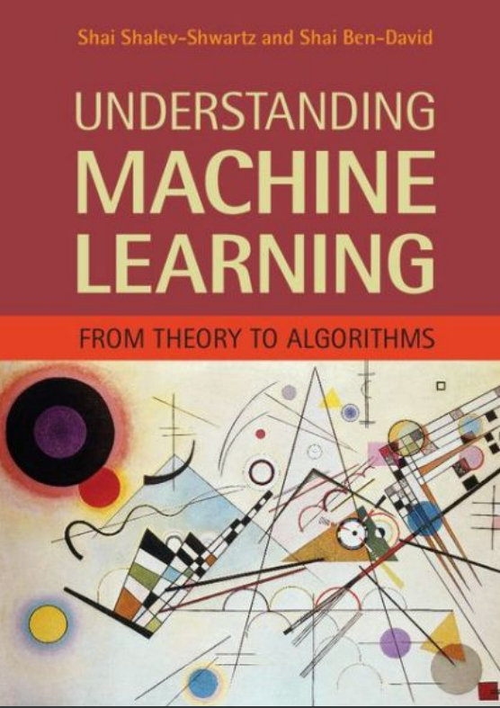
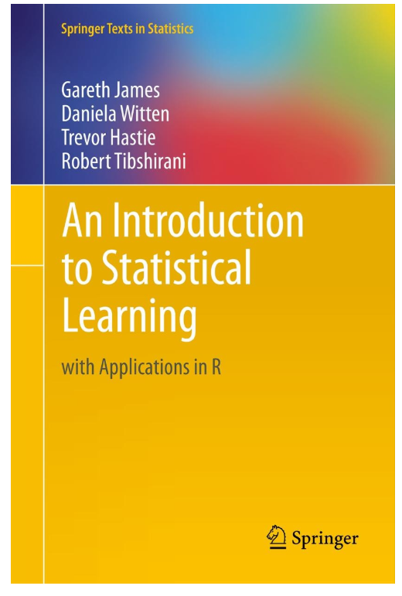
ADDITIONAL READING MATERIAL
Additional Resources, Page #123: http://www.cs.huji.ac.il/~shais/UnderstandingMachineLearning/understanding-machine-learning-theory-algorithms.pdf
Additional Resources, Page #61:
http://www-bcf.usc.edu/~gareth/ISL/ISLR%20Seventh%20Printing.pdf

Slide 9
WHAT ARE ANNs AND HOW DO THEY LEARN?

Slide 10
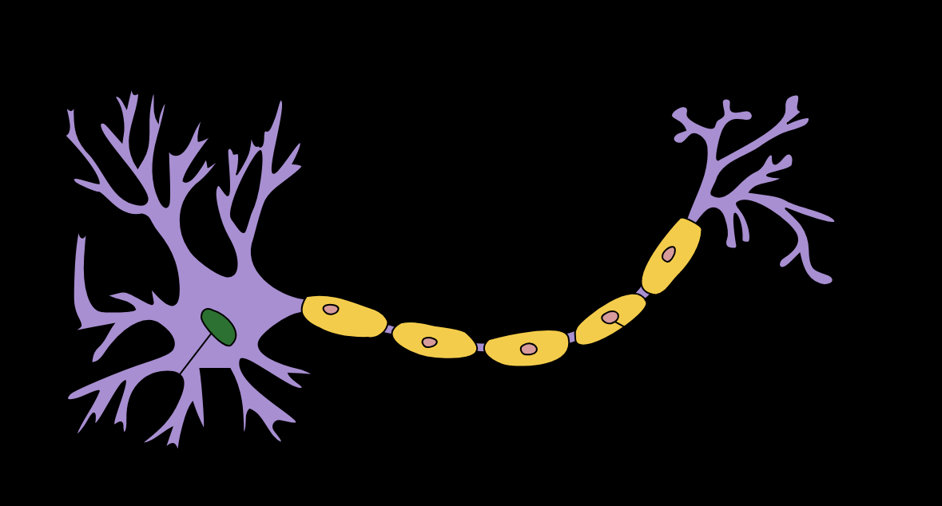
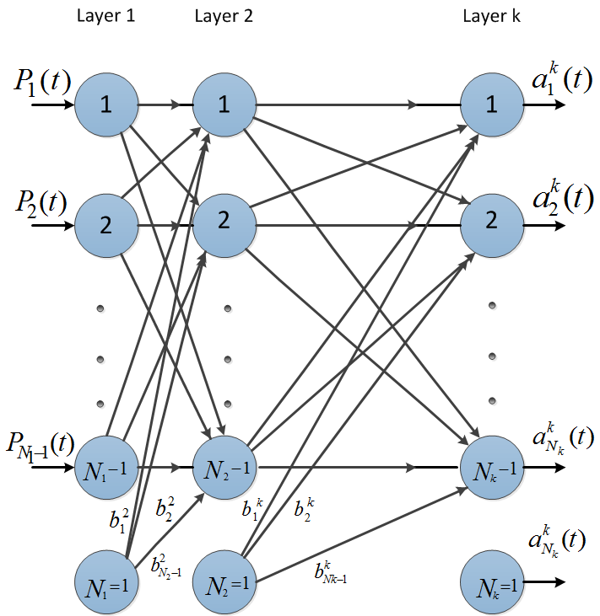
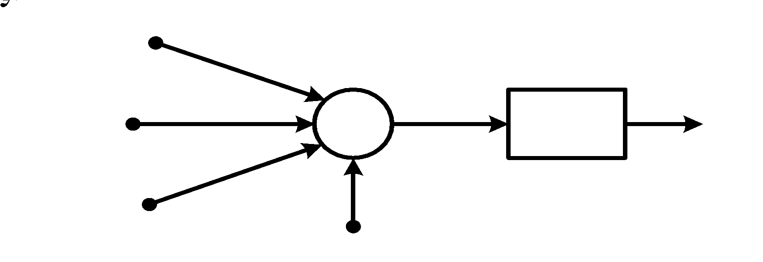
ARTIFICIAL NEURAL NETWORK: INTRODUCTION
The brain has over 100 billion neurons communicating through electrical and chemical signals.
Neurons communicate with each other and help us see, think, and generate ideas.
Human brain learns by creating connections among these neurons.
ANNs are information processing models inspired by the human brain.
Photo Credit: https://commons.wikimedia.org/wiki/File:Neuron_Hand-tuned.svg

Slide 11
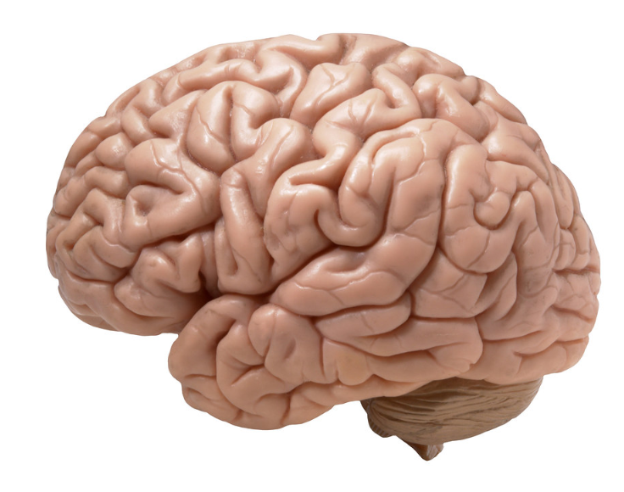

HOW DO HUMANS LEARN? FROM EXPERIENCE
Humans learn from experience (by example)
~Desired Outputs
LABEL: CAT!
Inputs
Deviated Outputs
Desired (Correct) Output
Update
Error
Photo Credit: https://www.flickr.com/photos/flamephoenix1991/8376271918
Photo Credit: https://www.pexels.com/photo/grey-and-white-short-fur-cat-104827/

Slide 12
SINGLE NEURON MODEL

Slide 13
NEURON MATHEMATICAL MODEL
The neuron collects signals from input channels named dendrites, processes information in its nucleus, and then generates an output in a long thin branch called axon.
X1
W1
NEURON
X2
W2
W3
DENDRITES
X3
AXON
NUCLEAS

Slide 14




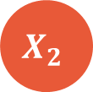



NEURON MATHEMATICAL MODEL
Bias allows to shift the activation function curve up or down.
Number of adjustable parameters = 4 (3 weights and 1 bias).
Activation function “F”.
b
F
INPUTS/INDEPENDENT VARIABLES

Slide 15
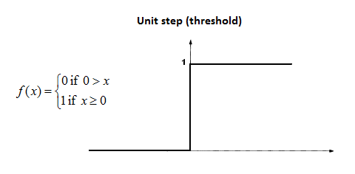










SINGLE NEURON MODEL IN ACTION
Let’s assume that the activation function is a Unit Step Activation Function.
The activation functions is used to map the input between (0, 1).
Input #1=1
F
Input #2=3
Input #3=4

Slide 16
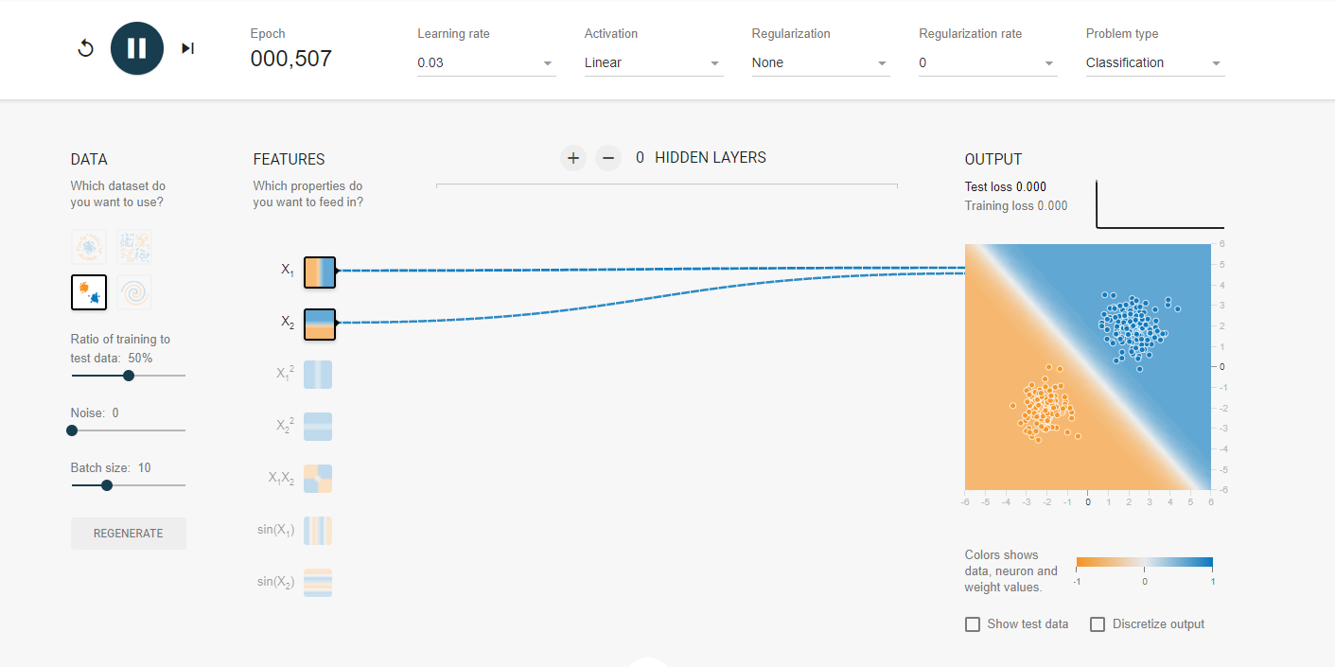
SINGLE NEURON MODEL IN ACTION
Check this out: https://playground.tensorflow.org

Slide 17
NETWORK TRAINING

Slide 18
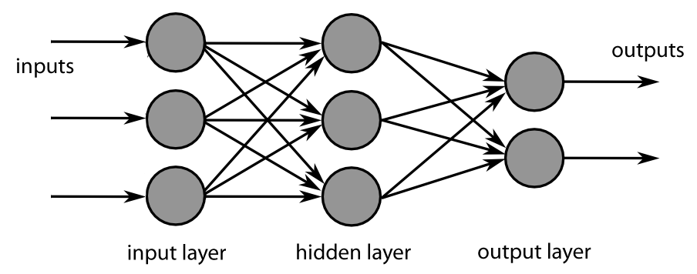
NETWORK TRAINING: BACK PROPAGATION
Backpropagation is a method used to train ANNs by calculating gradient needed to update network weights.
It is commonly used by the gradient descent optimization algorithm to adjust the weight of neurons by calculating the gradient of the loss function.
STEP 1: FORWARD PROPAGATION
STEP 2: ERROR CALCULATION
STEP 4: WEIGHT UPDATE
STEP 3: BACK PROPAGATION

Slide 19
NETWORK TRAINING: BACK PROPAGATION
Backpropagation Phase 1: propagation
Propagation forward through the network to generate the output value(s)
Calculation of the cost (error term)
Propagation of output activations back through network using training pattern target in order to generate the deltas (difference between targeted and actual output values)
STEP 1: FORWARD PROPAGATION
STEP 2: ERROR CALCULATION
STEP 4: WEIGHT UPDATE
STEP 3: BACK PROPAGATION

Slide 20
NETWORK TRAINING: BACK PROPAGATION
Phase 2: weight update
Calculate weight gradient.
A ratio (percentage) of the weight's gradient is subtracted from the weight.
This ratio influences the speed and quality of learning and called learning rate. The greater the ratio, the faster neuron train, but lower ratio, more accurate the training is.
STEP 1: FORWARD PROPAGATION
STEP 2: ERROR CALCULATION
STEP 4: WEIGHT UPDATE
STEP 3: BACK PROPAGATION

Slide 21
READING MATERIALS: BACK PROPAGATION
“Backpropagation neural networks: A tutorial” by Barry J.Wythoff
“Improved backpropagation learning in neural networks with windowed momentum”, International Journal of Neural Systems, vol. 12, no.3&4, pp. 303-318.

Slide 22
MULTI- NEURON MODEL

Slide 23
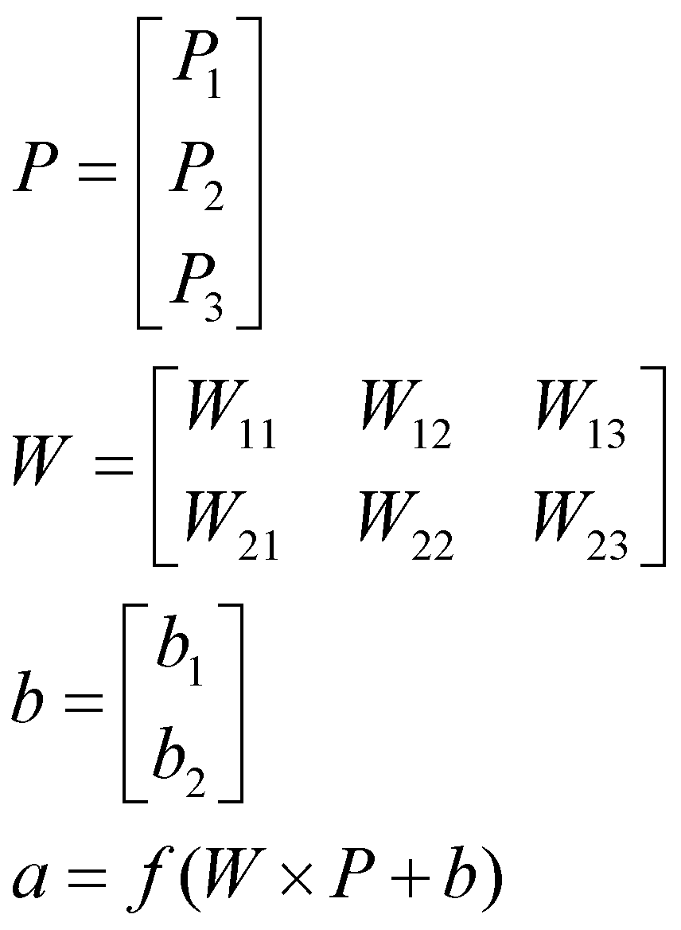
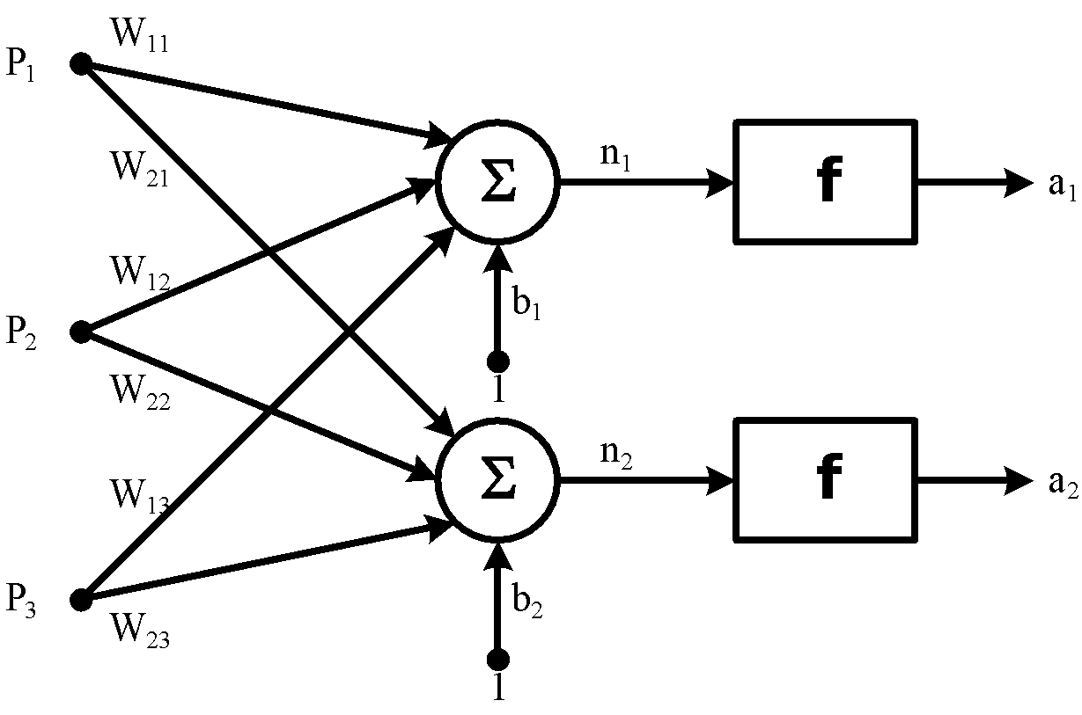
TWO NEURON MODEL: MATRIX REPRESENTATION
The network is represented by a matrix of weights, inputs and outputs.
Total Number of adjustable parameters = 8:
Weights = 6
Biases = 2
P1
W1
W2
n1
a1
Matrix Representation
P2
∑
f
W3
P3
b1
P1
W1
W2
n2
a2
P2
∑
f
W3
P3
b1

Slide 24
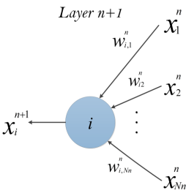
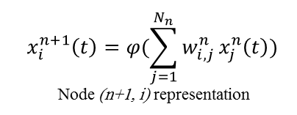
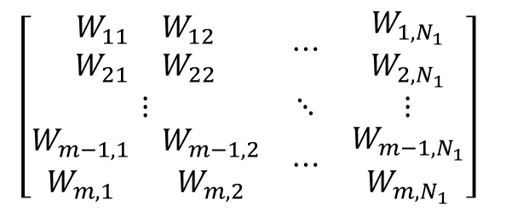


MULTI-LAYER PERCEPTRON MODEL: MATRIX REPRESENTATION
Non-Linear Sigmoid Activation function
m: number of neurons in the hidden layer

