Slide 1
DATABASE MANAGEMENT SYSTEM
Chapter 1
Introduction to DBMS

Slide 2
DBMS Buzz Words (Terminologies):
Data:
Data is the raw material (fact) that can be processed for any computing machine.
Example: Name of the student, Marks of the student, Mobile no., Image etc.
Information:
Information is the data that has been converted into more useful or intelligent form. Example: Report card sheet.
Database:
The database is a collection of inter-related data which is used to retrieve, insert and delete the data efficiently. It is also used to organize the data in the form of a table, schema, views, and reports, etc.
Database Management System:
A Database Management System (DBMS) is a software system that allows users to create, organize, and manage data stored in a database.

Slide 3
Table Of Content
DBMS Buzz Words
Introduction To Database Management System
Evolution Diagram of Database Management System
Types of DBMS

Slide 4
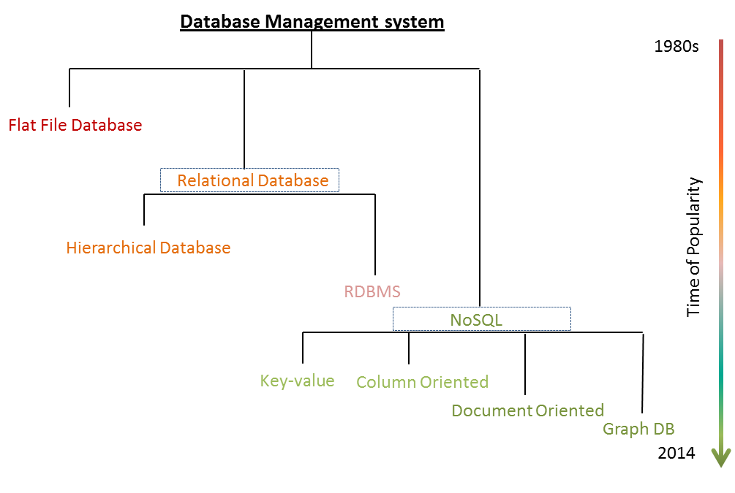
Evolution of Database Management System

Slide 5
What is Database Management System?
A Database Management System (DBMS) is a software system that allows users to create, organize, and manage data stored in a database. A database is a collection of data that is organized in a way that allows for efficient retrieval, updating, and management of the data.
Some popular DBMSs include MySQL, Oracle, Microsoft SQL Server, PostgreSQL, MongoDB, and Cassandra.
The choice of DBMS depends on the specific needs of an organization or individual, as each DBMS has its own strengths and weaknesses.

Slide 6
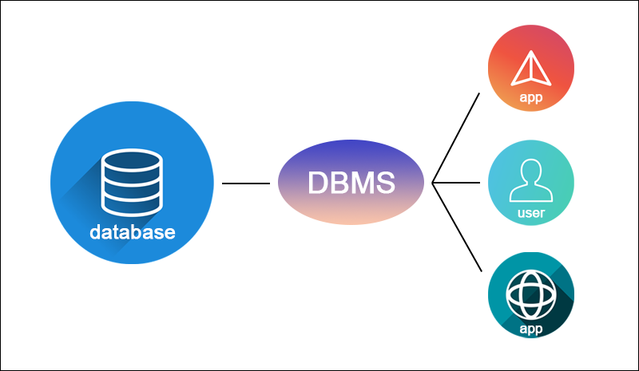
Database Management System

Slide 7
Types Of DBMS
There are several types of DBMS (database management system) available, including:
Relational DBMS (RDBMS)
Object-Oriented DBMS (OODBMS)
Hierarchical DBMS
Network DBMS
NoSQL DBMS
Graph DBMS
Columnar DBMS
Document DBMS
The choice of DBMS depends on the specific needs of an organization or individual, as each type has its own strengths and weaknesses.

Slide 8
Relational DBMS (RDBMS)
This is the most common type of DBMS and is based on the relational model.
Examples of RDBMS include:
MySQL,
Oracle, and
SQL Server.

Slide 9
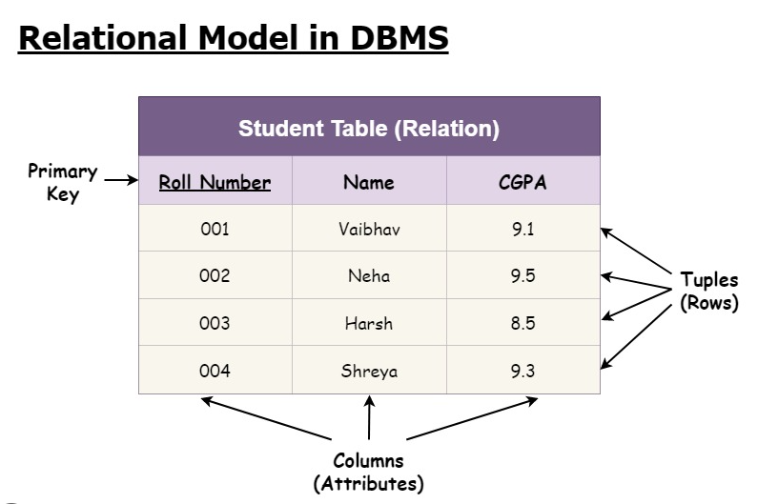
Example:

Slide 10
Object-Oriented DBMS (OODBMS)
This type of DBMS is based on the object-oriented programming paradigm and is designed to handle complex data structures.
Examples of OODBMS include:
Gemstone and
ObjectStore.

Slide 11
Hierarchical DBMS
This type of DBMS organizes data in a tree-like structure, where each record has one parent and one or more children.
Examples of hierarchical DBMS include:
IBM's Information Management System (IMS) and
Raima's RDM Embedded.

Slide 12
Network DBMS
This type of DBMS organizes data in a more complex manner than hierarchical DBMS by allowing each record to have multiple parent and child records.
Examples of network DBMS include:
Integrated Data Store (IDS) and
UniData.

Slide 13
NoSQL DBMS
This type of DBMS is designed to handle unstructured or semi-structured data, and provides a flexible schema.
Examples of NoSQL DBMS include:
MongoDB and
Cassandra.

Slide 14
Graph DBMS:
This type of DBMS is designed to manage data that consists of nodes and edges, and is used for data that has complex relationships.
Examples of graph DBMS include:
Neo4j and
OrientDB.

Slide 15
Columnar DBMS
This type of DBMS stores data in columns instead of rows, which makes it more efficient for analytical queries.
Examples of columnar DBMS include:
Apache Cassandra and
Google Bigtable.

Slide 16
Document DBMS:
This type of DBMS is designed to store data in a document format, such as JSON or XML.
Examples of document DBMS include:
Couchbase and
RavenDB.

Slide 17
END

