Slide 1
DATABASE MANAGEMENT SYSTEM
Chapter 2:
Database Design, Architecture and Model
2.1 Overview of the Database Designing Process

Slide 2
Outlines
Database Design
What is Well-designed Database?
Database Design Process
Requirement Collection
Conceptual Design
Logical Design
Physical Design
Implementation
Testing
Maintenance

Slide 3
Database Design
The process of creating a blueprint or structure for organizing and managing data in a database.
It involves determining what data needs to be stored, how it will be organized, and how it will be accessed and maintained.
The design process typically includes identifying entities, attributes, and relationships between data, as well as defining data types and constraints to ensure data integrity and accuracy.
It also involves selecting an appropriate database management system (DBMS) and designing the database schema and tables, as well as optimizing the database for efficient storage, retrieval, and querying of data.

Slide 4
What is Well-designed Database?
Good database design is critical for ensuring the reliability, scalability, and maintainability of a database system.
A well-designed database can
improve data quality,
reduce data redundancy,
increase data consistency,
and facilitate better decision-making through improved data access and analysis.

Slide 5
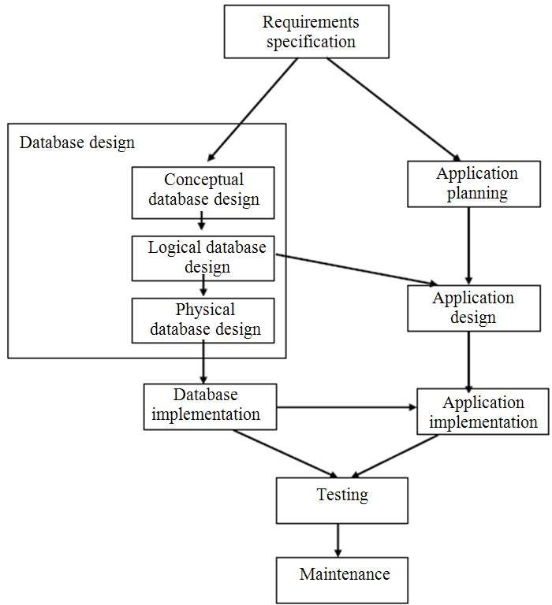
Database Design Process

Slide 6
Requirement Collection
Understanding what to do? And what you have is essential before you can dive into designing a Database
Planning: The first step in designing a database is to gather requirements by talking to stakeholders and identifying the data that needs to be stored, organized, and accessed.
System Definition: This involves understanding the purpose of the database and the specific needs of the users.

Slide 7
Conceptual design
Once the requirements are gathered, the next step is to create a conceptual design.
This step involves creating an entity-relationship diagram (ERD) that shows the high-level relationships between different entities in the system.
This diagram will help you to identify the entities, attributes, and relationships between data.

Slide 8
Logical design
After creating the ERD, the next step is to create a logical design, which involves converting the ERD into a set of normalized tables that represent the data in the system.
This step involves identifying primary keys, foreign keys, and relationships between tables.

Slide 9
Physical design
After creating the logical design, the next step is to create a physical design.
This step involves selecting a database management system (DBMS).
And designing the physical storage structures, including tables, indexes, and views.
This step also involves optimizing the database for performance, security, and scalability.

Slide 10
Implementation
Once the physical design is complete, the next step is to implement the database.
This step involve creating the tables, indexes, and other database objects.
This step also involves loading data into the database and creating the necessary relationships between tables.

Slide 11
Testing
After implementing the database, the next step is to test the database to ensure that it meets the requirements and is functioning correctly.
This step involves
verifying data integrity,
testing data access and retrieval,
and checking for performance issues.

Slide 12
Maintenance
Finally, the database design process involves ongoing maintenance and monitoring of the database to ensure that it continues to meet the changing needs of the users and the organization.
This includes monitoring performance, optimizing database structures, and updating the database schema as needed.

Slide 13
END

