Slide 1
DATABASE MANAGEMENT SYSTEM
Chapter 2:
Database Design, Architecture and Model
2.2 Views Of Data
Data abstraction/Three-Schema Architecture

Slide 2
Chapter Outlines
Introduction to Views of Data
Level of Abstractions/Three-Schema (Three-Level) Architecture
Diagram
Physical Level
Logical Level
View Level
Example

Slide 3
Introduction to View of Data
View of data in DBMS describes the abstraction of data at three-level i.e. physical level, logical level, view level.
View of data in DBMS narrate how the data is visualized at each level of data abstraction

Slide 4
Data Abstraction
Data abstraction is hiding the complex data structure in order to simplify the user’s interface of the system.
It is done because many of the users interacting with the database system are not that much computer trained to understand the complex data structures of the database system.
Data abstraction can be achieved by Three-Schema architecture which abstracts the database at three levels.

Slide 5
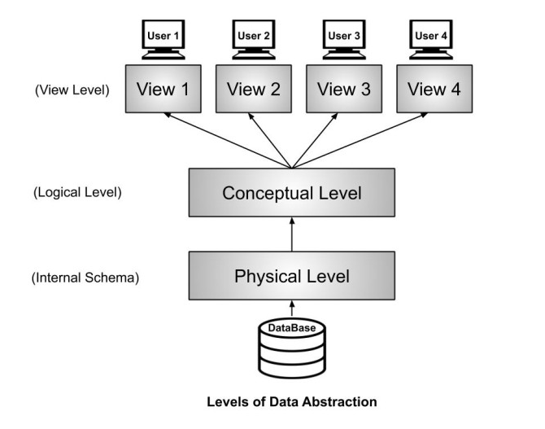
Level of Abstraction (Three-Schema Architecture)

Slide 6
Physical Level/ Internal Level
The physical or the internal level schema describes how the data is stored in the hardware.
It also describes how the data can be accessed.
The physical level shows the data abstraction at the lowest level and it has complex data structures.
Only the database administrator operates at this level.

Slide 7
Logical Level/ Conceptual Level
It is a level above the physical level.
This level deal with the information that is actually stored in the database in the form of tables.
It also stores the relationship among the data entities in relatively simple structures.
It is the developer and database administrator who operates at the logical or the conceptual level.

Slide 8
View Level/ User level/ External level
This is the highest level of abstraction.
Only a part of the actual database is viewed by the users.
This level exists to ease the accessibility of the database by an individual user. Users view data in the form of rows and columns.
Tables and relations are used to store data.
Multiple views of the same database may exist.
Users can just view the data and interact with the database, storage and implementation details are hidden from them.

Slide 9
Data Abstraction Level Example:
In case of storing customer data,
Physical level – it will contains block of storages (bytes,GB,TB,etc)
Logical level – it will contain the fields and the attributes of data.
View level – it works with CLI or GUI access of database.

Slide 10
END

