Slide 1
DATABASE MANAGEMENT SYSTEM
Chapter 2:
Database Design, Architecture and Model
2.4 Data Independence

Slide 2
Outlines
Introduction
Data Independence Diagram
Types of Data Independence
Logical Data Independence
Physical Data Independence

Slide 3
Data Independence
Data independence in DBMS (Database Management System) refers to the ability to modify the schema (structure or organization) of a database without affecting the applications that use the data.
Data is separated from the programs, so that the changes made to the data will not affect the program execution and the application.
Types of Data Independence:
Logical Data Independence
Physical Data Independence

Slide 4
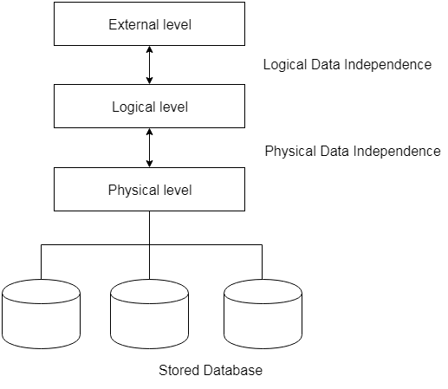
Data Independence Diagram
Fig: Data Independence

Slide 5
Logical Data Independence
This refers to the ability to modify the logical schema of a database without affecting the applications that use the data.
In other words, changes made to the way the data is organized and accessed such as
adding or removing or renaming tables,
adding or removing or renaming columns,
changing relationships between tables
should not affect the way the data is accessed or used by applications.
Codd’s Rule of Logical Data Independence says that users should be able to manipulate the Logical View of data without any information of its physical storage.

Slide 6
Physical Data Independence
This refers to the ability to modify the physical storage structure of a database without affecting the logical schema.
In other words, changes made to the way the data is stored on disk such as
adding or removing indexes,
changing data compression methods, or
moving to a different storage medium, like magnetic tape, hard disk
should not affect the way the data is accessed or used by applications.
Data independence is important because it allows for greater flexibility in managing databases, as well as easier maintenance and modification of the database schema over time.

Slide 7
END

