Slide 1
DATABASE MANAGEMENT SYSTEM
Chapter 2:
Database Design, Architecture and Model
2.5 Database Languages

Slide 2
Outlines
Introduction to Database Languages
Diagram for Database Languages
Types of Database Languages
Data Definition Language(DDL)
Data Manipulation Language(DML)
Data Control Language(DCL)
Transaction Control Language (TCL)

Slide 3
Introduction to Database Languages in DBMS
Database languages are special types of programming languages used to interact with a database management system (DBMS). These languages are used to create, modify, and query a database.
There are four main types of database languages:
Data Definition Language(DDL)
Data Manipulation Language(DML)
Data Control Language(DCL)
Transaction Control Language (TCL)
In addition to these core database languages, there are also higher-level programming languages used for working with databases, including SQL (Structured Query Language) and PL/SQL (Procedural Language/Structured Query Language). These languages provide a more user-friendly interface for working with databases and can be used in conjunction with the lower-level languages described above.

Slide 4
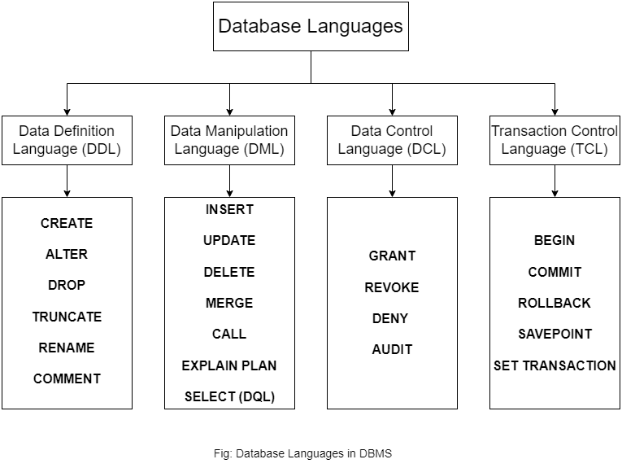
Diagram for Database Languages

Slide 5
Data Definition Language(DDL)
DDL stands for Data Definition Language in DBMS (Database Management System).
It is a set of SQL commands which are used to define the database schema, which is the structure of the database, including tables, columns, indexes, constraints, and other objects.
The schema defines the organization of the data in the database and the relationships between different tables.
The most common DDL commands are:
CREATE: This command is used to create new database objects such as tables, views, indexes, and sequences.

Slide 6
Data Definition Language(DDL) Cont…
ALTER: This command is used to modify the structure of the existing database objects. It can be used to add, delete, or modify columns, constraints, or indexes.
DROP: This command is used to delete database objects such as tables, views, indexes, or sequences.
TRUNCATE: This command is used to delete all the data from a table without deleting the table itself.
RENAME: This command is used to rename an existing database object such as a table, column, index, or sequence.
COMMENT: This command is used to add comments to the database objects such as tables, views, or columns.
These commands are essential for creating and maintaining the database structure and ensuring data consistency, accuracy, and integrity.

Slide 7
Data Manipulation Language(DML)
DML (Data Manipulation Language) is a language used in a database management system (DBMS) to manipulate the data stored in the database. The main purpose of DML is to insert, update, delete, and retrieve data from the database.
There are several commands in DML, some of which are:
SELECT: This command is used to retrieve data from the database. It allows you to select specific columns and rows from one or more tables in the database.
INSERT: This command is used to add new data into the database. You can insert one or more rows of data into a table using the INSERT command.
UPDATE: This command is used to modify existing data in the database. You can update one or more columns of data in a table using the UPDATE command.

Slide 8
Data Manipulation Language(DML) Cont…
DELETE: This command is used to remove data from the database. You can delete one or more rows of data from a table using the DELETE command.
MERGE: This command is used to combine data from two or more tables based on a common column. It allows you to insert, update, or delete data in the target table based on the data in the source tables.
CALL: Call a PL/SQL or JAVA subprogram.
EXPLAIN PLAN: It provides information on how the query optimizer intends to execute a given SQL statement..
DML commands are essential for managing the data stored in a database. They provide a way to manipulate data as per the requirements of the users or applications.

Slide 9
Data Control Language(DCL)
DCL (Data Control Language) is a set of commands used in a database management system (DBMS) to control access to the database. DCL commands are used to specify which users or roles have permissions to perform specific actions on the database objects.
Here are some common DCL commands:
GRANT: This command is used to grant permissions to users or roles to perform specific actions on the database objects. For example, you can use the GRANT command to give a user SELECT permission on a table.
REVOKE: This command is used to revoke permissions from users or roles. For example, you can use the REVOKE command to remove a user's SELECT permission on a table.

Slide 10
Data Control Language(DCL) Cont…
DENY: This command is used to deny permissions to users or roles. Unlike the REVOKE command, the DENY command prevents the user or role from ever gaining the permission again.
AUDIT: This command is used to enable or disable auditing for specific actions on the database objects. Auditing records information about who performed a specific action, when it was performed, and what the action was.
DCL commands are important for maintaining the security and integrity of the database. By controlling access to the database objects, you can ensure that only authorized users can perform specific actions on the data.

Slide 11
Transaction Control Language(TCL)
TCL (Transaction Control Language) is a set of commands used in a database management system (DBMS) to manage transactions. Transactions are sets of operations that are executed as a single unit of work. TCL commands allow you to control the behavior of transactions in the database.
Here are some common TCL commands:
BEGIN: This command indicates the start of a transaction, and all subsequent commands executed within the transaction are treated as a single unit of work.
COMMIT: This command is used to save the changes made to the database since the beginning of the transaction. When you execute a COMMIT command, the changes made to the database are made permanent.

Slide 12
Transaction Control Language(TCL) Cont…
ROLLBACK: This command is used to undo the changes made to the database since the beginning of the transaction. If a problem occurs during the execution of a transaction, you can use the ROLLBACK command to undo the changes made so far.
SAVEPOINT: This command is used to create a savepoint within a transaction. A savepoint is a marker that allows you to roll back to a specific point in the transaction if needed.
SET TRANSACTION: This command is used to set the characteristics of a transaction. For example, you can use the SET TRANSACTION command to specify the isolation level of a transaction.
TCL commands are important for ensuring the consistency and integrity of the database. By controlling the behavior of transactions, you can ensure that the changes made to the database are made in a controlled and consistent manner.

Slide 13
END

