Slide 1
Data Models

Slide 2
Outlines
What are Data Models?
Types of Data models
Hierarchical Model
Network Model
Entity-Relationship Model
Relational Model
Object-Oriented Data Model
Object-Relational Model

Slide 3
Data Models:
data models are used to define the structure and relationships between the data stored in the database.
The Data Model gives us an idea of how the final system would look after it has been fully implemented. It specifies the data items as well as the relationships between them.
In a database management system, data models are often used to show how data is connected, stored, accessed, and changed.
We portray the information using a set of symbols and language so that members of an organization may understand and comprehend it and then communicate.

Slide 4
Hierarchical Model
Hierarchical Model was the first DBMS model.
This model organizes the data in the hierarchical tree structure.
The hierarchy starts from the root which has root data and then it expands in the form of a tree adding child node to the parent node.
This model easily represents some of the real-world relationships like food recipes, sitemap of a website etc.
Example: We can represent the relationship between the shoes present on a shopping website in the following way:

Slide 5
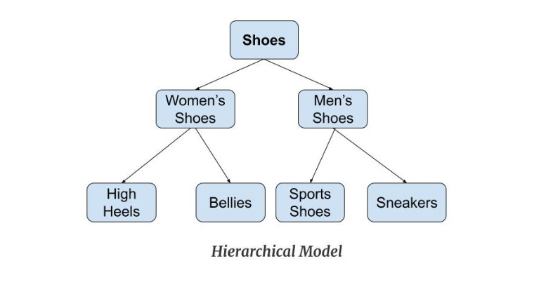
Example: Hierarchical Model

Slide 6
Features of a Hierarchical Model
1. One-to-many relationship
The data here is organized in a tree-like structure where the one-to-many relationship is between the datatypes.
Also, there can be only one path from parent to any node.
Example: In the above example, if we want to go to the node sneakers we only have one path to reach there i.e through men's shoes node.

Slide 7
Features of a Hierarchical Model
2. Parent-Child Relationship: Each child node has a parent node but a parent node can have more than one child node. Multiple parents are not allowed.
3. Deletion Problem: If a parent node is deleted then the child node is automatically deleted.
4. Pointers: Pointers are used to link the parent node with the child node and are used to navigate between the stored data.
Example: In the above example the ' shoes ' node points to the two other nodes ' women shoes ' node and ' men's shoes ' node.

Slide 8
Advantages of Hierarchical Model
It is very simple and fast to traverse through a tree-like structure.
Any change in the parent node is automatically reflected in the child node so, the integrity of data is maintained.

Slide 9
Disadvantages of Hierarchical Model
Complex relationships are not supported.
As it does not support more than one parent of the child node so if we have some complex relationship where a child node needs to have two parent node then that can't be represented using this model.
If a parent node is deleted then the child node is automatically deleted.

Slide 10
DBMS that implements Hierarchical Model
IBM Information Management System (IMS): IMS is a hierarchical database management system designed for transaction processing and online applications.
Integrated Data Store (IDS): IDS is a hierarchical database management system that provides an integrated environment for database management, application development, and data analysis.
CA-IDMS: CA-IDMS is a hierarchical database management system that provides a high-performance environment for large-scale transaction processing and database management.
CICS: CICS is a transaction processing system that supports the hierarchical data model through the use of data structures such as the CICS Data Table.

Slide 11
Network Model
This model is an extension of the hierarchical model. It was the most popular model before the relational model.
This model is the same as the hierarchical model, the only difference is that a record can have more than one parent.
It replaces the hierarchical tree with a graph.
Example: In the example below we can see that node student has two parents i.e. CSE Department and Library. This was earlier not possible in the hierarchical model.

Slide 12
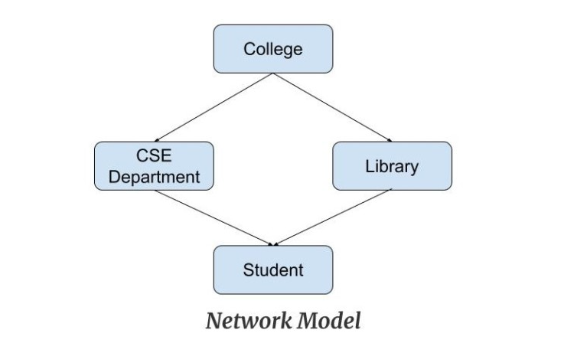
Example

Slide 13
Features of a Network Model
Ability to Merge more Relationships: In this model, as there are more relationships so data is more related. This model has the ability to manage one-to-one relationships as well as many-to-many relationships.
Many paths: As there are more relationships so there can be more than one path to the same record. This makes data access fast and simple.
Circular Linked List: The operations on the network model are done with the help of the circular linked list. The current position is maintained with the help of a program and this position navigates through the records according to the relationship.

Slide 14
Advantages of Network Model
The data can be accessed faster as compared to the hierarchical model. This is because the data is more related in the network model and there can be more than one path to reach a particular node. So the data can be accessed in many ways.
As there is a parent-child relationship so data integrity is present. Any change in parent record is reflected in the child record.

Slide 15
Disadvantages of Network Model
As more and more relationships need to be handled the system might get complex. So, a user must be having detailed knowledge of the model to work with the model.
Any change like updation, deletion, insertion is very complex.

Slide 16
DBMS which implements Network data Model?
Integrated Data Store (IDS): IDS is a hierarchical and network database management system that provides an integrated environment for database management, application development, and data analysis.
ADABAS: ADABAS is a high-performance network database management system designed for transaction processing and online applications.
Model 204: Model 204 is a high-performance network database management system designed for large-scale transaction processing and data management.

Slide 17
Entity-Relationship Model
Entity-Relationship Model or simply ER Model is a high-level data model diagram.
In this model, we represent the real-world problem in the pictorial form to make it easy for the stakeholders to understand.
It is also very easy for the developers to understand the system by just looking at the ER diagram.
We use the ER diagram as a visual tool to represent an ER Model.

Slide 18
ER diagram Components
Entities: Entity is a real-world thing. It can be a person, place, or even a concept. Example: Teachers, Students, Course, Building, Department, etc. are some of the entities of a School Management System.
Attributes: An entity contains a real-world property called attribute. This is the characteristics of that attribute. Example: The entity teacher has the property like teacher id, salary, age, etc.
Relationship: Relationship tells how two attributes are related. Example: Teacher works for a department.

Slide 19
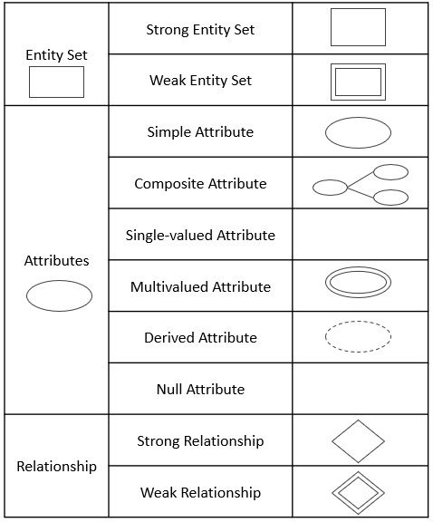
ER Diagram Symbol

Slide 20
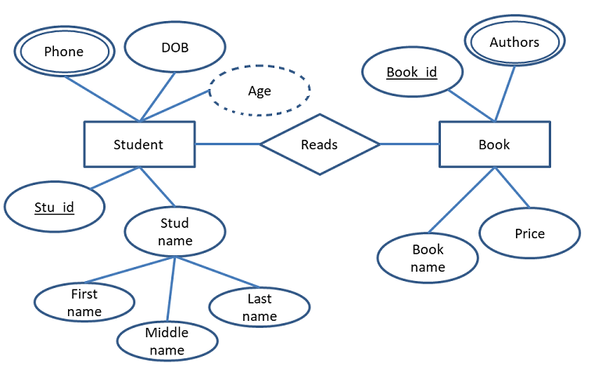
Example: Entity-Relationship Model

Slide 21
Features of ER Model
Graphical Representation for Better Understanding: It is very easy and simple to understand so it can be used by the developers to communicate with the stakeholders.
ER Diagram: ER diagram is used as a visual tool for representing the model.
Database Design: This model helps the database designers to build the database and is widely used in database design.

Slide 22
Advantages of ER Model
Simple: Conceptually ER Model is very easy to build. If we know the relationship between the attributes and the entities we can easily build the ER Diagram for the model.
Effective Communication Tool : This model is used widely by the database designers for communicating their ideas.
Easy Conversion to any Model : This model maps well to the relational model and can be easily converted relational model by converting the ER model to the table. This model can also be converted to any other model like network model, hierarchical model etc.

Slide 23
Disadvantages of ER Model
No industry standard for notation: There is no industry standard for developing an ER model. So one developer might use notations which are not understood by other developers.
Hidden information: Some information might be lost or hidden in the ER model. As it is a high-level view so there are chances that some details of information might be hidden.

Slide 24
DBMS that implements Entity-Relationship Model?
Oracle Database: Oracle Database is a relational database management system that supports the ER model through its entity-relationship diagramming tool, Oracle SQL Developer Data Modeler.
Microsoft SQL Server: Microsoft SQL Server is a relational database management system that supports the ER model through its database design tool, SQL Server Management Studio.
MySQL: MySQL is a popular open-source relational database management system that supports the ER model through various data modeling tools, such as MySQL Workbench and Navicat.
PostgreSQL: PostgreSQL is a powerful open-source relational database management system that supports the ER model through various data modeling tools, such as pgAdmin and SQL Power Architect.

Slide 25
Relational Model
Relational Model is the most widely used model.
In this model, the data is maintained in the form of a two-dimensional table.
All the information is stored in the form of row and columns. The basic structure of a relational model is tables.
So, the tables are also called relations in the relational model.

Slide 26
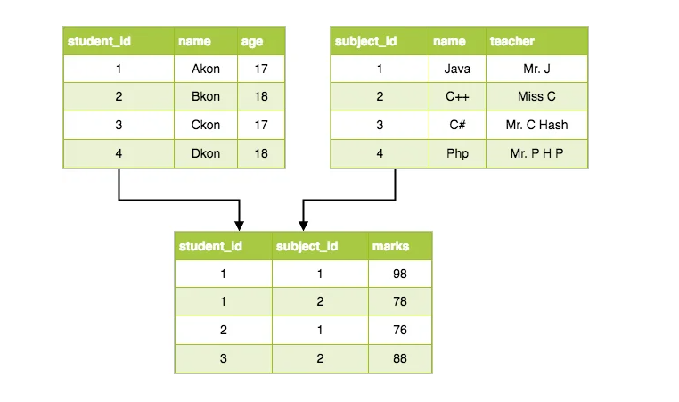
Example: Relational Model

Slide 27
Features of Relational Model
Tuples : Each row in the table is called tuple. A row contains all the information about any instance of the object. In the above example, each row has all the information about any specific individual like the first row has information about John.
Attribute or field: Attributes are the property which defines the table or relation. The values of the attribute should be from the same domain. In the above example, we have different attributes of the employee like Salary, Mobile_no, etc.

Slide 28
Advantages of Relational Model
Simple: This model is more simple as compared to the network and hierarchical model.
Scalable: This model can be easily scaled as we can add as many rows and columns we want.
Structural Independence: We can make changes in database structure without changing the way to access the data. When we can make changes to the database structure without affecting the capability to DBMS to access the data we can say that structural independence has been achieved.

Slide 29
Disadvantages of Relational Model
Hardware Overheads: For hiding the complexities and making things easier for the user this model requires more powerful hardware computers and data storage devices.
Bad Design: As the relational model is very easy to design and use. So the users don't need to know how the data is stored in order to access it. This ease of design can lead to the development of a poor database which would slow down if the database grows.
NOTE: But all these disadvantages are minor as compared to the advantages of the relational model. These problems can be avoided with the help of proper implementation and organization.

Slide 30
DBMS that Implements Relational Model
Oracle Database: Oracle is one of the most widely used relational database management systems in the world. It supports the Relational Model through its SQL language, which includes support for relational algebra operations such as join, union, and intersection.
Microsoft SQL Server: Microsoft SQL Server is another widely used relational database management system that supports the Relational Model. It includes features such as support for SQL, views, stored procedures, and triggers.
MySQL: MySQL is a popular open-source relational database management system that supports the Relational Model. It includes features such as support for SQL, stored procedures, and triggers.
PostgreSQL: PostgreSQL is a powerful open-source relational database management system that supports the Relational Model. It includes features such as support for SQL, views, stored procedures, and triggers.

Slide 31
Object-Oriented Data Model
The real-world problems are more closely represented through the object-oriented data model.
In this model, both the data and relationship are present in a single structure known as an object.
We can store audio, video, images, etc in the database which was not possible in the relational model(although you can store audio and video in relational database, it is adviced not to store in the relational database).
In this model, two are more objects are connected through links. We use this link to relate one object to other objects.

Slide 32
Elements of Object-Oriented Data Model
Objects: The real world entities and situations are represented as objects in the Object oriented database model.
Attributes and Method: Every object has certain characteristics. These are represented using Attributes. The behaviour of the objects is represented using Methods.
Class: Similar attributes and methods are grouped together using a class. An object can be called as an instance of the class.
Inheritance: A new class can be derived from the original class. The derived class contains attributes and methods of the original class as well as its own.

Slide 33
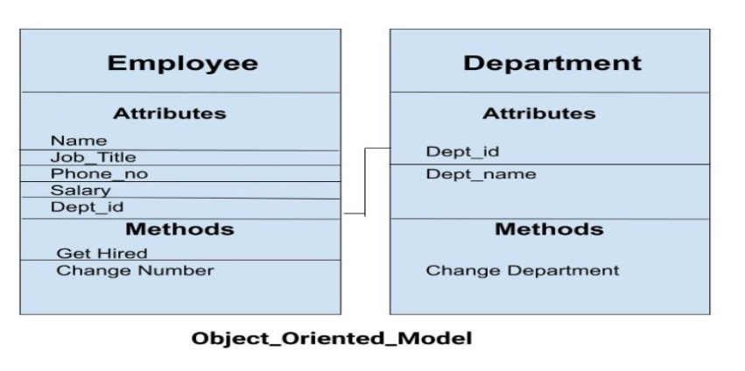
Example: Object Oriented Model

Slide 34
Object-oriented database management systems (OODBMS)
ObjectStore,
ObjectDB,
and db4o

Slide 35
Object-Relational Model
As the name suggests it is a combination of both the relational model and the object-oriented model.
This model was built to fill the gap between object-oriented model and the relational model.
We can have many advanced features like we can make complex data types according to our requirements using the existing data types.
The problem with this model is that this can get complex and difficult to handle. So, proper understanding of this model is required.

Slide 36
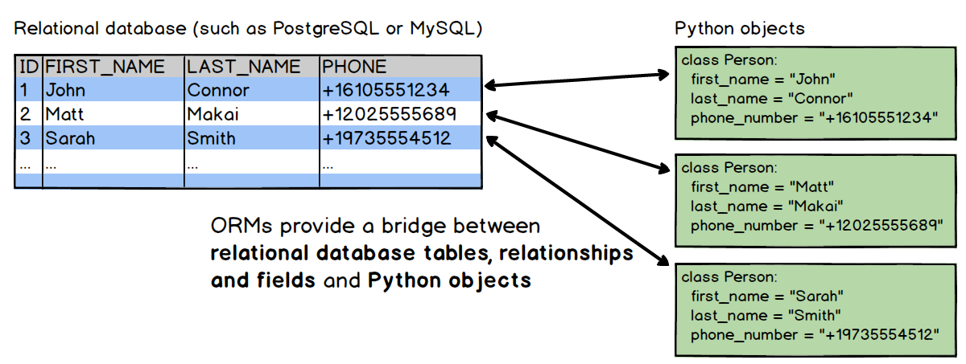
Example: Object – Relational Model

Slide 37
Object-relational database management systems (ORDBMS):
Oracle,
IBM DB2,
and PostgreSQL

