Slide 1
DATABASE MANAGEMENT SYSTEM
Chapter 2:
Database Design, Architecture and Model
2.8 Types of Database system

Slide 2
Outlines
Types of Database System
Centralized database system
Personal computer system
Client/Server database system
Distributed processing database system

Slide 3
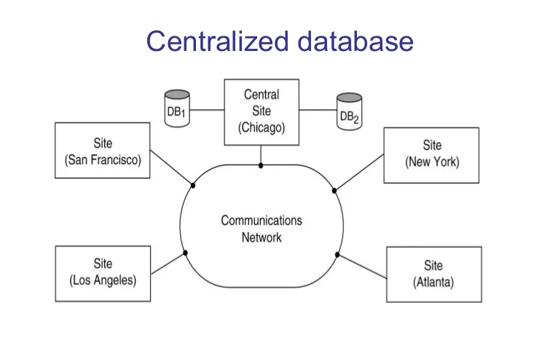
Centralized database system

Slide 4
Centralized database system
A centralized database system is a data storage system in which all data is stored in a single location, typically on a single server. In this type of system, users access the data through a single point of entry, usually a computer network.
In a centralized database system, all data is managed and controlled by a single entity, which can be advantageous in terms of data security, consistency, and reliability. It also simplifies data management and allows for easy backup and recovery of data.
However, there are also some potential drawbacks to a centralized database system. For example,
it can be more vulnerable to system failures,
and it can be more difficult to scale up as the amount of data and the number of users increase.
Additionally, if the centralized system fails, all data and applications can become unavailable.

Slide 5
Centralized database system
Overall, the choice of a centralized or decentralized database system depends on various factors,
including the size and complexity of the data,
the number of users,
and the level of security and control needed.
A common example of a centralized database system is a company's customer relationship management (CRM) system. In a centralized CRM system, all customer data is stored on a central server, and employees can access and update this data through a single point of entry. This allows the company to maintain consistent and accurate records of all customer interactions, which can improve customer service and support.

Slide 6
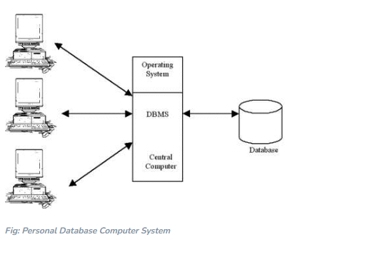
Personal computer system

Slide 7
Personal computer system
When a DBMS is run on a PC, the PC acts as both the host computer and the terminal unlike the larger systems. The DBMS functions and the database application functions are combined into one application. Database applications on a PC handle the user input, screen output and access to the data on the disk. Combining these different functions into one unit gives the DBMS a great deal of power, flexibility and speed, usually at the cost of decreased data security and integrity.
However, in recent years many have been connected to a Local Area Networks (LANs). In a LAN, the data and usually, the user applications reside on the File Server, a PC running a special Network Operating System (NOS) such as Novell’s NetWare or Microsoft’s LAN Manager or Windows NT. The file server manages the LAN access to other shared resources.

Slide 8
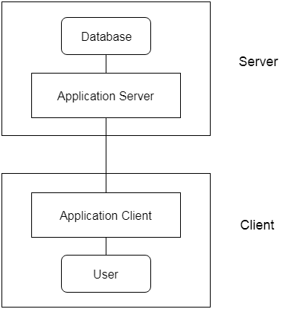
Client/Server database system

Slide 9
Client/Server database system
Client/server database systems are a type of database architecture in which the application is divided into two parts: the client and the server. The client is typically a user's computer or a device that interacts with the database, while the server is a centralized database management system that stores and manages the data.
In a client/server database system, the client application sends requests to the server to access or modify the data. The server processes these requests, retrieves or modifies the requested data, and sends it back to the client. This architecture allows for distributed processing and can improve performance by offloading some of the processing workload from the client to the server.
Examples of client/server database systems include Oracle Database, Microsoft SQL Server, and MySQL. These systems are widely used in enterprise-level applications, such as banking, finance, healthcare, and e-commerce, where large amounts of data need to be managed and accessed by multiple users simultaneously.

Slide 10
Client/Server database system
One of the advantages of client/server database systems is their scalability. As the number of users and the amount of data grow, additional servers can be added to the system to handle the increased workload. They also provide better data security by centralizing control of the database and allowing for access control and authentication mechanisms to be implemented.
However, client/server database systems can be complex to set up and maintain, requiring specialized knowledge and resources. They may also be more expensive than other database architectures, as they typically require dedicated hardware and software licenses.

Slide 11
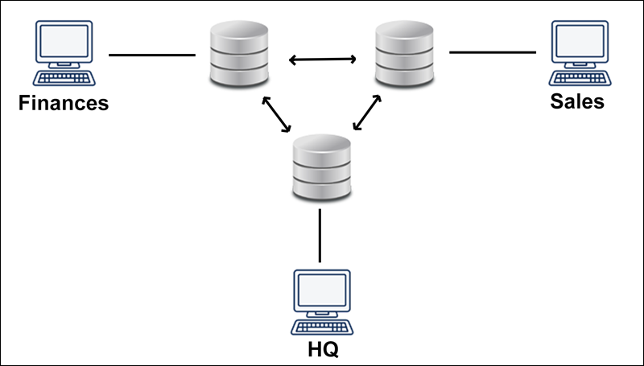
Distributed processing database system

Slide 12
Distributed processing database system
A distributed processing database system is a type of database architecture in which data is distributed across multiple nodes or servers, and processing tasks are divided and executed on different nodes in parallel.
In a distributed processing database system, the nodes are interconnected through a network, and each node has its own processing power and storage capacity. Data is partitioned and replicated across multiple nodes to improve data availability, fault tolerance, and scalability.
Examples of distributed processing database systems include Apache Cassandra, Hadoop Distributed File System (HDFS), and Google's Bigtable. These systems are commonly used in applications that require high scalability, fault tolerance, and low-latency access to large amounts of data, such as social media, e-commerce, and big data analytics.

Slide 13
Distributed processing database system
Distributed processing database systems offer several advantages over other database architectures. They provide better scalability and performance, as processing tasks can be distributed across multiple nodes, and data can be partitioned and replicated across multiple servers. They also offer improved fault tolerance, as data redundancy and replication can help to ensure data availability in the event of a node failure.
However, distributed processing database systems can be complex to set up and maintain, requiring specialized knowledge and skills. They may also require more resources and hardware to achieve high performance and scalability. Additionally, the complexity of managing data across multiple nodes can increase the risk of data inconsistency and conflicts.

