Slide 2
Structure of Relational Database
A relational database is a type of database that uses a structure based on tables and the relationships between them to organize and manage data.
The key components of a relational database structure include
tables,
fields,
records,
keys, and
relationships.

Slide 3
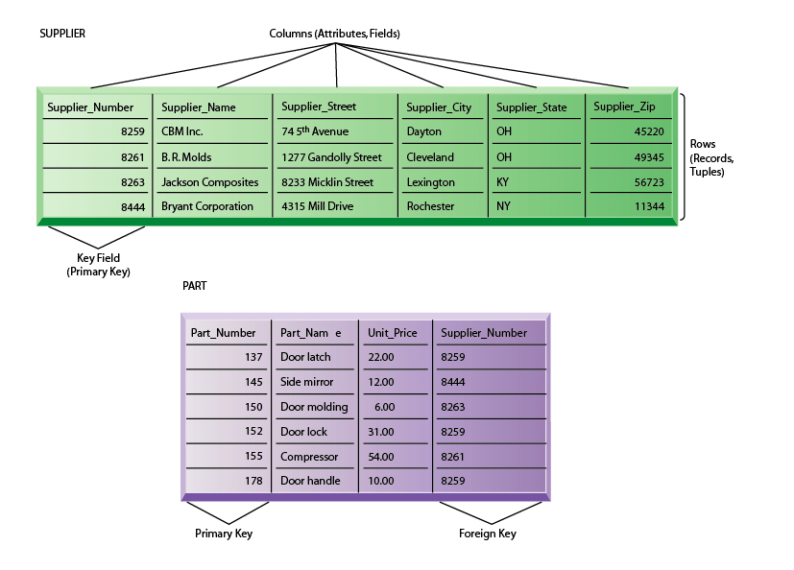
Example:

Slide 4
Tables
The fundamental building blocks of a relational database.
Represent a collection of related data, organized into rows (records) and columns (attributes).
Each row represents a unique entity, and each column stores a specific characteristic of that entity.

Slide 5
Field (Column):
Each column in a table is called a field.
Fields represent the attributes or properties of the entities.
For example, in a "Supplier" table, you might have fields such as "SupplierName," "SupplierNumber," etc.

Slide 6
Record (Row):
A row in a table is called a record.
Records represent individual instances of the entities described by the table.
Each record contains data for each field in the table.

Slide 7
Key
Keys are used to uniquely identify records in a table.
The Primary Key is a column or set of columns that uniquely identifies each record in a table.
Foreign Keys are columns that establish a link between two tables. They refer to the primary key of another table, creating a relationship between them.

Slide 8
Relationships
Relationships define the connections between tables in a relational database.
There are different types of relationships, including one-to-one, one-to-many, and many-to-many.
One-to-One: Each record in the first table is related to one and only one record in the second table, and vice versa.
One-to-Many: A record in the first table can be related to many records in the second table, but a record in the second table is related to only one record in the first table.
Many-to-Many: Records in both tables can be related to multiple records in the other table.

