Slide 2
In a relational database management system (DBMS), a schema serves as the blueprint that defines the structure of the database.
It outlines how data is organized into tables, the relationships between these tables, and the constraints that ensure data integrity.

Slide 3
Example
student (id, rollNo, name, degree, year, sex, deptNo, advisor)

Slide 4
Key Components of a Relational Database Schema:
Tables:
Rows: Represent individual records or entities.
Columns: Define the attributes or properties of each entity.
Primary Key: A unique identifier for each row.
Foreign Key: A reference to the primary key of another table, establishing relationships.

Slide 5
Relationships:
One-to-One: A single entity in one table is related to exactly one entity in another table.
One-to-Many: A single entity in one table is related to multiple entities in another table.
Many-to-Many: Multiple entities in one table are related to multiple entities in another table.

Slide 6
Constraints:
Data Types: Define the type of data allowed in each column (e.g., integer, string, date).
Not Null: Ensures that a column cannot contain null values.
Unique: Ensures that each value in a column is unique.
Primary Key: Defines the primary key of a table.
Foreign Key: Defines a foreign key and its relationship to another table's primary key.
Check Constraints: Enforce specific conditions on data values.

Slide 7
Benefits of a Well-Designed Schema:
Data Integrity: Ensures data accuracy and consistency.
Efficient Queries: Optimizes database performance.
Scalability: Allows for easy expansion of the database.
Data Security: Protects sensitive information.
Data Recovery: Facilitates data restoration in case of failures.

Slide 8
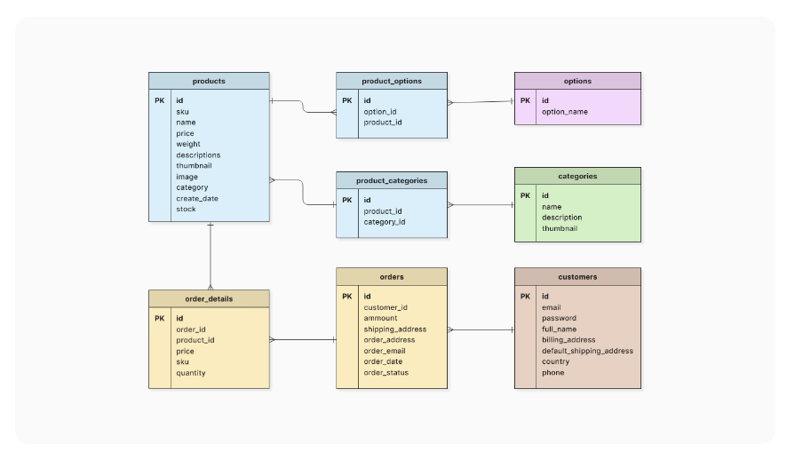
Schema Diagram

