Slide 1
DATABASE MANAGEMENT SYSTEM
Chapter 3:
Relational Algebra
3.5 Relational Algebra From Set Theory

Slide 2
Relational Algebra
Relational algebra is a formal query language that uses algebraic operators to manipulate and retrieve data from relational databases.
It provides a theoretical foundation for SQL, the most widely used database query language.
Relational Algebra is a procedural query language in relational databases that provides a set of operations to manipulate and retrieve data.
It serves as the foundation for SQL and other query languages.
Each operation in relational algebra takes one or more relations as input and produces a new relation as output.

Slide 3
Core Concepts of Relational Algebra
Relation: A table in a database, consisting of rows (tuples) and columns (attributes).
Operators: Used to perform operations on relations to retrieve desired data.

Slide 4
Basic Operations of Relational Algebra
Selection (σ):
Selects tuples from a relation based on a given condition.
Syntax: σ_condition(relation)
Example: σ_Salary>50000(Employee)
Projection (π):
Projects a relation onto a subset of its attributes.
Syntax: π_attribute_list(relation)
Example: π_Name,Salary(Employee)

Slide 5
Join
In Relational Algebra, a join is an operation used to combine tuples from two relations based on a condition.
It is a fundamental operation in relational databases that extends the Cartesian product by applying a filter condition.
Types of Joins
Inner Joins
Theta Join
Equi Join
Natural Join
Outer Join
Left Outer Join
Right Outer Join
Full Outer Join

Slide 6
Theta (θ) Join
The most general form of join.
Combines tuples from two relations based on a specified condition involving comparison operators like =, <, >, <=, >=, or ≠.
Notation: R1 ⋈_{θ} R2
R1 and R2 are relations having attributes (A1, A2, .., An) and (B1, B2,.. ,Bn) such that the attributes don’t have anything in common, that is R1 ∩ R2 = Φ.

Slide 7
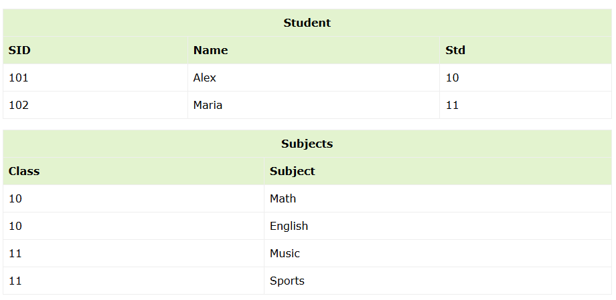
Example:

Slide 8
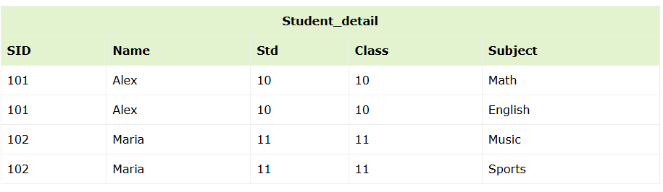
STUDENT ⋈Student.Std = Subject.Class SUBJECT

Slide 9
Equijoin
A specific type of theta join where the condition involves only equality (=).
Combines tuples with equal values in the specified columns.
Notation:

Slide 10
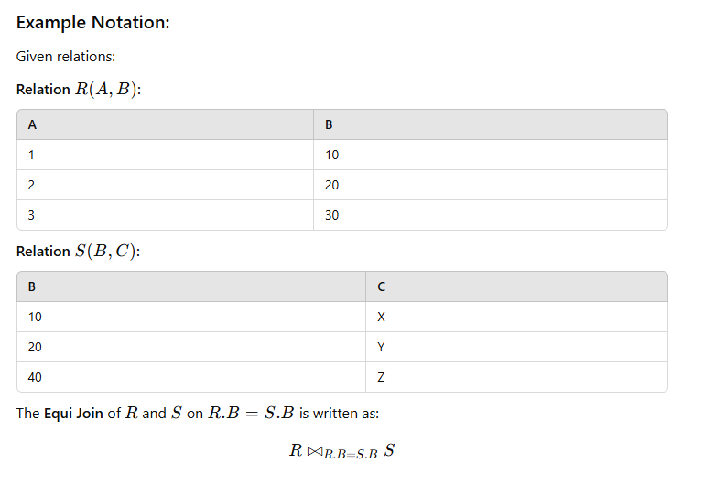

Slide 11


Slide 12
Natural Join
Natural join does not use any comparison operator.
It does not concatenate the way a Cartesian product does.
We can perform a Natural Join only if there is at least one common attribute that exists between two relations. In addition, the attributes must have the same name and domain.
Natural join acts on those matching attributes where the values of attributes in both the relations are same.
A special type of equijoin where the join is performed on all columns with the same name in both relations.
Duplicate columns are eliminated in the result.
It's a further specialization of equi-join.
Notation:
R ⋈S

Slide 13


Slide 14
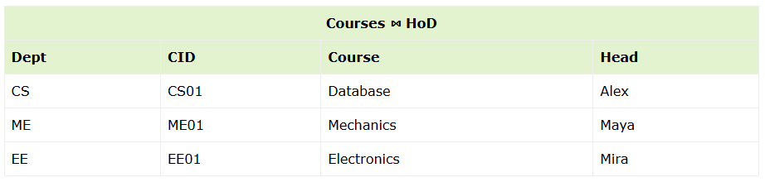
Result:

Slide 15
Outer Joins
An Outer Join in Relational Algebra is used to combine tuples from two relations 𝑅 and 𝑆, while also including unmatched tuples from one or both relations.
This is in contrast to an Inner Join, which only includes tuples that satisfy the join condition.

Slide 16
Left Outer Join (R S)
Includes all tuples from 𝑅, along with matched tuples from 𝑆.
If there is no match, attributes from 𝑆are padded with NULL.

Slide 17
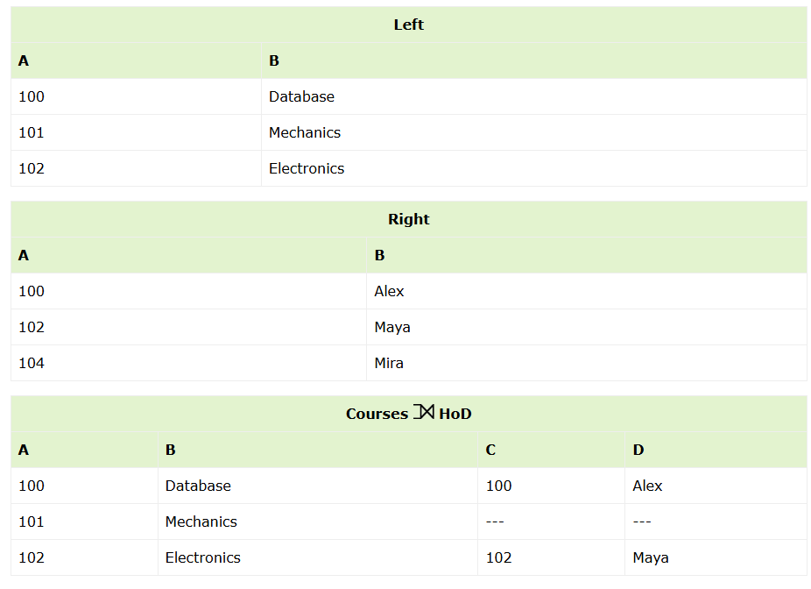
Example:

Slide 18
Right Outer Join: (R S )
Includes all tuples from 𝑆, along with matched tuples from 𝑅.
If there is no match, attributes from 𝑅 are padded with NULL.

Slide 19
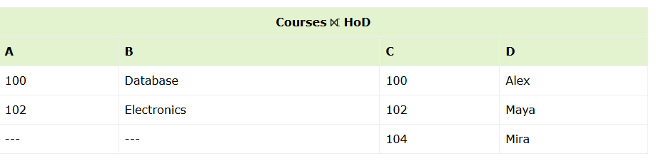
Example:

Slide 20
Full Outer Join: ( R S)
Combines the results of the Left Outer Join and Right Outer Join.
Includes all tuples from 𝑅and 𝑆, with unmatched tuples from both relations padded with NULL.

Slide 21
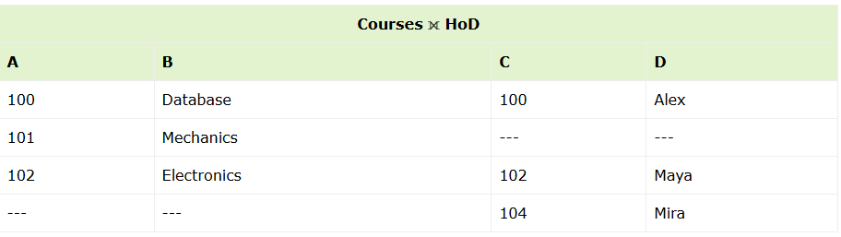
Example:

