Slide 1
DATABASE MANAGEMENT
Chapter 4:
Normalization
4.2 Functional Dependencies

Slide 2
Functional Dependency
The functional dependency is a relationship between two sets of attributes within a table.
It describes the dependency of one set of attributes on another set, meaning that the values of one set can be determined based on the values of the other set.
A->B , Where A is determinant and B is dependent.
More formally, given a relation (table) R with attributes A and B, attribute B is functionally dependent on attribute A if for every valid combination of values for attribute A, there is a unique corresponding value for attribute B.
This means that knowing the value of A allows us to determine the value of B without any ambiguity.

Slide 3
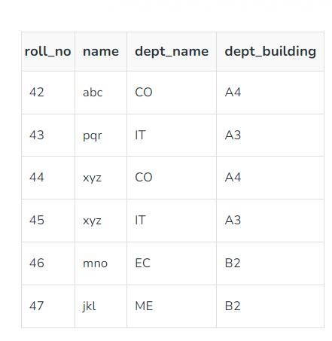
Example:

Slide 4
Armstrong’s axioms/properties of functional dependencies:
Reflexivity: If Y is a subset of X, then X→Y holds by reflexivity rule Example: {roll_no, name} → name is valid.
Augmentation: If X → Y is a valid dependency, then XZ → YZ is also valid by the augmentation rule.
Example: {roll_no, name} → dept_building is valid, hence {roll_no, name, dept_name} → {dept_building, dept_name} is also valid.
Transitivity: If X → Y and Y → Z are both valid dependencies, then X→Z is also valid by the Transitivity rule.
Example: roll_no → dept_name & dept_name → dept_building, then roll_no → dept_building is also valid.

Slide 5
Types of Functional Dependency
Trivial functional dependency
Non-Trivial functional dependency
Multivalued functional dependency
Transitive functional dependency
Fully functional dependency
Partially Functional dependency

Slide 6
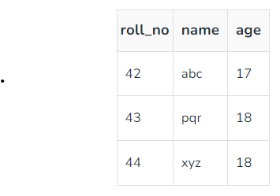
Trivial functional dependency
In Trivial Functional Dependency, a dependent is always a subset of the determinant. i.e. If X → Y and Y is the subset of X, then it is called trivial functional dependency.
Here, {roll_no, name} → name is a trivial functional dependency, since the dependent name is a subset of determinant set {roll_no, name}. Similarly, roll_no → roll_no is also an example of trivial functional dependency.

Slide 7
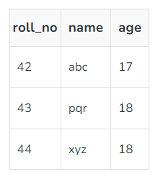
Non-trivial Functional Dependency
In Non-trivial functional dependency, the dependent is strictly not a subset of the determinant. i.e. If X → Y and Y is not a subset of X, then it is called Non-trivial functional dependency.
Here, roll_no → name is a non-trivial functional dependency, since the dependent name is not a subset of determinant roll_no. Similarly, {roll_no, name} → age is also a non-trivial functional dependency, since age is not a subset of {roll_no, name}

Slide 8
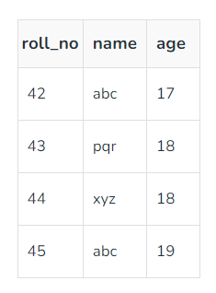
Multivalued Functional Dependency
In Multivalued functional dependency, entities of the dependent set are not dependent on each other. i.e. If a → {b, c} and there exists no functional dependency between b and c, then it is called a multivalued functional dependency.
Here, roll_no → {name, age} is a multivalued functional dependency, since the dependents name & age are not dependent on each other(i.e. name → age or age → name doesn’t exist !)

Slide 9
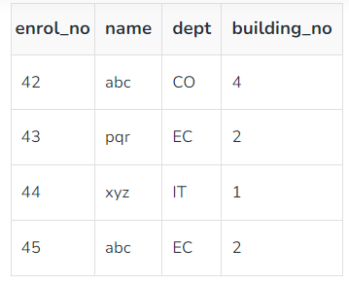
Transitive Functional Dependency
In transitive functional dependency, dependent is indirectly dependent on determinant. i.e. If a → b & b → c, then according to axiom of transitivity, a → c. This is a transitive functional dependency.
Here, enrol_no → dept and dept → building_no. Hence, according to the axiom of transitivity, enrol_no → building_no is a valid functional dependency. This is an indirect functional dependency, hence called Transitive functional dependency.

Slide 10
Fully Functional Dependency
A functional dependency is fully functional if an attribute is functionally dependent on the entire candidate key and not on any proper subset of the candidate key.
Definition: X→Y is a fully functional dependency if Y is functionally dependent on X and not on any subset of X.
Explanation: Y depends entirely on X, meaning no part of X alone can determine Y.
Importance: Fully functional dependency is required to achieve Third Normal Form (3NF).
Example:
Relation: R(A,B,C)
Candidate key:{A,B}
Dependency: {A,B}→C is fully functional, as C depends on the entire candidate key {A,B} and not just A or B.

Slide 11
Partial Functional Dependency
A functional dependency is partial if an attribute is functionally dependent on a proper subset of a candidate key.
Definition: X→Y is a partial functional dependency if X is a proper subset of a candidate key, and Y is dependent on X.
Explanation: Y can be determined by only part of the candidate key.
Importance: Partial functional dependencies cause data redundancy and anomalies. They are removed during normalization to achieve Second Normal Form (2NF).
Example:
Relation: R(A,B,C)
Candidate key: {A,B}
Dependency: A→C is a partial functional dependency because 𝐴A is a subset of the candidate key {A,B} and determines C.

Slide 12
Closure of a Set of Functional Dependencies
The closure of a set of functional dependencies in a relational database refers to the set of all functional dependencies that can be derived or inferred from the given set.
In other words, it is the complete set of functional dependencies that hold based on the given set of dependencies.
To find the closure of a set of functional dependencies, you can use a process called attribute closure or Armstrong's axioms.
Armstrong's axioms provide a set of rules that can be applied iteratively to determine the closure of a set of dependencies.
These axioms include:
Reflexivity: If α is a set of attributes and β is a subset of α, then α → β.
Augmentation: If α → β, then αγ → βγ, where γ is a set of attributes.
Transitivity: If α → β and β → γ, then α → γ.

Slide 13
Algorithmic approach
Here is an algorithmic approach to finding the closure of a set of functional dependencies:
Start with the given set of functional dependencies.
Apply the reflexivity rule to derive any new functional dependencies where the right-hand side is a subset of the left-hand side.
Apply the augmentation rule to derive any new functional dependencies by adding the same attributes to both sides.
Apply the transitivity rule to derive any new functional dependencies by combining existing dependencies.
Repeat steps 2 to 4 until no new functional dependencies can be derived.
The resulting set of functional dependencies is the closure of the original set.
By finding the closure of a set of functional dependencies, you can determine all the implicit dependencies that hold based on the given set. This information is useful in database design and normalization to ensure data integrity and eliminate redundancies.

Slide 14
Example:
Given the set of functional dependencies:
A → B
B → C
To find the closure of this set, we can apply the inference rules:
Start with the given set of functional dependencies:
A → B
B → C
Apply the reflexivity rule:
A → B
B → C
A → A (reflexivity rule)

Slide 15
Example cont.
Apply the augmentation rule:
A → B
B → C
A → AB (augmentation rule)
B → BC (augmentation rule)
Apply the transitivity rule:
A → B
B → C
A → C (A → B, B → C, transitivity rule)
After applying the rules, we obtain the closure of the given set:
A → B
B → C
A → C
These are all the functional dependencies that can be inferred from the given set using the reflexivity, augmentation, and transitivity rules.

Slide 16
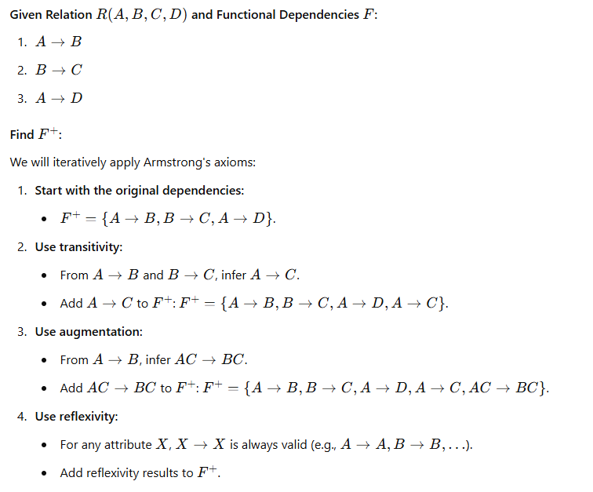
Example1

Slide 17
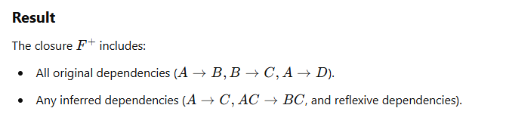
Result

Slide 18
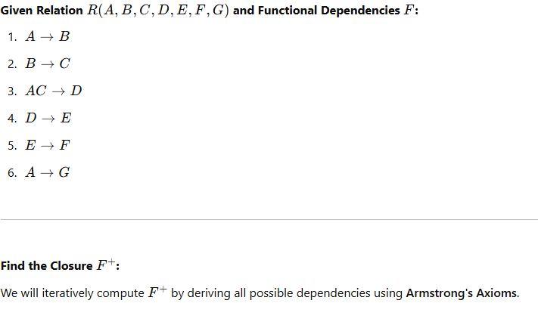
Example2:

Slide 19
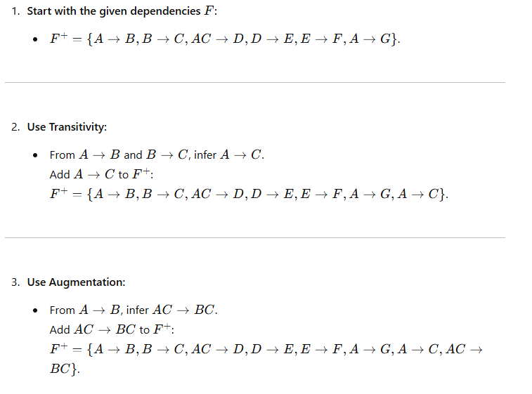

Slide 20
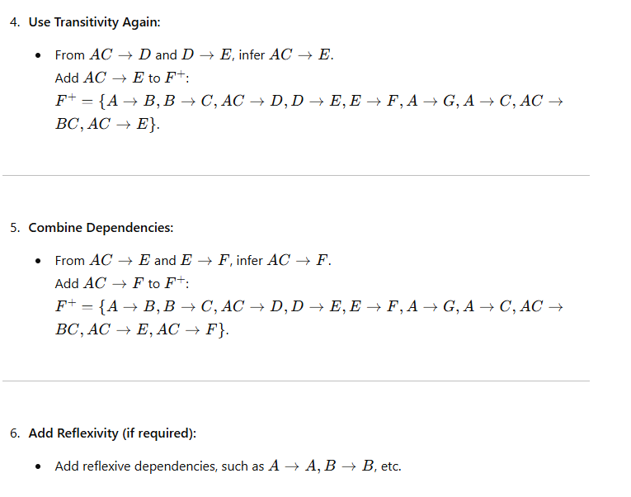

Slide 21
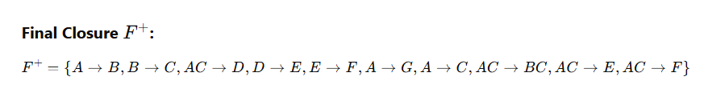

Slide 22
Verify Candidate Key

Slide 23
Closure of Attribute Sets
The closure of an attribute set with respect to a set of functional dependencies is the complete set of attributes that can be functionally determined by that attribute set using the given functional dependencies.
In other words, it represents all the attributes that can be determined or inferred from a given set of attributes using the functional dependencies.

Slide 24
Algorithmic approach
To find the closure of an attribute set, you can apply the following algorithm:
Start with the given attribute set.
Initialize a variable, let's call it closure, with the given attribute set.
Repeat the following steps until no more attributes can be added to the closure:
For each functional dependency in the given set of functional dependencies:
Check if the left-hand side of the functional dependency is a subset of the closure. If it is, proceed to the next step. Otherwise, move on to the next functional dependency.
Add all attributes from the right-hand side of the functional dependency to the closure if they are not already present.
Once no more attributes can be added to the closure, the resulting closure set will be the closure of the given attribute set.

Slide 25
Example:
Given the functional dependencies:
A → B
B → C
C → D
Let's find the closure of the attribute set {A}.
Start with the given attribute set: {A}.
Initialize the closure: {A}.
Repeat the following steps:
a. For the first functional dependency A → B:
i. Since A is already in the closure, proceed to the next step.
Ii. Add B to the closure. The closure becomes {A, B}.

Slide 26
Example cont.
b. For the second functional dependency B → C:
i. Since B is in the closure, proceed to the next step.
Ii. Add C to the closure. The closure becomes {A, B, C}.
c. For the third functional dependency C → D:
i. Since C is in the closure, proceed to the next step.
ii. Add D to the closure. The closure becomes {A, B, C, D}.
Since no more attributes can be added to the closure, the resulting closure is:
{A, B, C, D}.
Therefore, the closure of the attribute set {A} with respect to the given functional dependencies is {A, B, C, D}.

Slide 27
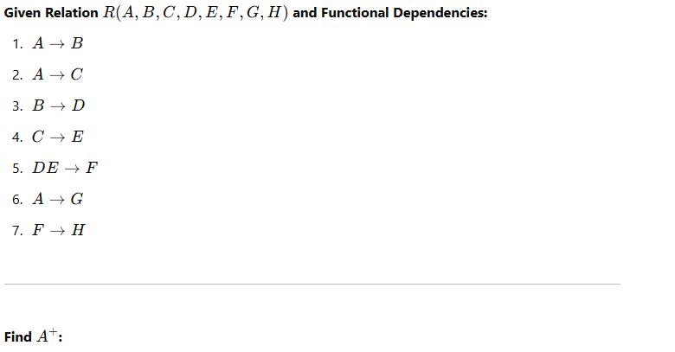
Example2

Slide 28
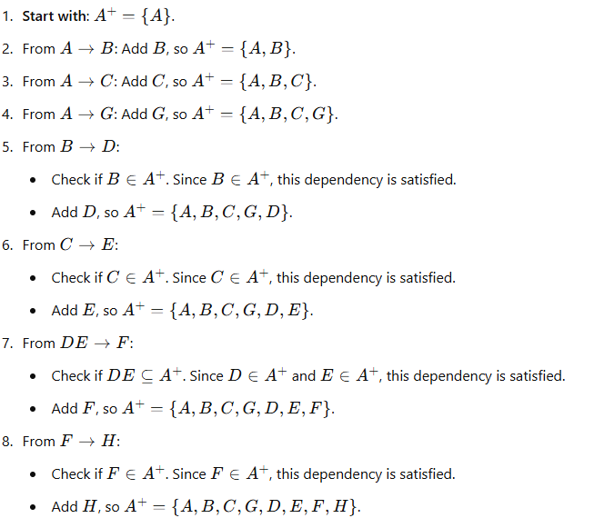


Slide 29
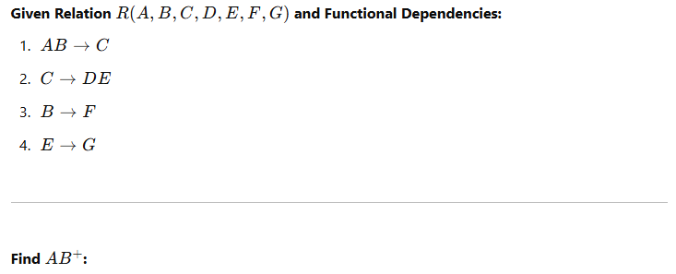

Slide 30
Example3

Slide 31
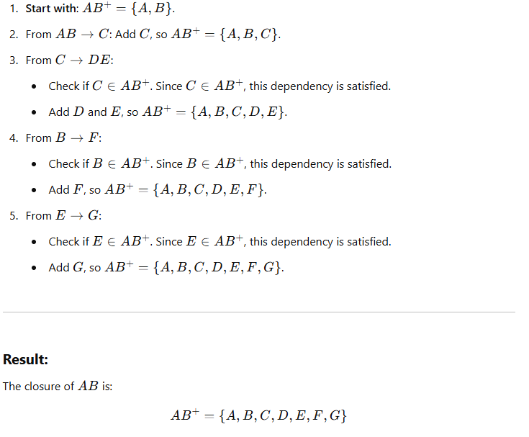

Slide 33
END

