Slide 1
DATABASE MANAGEMENT SYSTEM
Chapter 6:
Manipulating And Querying Data

Slide 2
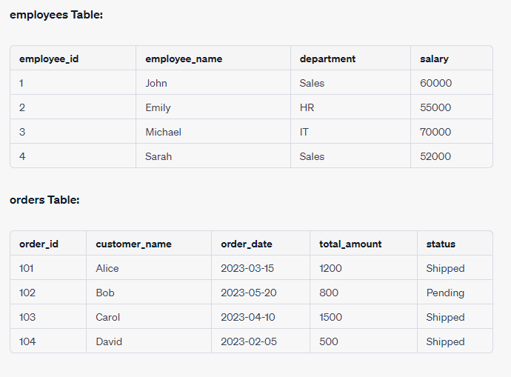

Slide 3
Logical Operator
In SQL, we can use logical operators to combine multiple conditions in the WHERE clause to create more complex filtering criteria.
The common logical operators are AND, OR, and NOT.
Here's how you can use them:

Slide 4
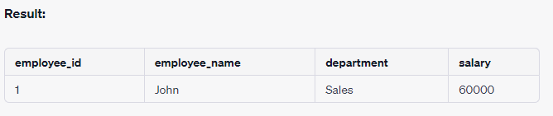
AND Operator: This operator allows you to retrieve rows that satisfy multiple conditions.
SELECT * FROM employees
WHERE department = 'Sales' AND salary > 55000;

Slide 5
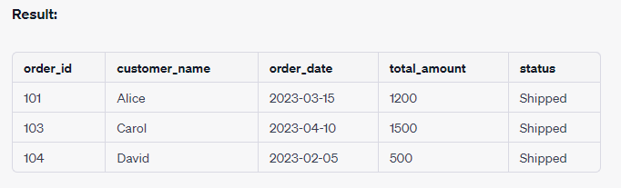
OR Operator: This operator allows you to retrieve rows that satisfy at least one of the specified conditions.
SELECT * FROM orders
WHERE status = 'Shipped' OR total_amount > 1000;

Slide 6
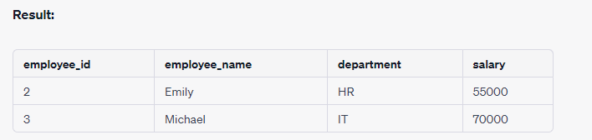
NOT Operator: This operator negates a condition, allowing you to retrieve rows that do not meet a certain condition.
SELECT * FROM employees
WHERE NOT department = 'Sales';

Slide 7
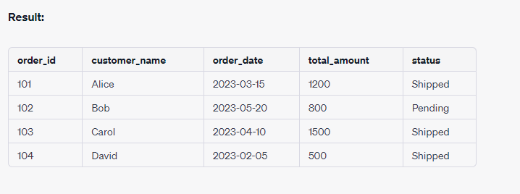
Combining Logical Operators: You can also combine multiple logical operators to create more intricate conditions.
SELECT * FROM orders
WHERE (order_date >= '2023-01-01' AND order_date <= '2023-06-30')
OR (total_amount > 1000 AND status = 'Shipped');

Slide 8
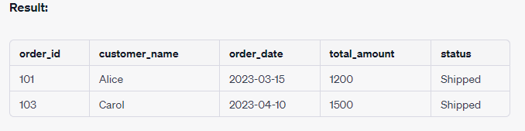
BETWEEN / NOT BETWEEN operator
Using the BETWEEN operator:
SELECT * FROM orders
WHERE order_date BETWEEN '2023-01-01' AND '2023-06-30';

Slide 9
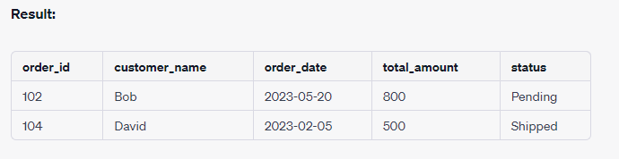
Using the NOT BETWEEN operator:
SELECT * FROM orders
WHERE order_date NOT BETWEEN '2023-01-01' AND '2023-06-30';

Slide 10
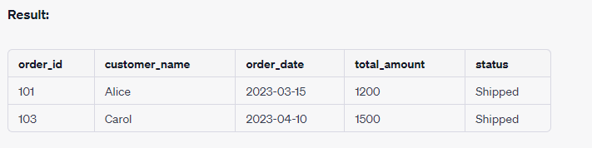
IN Operator
SELECT * FROM orders
WHERE customer_name IN ('Alice', 'Carol');

Slide 11
wildcards (LIKE operator)
% (Percent Sign):
The % wildcard is used to match any sequence of characters (including zero characters).
It is typically used for pattern matching where you want to match any characters or a variable number of characters.
For example, using LIKE 'A%' would match any string that starts with the letter "A," followed by any number of characters.
_ (Underscore):
The _ wildcard is used to match a single character.
It is used when you want to specify that a certain character should be present at a particular position in the pattern.
For example, using LIKE '_pple' would match strings like "apple" or "zpple," where the first character can be any character.

Slide 12
Here are some guidelines on when to use each wildcard:
Use % when you want to match patterns that can have any sequence of characters or a variable number of characters before, after, or in between specific characters.
Example: LIKE '%apples%' would match any string containing the word "apples" anywhere in it.
Use _ when you want to match patterns with a fixed length and specific characters at certain positions.
Example: LIKE 'A___e' would match strings like "Apple" or "Agree" where

Slide 13
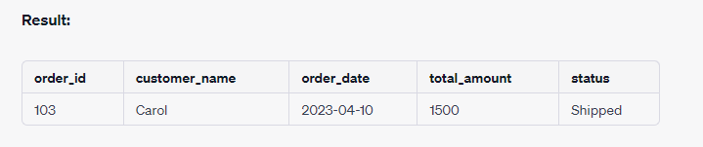
Example1: (using the % wildcard)
SELECT * FROM orders
WHERE customer_name LIKE 'C%';

Slide 14
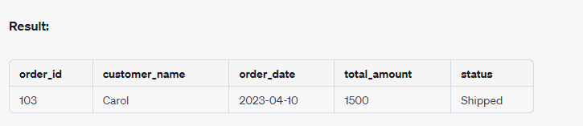
Example 2 (using the _ wildcard )
SELECT * FROM orders
WHERE customer_name LIKE 'C_l';

Slide 15
ORDER BY Statement (Sorting the output)
The ORDER BY clause in SQL is used to sort the result set of a query based on one or more columns.
It allows you to specify the column(s) by which you want to sort the rows and whether you want the sorting to be in ascending (ASC) or descending (DESC) order.

Slide 16
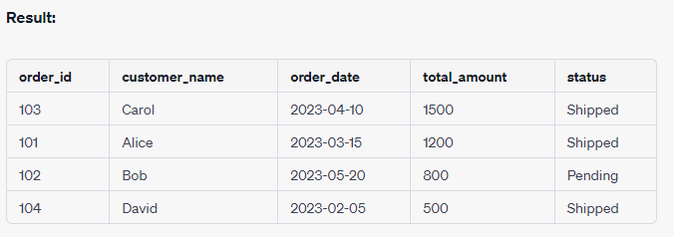
Example
SELECT * FROM orders
ORDER BY total_amount DESC;
In this example, the ORDER BY clause is used to sort the result set of the query based on the total_amount column in descending order. The result displays the orders with the highest total_amount first.

Slide 17
SQL ALIASES
In SQL, the "AS" keyword is used to create aliases for tables and columns.
An alias provides a temporary alternative name for a table or column in the context of a query.
This can make queries more readable, especially when dealing with complex queries involving multiple tables or calculations.
Here's how the "AS" keyword is used with aliases for both tables and columns:

Slide 18
Table Aliases:
We can use an alias for a table to give it a shorter or more meaningful name in your query.
This is particularly useful when you're joining multiple tables.
SELECT
o.order_id,
c.customer_name
FROM
orders AS o
JOIN
customers AS c
ON
o.customer_id = c.customer_id;
In this example, "o" is an alias for the "orders" table, and "c" is an alias for the "customers" table.

Slide 19
Column Aliases:
We can use an alias for a column to change its name in the result set of a query or to provide a name for a calculated expression.
SELECT
first_name,
last_name,
salary * 12 AS annual_salary
FROM
employees;
In this example, the "salary * 12" calculation is given an alias "annual_salary" in the result set.

Slide 20
Introduction To Aggregate Function
Aggregate functions in SQL are special functions that operate on a set of values and return a single value as a result.
These functions are typically used in conjunction with the SELECT statement to perform calculations on columns or expressions within a table.
Aggregate functions are used to summarize data and provide insights such as totals, averages, counts, minimum and maximum values, etc.

Slide 21
Aggregate functions
COUNT
SUM
AVG
MIN
MAX

Slide 22
Table for examples
ID | Name | Course | Age
1 | John | Math | 20
2 | Alice | Science | 22
3 | Mike | Math | 21
4 | Sarah | History | 19
5 | Jessica | Science | 20
6 | Michael | Math | 23
Table: Student

Slide 23
COUNT
COUNT: Returns the number of rows or non-null values in a column.
Syntax: SELECT COUNT(*) FROM table_name;

Slide 24
Count cont.
Example 1: Count All rows in Students Table
Ans: SELECT COUNT(*) FROM students;
Result:
COUNT(*)
6

Slide 25
Count cont.
Example 2: Count the number of students taking the "Math" course
Ans: SELECT COUNT(*) FROM students WHERE Course = 'Math’;
COUNT(*)
3

Slide 26
Count cont.
Example 3: Count the number of distinct courses in the "students" table
Ans: SELECT COUNT(DISTINCT Course) FROM students;
Result:
COUNT(DISTINCT Course)
3

Slide 27
Count cont.
Example 4: Count the number of students for each course using GROUP BY
SELECT Course, COUNT(*) FROM students GROUP BY Course;
Result:
Course | COUNT(*)
Math | 3
Science | 2
History | 1

Slide 28
Count cont.
find courses that have more than 1 student enrolled.
SELECT Course, COUNT(*) AS TotalStudents FROM students
GROUP BY Course HAVING COUNT(*) > 1 ORDER BY TotalStudents ASC;
Result
Course | TotalStudents
Science | 2
Math | 3

Slide 29
SUM
The SUM function is an aggregate function in SQL that allows you to calculate the sum of a specific column's values within a table.
It is commonly used with numerical columns.
Syntax: SELECT SUM(column_name) FROM table_name;
Example: SELECT SUM(Age) AS TotalAge FROM students;
Result
TotalAge
123

Slide 30
AVG
AVG: Computes the average of values in a column.
Syntax: SELECT AVG(column_name) FROM table_name;
Example: Calculate Average Age of students
Ans: SELECT AVG(Age) AS AverageAge FROM students;
Result:
AverageAge
20.8333

Slide 31
MIN
MIN: Retrieves the minimum value from a column.
Syntax: SELECT MIN(column_name) FROM table_name;
Example: Find Minimum Age of student
Ans: SELECT MIN(Age) AS MinimumAge FROM students;
Result:
MinimumAge
19

Slide 32
MAX
MAX: Retrieves the maximum value from a column.
Syntax: SELECT MAX(column_name) FROM table_name;
Example: Find Maximum age of students.
Ans: SELECT MAX(Age) AS MaximumAge FROM students;
Result:
MaximumAge
23

Slide 33
GROUP BY clause
The GROUP BY clause is used to group rows from a table based on one or more columns.
It's often used in combination with aggregate functions like SUM, COUNT, AVG, etc., to perform calculations on groups of data rather than individual rows.
SELECT department_id, AVG(salary) AS avg_salary
FROM employees
GROUP BY department_id
HAVING AVG(salary) > 50000;

Slide 34
HAVING Clause
The HAVING clause is used to filter the grouped data based on aggregated values.
It allows you to specify conditions for the aggregated values calculated using aggregate functions.
SELECT department_id, AVG(salary) AS avg_salary
FROM employees
GROUP BY department_id
HAVING AVG(salary) > 50000;

Slide 35
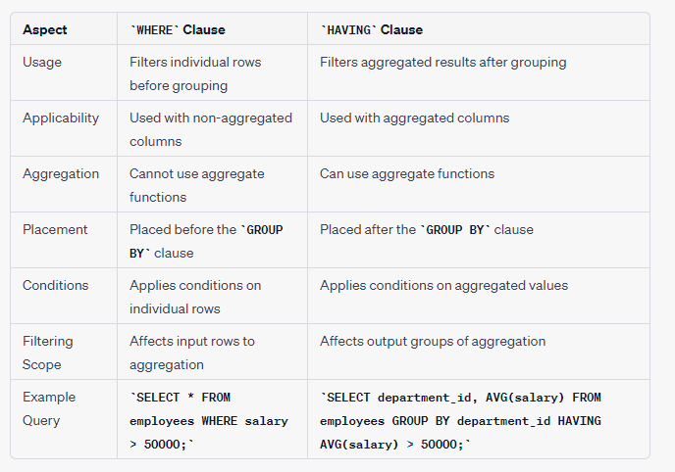
What are the difference between having and where clause?

Slide 36
Types of JOINS
SQL Join statement is used to combine data or rows from two or more tables based on a common field between them.
Different types of Joins are as follows:
INNER JOIN
LEFT JOIN
RIGHT JOIN
FULL JOIN
NATURAL JOIN

Slide 37
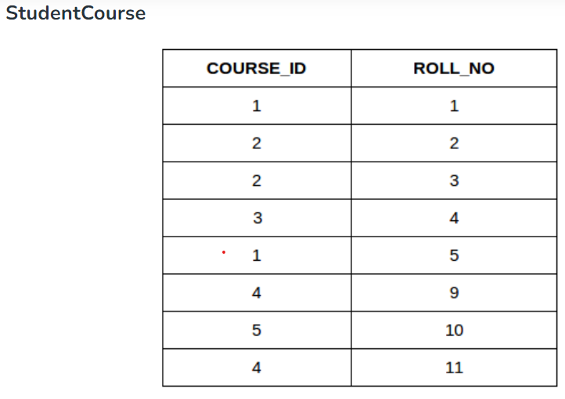
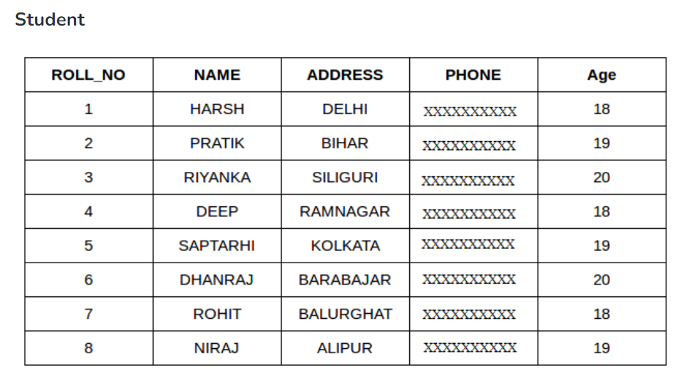

Slide 38
INNER JOIN
SELECT table1.column1,table1.column2,table2.column1,....
FROM table1
INNER JOIN table2
ON table1.matching_column = table2.matching_column;
table1: First table.
table2: Second table
matching_column: Column common to both the tables.

Slide 39
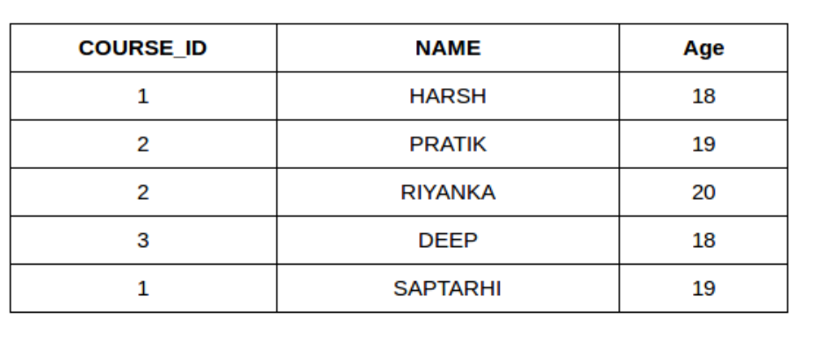
Example:
SELECT StudentCourse.COURSE_ID, Student.NAME, Student.AGE FROM Student
INNER JOIN StudentCourse
ON Student.ROLL_NO = StudentCourse.ROLL_NO;

Slide 40
LEFT JOIN
This join returns all the rows of the table on the left side of the join and matches rows for the table on the right side of the join.
For the rows for which there is no matching row on the right side, the result-set will contain null.
LEFT JOIN is also known as LEFT OUTER JOIN.
Syntax
SELECT table1.column1,table1.column2,table2.column1,....
FROM table1
LEFT JOIN table2
ON table1.matching_column = table2.matching_column;
table1: First table.
table2: Second table
matching_column: Column common to both the tables.
Note: We can also use LEFT OUTER JOIN instead of LEFT JOIN, both are the same.

Slide 41
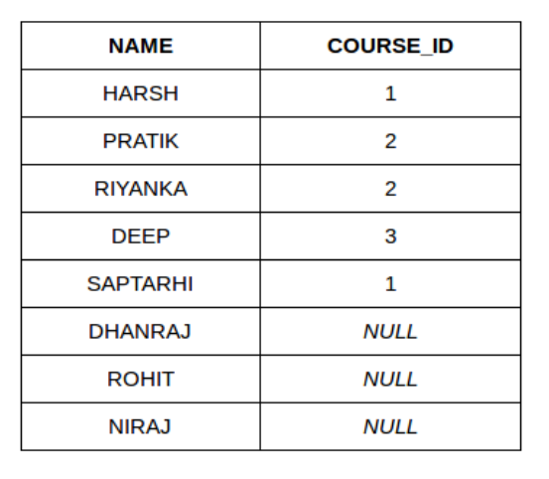
Example Queries(LEFT JOIN):
SELECT Student.NAME,StudentCourse.COURSE_ID
FROM Student
LEFT JOIN StudentCourse
ON StudentCourse.ROLL_NO = Student.ROLL_NO;

Slide 42
RIGHT JOIN
RIGHT JOIN is similar to LEFT JOIN. This join returns all the rows of the table on the right side of the join and matching rows for the table on the left side of the join.
For the rows for which there is no matching row on the left side, the result-set will contain null.
RIGHT JOIN is also known as RIGHT OUTER JOIN.

Slide 43
Syntax:
SELECT table1.column1,table1.column2,table2.column1,....
FROM table1
RIGHT JOIN table2
ON table1.matching_column = table2.matching_column;
table1: First table.
table2: Second table
matching_column: Column common to both the tables.
Note: We can also use RIGHT OUTER JOIN instead of RIGHT JOIN, both are the same.

Slide 44
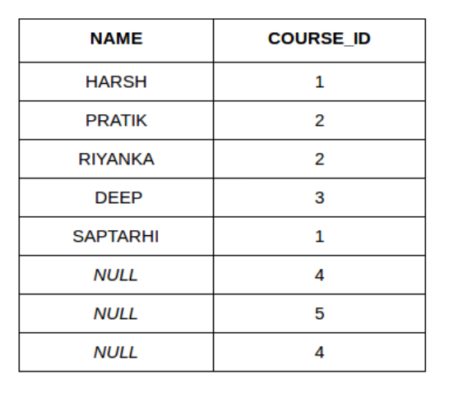
Example Queries(RIGHT JOIN):
SELECT Student.NAME,StudentCourse.COURSE_ID
FROM Student
RIGHT JOIN StudentCourse
ON StudentCourse.ROLL_NO = Student.ROLL_NO;

Slide 45
FULL JOIN
FULL JOIN creates the result-set by combining results of both LEFT JOIN and RIGHT JOIN.
The result-set will contain all the rows from both tables.
For the rows for which there is no matching, the result-set will contain NULL values.
syntax:
SELECT table1.column1,table1.column2,table2.column1,....
FROM table1
FULL JOIN table2
ON table1.matching_column = table2.matching_column;
table1: First table.
table2: Second table
matching_column: Column common to both the tables.

Slide 46
Example Queries(FULL JOIN):
SELECT Student.NAME,StudentCourse.COURSE_ID
FROM Student
FULL JOIN StudentCourse
ON StudentCourse.ROLL_NO = Student.ROLL_NO;

Slide 47
Creating Altering Database VIEW
Creating and altering views are tasks commonly performed in database management systems (DBMS) to provide a simplified or customized way of querying data from one or more tables.
A view is a virtual table that contains the result of a SELECT query and is stored in the database.
Views can be used to encapsulate complex queries, restrict access to sensitive data, and provide a more user-friendly interface to the database.

Slide 48
Creating a View:
To create a view, you typically use the CREATE VIEW statement. Here's the basic syntax:
CREATE VIEW view_name AS
SELECT column1, column2, ...
FROM table_name
WHERE condition;

Slide 49
Example:
Suppose you have a database with a table named "employees" and you want to create a view that shows only the names and job titles of employees with a certain job title:
CREATE VIEW employee_names_titles AS
SELECT employee_name, job_title
FROM employees
WHERE job_title = 'Manager';

Slide 50
Altering a View:
We can also alter a view to modify its definition.
This might involve changing the columns, the underlying query, or other aspects of the view.
However, not all DBMS support altering views.
syntax:

Slide 51
Example:
Let's say you want to modify the "employee_names_titles" view to include a column for the department each employee belongs to:
ALTER VIEW employee_names_titles AS
SELECT employee_name, job_title, department
FROM employees
WHERE job_title = 'Manager';

Slide 52
Dropping a View:
If you no longer need a view, you can drop it using the DROP VIEW statement:
DROP VIEW view_name;
Example:
To remove the "employee_names_titles" view, you can execute:
DROP VIEW employee_names_titles;
Keep in mind that views do not store data themselves; they are simply queries that are stored as objects in the database. When you query a view, the database engine runs the underlying SELECT statement and presents the result as if it were a table.

