Slide 1
DATABASE MANAGEMENT SYSTEM
Chapter 7
Developing Stored Procedures DML Triggers Indexing

Slide 2
What is Stored Procedure?
A stored procedure is a database object in a relational database management system (RDBMS) that encapsulates a predefined set of SQL statements or procedural logic.
It is typically stored within the database and can be executed using a specific name or identifier.
Stored procedures are used to perform repetitive or complex tasks, such as querying and modifying data, and can be called from various application programs or directly from the database management system.

Slide 3
Key characteristics (Features) of stored procedures :
Precompiled Logic:
Stored procedures are precompiled and stored in the database, which can result in better performance compared to executing individual SQL statements separately.
Reusability:
Once a stored procedure is defined, it can be called from multiple applications or scripts, promoting code reuse and reducing redundancy.
Modularity:
Stored procedures allow you to break down complex tasks into smaller, manageable steps, enhancing code organization and maintainability.

Slide 4
Security and Access Control:
Permissions can be granted to execute specific stored procedures, offering a controlled way to access and manipulate data.
Transaction Control:
You can include transaction control statements within stored procedures to ensure data integrity and consistency.
Performance Optimization:
By centralizing data access and manipulation logic, stored procedures can help optimize database operations, reducing network overhead and latency.

Slide 5
Parameterization:
Stored procedures often accept input parameters, enabling you to customize their behavior for different situations.
Reduced Network Traffic:
Since the entire stored procedure is executed on the database server, only the results need to be transferred over the network, reducing data transfer overhead.
Different database management systems may have their own variations of stored procedures and their associated syntax. For example, Microsoft SQL Server uses T-SQL (Transact-SQL) for stored procedures, while Oracle Database uses PL/SQL (Procedural Language/Structured Query Language).
Stored procedures are a powerful tool for managing and interacting with databases, especially in scenarios where performance, security, and code organization are crucial considerations.

Slide 6
Disadvantages of Stored Procedure
Limited Portability:
Stored procedures are specific to the database system in which they are created. Moving or migrating them to a different database system can be complex and may require rewriting the procedures to match the new system's syntax and features.
Debugging and Troubleshooting:
Debugging stored procedures can be more challenging compared to debugging application code. Some database systems offer debugging tools, but the process can still be more intricate and time-consuming.
Version Control and Deployment:
Managing versions of stored procedures can be challenging, especially in environments where multiple developers are working on the same procedures. Deploying updates to stored procedures across different environments might require careful coordination.
Complexity and Maintenance:
As stored procedures grow in complexity, they can become difficult to maintain and understand. Complex logic and extensive parameter lists can make procedures harder to manage, leading to potential maintenance issues and performance bottlenecks.
Security and Access Control:
While stored procedures can provide security benefits by limiting direct access to the underlying tables, they can also introduce security challenges. Poorly designed or improperly implemented procedures can expose sensitive data or allow unauthorized access if not properly secured.

Slide 7
Learning Curve:
Learning to create, manage, and optimize stored procedures requires specific knowledge of the database system and its procedural language. Developers and administrators need to invest time in learning these skills.
Performance and Optimization:
While stored procedures can improve performance by reducing network traffic and optimizing execution plans, they can also lead to suboptimal performance if not designed and optimized carefully. Changes to the underlying data structures might require modifications to procedures for optimal performance.
Remember that the suitability of stored procedures depends on the specific use case and requirements of your application. While they offer benefits like encapsulation, performance improvements, and security, it's essential to weigh these advantages against the potential disadvantages when making architectural decisions.

Slide 8
Types of Stored Procedure
User-Defined Stored Procedures:
These are procedures created by users or database developers to perform specific tasks. They encapsulate custom business logic, data manipulation operations, and other functionalities tailored to the needs of the application. User-defined stored procedures are typically written in SQL or a procedural language supported by the database system, such as PL/SQL for Oracle or T-SQL for SQL Server. They provide a way to modularize code and promote code reusability.
System Stored Procedures:
These are predefined procedures that come bundled with the database management system. They are created by the database vendor and are used to perform various administrative and maintenance tasks on the database. System stored procedures are often used for tasks such as database backups, integrity checks, security management, and performance monitoring. They are an integral part of the database system and can't be modified by users. System stored procedures are written in the same language as user-defined stored procedures (such as SQL, PL/SQL, T-SQL, etc.).

Slide 9
Creating Stored Procedure
Syntax
CREATE PROCEDURE schema_name.procedure_name
@parameter1 data_type,
@parameter2 data_type,
-- Add more parameters as needed
AS
BEGIN
-- SQL statements
END;

Slide 10
Explanation:
schema_name: Replace this with the name of the schema where you want to create the stored procedure.
procedure_name: Replace this with the desired name for your stored procedure.
@parameter1, @parameter2: These are input parameters that the stored procedure can accept. Replace data_type with the actual data type of the parameter.
The rest of the syntax remains the same, with the AS keyword marking the beginning of the stored procedure's body, and the logic contained within the BEGIN and END block.

Slide 11
How to Execute Stored Procedure?
EXEC procedure_name;
OR
EXECUTE procedure_name;

Slide 12
Modify Stored Procedure
Syntax:
ALTER PROCEDURE schema_name.procedure_name
-- Updated procedure parameters and logic here

Slide 13
Example:
CREATE OR REPLACE PROCEDURE mydb.GetCustomerInfo
(p_customerID IN NUMBER)
IS
v_customerName VARCHAR2(50);
BEGIN
SELECT CustomerName
INTO v_customerName
FROM Customers
WHERE CustomerID = p_customerID;
DBMS_OUTPUT.PUT_LINE('Customer Name: ' || v_customerName);
END;

Slide 14
Altering Stored procedure:
ALTER PROCEDURE mydb.GetCustomerInfo
(p_customerID IN NUMBER,
p_email OUT VARCHAR2)
IS
v_customerName VARCHAR2(50);
BEGIN
SELECT CustomerName, Email
INTO v_customerName, p_email
FROM Customers
WHERE CustomerID = p_customerID;
DBMS_OUTPUT.PUT_LINE('Customer Name: ' || v_customerName);
END;

Slide 15
How to DROP sStored Procedure?
Drop Stored procedure
Syntax:
DROP PROCEDURE schema_name.procedure_name;

Slide 16
Passing Data to Stored Procedure
Syntax:
CREATE OR REPLACE PROCEDURE procedure_name
(parameter_name data_type)
AS
BEGIN
-- Procedure logic that uses the parameter
END;

Slide 17
Example:
CREATE OR REPLACE PROCEDURE GetEmployeeName
(p_employeeID IN NUMBER)
AS
v_employeeName VARCHAR2(100);
BEGIN
SELECT FirstName || ' ' || LastName
INTO v_employeeName
FROM Employees
WHERE EmployeeID = p_employeeID;
DBMS_OTPUT.PUT_LINE('Employee Name: ' || v_employeeName);
EXCEPTION
WHEN NO_DATA_FOUND THEN
DBMS_OUTPUT.PUT_LINE('Employee not found.');
WHEN OTHERS THEN
DBMS_OUTPUT.PUT_LINE('An error occurred: ' || SQLERRM);
END;

Slide 18
Trigger
A trigger is a stored procedure in a database that automatically invokes whenever a special event in the database occurs.
For example, a trigger can be invoked when a row is inserted into a specified table or when specific table columns are updated.
In simple words, a trigger is a collection of SQL statements with particular names that are stored in system memory. It belongs to a specific class of stored procedures that are automatically invoked in response to database server events. Every trigger has a table attached to it.

Slide 19
Charactristics of Trigger
Because a trigger cannot be called directly, unlike a stored procedure, it is referred to as a special procedure.
A trigger is automatically called whenever a data modification event against a table takes place, which is the main distinction between a trigger and a procedure. On the other hand, a stored procedure must be called directly.
The following are the key differences between triggers and stored procedures:
Triggers cannot be manually invoked or executed.
There is no chance that triggers will receive parameters.
A transaction cannot be committed or rolled back inside a trigger.

Slide 20
Advantages of Triggers:
Database object rules are established by triggers, which cause changes to be undone if they are not met.
The trigger will examine the data and, if necessary, make changes.
We can enforce data integrity thanks to triggers.
Data is validated using triggers before being inserted or updated.
Triggers assist us in maintaining a records log.
Due to the fact that they do not need to be compiled each time they are run, triggers improve the performance of SQL queries.
The client-side code is reduced by triggers, saving time and labor.
Trigger maintenance is simple.

Slide 21
Disadvantage of Triggers
Only triggers permit the use of extended validations.
Automatic triggers are used, and the user is unaware of when they are being executed. Consequently, it is difficult to troubleshoot issues that arise in the database layer.
The database server’s overhead may increase as a result of triggers.
In a single CREATE TRIGGER statement, we can specify the same trigger action for multiple user actions, such as INSERT and UPDATE.
Only the current database is available for creating triggers, but they can still make references to objects outside the database.

Slide 22
Syntax:
create trigger [trigger_name]
[before | after]
{insert | update | delete}
on [table_name]
[for each row]
[trigger_body]

Slide 23
Explanation of Syntax:
Create trigger [trigger_name]: Creates or replaces an existing trigger with the trigger_name.
[before | after]: This specifies when the trigger will be executed.
{insert | update | delete}: This specifies the DML operation.
On [table_name]: This specifies the name of the table associated with the trigger.
[for each row]: This specifies a row-level trigger, i.e., the trigger will be executed for each affected row.
[trigger_body]: This provides the operation to be performed as the trigger is fired

Slide 24
Example:
CREATE TRIGGER log_insert
AFTER INSERT ON orders
FOR EACH ROW
BEGIN
INSERT INTO audit_log (event_type, event_timestamp, table_name, row_id)
VALUES ('INSERT', NOW(), 'orders', NEW.order_id);
END;

Slide 25
Why Do We Employ Triggers?
When we need to carry out some actions automatically in certain desirable scenarios, triggers will be useful. For instance, we need to be aware of the frequency and timing of changes to a table that is constantly changing. In such cases, we could create a trigger to insert the required data into a different table if the primary table underwent any changes.

Slide 26
Types of Triggers
Data Defination Language(DDL) Trigger
Data Manipulation Language(DDL) Trigger
After Triggers
Instead of Triggers
Log on Trigger

Slide 27
DDL Triggers
The Data Definition Language (DDL) command events such as Create_table, Create_view, drop_table, Drop_view, and Alter_table cause the DDL triggers to be activated.
Syntax:
CREATE TRIGGER trigger_name
ON { DATABASE | ALL SERVER}
[WITH ddl_trigger_option]
FOR { event_type | event_group }
AS
{sql_statement}

Slide 28
Example
CREATE TRIGGER trgTablechanges
ON DATABASE
FOR
CREATE_TABLE, ALTER_TABLE, DROP_TABLE
AS
BEGIN
SET NOCOUNT ON;
INSERT INTO TableLog
(
EventVal, DateChanged, ChangedBy
)
VALUES (EVENTDATA(), GETDATE(), USER
);
END;

Slide 29
DML Trigger
In SQL Server we can create triggers on DML statements (like INSERT, UPDATE, and DELETE) and stored procedures that perform DML-like operations. DML Triggers are of two types
After Trigger (using FOR/AFTER CLAUSE)
This type of trigger fires after SQL Server finishes the execution of the action successfully that fired it.
Example: If you insert record/row in a table then the trigger related/associated with the insert event on this table will fire only after the row passes all the constraints, like as primary key constraint, and some rules. If the record/row insertion fails, SQL Server will not fire the After Trigger.
Instead of Trigger (using INSTEAD OF CLAUSE)
This type of trigger fires before SQL Server starts the execution of the action that fired it. This differs from the AFTER trigger, which fires after the action that caused it to fire. We can have an INSTEAD OF insert/update/delete trigger on a table that successfully executed but does not include the actual insert/update/delete to the table.
Example: If you insert record/row in a table then the trigger related/associated with the insert event on this table will fire before the row passes all the constraints, such as primary key constraint and some rules. If the record/row insertion fails, SQL Server will fire the Instead of Trigger.

Slide 30
After Trigger (using FOR/AFTER CLAUSE)
Syntax:
CREATE TRIGGER trigger_name
AFTER {INSERT | UPDATE | DELETE}
ON table_name
[REFERENCING OLD AS old_row NEW AS new_row]
[FOR EACH ROW]
BEGIN
-- Trigger logic here
END;

Slide 31
Example:
CREATE TRIGGER update_salary_history
AFTER UPDATE OF salary ON employees
REFERENCING OLD AS old_row NEW AS new_row
FOR EACH ROW
BEGIN
INSERT INTO salary_history (employee_id, old_salary, new_salary, change_date)
VALUES (new_row.employee_id, old_row.salary, new_row.salary, CURRENT_TIMESTAMP);
END;

Slide 32
Instead of Trigger (using INSTEAD OF CLAUSE)
Syntax:
CREATE TRIGGER trigger_name
INSTEAD OF {INSERT | UPDATE | DELETE}
ON view_name
[FOR EACH ROW]
BEGIN
-- Trigger logic here
END;

Slide 33
Example:
CREATE TRIGGER instead_of_update_employee_info
INSTEAD OF UPDATE
ON employee_info_view
FOR EACH ROW
BEGIN
UPDATE employees
SET salary = new.salary
WHERE employee_id = new.employee_id;
UPDATE departments
SET budget = budget + (new.salary - old.salary)
WHERE department_id = new.department_id;
END;

Slide 34
LOGON Trigger
In SQL Server, the Logon trigger is fired automatically on a LOGON event. They are DDL triggers and are created at the server level. We can define more than one LOGON trigger on a server.
A LOGON trigger can be used in controlling server sessions by tracking login activity, restricting logins to the SQL Server, or limiting the number of sessions for a particular login.
The following LOGON trigger restricts the login attempt to SQL Server by sa login if there are already two user sessions created by that login.

Slide 35
Example:
CREATE TRIGGER trgLoginConnection
ON ALL SERVER WITH EXECUTE AS N'sa'
FOR LOGON
AS
BEGIN
IF ORIGINAL_LOGIN() = N'sa' AND
(SELECT COUNT(*) FROM sys.dm_exec_sessions
WHERE is_user_process = 1 AND
original_login_name = N'sa') > 2
ROLLBACK;
END;

Slide 36
How to Delete Triggers?
Syntax:
DROP TRIGGER [schema_name.]trigger_name;
Example:
DROP TRIGGER public.audit_trigger;
OR
DROP TRIGGER audit_trigger;

Slide 37
How to enable/disable Trigger?
Enabling and disabling triggers in a database management system involves controlling whether a trigger will execute or not in response to its associated events. This is useful when we want to temporarily suspend the actions performed by triggers without deleting them.
Example:
Disable Trigger:
ALTER TRIGGER trigger_name DISABLE;
Enable Trigger:
ALTER TRIGGER trigger_name ENABLE;

Slide 38
What is Indexing?
Indexing refers to a data structure technique that is used for quickly retrieving entries from database files using some attributes that have been indexed.
In database systems, indexing is comparable to indexing in books. The indexing attributes are used to define the indexing.

Slide 39
Advantages of Indexing
Improved Query Performance: Indexing enables faster data retrieval from the database. The database may rapidly discover rows that match a specific value or collection of values by generating an index on a column, minimizing the amount of time it takes to perform a query.
Efficient Data Access: Indexing can enhance data access efficiency by lowering the amount of disk I/O required to retrieve data. The database can maintain the data pages for frequently visited columns in memory by generating an index on those columns, decreasing the requirement to read from disk.
Optimized Data Sorting: Indexing can also improve the performance of sorting operations. By creating an index on the columns used for sorting, the database can avoid sorting the entire table and instead sort only the relevant rows.
Consistent Data Performance: Indexing can assist ensure that the database performs consistently even as the amount of data in the database rises. Without indexing, queries may take longer to run as the number of rows in the table grows, while indexing maintains a roughly consistent speed.
By ensuring that only unique values are inserted into columns that have been indexed as unique, indexing can also be utilized to ensure the integrity of data. This avoids storing duplicate data in the database, which might lead to issues when performing queries or reports.

Slide 40
Disadvantages of Indexing
Indexing necessitates more storage space to hold the index data structure, which might increase the total size of the database.
Increased database maintenance overhead: Indexes must be maintained as data is added, destroyed, or modified in the table, which might raise database maintenance overhead.
Indexing can reduce insert and update performance since the index data structure must be updated each time data is modified.
Choosing an index can be difficult: It can be challenging to choose the right indexes for a specific query or application and may call for a detailed examination of the data and access patterns.

Slide 41
Features of Indexing
The development of data structures, such as B-trees or hash tables, that provide quick access to certain data items is known as indexing. The data structures themselves are built on the values of the indexed columns, which are utilized to quickly find the data objects.
The most important columns for indexing columns are selected based on how frequently they are used and the sorts of queries they are subjected to. The cardinality, selectivity, and uniqueness of the indexing columns can be taken into account.
There are several different index types used by databases, including primary, secondary, clustered, and non-clustered indexes. Based on the particular needs of the database system, each form of index offers benefits and drawbacks.
For the database system to function at its best, periodic index maintenance is required. According to changes in the data and usage patterns, maintenance work involves building, updating, and removing indexes.
Database query optimization involves indexing, which is essential. The query optimizer utilizes the indexes to choose the best execution strategy for a particular query based on the cost of accessing the data and the selectivity of the indexing columns.
Databases make use of a range of indexing strategies, including covering indexes, index-only scans, and partial indexes. These techniques maximize the utilization of indexes for particular types of queries and data access.
When non-contiguous data blocks are stored in an index, it can result in index fragmentation, which makes the index less effective. Regular index maintenance, such as defragmentation and reorganization, can decrease fragmentation.

Slide 42
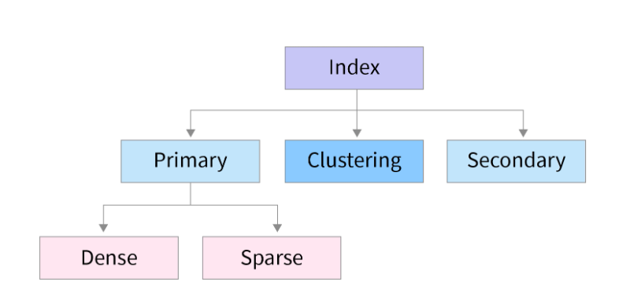
Types of Indexing

Slide 43
Primary Index:
If the index is created on the basis of the primary key of the table, then it is known as primary indexing.
These primary keys are unique to each record and contain 1:1 relation between the records.
As primary keys are stored in sorted order, the performance of the searching operation is quite efficient.
The primary index can be classified into two types:
Dense index
Sparse index

Slide 44
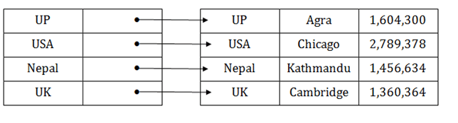
Dense index
The dense index contains an index record for every search key value in the data file. It makes searching faster.
In this, the number of records in the index table is same as the number of records in the main table.
It needs more space to store index record itself. The index records have the search key and a pointer to the actual record on the disk.

Slide 45
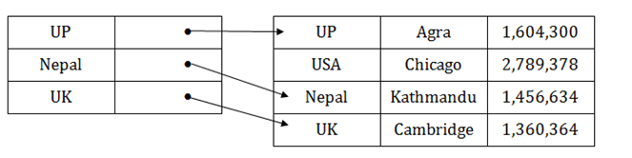
In the data file, index record appears only for a few items. Each item points to a block.
In this, instead of pointing to each record in the main table, the index points to the records in the main table in a gap.

Slide 46
Clustering Index
A clustered index can be defined as an ordered data file. Sometimes the index is created on non-primary key columns which may not be unique for each record.
In this case, to identify the record faster, we will group two or more columns to get the unique value and create index out of them. This method is called a clustering index.
The records which have similar characteristics are grouped, and indexes are created for these group.

Slide 47
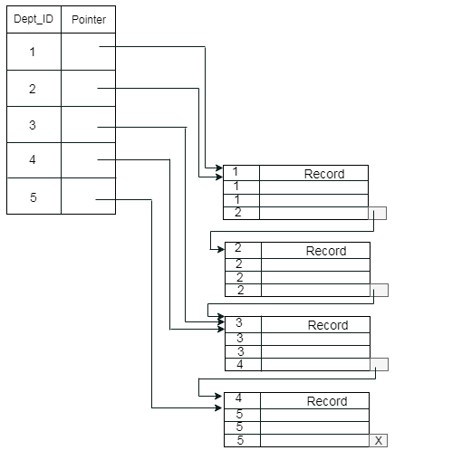
Example:
suppose a company contains several employees in each department. Suppose we use a clustering index, where all employees which belong to the same Dept_ID are considered within a single cluster, and index pointers point to the cluster as a whole. Here Dept_Id is a non-unique key.

Slide 48
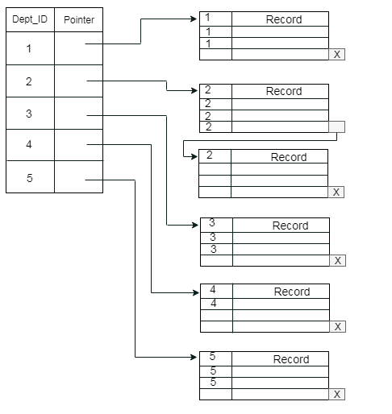
The previous schema is little confusing because one disk block is shared by records which belong to the different cluster. If we use separate disk block for separate clusters, then it is called better technique.

Slide 49
Secondary Index
In the sparse indexing, as the size of the table grows, the size of mapping also grows. These mappings are usually kept in the primary memory so that address fetch should be faster.
Then the secondary memory searches the actual data based on the address got from mapping. If the mapping size grows then fetching the address itself becomes slower. In this case, the sparse index will not be efficient.
To overcome this problem, secondary indexing is introduced.
In secondary indexing, to reduce the size of mapping, another level of indexing is introduced.
In this method, the huge range for the columns is selected initially so that the mapping size of the first level becomes small. Then each range is further divided into smaller ranges.
The mapping of the first level is stored in the primary memory, so that address fetch is faster. The mapping of the second level and actual data are stored in the secondary memory (hard disk).

Slide 50
Example:
If you want to find the record of roll 111 in the diagram, then it will search the highest entry which is smaller than or equal to 111 in the first level index. It will get 100 at this level.
Then in the second index level, again it does max (111) <= 111 and gets 110. Now using the address 110, it goes to the data block and starts searching each record till it gets 111.
This is how a search is performed in this method. Inserting, updating or deleting is also done in the same manner.

Slide 51
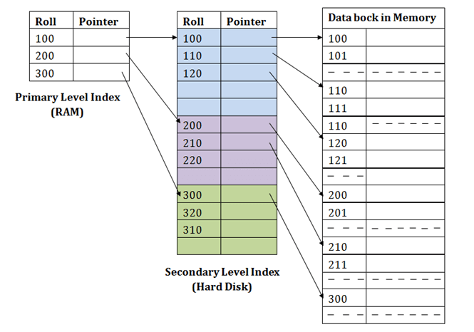

Slide 52
Example of Indexing
CREATE TABLE Students (
student_id INT PRIMARY KEY,
first_name VARCHAR(50),
last_name VARCHAR(50),
age INT
);
creating indexing:
CREATE INDEX idx_last_name ON Students (last_name);

Slide 53
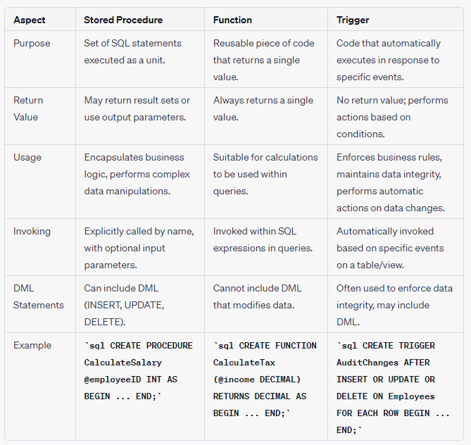
Difference between Stored procedure and function and trigger

Slide 54
END

