Slide 2
What is Query Processing?
Query Processing includes translations on high level Queries into low level expressions that can be used at physical level of file system, query optimization and actual execution of query to get the actual result.
The basic steps are:
Parsing and translation.
Optimization.
Evaluation.

Slide 3
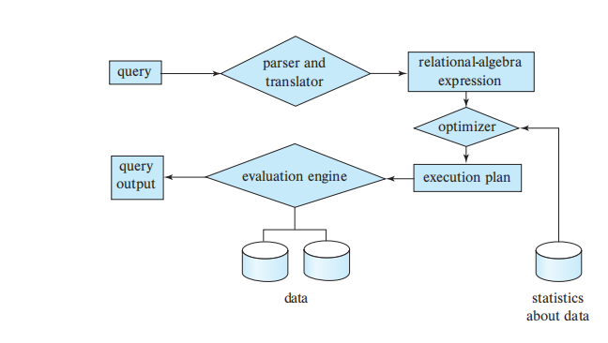
Steps in query processing

Slide 4
Parsing and translation
The first step involves understanding what you're asking for. The DBMS takes your query, written in a high-level language like SQL (Structured Query Language), and breaks it down into its basic components.
It performs checks to ensure the query is written correctly (syntax) and uses valid commands (semantics).
Then, it translates the query into a more machine-readable format, often using relational algebra, that the database system can understand.

Slide 5
Optimization:
Once the DBMS understands the query, it explores different ways to retrieve the data. It considers factors like data organization, available indexes, and processing costs.
The goal is to find the most efficient execution plan, the one that retrieves the data you need as quickly as possible.

Slide 6
Evaluation:
With a plan in place, the DBMS gets down to business. It executes the chosen plan, step by step, to retrieve the data from the database.
This might involve accessing specific tables, applying filters, and performing calculations based on your query.

