Slide 1
DATABASE MANAGEMENT
Chapter 9:
Transaction Management
9.1 ACID Properties

Slide 2
Introduction
A transaction is a single logical unit of work that accesses and possibly modifies the contents of a database.
Transactions access data using read and write operations. In order to maintain consistency in a database, before and after the transaction, certain properties are followed. These are called ACID properties.

Slide 3
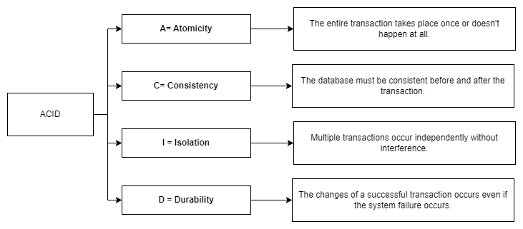
ACID Properties

Slide 4
Atomicity
Atomicity means that an entire transaction either takes place all at once or it doesn’t occur at all. It means that there’s no midway. The transactions can never occur partially.
Every transaction can be considered as a single unit, and they either run to completion or do not get executed at all. We have the following two operations here:
Commit: In case a transaction commits, the changes made are visible to us. Thus, atomicity is also called the ‘All or nothing rule’.
Abort: In case a transaction aborts, the changes made to the database are not visible to us.
Consider this transaction T that consists of T1 and T2: Transfering 100 from account A to account B.

Slide 5
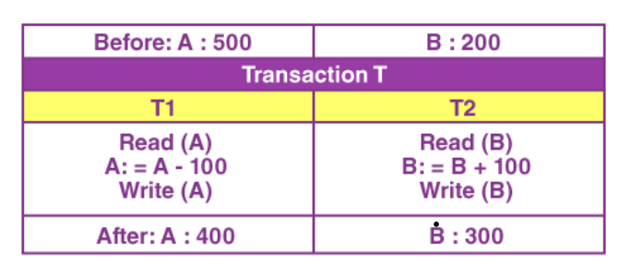

Slide 6
In case the transaction fails when the T1 is completed but the T2 is not completed (say, after write(A) but before write(B)), then the amount has been deducted from A but not added to B.
This would result in a database state that is inconsistent. Thus, the transaction has to be executed in its entirety in order to ensure the correctness of the database state.

Slide 7
Consistency
Consistency means that we have to maintain the integrity constraints so that any given database stays consistent both before and after a transaction. If we refer to the example discussed above, then we have to maintain the total amount, both before and after the transaction.
Total after T occurs = 400 + 300 = 700.
Total before T occurs = 500 + 200 = 700.
Thus, the given database is consistent. Here, an inconsistency would occur when T1 completes, but then the T2 fails. As a result, the T would remain incomplete.

Slide 8
Isolation
Isolation ensures the occurrence of multiple transactions concurrently without a database state leading to a state of inconsistency.
A transaction occurs independently, i.e. without any interference. Any changes that occur in any particular transaction would NOT be ever visible to the other transactions unless and until this particular change in this transaction has been committed or written to the memory.
The property of isolation ensures that when we execute the transactions concurrently, it will result in such a state that’s equivalent to the achieved state that was serially executed in a particular order.
Let A = 500, B = 500
Let us consider two transactions here- T and T”

Slide 9
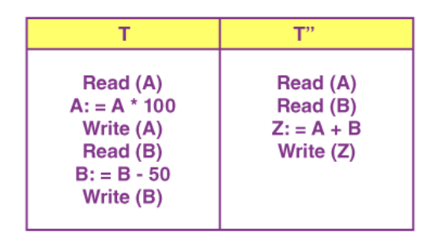

Slide 10
Suppose that T has been executed here till Read(B) and then T’’ starts. As a result, the interleaving of operations would take place. And due to this, T’’ reads the correct value of A but incorrect value of B.
T’’: (X+B = 50, 000+500=50, 500)
Thus, the sum computed here is not consistent with the sum that is obtained at the end of the transaction:
T: (A+B = 50, 000 + 450 = 50, 450).
It results in the inconsistency of a database due to the loss of a total of 50 units. The transactions must, thus, take place in isolation. Also, the changes must only be visible after we have made them on the main memory.

Slide 11
durability
The durability property states that once the execution of a transaction is completed, the modifications and updates on the database gets written on and stored in the disk.
These persist even after the occurrence of a system failure. Such updates become permanent and get stored in non-volatile memory. Thus, the effects of this transaction are never lost.

Slide 12
Advantages of ACID Properties in DBMS:
Data Consistency: ACID properties ensure that the data remains consistent and accurate after any transaction execution.
Data Integrity: ACID properties maintain the integrity of the data by ensuring that any changes to the database are permanent and cannot be lost.
Concurrency Control: ACID properties help to manage multiple transactions occurring concurrently by preventing interference between them.
Recovery: ACID properties ensure that in case of any failure or crash, the system can recover the data up to the point of failure or crash.

Slide 13
Disadvantages of ACID Properties in DBMS:
Performance: The ACID properties can cause a performance overhead in the system, as they require additional processing to ensure data consistency and integrity.
Scalability: The ACID properties may cause scalability issues in large distributed systems where multiple transactions occur concurrently.
Complexity: Implementing the ACID properties can increase the complexity of the system and require significant expertise and resources. Overall, the advantages of ACID properties in DBMS outweigh the disadvantages. They provide a reliable and consistent approach to data
management, ensuring data integrity, accuracy, and reliability. However, in some cases, the overhead of implementing ACID properties can cause performance and scalability issues. Therefore, it’s important to balance the benefits of ACID properties against the specific needs and requirements of the system.

