Slide 1
DATABASE MANAGEMENT
Chapter 9:
Transaction Management
9.2 Transaction States

Slide 2
Introduction
States through which a transaction goes during its lifetime.
These are the states which tell about the current state of the Transaction and also tell how we will further do the processing in the transactions.
These states govern the rules which decide the fate of the transaction whether it will commit or abort.
They also use Transaction log. Transaction log is a file maintain by recovery management component to record all the activities of the transaction. After commit is done transaction log file is removed.

Slide 3
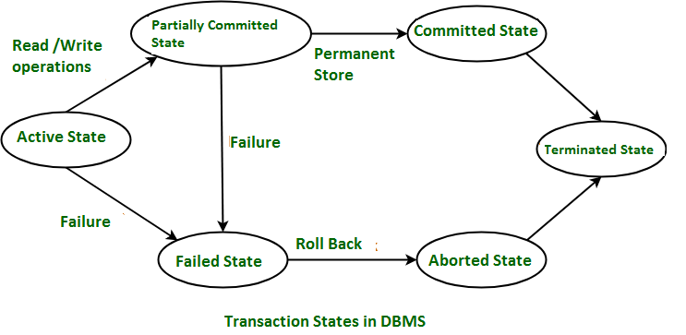
Transaction States Diagram

Slide 4
Transaction States
Active State
Partially Committed
Failed State
Aborted State
Committed State
Terminated State

Slide 5
Transaction States
Active State
When the instructions of the transaction are running then the transaction is in active state.
If all the ‘read and write’ operations are performed without any error then it goes to the “partially committed state”; if any instruction fails, it goes to the “failed state”.
Partially Committed
After completion of all the read and write operation the changes are made in main memory or local buffer.
If the changes are made permanent on the DataBase then the state will change to “committed state” and in case of failure it will go to the “failed state”.

Slide 6
types of Transaction States
Failed State When any instruction of the transaction fails, it goes to the “failed state” or if failure occurs in making a permanent change of data on Data Base.
Aborted State After having any type of failure the transaction goes from “failed state” to “aborted state” and since in previous states, the changes are only made to local buffer or main memory and hence these changes are deleted or rolled-back.

Slide 7
types of Transaction States
Committed State It is the state when the changes are made permanent on the Data Base and the transaction is complete and therefore terminated in the “terminated state”.
Terminated State If there isn’t any roll-back or the transaction comes from the “committed state”, then the system is consistent and ready for new transaction and the old transaction is terminated.

