Slide 1
DATABASE MANAGEMENT
Chapter 9:
Transaction Management
9.2.2 Serializability

Slide 2
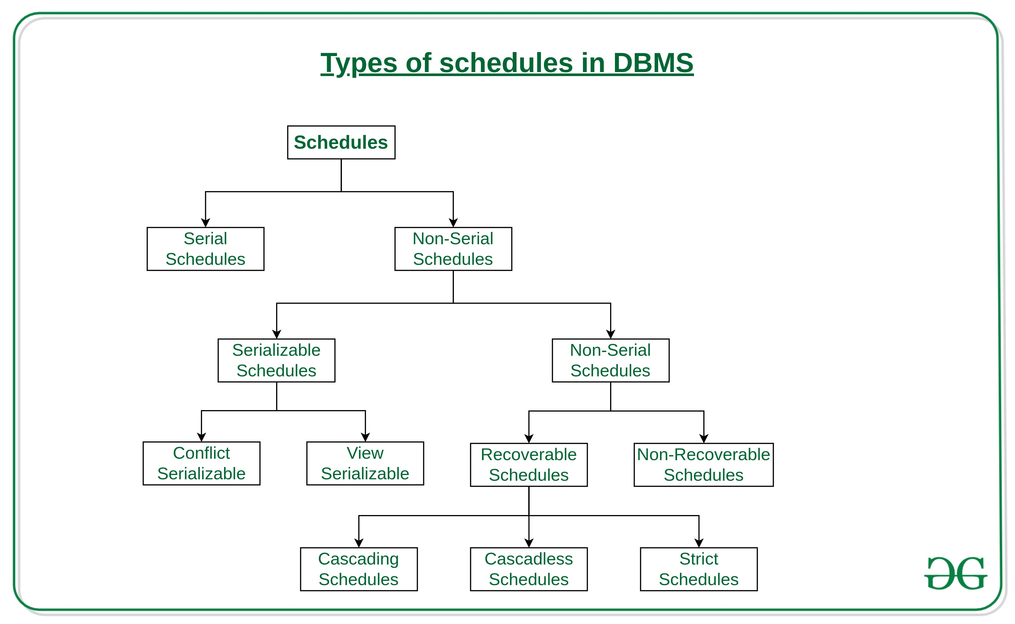
Types of Schedules in DBMS

Slide 3
Serializability
Serializability is a property of a schedule of transactions in a database system that ensures that the results of the schedule are the same as if the transactions were executed one at a time, in some sequential order.
In other words, serializability ensures that concurrent transactions do not interfere with each other in a way that produces an invalid outcome.

Slide 4
Types of serializability
Conflict serializability
View serializability

Slide 5
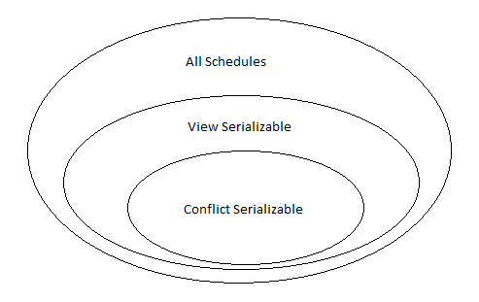
Serializability

Slide 6
Conflict serializability
Conflict Serializability in DBMS is simply when a schedule is converted into a serial schedule by swapping non-conflicting operations is called Conflict Serializability.
Conflict serializability ensures that transactions are executed in a way that avoids conflicting operations on the same data item.
For example, if two transactions both try to update the same data item, conflict serializability ensures that one of the transactions will be blocked from executing until the other transaction has finished.

Slide 7
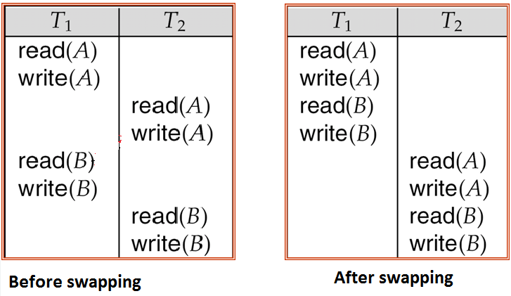

Slide 8
Precedence Graph For Testing Conflict Serializability
A Precedence Graph or Serialization Graph is used commonly to test the Conflict Serializability of a schedule.
It is a directed Graph (V, E) consisting of a set of nodes V = {T1, T2, T3……….Tn} and a set of directed edges E = {e1, e2, e3………………em}.
The graph contains one node for each Transaction Ti.
An edge ei is of the form Tj –> Tk where Tj is the starting node of ei and Tk is the ending node of ei.
An edge ei is constructed between nodes Tj to Tk if one of the operations in Tj appears in the schedule before some conflicting operation in Tk.

Slide 9
The Algorithm can be written as:
Create a node T in the graph for each participating transaction in the schedule.
For the conflicting operation read_item(X) and write_item(X) – If a Transaction Tj executes a read_item (X) after Ti executes a write_item (X), draw an edge from Ti to Tj in the graph.
For the conflicting operation write_item(X) and read_item(X) – If a Transaction Tj executes a write_item (X) after Ti executes a read_item (X), draw an edge from Ti to Tj in the graph.
For the conflicting operation write_item(X) and write_item(X) – If a Transaction Tj executes a write_item (X) after Ti executes a write_item (X), draw an edge from Ti to Tj in the graph.
Schedule S is serializable if there is no cycle in the precedence graph.

Slide 10
Example:
Consider the schedule S: r1(x) r1(y) w2(x) w1(x) r2(y)
Convert to table form:
T1 | T2
R(X)
R(Y)
 | W(X)
W(X)
 | R(Y)

Slide 11
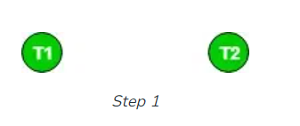
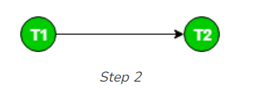
Creating Precedence Graph
Step 1: Make two nodes corresponding to Transaction T1 and T2.
Step 2: For the conflicting pair r1(x) w2(x), where r1(x) happens before w2(x), draw an edge from T1 to T2.

Slide 12
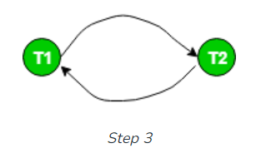
Step 3: For the conflicting pair w2(x) w1(x), where w2(x) happens before w1(x), draw an edge from T2 to T1.
Since the graph is cyclic, we can conclude that it is not conflict serializable to any schedule serial schedule.

Slide 13
Example2
Consider another schedule S1: r1(x) r3(y) w1(x) w2(y) r3(x) w2(x)
T1 | T2 | T3
R(X)
 |  | R(Y)
W(X)
 | W(Y)
 |  | R(X)
 | W(X)

Slide 14
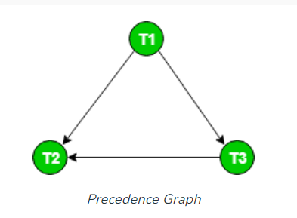
Precedence Graph
The graph for this schedule is:
Since the graph is acyclic, the schedule is conflict serializable.

Slide 15
View serializability
View serializability is a type of serializability that ensures that the results of executing a set of transactions concurrently are the same as if the transactions were executed serially, under a given view. A view is a set of data items that are relevant to a particular user or application.
For example, if two users are both viewing the same data item, view serializability ensures that they will not see different versions of the data item if they both execute transactions that modify the data item.

Slide 16
View Equivalent : Two view equivalent schedules S1 and S2 should satisfy the following conditions:
Initial Read
The initial read of both the schedules must be in the same transaction.
Suppose two schedule S1 and S2. In schedule S1, if a transaction T1 is reading the data item A, then in S2, transaction T1 should also read A.
The two schedules S1 and S2 are view equivalent because Initial read operation in S1 is done by T1 and in S2 also it is done by T1.
Updated Read
Suppose in schedule S1, if transaction Tm is reading A which is updated by transaction Tn then in S2 also, Tm should read A which is updated by Tn.
The two schedules are not view equal because, in S1,transaction T3 is reading A updated by transaction T2 and in S2, transaction T3 is reading A which is updated by transaction T1.
Final Write
A final write must be the same in both the schedules.
Suppose in schedule S1, if a transaction T1 updates A in the last, then in S2 final write operation should also be done by transaction T1.
The two schedules is view equal because Final write operation in S1 is done by T3 and in S2 also the final write operation is done by T3.

Slide 17
