Slide 1
DATABASE MANAGEMENT
Chapter 9:
Transaction Management
9.2.3 Basic Concept of Concurrency Control and Recovery

Slide 2
Concurrency Control
Concurrency control in database management systems (DBMS) is a technique used to manage simultaneous access to shared data by multiple transactions or processes.
It ensures that the transactions can execute concurrently while preserving data consistency and integrity.
The primary goal of concurrency control is to prevent undesirable phenomena such as lost updates, inconsistent reads, and conflicts that may arise when multiple transactions access and modify the same data simultaneously.

Slide 3
Advantages
The advantages of concurrency control are as follows −
Waiting time will be decreased.
Response time will decrease.
Resource utilization will increase.
System performance & Efficiency is increased.

Slide 4
Control concurrency
The simultaneous execution of transactions over shared databases can create several data integrity and consistency problems.
For example, if too many people are logging in the ATM machines, serial updates and synchronization in the bank servers should happen whenever the transaction is done, if not it gives wrong information and wrong data in the database.

Slide 5
Main problems in using Concurrency
The problems which arise while using concurrency are as follows −
Updates will be lost −
One transaction does some changes and another transaction deletes that change. One transaction nullifies the updates of another transaction.
Uncommitted Dependency or dirty read problem −
On variable has updated in one transaction, at the same time another transaction has started and deleted the value of the variable there the variable is not getting updated or committed that has been done on the first transaction this gives us false values or the previous values of the variables this is a major problem.
Inconsistent retrievals −
One transaction is updating multiple different variables, another transaction is in a process to update those variables, and the problem occurs is inconsistency of the same variable in different instances.

Slide 6
Concurrency control techniques
Locking
Lock guaranties exclusive use of data items to a current transaction. It first accesses the data items by acquiring a lock, after completion of the transaction it releases the lock.
Types of Locks
Shared Lock [Transaction can read only the data item values]
Shared lock is also known as read lock which allows multiple transactions to read the data simultaneously. The transaction which is holding a shared lock can only read the data item but it can not modify the data item.
Exclusive Lock [Used for both read and write data item values]
Exclusive lock is also known as the write lock. Exclusive lock allows a transaction to update a data item. Only one transaction can hold the exclusive lock on a data item at a time. While a transaction is holding an exclusive lock on a data item, no other transaction is allowed to acquire a shared/exclusive lock on the same data item.

Slide 7
Concurrency control techniques
Time Stamping
Time stamp is a unique identifier created by DBMS that indicates relative starting time of a transaction. Whatever transaction we are doing it stores the starting time of the transaction and denotes a specific time.
This can be generated using a system clock or logical counter. This can be started whenever a transaction is started. Here, the logical counter is incremented after a new timestamp has been assigned.
Optimistic
It is based on the assumption that conflict is rare and it is more efficient to allow transactions to proceed without imposing delays to ensure serializability.

Slide 8
Database Recovery
Recovery is basically making the database or rebuilding the database after the problem of failures.
The most basic objective of database recovery is to maintain the integrity of the database.
Backup and Recovery is basically a way to restore critical data in case of a loss.

Slide 9
Why Recovery is Required in Database?
System failures:
The DBMS can experience various types of failures, such as hardware failures, software bugs, or power outages, which can lead to data corruption or loss. Recovery mechanisms can help restore the database to a consistent state after such failures.
Transaction failures:
Transactions can fail due to various reasons, such as network failures, deadlock, or errors in application logic. Recovery mechanisms can help roll back or undo the effects of such failed transactions to ensure data consistency.
Human errors:
Human errors such as accidental deletion, updating or overwriting data, or incorrect data entry can cause data inconsistencies. Recovery mechanisms can help recover the lost or corrupted data and restore it to the correct state.
Security breaches:
Security breaches such as hacking or unauthorized access can compromise the integrity of data. Recovery mechanisms can help restore the database to a consistent state and prevent further data breaches.

Slide 10
Why Recovery is Required in Database?
Hardware upgrades:
When a DBMS is upgraded to a new hardware system, the migration process can potentially lead to data loss or corruption. Recovery mechanisms can help ensure that the data is successfully migrated and the integrity of the database is maintained.
Natural disasters:
Natural disasters such as earthquakes, floods, or fires can damage the hardware on which the database is stored, leading to data loss. Recovery mechanisms can help restore the data from backups and minimize the impact of the disaster.
Compliance regulations:
Many industries have regulations that require businesses to retain data for a certain period of time. Recovery mechanisms can help ensure that the data is available for compliance purposes even if it was deleted or lost accidentally.
Data corruption:
Data corruption can occur due to various reasons such as hardware failure, software bugs, or viruses. Recovery mechanisms can help restore the database to a consistent state and recover any lost or corrupted data.
Recovery is needed in DBMS to ensure data consistency, integrity, and availability in the face of various types of failures and errors.

Slide 11
Database recovery Classification
Database recovery can be classified into two parts;
Rolling Forward :
applies redo records to the corresponding data blocks.
Rolling Back :
applies rollback segments to the datafiles. It is stored in transaction tables.

Slide 12
Log-Based Recovery
Logs are the sequence of records, that maintain the records of actions performed by a transaction.
In Log – Based Recovery, log of each transaction is maintained in some stable storage. If any failure occurs, it can be recovered from there to recover the database.
The log contains the information about the transaction being executed, values that have been modified and transaction state.
All these information will be stored in the order of execution.

Slide 13
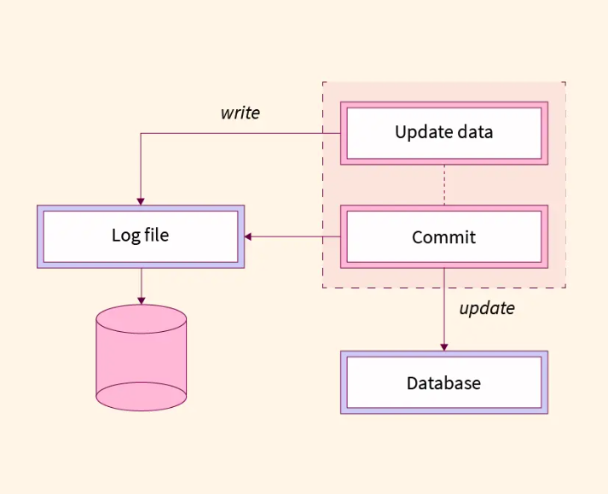
Log-Based Recovery

Slide 14
Example:
Assume, a transaction to modify the address of an employee. The following logs are written for this transaction, Log 1: Transaction is initiated, writes 'START' log. Log: <T_{n} START> Log 2: Transaction modifies the address from 'Pune' to 'Mumbai'. Log: <T_{n} Address, 'Pune', 'Mumbai'> Log 3: Transaction is completed. The log indicates the end of the transaction. Log: <T_{n} COMMIT>

Slide 15
Log File creation Methods
There are two methods of creating the log files and updating the database, 1. In Deferred Database Modification, all the logs for the transaction are created and stored into stable storage system. In the above example, three log records are created and stored it in some storage system, the database will be updated with those steps. 2. In Immediate Database Modification, after creating each log record, the database is modified for each step of log entry immediately. In the above example, the database is modified at each step of log entry that means after first log entry, transaction will hit the database to fetch the record, then the second log will be entered followed by updating the employee's address, then the third log followed by committing the database changes.

Slide 16
Recovery with Concurrent Transaction
When two transactions are executed in parallel, the logs are interleaved. It would become difficult for the recovery system to return all logs to a previous point and then start recovering.
To overcome this situation 'Checkpoint' is used.

Slide 17
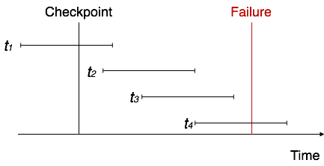
Diagram

Slide 18
Checkpoint
Checkpoint acts like a benchmark.
Checkpoints are also called as Syncpoints or Savepoints.
It is a mechanism where all the previous logs are removed from the system and stored permanently in a storage system.
It declares a point before which the database management system was in consistent state and all the transactions were committed.
It is a point of synchronization between the database and the transaction log file.
It involves operations like writing log records in main memory to secondary storage, writing the modified blocks in the database buffers to secondary storage and writing a checkpoint record to the log file.
The checkpoint record contains the identifiers of all transactions that are active at the time of the checkpoint.

Slide 19
Recovery
When concurrent transactions crash and recover, the checkpoint is added to the transaction and recovery system recovers the database from failure in following manner,
Recovery system reads the log files from end to start checkpoint. It can reverse the transaction.
It maintains undo log and redo log.
It puts the transaction in the redo log if the recovery system sees a log <T_{n}, Commit>.
It puts the transaction in undo log if the recovery system sees a log with <T_{n}, Start>.
All the transactions in the undo log are undone and their logs are removed.
All the transactions in the redo log and their previous logs are removed and then redone before saving their logs.

