Slide 1
Chapter-10
Software Project Management
Prepared by
Asst. Prof. Bal Krishna Subedi

Slide 2
Topics Covered
Software Project Management;
Project Management Activities
Project Planning (Software Pricing, Plan-Driven Development, Project Scheduling, Estimation Techniques, COCOMO Cost Modelling);
Introduction to Quality Management and Configuration Management

Slide 3
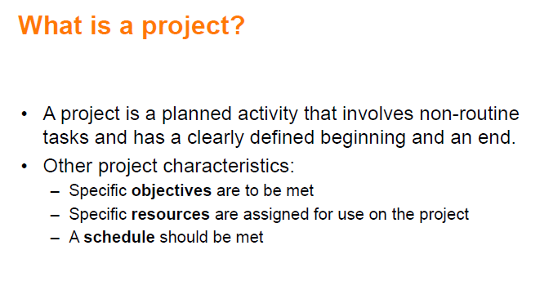

Slide 4
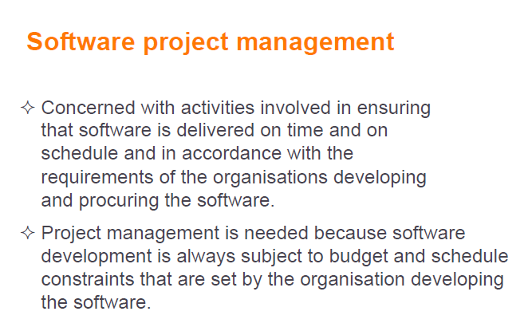

Slide 5
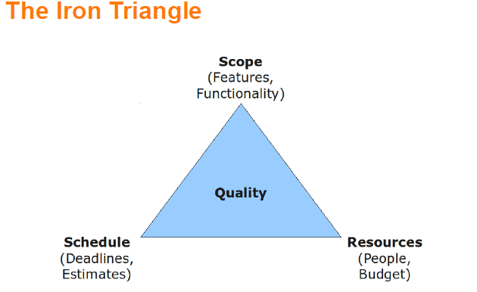

Slide 6
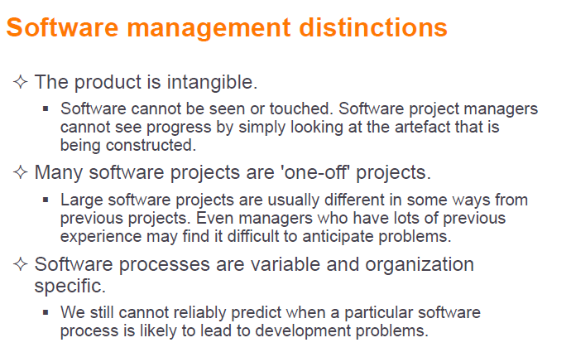

Slide 7
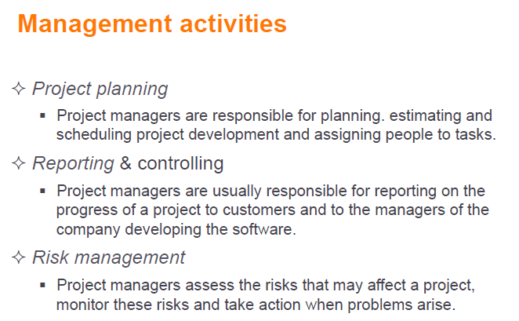

Slide 8
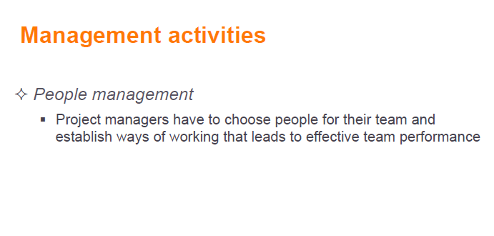

Slide 9
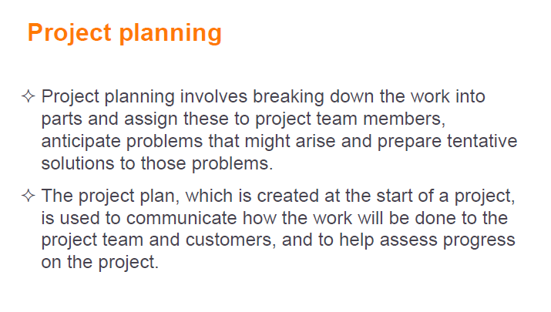

Slide 10
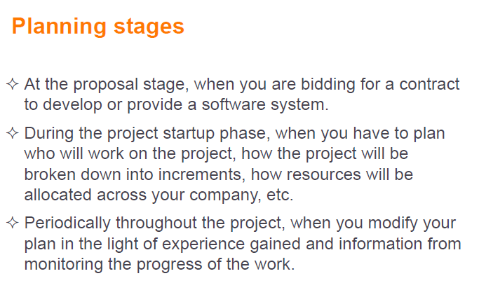

Slide 11
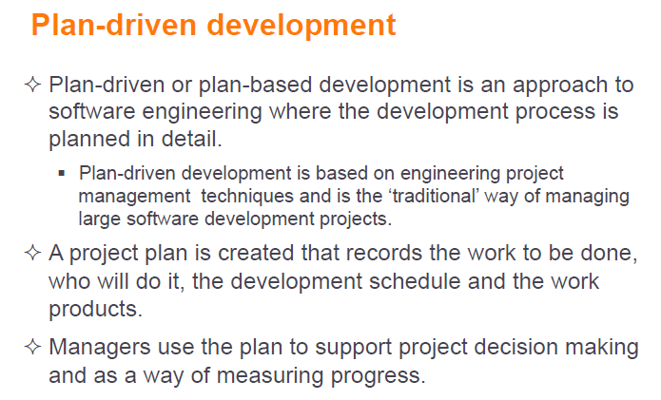

Slide 12
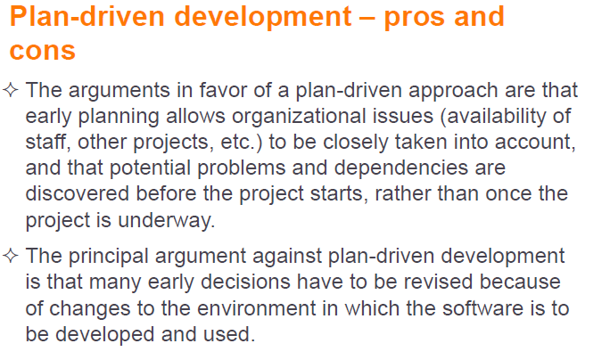

Slide 13
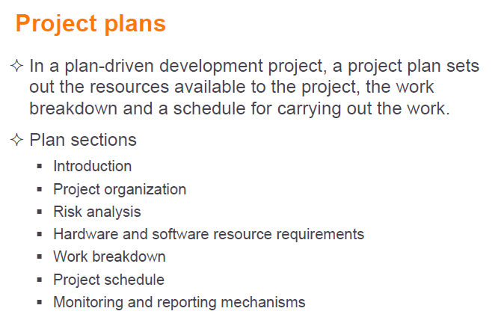

Slide 14
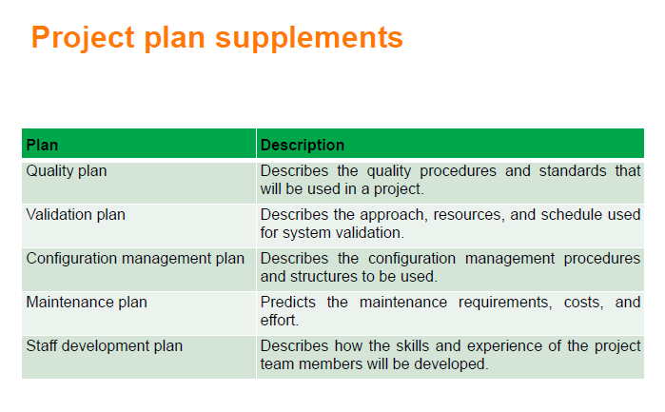

Slide 15
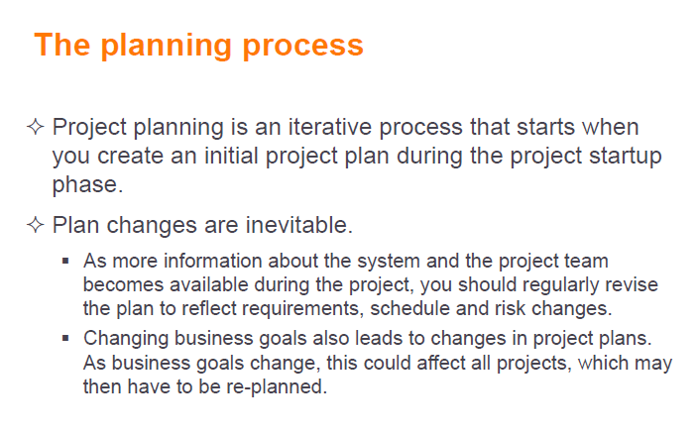

Slide 16
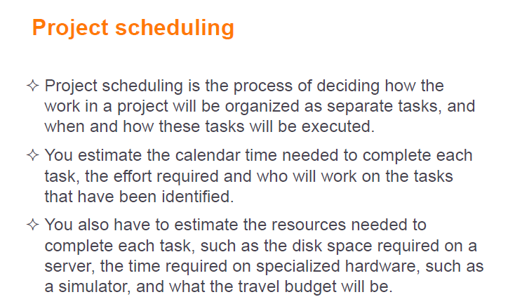

Slide 17
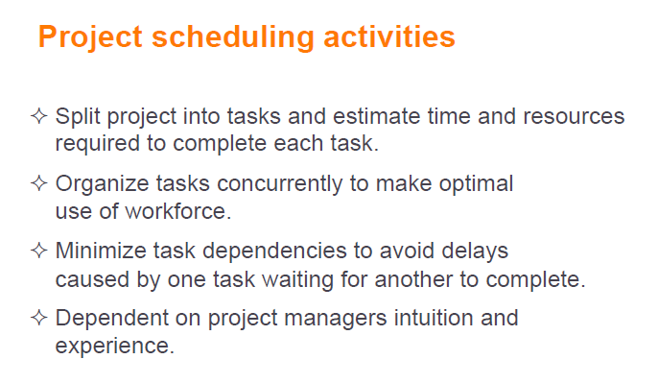

Slide 18
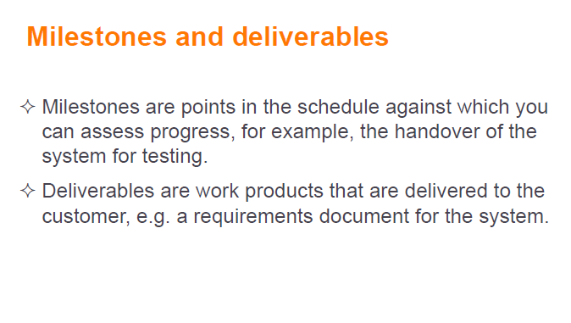

Slide 19
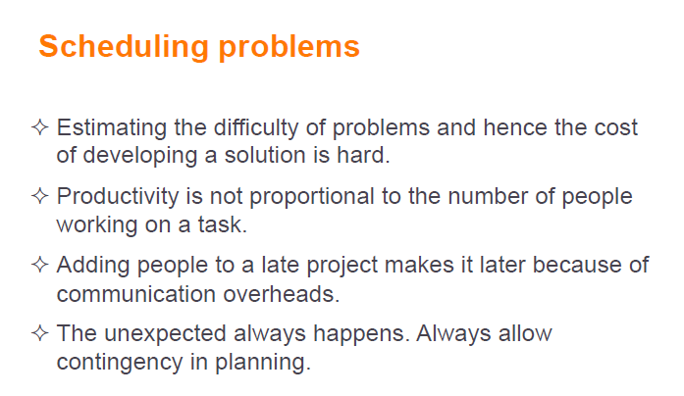

Slide 20
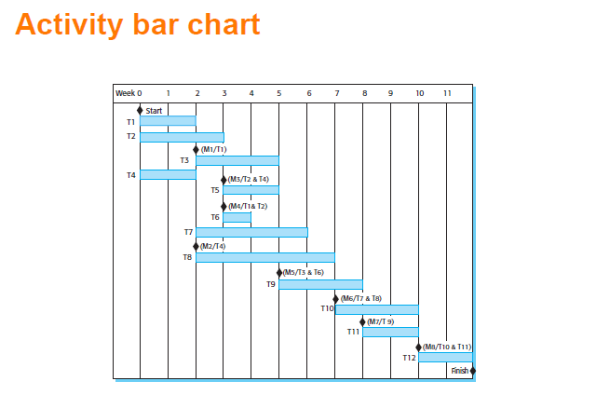

Slide 21
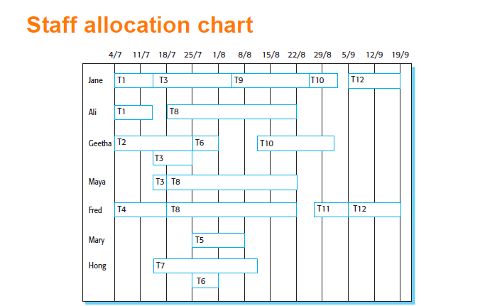

Slide 22
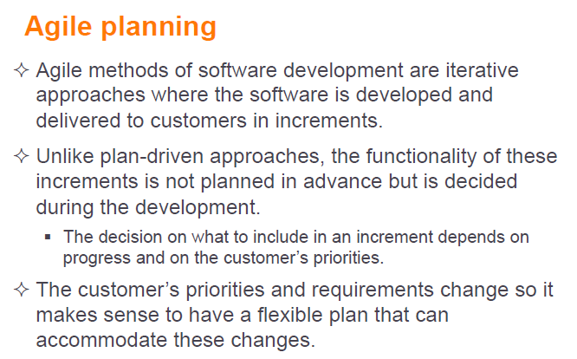

Slide 23
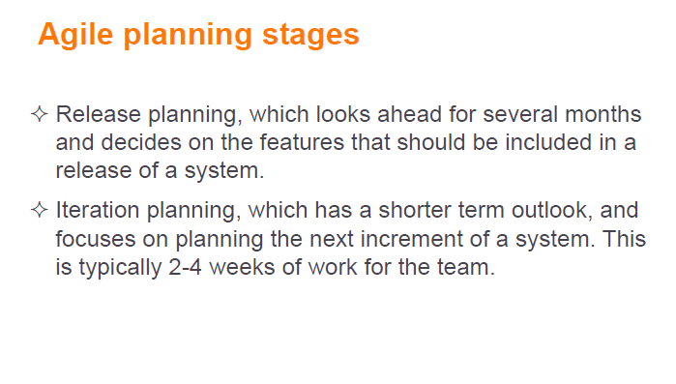

Slide 24
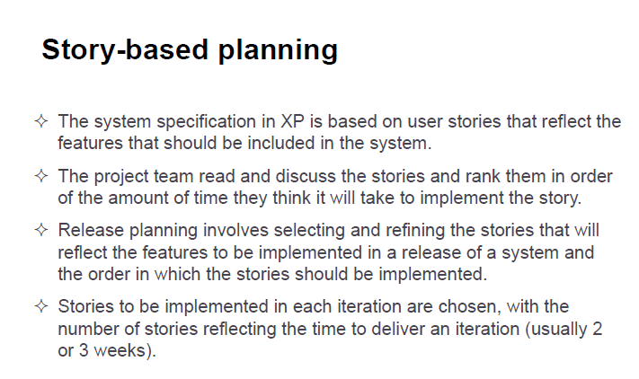

Slide 25
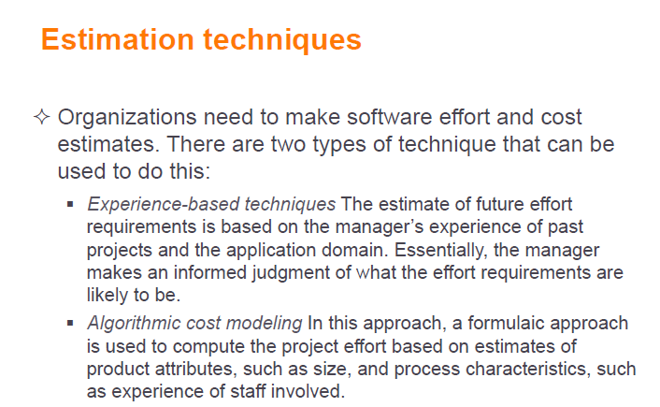

Slide 26
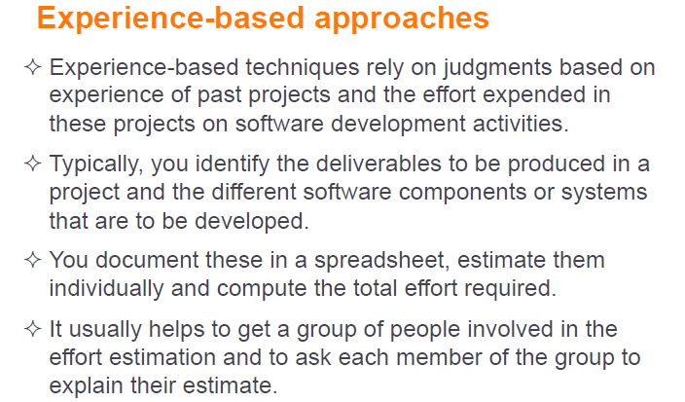

Slide 27
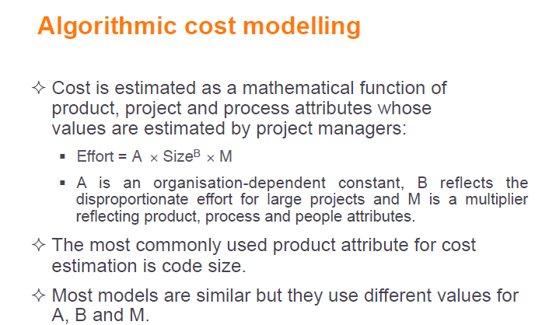

Slide 28
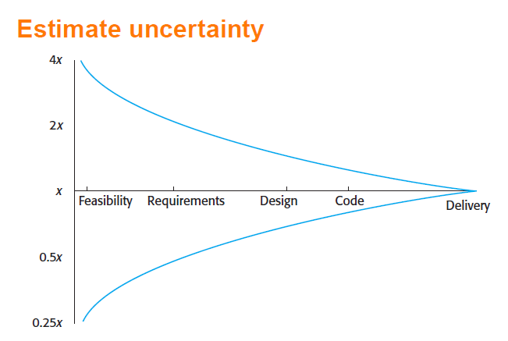

Slide 29
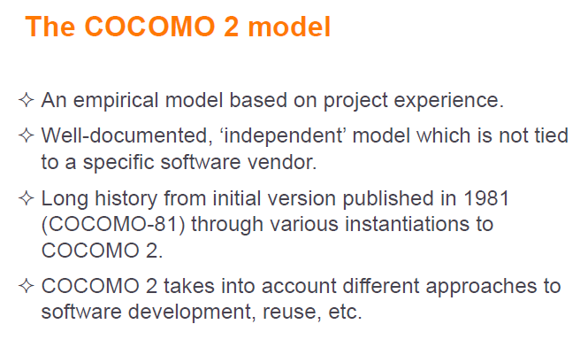

Slide 30
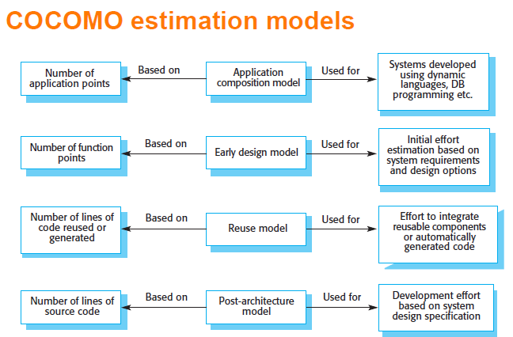

Slide 31
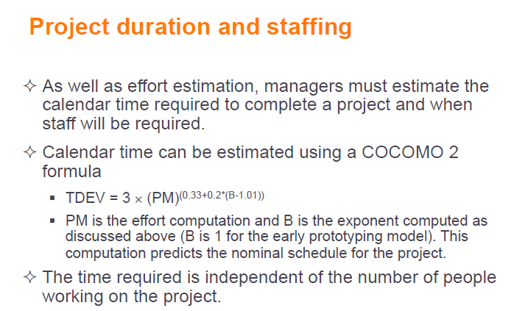

Slide 32
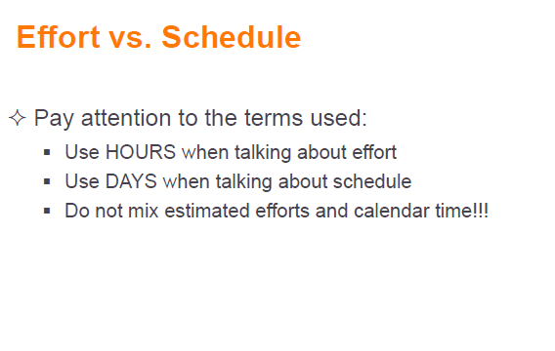

Slide 33
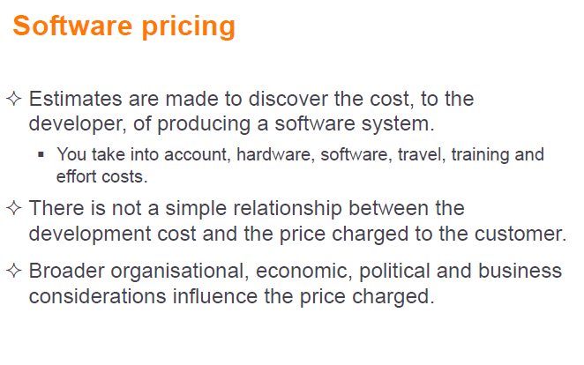

Slide 34
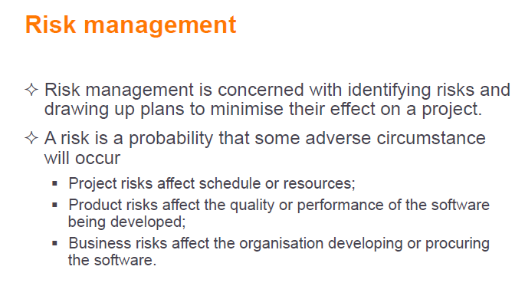

Slide 35
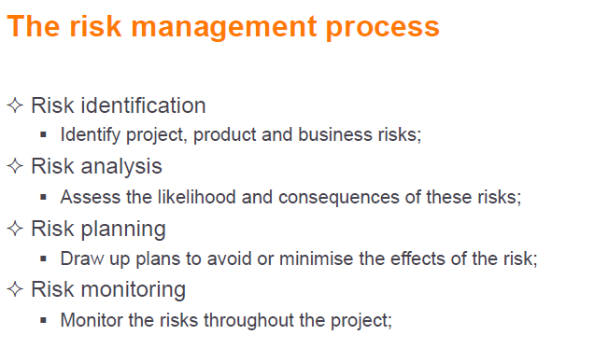

Slide 36
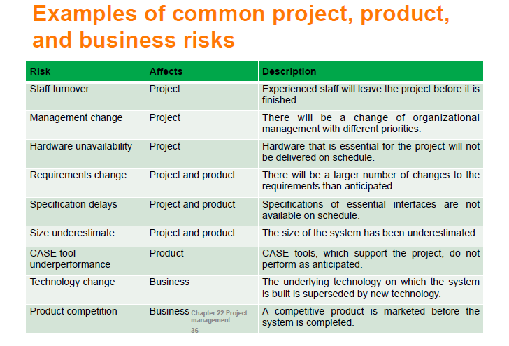

Slide 37
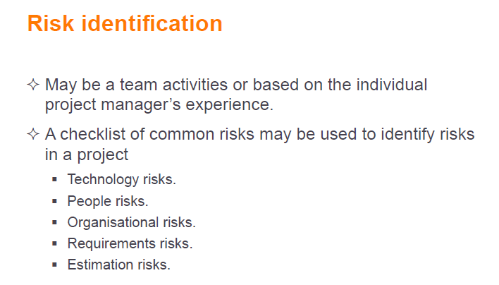

Slide 38
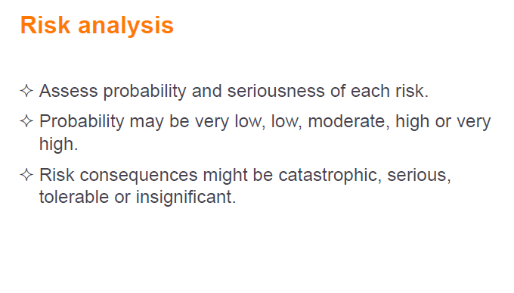

Slide 39
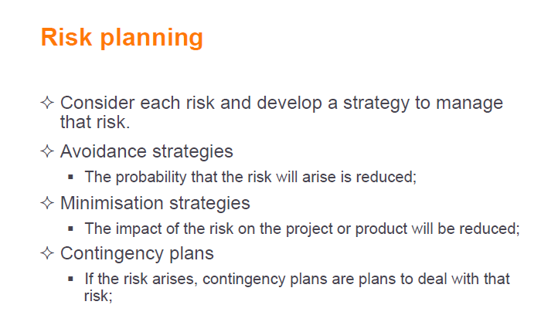

Slide 40
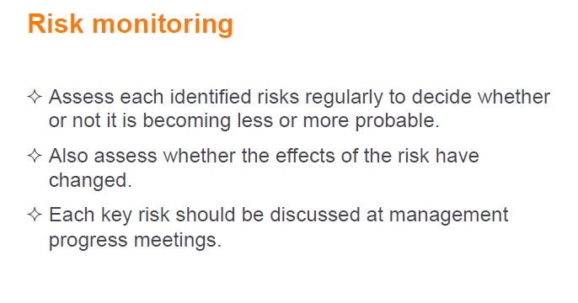

Slide 41
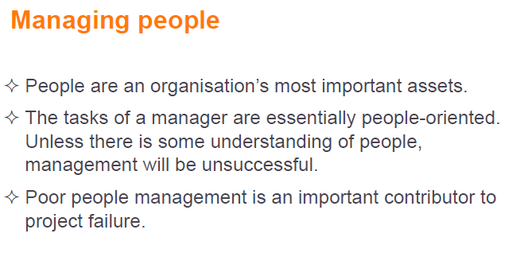

Slide 42
Quality Management System
A Quality Management System is a collection of policies, procedures, plans, resources, processes, practices, and the specification of responsibilities and authority of an organization designed to achieve product and service quality levels, customer satisfaction and company objectives.

Slide 43
Quality Management System
Quality Policy – describes the organizations approach to quality
Quality Manual – Addresses each principle of the ISO 9000 Standard
Origin Of ISO 9000 Standards

Slide 44
Configuration management
Configuration management encompasses the technical and administrative activities concerned with the creation, maintenance, controlled change and quality control of the scope of work.
A configuration is the functional and physical characteristics of a product as defined in its specification and achieved through the deployment of project management plans.
Configuration management can be regarded as an asset control and it is essential whether one or more versions of a deliverable is created
To implement configuration management, the project professional resources the following five activities:

Slide 45
Configuration management (Cont.)
Configuration management planning: A configuration management plan describes any project specific procedures and the extent of their application.
Configuration identification: Involves breaking down the project and creating a referencing system for each item.
Configuration control: Ensures that all changes to configuration items are controlled. Configuration control of specifications and test plans is vital for quality control to be effective.
Configuration status accounting: Provides records and reports that relate to a deliverable and its configuration information.
Configuration verification audit: Determines whether a deliverable conforms to its requirements and configuration information

Slide 46
Quality Management System: Principles of the ISO 9000 Standard:
    Customer Focus – understand needs, meet requirements, exceed expectations
    Leadership – unity of purpose, organizational direction, empowerment, achieve objectives
    Involvement of People – fully involved employees, to benefit the organization
    Process Approach – accomplishments by processes, resources must be managed
    System Approach to Management- processes are managed as a system
    Continual Improvement – permanently applied to the organization, its people, their processes, their systems and their products
    Factual Approach to Decision Making – decisions based on analysis of accurate, relevant and reliable data
    Mutually Beneficial Supplier relationships – organization and suppliers benefit from each other’s resources and knowledge

Slide 47
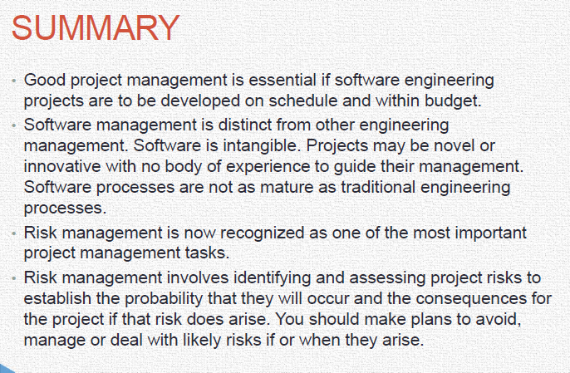

Slide 48
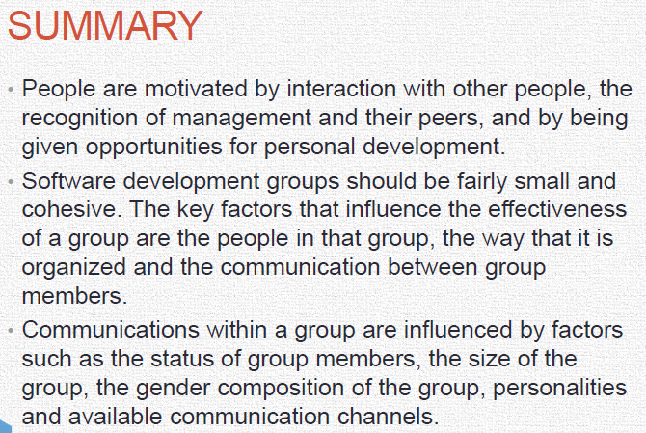

Slide 49
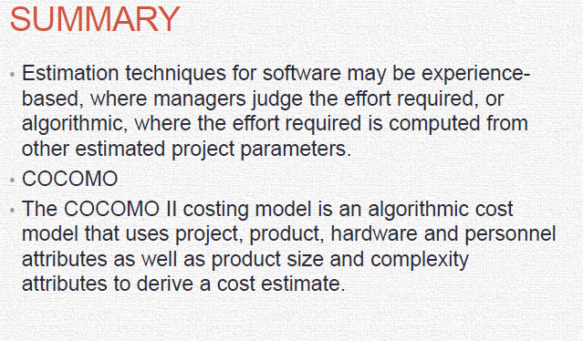

Slide 50
THANK YOU
ANY QUERY?

