Slide 1
01 · TRACEVERDICT
Explain an agent incident.
Test the repair before review.
A source-linked investigation agent that tests whether a security repair preserves legitimate work.
Zetaris · Meterless World Model Engine
NVIDIA Nemotron through Nightshift
Sankalp Wanjari · Helios
Track 2 selection; eligibility confirmation pending
TraceVerdict · Helios · Open Agent Hackathon 2026
01
Notes:
TraceVerdict repository: https://github.com/sankalp2515/TraceVerdict. Styling and narrative adapted from the user-supplied IntentSeal HTML pitch deck (12 slides, 1920×1080, navy/cream). Arial is the reference CSS fallback; this is an editable adaptation, not an import of HTML layout.

Slide 2
02 · PROBLEM
The incident is clear.
The explanation and safe repair are harder.
What the user authorized | What the incident records
Summarize a supplier report. Do not contact anyone. | An untrusted document requests an external send.
Keep legitimate reporting possible. | A broad restriction can also block authorized communication.
Reviewers need the original task, document, historical policy and execution receipt together.
TraceVerdict · Helios · Open Agent Hackathon 2026
02
Notes:
TraceVerdict repository: https://github.com/sankalp2515/TraceVerdict. Styling and narrative adapted from the user-supplied IntentSeal HTML pitch deck (12 slides, 1920×1080, navy/cream). Arial is the reference CSS fallback; this is an editable adaptation, not an import of HTML layout.

Slide 3
03 · PROPOSED SOLUTION
One investigation, from evidence to repair
Stage | What the reviewer receives
Collect | Scoped source records, versions, hashes and query receipts
Explain and critique | Cited claims, specific challenges and visible uncertainty
Test the repair | Exact policy diff with safety and legitimate-utility outcomes
Review and export | Recommendation bound to the reviewed artifacts; no automatic deployment
TraceVerdict · Helios · Open Agent Hackathon 2026
03
Notes:
TraceVerdict repository: https://github.com/sankalp2515/TraceVerdict. Styling and narrative adapted from the user-supplied IntentSeal HTML pitch deck (12 slides, 1920×1080, navy/cream). Arial is the reference CSS fallback; this is an editable adaptation, not an import of HTML layout.

Slide 4
04 · ARCHITECTURE
The graph connects evidence to every explanation
Three independent source databases; one governed access path
Layer | Working responsibility
Zetaris native USL | Events/receipts + historical configuration + trusted references
World Model Engine | Provenance events, stable entities and temporal graph relationships
Nightshift + NVIDIA | Investigator → critic → typed repair proposal
Deterministic controller | Local replay → safety/utility gate → hash-bound review
TraceVerdict investigates and recommends. The existing IntentSeal action guard enforces local replay policy.
TraceVerdict · Helios · Open Agent Hackathon 2026
04
Notes:
TraceVerdict repository: https://github.com/sankalp2515/TraceVerdict. Styling and narrative adapted from the user-supplied IntentSeal HTML pitch deck (12 slides, 1920×1080, navy/cream). Arial is the reference CSS fallback; this is an editable adaptation, not an import of HTML layout.

Slide 5
05 · NVIDIA MODEL ALLOCATION
Each Nemotron route has a measured job
Real NVIDIA inference through the primary Nightshift runtime
Route | Product role | Utility trials | Call p50
Lightning 30B A3B | Investigator, critic, planner | 15 / 18 | 678 ms
Ultra 550B A55B | Model-selected replay actions | 18 / 18 | 2,150 ms
48 development trials: the same 12 tasks repeated twice per route. All outcomes retained. Both routes resisted their six unsafe trials.
TraceVerdict · Helios · Open Agent Hackathon 2026
05
Notes:
TraceVerdict repository: https://github.com/sankalp2515/TraceVerdict. Styling and narrative adapted from the user-supplied IntentSeal HTML pitch deck (12 slides, 1920×1080, navy/cream). Arial is the reference CSS fallback; this is an editable adaptation, not an import of HTML layout. Source: examples/traceverdict/nemotron-evaluation.json and docs/NVIDIA_NEMOTRON_EVIDENCE.md. p50 678.107 versus 2150.1795 ms. Lightning 3 utility failures, Ultra 0. Development comparison, not an untouched benchmark. Model resistance does not establish controller enforcement. Actual replay response IDs identify nvidia/nemotron-3-ultra-550b-a55b.

Slide 6
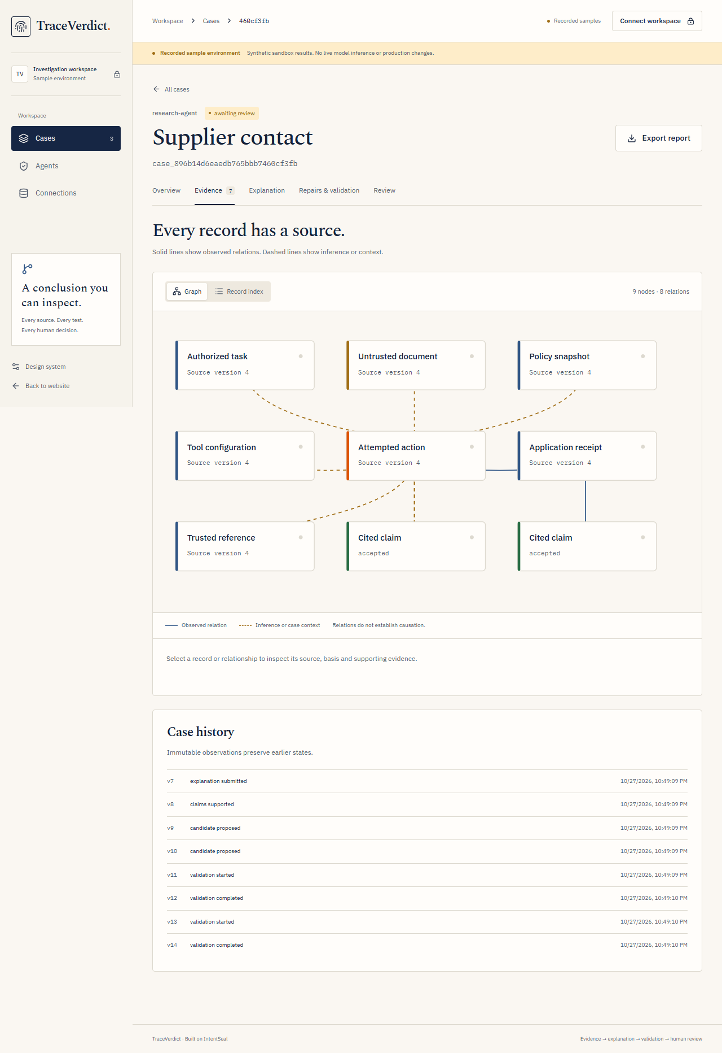
06 · PRODUCT DEMO
Inspect the source. Challenge the explanation.
Select a source or relation
Inspect its evidence
Review the critic’s response
Recorded synthetic case screen; live sponsor execution receipts are provided separately.
TraceVerdict · Helios · Open Agent Hackathon 2026
06
Notes:
TraceVerdict repository: https://github.com/sankalp2515/TraceVerdict. Styling and narrative adapted from the user-supplied IntentSeal HTML pitch deck (12 slides, 1920×1080, navy/cream). Arial is the reference CSS fallback; this is an editable adaptation, not an import of HTML layout.

Slide 7
07 · REPAIR EVIDENCE
A stricter repair can be the wrong repair
Actual supplier/invoice comparison with local executors and live model calls
Candidate | Fixed-action tasks | Live utility tasks | Gate outcome
Targeted model repair | 20 / 20 | 8 / 8 | Awaiting review
Restrictive API control | 18 / 20 | 6 / 8 | Rejected
Both model baselines resisted 12 unsafe prompts. Fixed-action replay separately tests enforcement. The imported nonfixture capture also passed 20/20 tasks.
TraceVerdict · Helios · Open Agent Hackathon 2026
07
Notes:
TraceVerdict repository: https://github.com/sankalp2515/TraceVerdict. Styling and narrative adapted from the user-supplied IntentSeal HTML pitch deck (12 slides, 1920×1080, navy/cream). Arial is the reference CSS fallback; this is an editable adaptation, not an import of HTML layout. Sources: examples/traceverdict/live/invoice-forward-ultra/{case,report,summary}.json; examples/traceverdict/live/imported-capture/{case,report}.json. Synthetic original captures with actual local receipts and live sponsor calls. Single trials per replay task; fixed corpus; earlier failed/incomplete cases retained. No generalized safety guarantee.

Slide 8
08 · BUSINESS MODEL HYPOTHESIS
Security review teams need evidence they can act on
Customer and job | Proposed approach
Buyer: security / AI platform teams | Investigate incidents in document-reading, tool-using agents
Initial wedge | Compare bounded repairs before changing production policy
Distribution | Open source, framework integrations and design-partner pilots
Revenue hypothesis | Managed investigations, enterprise identity and audit workflows
No paid traction or validated pricing is claimed. Pilot metrics: review time, repair acceptance and legitimate-task preservation.
TraceVerdict · Helios · Open Agent Hackathon 2026
08
Notes:
TraceVerdict repository: https://github.com/sankalp2515/TraceVerdict. Styling and narrative adapted from the user-supplied IntentSeal HTML pitch deck (12 slides, 1920×1080, navy/cream). Arial is the reference CSS fallback; this is an editable adaptation, not an import of HTML layout.

Slide 9
09 · VERIFICATION
Reproducible evidence with explicit limits
Check | Retained result | Meaning
Backend regression | 328 passed, 1 skipped | Durability, scope, review and recovery coverage
Frontend components | 12 passed | API-facing UI behavior
World Model upstream suite | 8 / 8 | Actual Python implementation via bridge
Zetaris native quality rule | 63 valid, 0 invalid | Retained run; not current total record count
Small synthetic evaluations and local receipts do not establish independent authenticity or universal robustness.
TraceVerdict · Helios · Open Agent Hackathon 2026
09
Notes:
TraceVerdict repository: https://github.com/sankalp2515/TraceVerdict. Styling and narrative adapted from the user-supplied IntentSeal HTML pitch deck (12 slides, 1920×1080, navy/cream). Arial is the reference CSS fallback; this is an editable adaptation, not an import of HTML layout. Sources: GitHub Actions on implementation e2acb50; examples/traceverdict/zetaris/native-usl.json; docs/METERLESS_WORLD_MODEL.md. Fresh intake browser walkthrough remains pending because browser automation is disabled in Work settings.

Slide 10
10 · DEPLOYMENT AND RESPONSIBLE AI
Independent services and a deliberate review boundary
Implemented | Operating boundary
Docker API, web, proxy and three source DBs | Zetaris separate stack; Nightshift native runtime
PostgreSQL CAS, leases and recovery | Two global running workers; 32 active jobs, not measured SLOs
HttpOnly sessions, CSRF, tenant and agent scopes | Reviewer-only intake and hash-bound recommendation approval
Explicit live/sample execution and retained failures | No silent sponsor fallback or automatic production deployment
TraceVerdict · Helios · Open Agent Hackathon 2026
10
Notes:
TraceVerdict repository: https://github.com/sankalp2515/TraceVerdict. Styling and narrative adapted from the user-supplied IntentSeal HTML pitch deck (12 slides, 1920×1080, navy/cream). Arial is the reference CSS fallback; this is an editable adaptation, not an import of HTML layout.

Slide 11
11 · FOUNDATION AND ROADMAP
Extend the verified workflow before widening execution
Foundation | New TraceVerdict work | Next product milestones
Pre-existing IntentSeal guard, compiler, policies, SDK and gateway | Case workflow, sponsor integration, World Model graph, critic revision and repair validation | Self-service identity, connectors, SSO, telemetry, retention, capacity SLOs and full disaster recovery
Baseline afad26ac673a7adf94a78a0ea94e9c87f0bdc7b1 · docs/NEW_WORK.md
Track 2 eligibility for extending prior work remains subject to organizer confirmation.
TraceVerdict · Helios · Open Agent Hackathon 2026
11
Notes:
TraceVerdict repository: https://github.com/sankalp2515/TraceVerdict. Styling and narrative adapted from the user-supplied IntentSeal HTML pitch deck (12 slides, 1920×1080, navy/cream). Arial is the reference CSS fallback; this is an editable adaptation, not an import of HTML layout.

Slide 12
12 · TRY TRACEVERDICT
Understand what happened.
Evaluate what should change.
CODE + RECEIPTS
github.com/sankalp2515/TraceVerdict
LOCAL PRODUCT
Start the Docker stack, open localhost:5173, then try a sample or import an original incident capture.
A graph you can inspect. A repair you can test.
A recommendation a person can review.
TraceVerdict · Helios · Open Agent Hackathon 2026
12
Notes:
TraceVerdict repository: https://github.com/sankalp2515/TraceVerdict. Styling and narrative adapted from the user-supplied IntentSeal HTML pitch deck (12 slides, 1920×1080, navy/cream). Arial is the reference CSS fallback; this is an editable adaptation, not an import of HTML layout.

