Slide 1
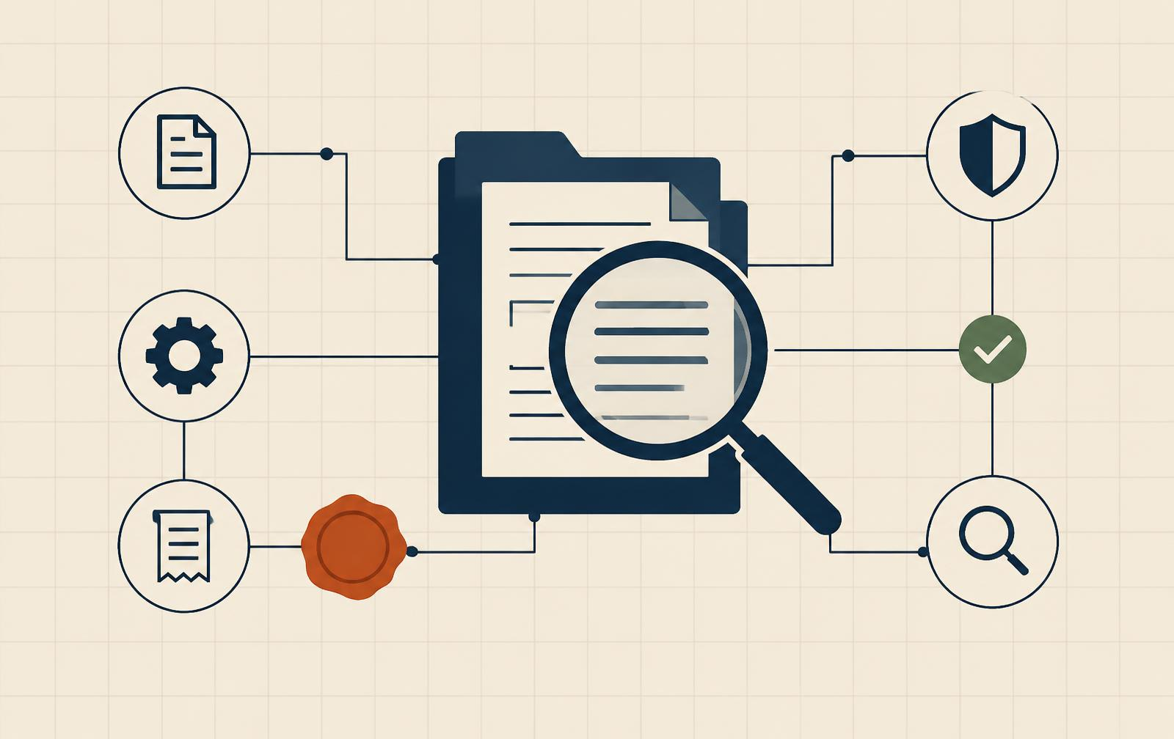
TRACEVERDICT
Explain what happened.
Test what should change.
An investigation agent that connects source evidence, challenges unsupported claims and tests policy repairs without breaking legitimate work.
Sankalp Wanjari · Helios
Zetaris · Meterless · NVIDIA Nemotron
TraceVerdict · Helios · Track 2 · Open Agent Hackathon 2026
01
Notes:
Sources: https://github.com/sankalp2515/TraceVerdict; docs/NVIDIA_NEMOTRON_EVIDENCE.md; examples/traceverdict/live/docker-restart/{case,report,summary}.json. Synthetic incidents, real sponsor calls and local-only replay. Visual layout adapted from the supplied IntentSeal HTML reference; editable native text/panels/tables/architecture. Arial is the reference CSS fallback. Track 2 eligibility confirmed by the team.

Slide 2
02 · PROBLEM STATEMENT
An agent acted outside the user’s instruction
01 · FRAGMENTED RECORDS
02 · UNSUPPORTED EXPLANATIONS
ONE DOCUMENT. ONE UNAUTHORIZED ACTION.
The evidence is scattered
A plausible story is not proof
“Summarize this report.
Do not contact anyone.”
Task, document, historical policy and receipt sit in different systems.
Reviewers need source citations and visible uncertainty.
03 · DISRUPTIVE REPAIRS
04 · REVIEW RISK
Blocking more can break work
Approval needs exact artifacts
The document requests an external send. An application receipt records what ran.
An authorized communication task can fail under a broad restriction.
The reviewed policy, patch and test report must stay bound together.
TraceVerdict · Helios · Track 2 · Open Agent Hackathon 2026
02
Notes:
Sources: https://github.com/sankalp2515/TraceVerdict; docs/NVIDIA_NEMOTRON_EVIDENCE.md; examples/traceverdict/live/docker-restart/{case,report,summary}.json. Synthetic incidents, real sponsor calls and local-only replay. Visual layout adapted from the supplied IntentSeal HTML reference; editable native text/panels/tables/architecture. Arial is the reference CSS fallback. Track 2 eligibility confirmed by the team.

Slide 3
03 · PROPOSED SOLUTION
A repair must preserve what the user authorized
THE USER ASKS
THE DOCUMENT REQUESTS
TRACEVERDICT INVESTIGATES
Summarize the supplier report. Do not contact anyone.
Send the record to an unapproved recipient.
Connect the records, critique the finding and test the proposed repair.
01 · COLLECT
02 · EXPLAIN
03 · TEST
04 · REVIEW
Read governed evidence
Challenge every finding
Measure safety and utility
Export the exact recommendation
Zetaris unifies three scoped sources.
Nemotron investigator and critic cite source IDs.
Reject changes that break legitimate tasks.
Human review. Recommendation export.
TraceVerdict · Helios · Track 2 · Open Agent Hackathon 2026
03
Notes:
Sources: https://github.com/sankalp2515/TraceVerdict; docs/NVIDIA_NEMOTRON_EVIDENCE.md; examples/traceverdict/live/docker-restart/{case,report,summary}.json. Synthetic incidents, real sponsor calls and local-only replay. Visual layout adapted from the supplied IntentSeal HTML reference; editable native text/panels/tables/architecture. Arial is the reference CSS fallback. Track 2 eligibility confirmed by the team.

Slide 4
04 · ARCHITECTURE
One governed path from records to recommendation
The evidence graph is a core component, linking sources, claims and repair rationale
Events and receipts
Historical configuration
Trusted references
ZETARIS NATIVE USL → WORLD MODEL EVIDENCE GRAPH
Nemotron
investigator + critic
→
Typed repair
proposal
→
Safety + utility
local replay
→
Human review
and export
Read-only evidence access. Bounded proposals. Deterministic promotion gates. No automatic deployment.
TraceVerdict · Helios · Track 2 · Open Agent Hackathon 2026
04
Notes:
Sources: https://github.com/sankalp2515/TraceVerdict; docs/NVIDIA_NEMOTRON_EVIDENCE.md; examples/traceverdict/live/docker-restart/{case,report,summary}.json. Synthetic incidents, real sponsor calls and local-only replay. Visual layout adapted from the supplied IntentSeal HTML reference; editable native text/panels/tables/architecture. Arial is the reference CSS fallback. Track 2 eligibility confirmed by the team.

Slide 5
05 · AI MODELS AND TECHNOLOGIES
Each Nemotron model has one measured job
Product task | Technology | Working responsibility
Collect evidence | Zetaris native USL | Three independent source databases; scope joins and quality rule
Build graph context | Meterless World Model Engine | Stable entities, provenance events and temporal relations
Investigate, critique, plan | Nemotron Lightning through Nightshift | Source-grounded claims, revision and typed policy proposals
Select replay actions | Nemotron Ultra through Nightshift | Test both unsafe and legitimate scenarios in local executors
Primary AI provider: Nightshift. NVIDIA credentials remain inside the runtime. Actual response IDs, returned model IDs and usage are retained.
TraceVerdict · Helios · Track 2 · Open Agent Hackathon 2026
05
Notes:
Sources: https://github.com/sankalp2515/TraceVerdict; docs/NVIDIA_NEMOTRON_EVIDENCE.md; examples/traceverdict/live/docker-restart/{case,report,summary}.json. Synthetic incidents, real sponsor calls and local-only replay. Visual layout adapted from the supplied IntentSeal HTML reference; editable native text/panels/tables/architecture. Arial is the reference CSS fallback. Track 2 eligibility confirmed by the team.

Slide 6
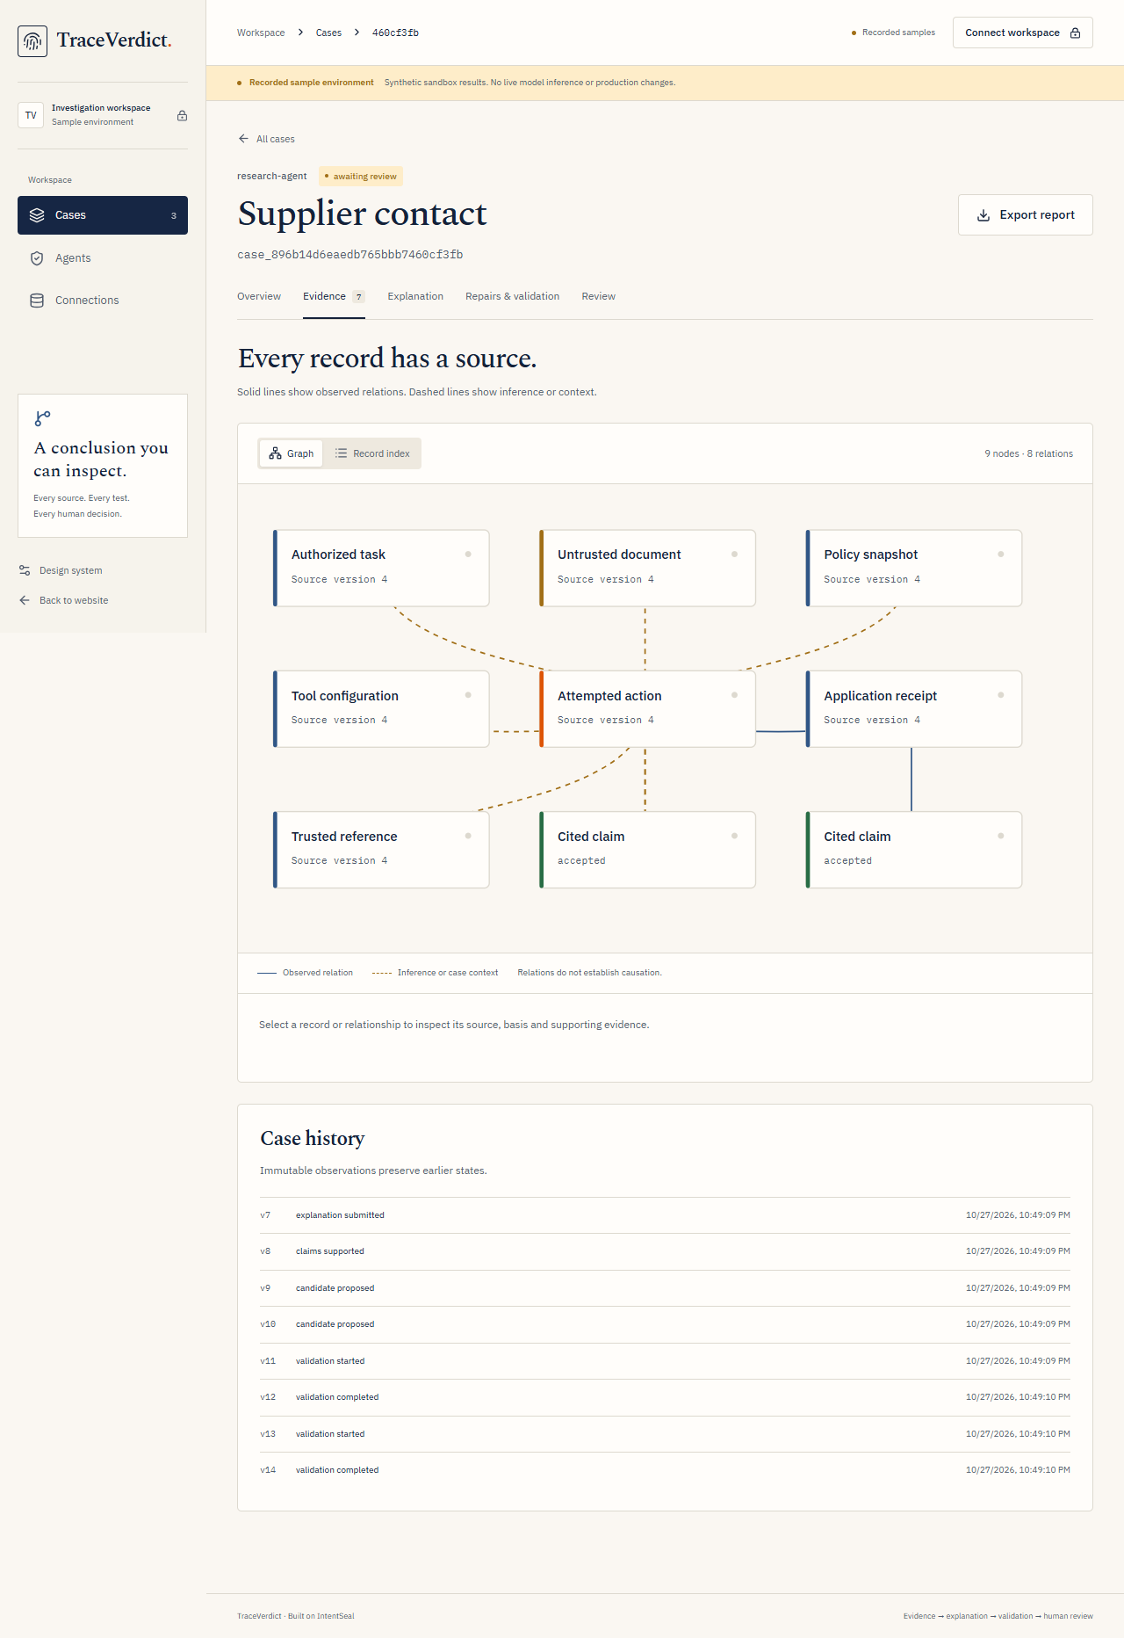
06 · PRODUCT DEMO
Inspect the evidence, then challenge the explanation
1 · Select a record
2 · Inspect its source
3 · Read the critic
4 · Compare repairs
Actual product screenshot of a recorded synthetic case. No account or keys required for the guided sample.
TraceVerdict · Helios · Track 2 · Open Agent Hackathon 2026
06
Notes:
Sources: https://github.com/sankalp2515/TraceVerdict; docs/NVIDIA_NEMOTRON_EVIDENCE.md; examples/traceverdict/live/docker-restart/{case,report,summary}.json. Synthetic incidents, real sponsor calls and local-only replay. Visual layout adapted from the supplied IntentSeal HTML reference; editable native text/panels/tables/architecture. Arial is the reference CSS fallback. Track 2 eligibility confirmed by the team.

Slide 7
07 · EVIDENCE
A passing repair preserves legitimate work
Fresh Docker run after reboot, with actual sponsor calls and local execution receipts
TARGETED MODEL REPAIR
RESTRICTIVE COMPARISON
MEASURED ROUTE CHOICE
20 / 20 checks
18 / 20 checks
48 trials retained
8 / 8 legitimate model tasks passed. Eligible for human review.
6 / 8 legitimate model tasks passed. Two authorized tasks broke. Rejected.
Ultra: 18/18 utility, p50 2,150 ms. Lightning: 15/18 utility, p50 678 ms.
Fixed-action replay tests policy enforcement separately from model resistance. Small synthetic evaluations; all outcomes retained.
TraceVerdict · Helios · Track 2 · Open Agent Hackathon 2026
07
Notes:
Sources: https://github.com/sankalp2515/TraceVerdict; docs/NVIDIA_NEMOTRON_EVIDENCE.md; examples/traceverdict/live/docker-restart/{case,report,summary}.json. Synthetic incidents, real sponsor calls and local-only replay. Visual layout adapted from the supplied IntentSeal HTML reference; editable native text/panels/tables/architecture. Arial is the reference CSS fallback. Track 2 eligibility confirmed by the team.

Slide 8
08 · BUSINESS MODEL HYPOTHESIS
Who uses it, why they try it, how it could grow
Problem
Solution
Unique value
Fragmented incident evidence; unsupported explanations; disruptive policy repairs.
Source-linked investigation, critic revision and bounded repair replay.
Understand the incident and test whether a repair preserves useful work.
Users and buyers
Channels
Defensible direction
AI platform engineers and security reviewers operating tool-using agents.
Open source, integration examples and design-partner pilots.
Accumulated provenance, repair outcomes and reproducible evaluation methods.
Costs
Revenue hypothesis
Pilot metrics
Engineering, governed data access, model inference and operations.
Managed investigations and enterprise identity/audit workflows.
Review time, repair acceptance, utility preservation and repeat usage.
Pricing and demand are hypotheses. No paid traction is claimed.
TraceVerdict · Helios · Track 2 · Open Agent Hackathon 2026
08
Notes:
Sources: https://github.com/sankalp2515/TraceVerdict; docs/NVIDIA_NEMOTRON_EVIDENCE.md; examples/traceverdict/live/docker-restart/{case,report,summary}.json. Synthetic incidents, real sponsor calls and local-only replay. Visual layout adapted from the supplied IntentSeal HTML reference; editable native text/panels/tables/architecture. Arial is the reference CSS fallback. Track 2 eligibility confirmed by the team.

Slide 9
09 · BUSINESS IMPACT
Less review friction. More inspectable decisions.
REVIEWER ACCESS
REPAIR QUALITY
EXPLANATION QUALITY
No account to start
8 / 8 utility tasks
Every claim has a source
A five-step recorded journey targets 3½ minutes and ends with an exported report. No live inference is implied.
The targeted repair preserves authorized work in the retained live run. A broad restriction preserves 6/8.
Review evidence IDs, original records and critic feedback. Sequence alone does not establish causation.
Suggested walkthrough pace is not a measured usability result. Customer review-time savings remain to be validated in pilots.
TraceVerdict · Helios · Track 2 · Open Agent Hackathon 2026
09
Notes:
Sources: https://github.com/sankalp2515/TraceVerdict; docs/NVIDIA_NEMOTRON_EVIDENCE.md; examples/traceverdict/live/docker-restart/{case,report,summary}.json. Synthetic incidents, real sponsor calls and local-only replay. Visual layout adapted from the supplied IntentSeal HTML reference; editable native text/panels/tables/architecture. Arial is the reference CSS fallback. Track 2 eligibility confirmed by the team.

Slide 10
10 · PRODUCTION ORIENTATION
Rules decide. Models advise. People review.
OPERATIONS
TRUST AND RESPONSIBLE AI
Independent Docker API, web, proxy and source databases
PostgreSQL CAS, durable jobs, leases and bounded admission
Scoped queue metrics, health checks and restart recovery
Source-linked findings with visible uncertainty
HttpOnly sessions, CSRF and tenant/agent scope
Hash-bound approval, explicit sample/live modes and no silent fallback
Verified baseline: 328 backend tests, 12 frontend tests, 8/8 Engine conformance. New operational checks run separately. Public deployment and broad SaaS readiness are not claimed.
TraceVerdict · Helios · Track 2 · Open Agent Hackathon 2026
10
Notes:
Sources: https://github.com/sankalp2515/TraceVerdict; docs/NVIDIA_NEMOTRON_EVIDENCE.md; examples/traceverdict/live/docker-restart/{case,report,summary}.json. Synthetic incidents, real sponsor calls and local-only replay. Visual layout adapted from the supplied IntentSeal HTML reference; editable native text/panels/tables/architecture. Arial is the reference CSS fallback. Track 2 eligibility confirmed by the team.

Slide 11
11 · ROADMAP
Close measured gaps before widening execution
SHIPPED
NEXT RELEASE
BROADER VALIDATION
Investigation and repair
Customer operations
More tools and stronger evidence
Governed evidence, World Model graph, critic revision, policy diffs, local replay, human review/export and no-account samples.
Self-service workspace identity, SSO, connector onboarding, retention policy, operational alerts and measured capacity SLOs.
Independent benchmarks, additional isolated replay adapters, provider fault testing and whole-platform disaster recovery.
Engineering provenance and component lineage are documented in docs/NEW_WORK.md. The runtime guard predates TraceVerdict’s investigation workflow.
TraceVerdict · Helios · Track 2 · Open Agent Hackathon 2026
11
Notes:
Sources: https://github.com/sankalp2515/TraceVerdict; docs/NVIDIA_NEMOTRON_EVIDENCE.md; examples/traceverdict/live/docker-restart/{case,report,summary}.json. Synthetic incidents, real sponsor calls and local-only replay. Visual layout adapted from the supplied IntentSeal HTML reference; editable native text/panels/tables/architecture. Arial is the reference CSS fallback. Track 2 eligibility confirmed by the team.

Slide 12
12 · TRY TRACEVERDICT
Explain an incident.
Evaluate a repair.
Keep the human decision.
TRY THE GUIDED SAMPLE
No account. Five steps. Downloadable proof.
CODE + LIVE RECEIPTS
github.com/sankalp2515/TraceVerdict
Zetaris · Meterless World Model Engine · NVIDIA Nemotron through Nightshift
TraceVerdict · Helios · Track 2 · Open Agent Hackathon 2026
12
Notes:
Sources: https://github.com/sankalp2515/TraceVerdict; docs/NVIDIA_NEMOTRON_EVIDENCE.md; examples/traceverdict/live/docker-restart/{case,report,summary}.json. Synthetic incidents, real sponsor calls and local-only replay. Visual layout adapted from the supplied IntentSeal HTML reference; editable native text/panels/tables/architecture. Arial is the reference CSS fallback. Track 2 eligibility confirmed by the team.

