Slide 1

Trade Dataset Analysis
– Visualization & Insights
Presentation By-
Sankalp Parasharam Chougule

Slide 2
Data Journey
Dataset Overview
- Data Cleaning & Pre-processing
- EDA Insights
- Power BI Dashboard
- SQL Analysis
- Conclusion

Slide 3
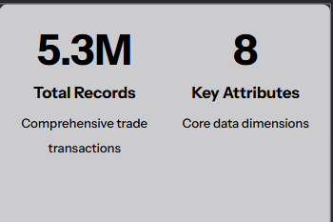
Dataset Overview
Data Structure
Our dataset captures multidimensional trade metrics across time, geography, and product categories:
Temporal: Period dates (ym) tracking monthly trends
Directional: Import/export classification (exp_imp)
Geographic: Country and customs regions
Product: HS9 codes for commodity classification
Metrics: Quantities (Q1, Q2) and transaction values

Slide 4

Data Cleaning & Transformation
Column Standardization
Renamed all fields using clear, consistent naming conventions for improved readability and downstream analysis 2
Type Conversion
Transformed categorical dimensions (country, hs_code, exp_imp) to text format ensuring data integrity
Date Engineering
Converted raw ym values into structured PeriodDate format using DAX for accurate time-series modeling
Quality Validation
Removed inconsistent entries, validated datatypes, and created a 100K sample for exploratory testing
• Renamed all columns for better readability
• Converted ym → PeriodDate using DAX
• Converted categoricals (country, hs_code, exp_imp) to Text
• Removed inconsistent entries & performed datatype validation
• Generated a 100K sample dataset for testing and EDA

Slide 5
Exploratory Data Analysis (EDA)
Seasonal Behavior
Monthly trade values exhibit clear seasonal patterns with predictable peaks and troughs throughout the year
Trade Balance
Import versus export distribution analysis identified key imbalances across regions
Regional Contribution
Customs regions show varying participation levels in global trade networks
Top Commodities
Specific HS codes dominate transaction volumes, representing critical trade corridors

Slide 6
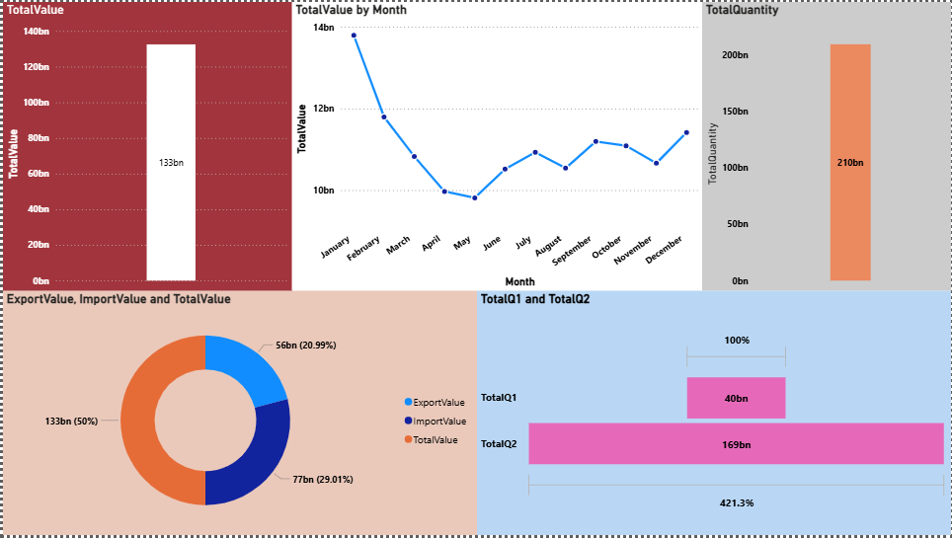
Power BI Dashboard Highlights

Slide 7
Total Value (First Bar Chart — 133bn)
This chart shows the total trade value aggregated across the entire dataset.
Observation:
The total trade value for the period analyzed is 133 billion.
This acts as the baseline metric for comparing import, export, and product performance.
2. Total Value by Month (Line Chart)
This line chart displays the month-wise trend in total trade value across the year.
Observations:
The highest trading month is January (~14bn).
A noticeable decline occurs between February → May, reaching the lowest point around May (~9.8bn).
A moderate recovery is observed from June to September.
Slight fluctuations occur from September to December, ending the year stronger.

Slide 8
3. Total Quantity (Bar Chart — 210bn)
This chart shows the total combined traded quantity across Q1 and Q2.
Observations:
Total traded volume is 210 billion units, significantly higher than the value scale.
This suggests that the dataset contains large-quantity, low-value items in some HS code categories.
4. Export Value vs Import Value vs Total Value (Donut Chart)
This donut chart compares the share of exports, imports, and total value.
Observations:
Total Value (50%) — 133bn acts as the central reference.
Exports = 56bn (21%)
Imports = 77bn (29%)
Imports exceed exports → indicating a trade deficit.
A trade deficit can imply domestic demand > domestic supply.

Slide 9
5. TotalQ1 vs TotalQ2 (Horizontal Bar Comparison)
This visual compares the two quantity metrics Q1 and Q2.
Observations:
TotalQ1 = 40bn
TotalQ2 = 169bn
Q2 is 421% higher than Q1.
This suggests Q2 represents the primary measurement for quantity (major traded volume category).

Slide 10
SQL-Based Analysis
Structured Query Approach
We leveraged SQL to validate our Power BI findings and extract additional intelligence from the dataset:
Schema Validation
Confirmed data structure integrity and relationship consistency across all tables
Multi-Dimensional Aggregation
Computed trade values grouped by country, year, customs region, and HS code hierarchies
Performance Analysis
Identified top-performing commodities based on transaction frequency and value thresholds

Slide 11

Conclusion
Clean Dataset
Dashboard
Raw Data
Insights
Our comprehensive analysis transformed 5.3 million raw trade records into actionable business intelligence through systematic data preparation, exploratory analysis, and visualization.

