Slide 1

JoyRide® Share a Ride, Maybe a Story!
Carpooling Made Easy & Rewarding - Mobile Application Development Proposal
Sadhana Muralidharan
Rachana Kanagala
Sankalp Karkera
Poojitha Katragadda
Shivadhar Pingili

Slide 2

Business Domain
Market Space
Carpooling is a solution to the woes of daily commuting.
Competitors
Opportunity
Security of the passengers and driver
User Verification
Rewards & Loyalty schemes
Unavailability in the local market
Environment Friendly
Cost Effective
Great way to Socialize, even on a work day!
View Competition Matrix

Slide 3
Goals & Objectives
Goals:
Provide an easy to use Carpooling application.
Focus on Security as a feature
Provide a forum for people to find other travelers.
Resources:
Capital: $3,000
Investors: Expected revenue $10,000 – $12,000 per year
Time:
Time taken to develop an application: 2-3 months (approx.)
Success Criteria:
Ease of access
User-friendly
Privacy and security
Low costs
No bugs

Slide 4
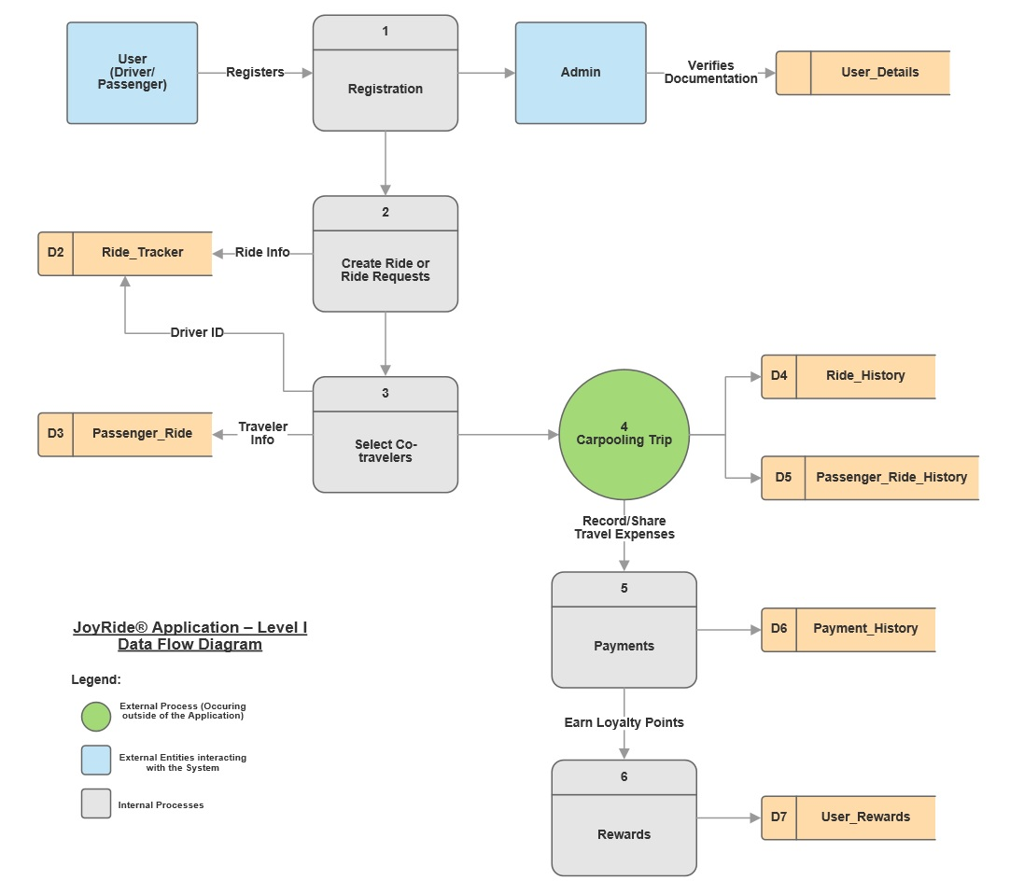
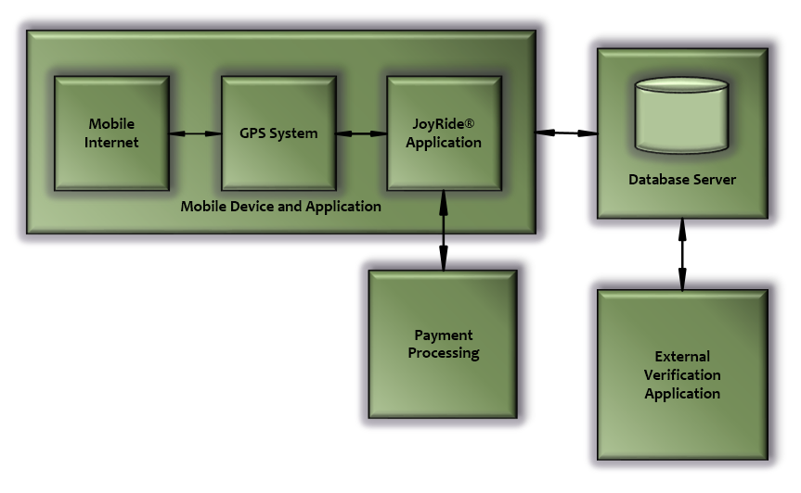
Functional Requirements Overview
Model Diagram of Major Components
Data Flow Diagram – Level I

Slide 5
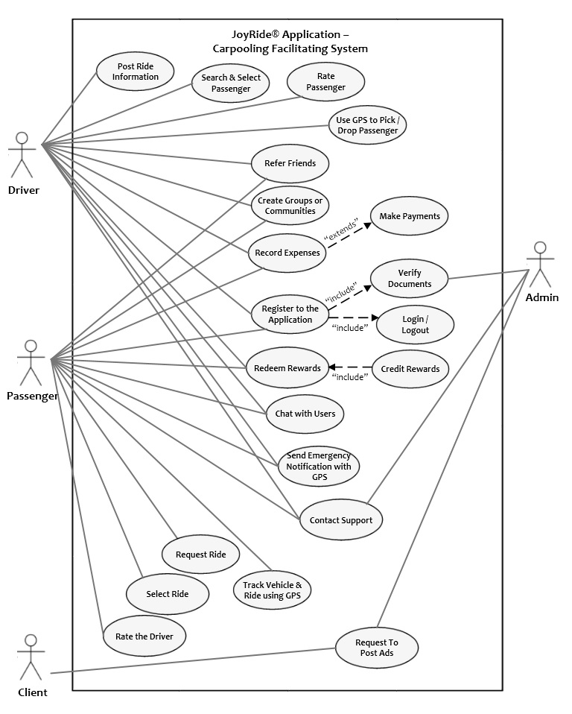
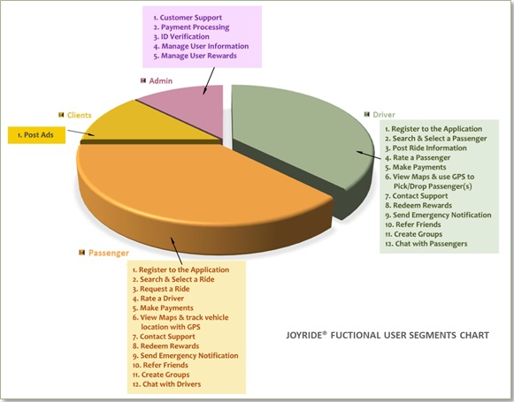
Functional Requirements
User Functional Segment Chart
System Level Use Case Diagram

Slide 6
Functional Requirements (cont’d)

Slide 7
Extra Functional Requirements
Performance
Quality of the application and the user experience is performance.
Seamless user interaction
Portability
Coding is self-contained - not impacted by external changes
Security
Encryption of passwords and other data,
Usage of a dedicated server for user information,
Resolution plans in worst case scenarios such as breach, and
Secured payment portals
Scalability
Accommodates unrestricted growth

Slide 8
Prototype

Slide 9
Process Model
Process Model: Agile – Scrum Methodology
Reasons for Selecting Scrum:
Avoid scalability issues within the team
Cross-functional development aided in adhering to development schedule.
Iterative nature provides continuous feedback
Adaptable and versatile to changes
Scrum Team Info:
➢ Sprint Details:
Sprint Length: 2 weeks iterations
Day 1 – Sprint Planning
Day 14 – Retrospective & Sprint Review
Everyday – 10 minute Stand up Meetings
Release Plans:
Release 1 has 4 sprints planned.
Hardening sprint not planned yet.
Schedules as below:
Role | Participants
Product Owner | Sadhana Muralidharan
Scrum Master | Rachana Kanagala
Scrum Team | Shivadhar Pingili Sankalp Karkera Poojitha Katragadda
Iteration | Iteration Start Date | Status
Sprint 0 | 09/13/2017 | Closed
Sprint 1 | 09/27/2017 | Closed
Sprint 2 | 10/04/2017 | Closed
Sprint 3 | 10/18/2017 | Closed
Sprint 4 | 11/01/2017 | In Progress

Slide 10
Product Backlog
Sprint 0

Slide 11
Product Backlog (cont’d)
Sprint 1

Slide 12
Product Backlog (cont’d)
Sprint 2

Slide 13
Product Backlog (cont’d)
Sprint 3

Slide 14
Product Backlog (cont’d)
Sprint 4
Sprint Burn Down Charts

Slide 15
Risk Management
Financial:
Mitigation: Finding investors
User Acceptance:
Risk: Low number of people who heard of or are drawn to the app.
Technical:
Mitigation: Constant updates of anti-malware softwares, encryption, etc.
Risk: Certain features like identity certification can prove to be expensive and cause an overrun in the budget
Mitigation: Communication, campaigns, promotions
Risk: Data breach of identity of banking information.

Slide 16
Future Enhancements
Possible enhancements include:
Provide options for the Driver to optionally charge for rides.
More customized User Interface and features for users who register through Employers.
Including restaurant guides, lodging, and other travel related options.

Slide 17
Conclusion
Factors that enabled:
Documents
SRS Template – IEEE Publication: Extremely useful to cover all aspects of the software requirement documentation.
Use Case – Alistair Cockburn’s Use Case Template: Allowed simple and straightforward registering of a user’s interactions.
Prototype
Axure
Development
Process Model: Agile – Scrum Practices
Burn Down Charts – Microsoft Excel

Slide 18
THANK YOU
Questions?

Slide 19
Product Backlog Burn Down Charts
Return to
Product
Backlog

Slide 20
Competitor Analysis
Competitors | GPS | Automatic Matches | Manual Matches | Match/Trip Alerts | Regular Scheduling | Making Groups | Rating Driver/Rider | Payment Gateway | Background & Security Measures | Set Personal Preferences | Rewards System
Scoop |  |  | x |  | x | x
Zimride |  | x | x | x | x | x |  | x
Carpool - School Edition |  | x | x |  | x | x
BlaBla Car | x |  | x |  | x |  | x | x | x | x | x
Rideshare | x | x | x |  | x
Carma | x |  | x | x | x
JoyRide | x | x | x | x | x | x | x | x | x | x | x
Return to
Business Domain

