Slide 1
PROJECT TITLE
CAPSTONE PROJECT
Presented By:
Sankalp Laxman Khatake
-VPKBIET, Baramati
-Artificial Intelligence and Data Science

Slide 2
OUTLINE
Problem Statement (Should not include solution)
System Development Approach (Technology Used)
Algorithm & Deployment (Step by Step Procedure)
Result
Conclusion
Future Scope(Optional)
References

Slide 3
Problem Statement
Small businesses lack an easy-to-use online platform to display their products.
Existing e-commerce solutions are often too complex and expensive.
There is a need for a lightweight, visually appealing, and easy-to-manage product gallery.
Must allow customers to browse, filter, and view details of products interactively.

Slide 4
System Approach
Frontend Technologies:
HTML5 – Provides the structure and semantic layout of the product showcase webpage.
CSS3 – Ensures attractive styling, color schemes, and responsive layouts for different devices.
JavaScript (Vanilla JS / Swiper.js optional) – Enables dynamic interactivity such as product filtering, modal pop-ups for product details, and smooth navigation.
Design Approach:
Clean and User-Friendly Interface – Simple, clutter-free UI for easy browsing.
Mobile-Responsive Design – Works seamlessly on desktops, tablets, and smartphones.
Modular Development – HTML, CSS, and JavaScript kept in separate files for better maintainability.
Scalable Layout – Easy to extend with more products, categories, or animations in the future.

Slide 5
Algorithm & Deployment
Product Catalog Creation
Define product categories.
Add product details (image, title, price, description).
Frontend Design
Use HTML for product grid & card layout.
Apply CSS for styling, hover effects, and responsive design.
Interactive Features (JavaScript)
Filtering: Show products by category.
Modal Views: Display enlarged product images and descriptions.
Cart Functions: Add-to-Cart, Remove-from-Cart.
Real-time Total Calculation: Update price dynamically.
Testing
Ensure cross-browser compatibility.
Check mobile responsiveness.
Validate correct cart functionality and filtering.
Deployment:
Host the project on GitHub Pages or Netlify for free and public access.
Ensure project files are modular and well-documented for easy updates.

Slide 6
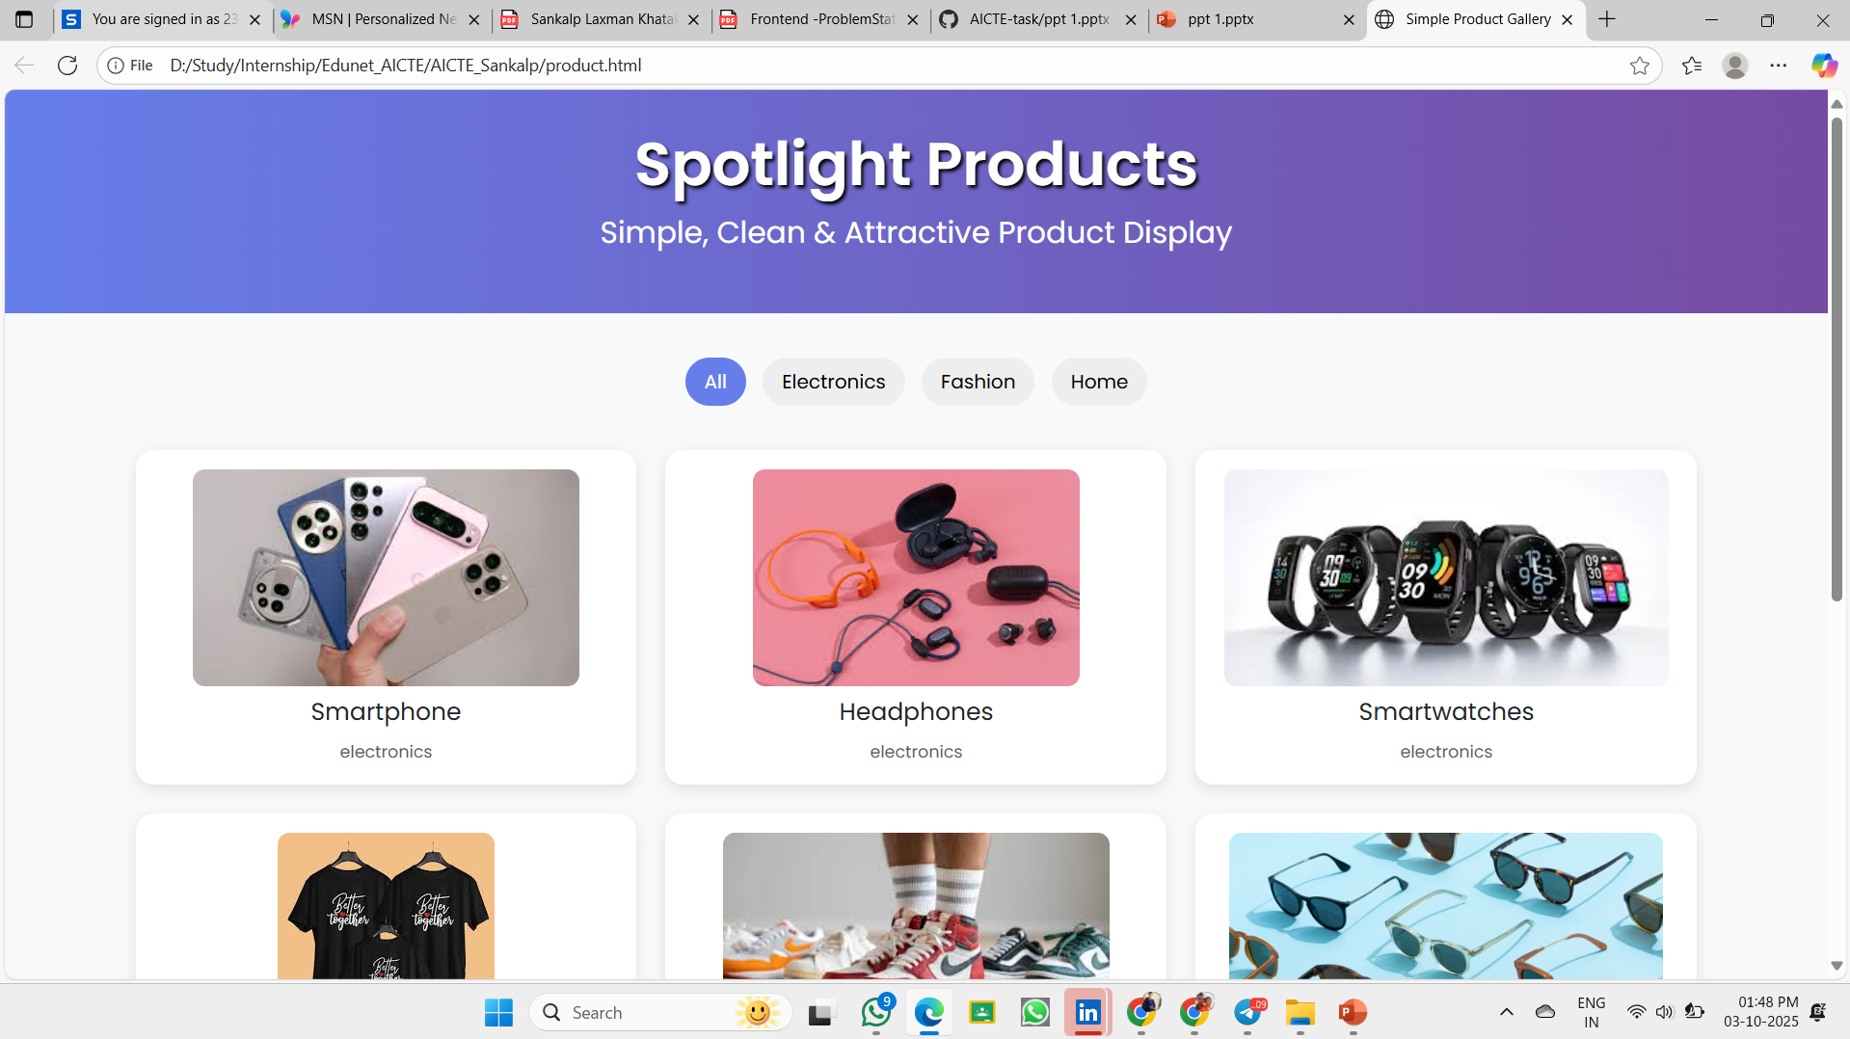
Result
Attach your Github link
https://github.com/sankalpkhatake07/AICTE_edunet_intership.git

Slide 7
Conclusion
Provides a cost-effective online presence for small businesses.
Eliminates dependency on heavy and complex e-commerce platforms.
Ensures a simple yet attractive product showcase with filtering and modal views.
Offers an engaging and interactive experience for customers across devices.
Serves as a scalable foundation that can be extended with cart, payment, or backend features in the future.

Slide 8
Future scope(Optional)
Backend Integration (Node.js / Django / Firebase): For order management, user accounts, and real-time data storage.
Secure Payment Gateway Integration: Allow customers to make direct purchases online.
Admin Dashboard: For managing products, updating inventory, and tracking orders.
AI-based Recommendations: Suggest products to customers based on browsing and purchase history.
Multi-language & Multi-currency Support: To reach a wider audience globally.
Progressive Web App (PWA): Enable offline browsing and mobile app–like experience.

Slide 9
References
NanthiniMoha/TNSDC-FWD-DIGITAL_PORTFOLIO – GitHub Repository. Available at: https://github.com/NanthiniMoha/TNSDC-FWD-DIGITAL_PORTFOLIO
Bootstrap Documentation – Get started with Bootstrap v5.3. Available at: https://getbootstrap.com/docs/5.3/getting-started/introduction/
W3Schools. HTML, CSS, and JavaScript Tutorials. Available at: https://www.w3schools.com
MDN Web Docs. Web Technologies for Developers. Mozilla. Available at: https://developer.mozilla.org
Swiper.js Documentation. Modern Mobile Touch Slider. Available at: https://swiperjs.com

Slide 10
THANK YOU

