Slide 1
Data Science Project
Sentiment Analysis using Tweets of Indian users on the Nation-wide Lockdown in India due to COVID-19
Presented By:
2017CSC1012 Sankalp Loomba
2017CSC1059 Dhruv Chandra Lohani

Slide 2
Abstract
In recent years the increasing computer power and availability of social networking sites such as Twitter, Facebook, etc. has emerged as an effective medium to express instant views about commercial products, social conditions, political situations, etc. Twitter is one such powerful source of information, which can be utilized to investigate the opinion of users.
This project presents an efficient visualization-based framework, which detects opinion from tweets employing lexical analysis approach. The approach is illustrated by taking the example of lockdown in India due to COVID-19. The idea is to try and detect the users sentiment about the lockdown and extension of lockdown.
Keywords: 6
Data Analytics, Social Media, Twitter, Sentiment Analysis, Opinion Mining, lexical analysis.

Slide 3
Introduction
With the advent of Social Networking websites and their massive usage, it has become a trend to post the views on any recent topic on these websites. Social Networking websites like Facebook or Micro Blogging websites like Twitter have been so popular these days that more and more people are joining these sites. The members (users) post their views on any topic of their interest in the form of comment, message, ‘tweet’ or feedback on these sites which is circulated to all the people connected to them. These opinions provide an insight to various stakeholders, like businesses, marketers and advertisers, etc., to improve their services and quality of their products.

Slide 4
Introduction (Contd.)
These views are not a source of insight to just the stakeholders mentioned above but to some unorthodox stakeholders as well; for example, the biggest feature of a Democracy is people’s dissent. With the availability and popularity of websites like Facebook, Twitter and Instagram, and because of various other features like ease-of-use, and insant reach to public, these websites are a major source of people’s opinion on Socio-Political Matters, Economic Schemes and National Policies.
By analysing the user’s views in the form of comments, posts, tweets, etc., Political Parties or even departments of Govt., in form of these unorthodox stakeholders, can better understand the public’s opinion and improve their policies and schemes to better suit the needs of the public.

Slide 5
Introduction (Contd.)
The biggest challenge for these stakeholders is to analyze these views to know whether sentiments of people are positive, negative or neutral. This is where Sentiment Analysis comes in.
Some of the popular techniques being used for Sentiment Analysis are Supervised Machine Learning and Lexical Analysis.

Slide 6
Introduction – Supervised Machine Learning
Supervised learning is the machine learning task of learning a function that maps an input to an output based on example input-output pairs.^{[1]} It infers a function from labeled training data consisting of a set of training examples.^{[2]}
In supervised learning, each example is a pair consisting of an input object (typically a vector) and a desired output value (also called the supervisory signal). A supervised learning algorithm analyzes the training data and produces an inferred function, which can be used for mapping new examples. An optimal scenario will allow for the algorithm to correctly determine the class labels for unseen instances. This requires the learning algorithm to generalize from the training data to unseen situations in a "reasonable" way.

Slide 7
Introduction – Lexical Analysis
Lexical Analysis is the process of converting a sequence of characters (such as in a computer program or web page) into a sequence of tokens (strings with an assigned and thus identified meaning).^{[3]}
A program that performs lexical analysis may be termed a Lexer, Tokenizer, or simply, a Lexical Analyzer. Lexical Analyzer has been used by many applications to extract meaningful tokens while removing unwanted white spaces, comments, etc.
In this paper lexical analysis approach has been used to evaluate the polarity of the sentiment shared on twitter using the user-defined function score.sentiment which fulfils the dual task of filtering the tweets and then classifying them into a category positive, negative or neutral according to the score assigned.

Slide 8
Research Problem
What is the people’s reaction/opinion on the Nation-wide Lockdown and extension of the Nation-wide Lockdown in place due to the pandemic COVID-19?

Slide 9
Motivation
With the arising of this unusal situation presented by Novel Coronavirus, countries across the globe have gone under lockdown and have urged people to stay at their homes and follow home quarantines.
India also annouced a nation-wide lockdown on 24th March 2020 that came into effect from the midnight of 25th March 2020. Though the local governments had placed some restrictions on free movement, the lockdown caught a lot of people off-guard. With trains and flights being cancelled a lot of people, specially belonging to lower-class families were left stranded in different cities and wanting to go back. On 14th April 2020, the Prime Minister of India announced that the lockdown will be extended till 3rd May 2020.
People have had various opinions about this move and analysing these opinions using a quantitative measure is the motivation behind this project.

Slide 10
Approach
We analyse people’s opinion about the Nation-wide Lockdown using Sentiment Analysis of Tweets being tweeted on Twitter related to the same.
For that, we developed an App on twitter-developer platform that allows us access to tweets. ^{(Pic 1)}
We then wrote an R-Script to fulfil our task.
We have used TwitteR library to be able to fetch tweets to our script using our developed app, tidyverse library for ‘qplot’ and dplyr library for it’s function ‘laply’ that is being used in the user-defined function ‘score.sentiment.’
We have used ‘ROAuth’ package which provides an interface to the OAuth 1.0 specification allowing users to authenticate via OAuth to the server of their choice. ^{(Pic 2)}

Slide 11
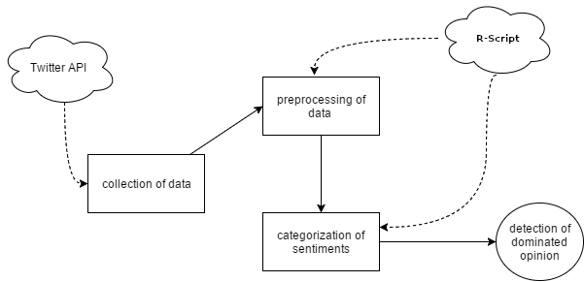
Approach
Fig 1 - Methodology

Slide 12
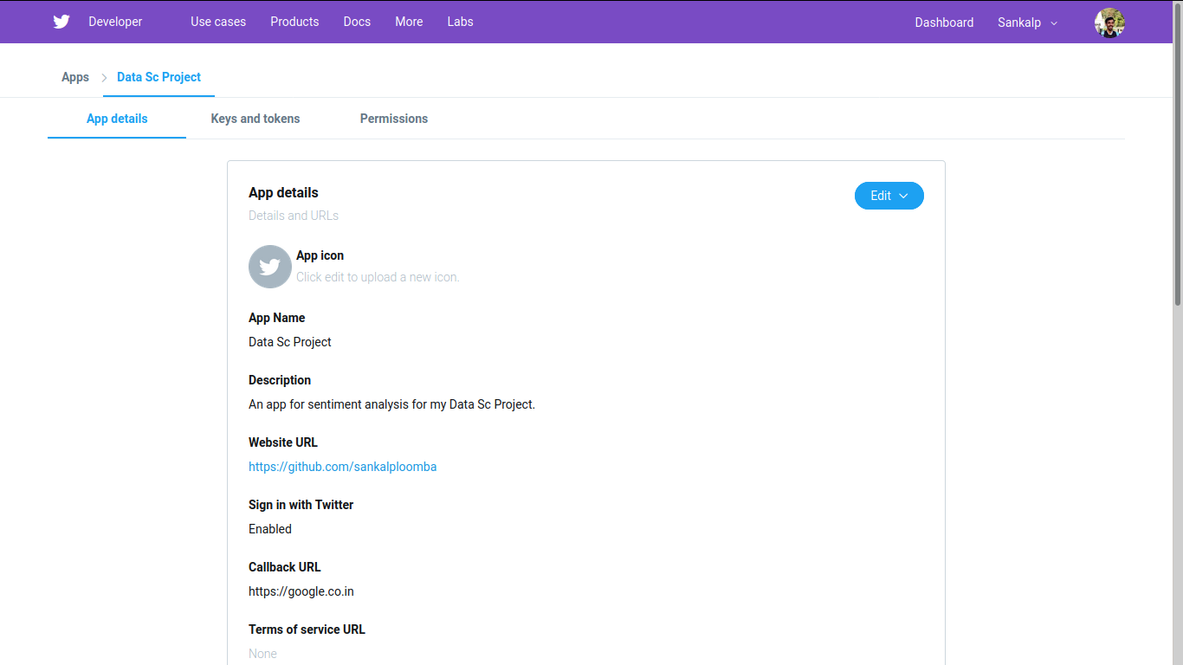
Approach (Contd.)
Pic 1 – Showing the app developed for getting access to tweets

Slide 13
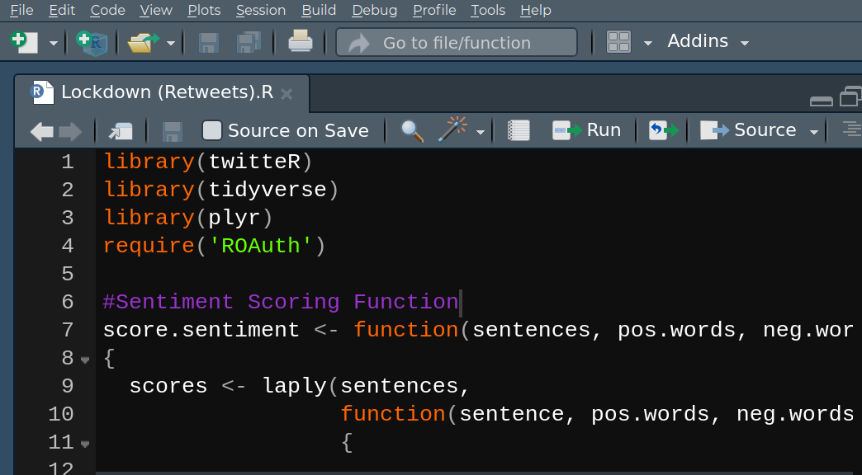
Approach (Contd.)
Pic 2 – Showing the libraries being used in the R-Script

Slide 14
Approach – Establishing Connection
To establish connection to the app we developed on the twitter platform, we use functions of the TwitteR library. ^{(Pic 3)}
We define variables to contain values that are required to establish a connection. These variables are then later passed as arguments to functions that establish the connection. (The values are available to the developers of the app in their developer-account.)
When twitCred$handshake() method is called, the rconsole takes some time and then loads a webpage that directs to the twitter app authorisation page. ^{(Pic 4)}
After the user logins and authorises the app, they are redirected to a google page. There, one needs to copy the latter part of the query string and paste it into the rconsole to finish the authentication process. ^{(Pic 5)}

Slide 15
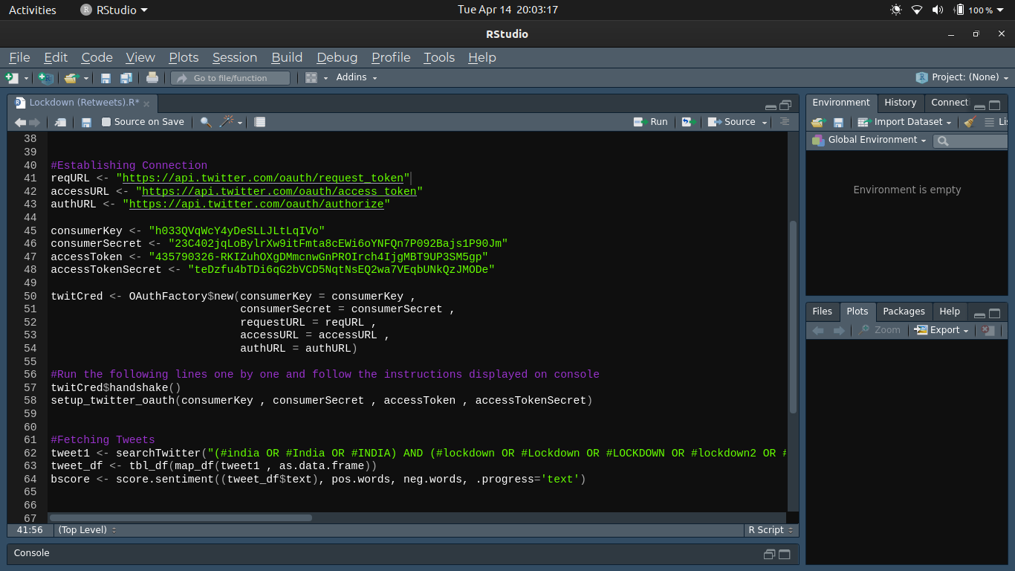
Approach - Establishing Connection (Contd.)
Pic 3 – Showing the code used to establish connection to the twitter app

Slide 16
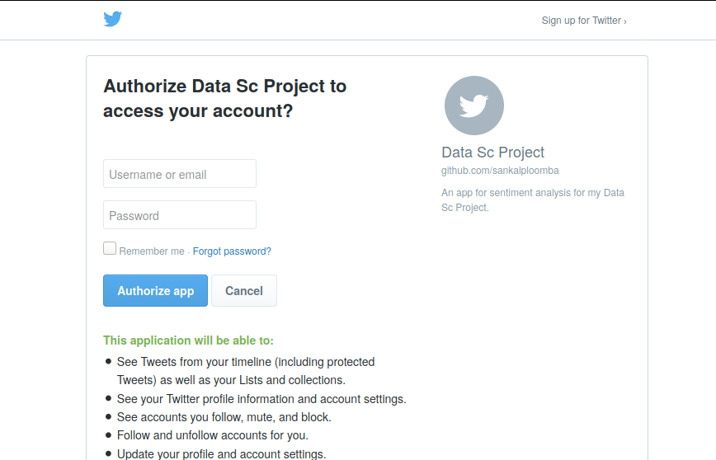
Approach - Establishing Connection (Contd.)
Pic 4 – Showing the authorisation page for the twitter app

Slide 17
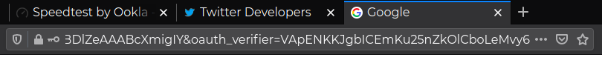
Approach - Establishing Connection (Contd.)
Pic 5 – Showing the redirected page for the twitter app. Copy the value after “oauth_verifier=” and paste that into rconsole.

Slide 18
Approach – Establishing Connection (Contd.)
Variable Name | Intended Purpose
reqURL | The URL provided for retrieving request tokens
authURL | The URL provided for authorization/verification purposes
accessURL | The URL provided for retrieving access tokens
consumerKey | The consumer key provided by your application
consumerSecret | The consumer secret provided by your application
accessToken | The access token supplied by Twitter
accessTokenSecret | The access secret supplied by Twitter

Slide 19
Approach – Establishing Connection (Contd.)
Name | Type | Purpose
twitCred | Object of OAuth Class | Class OAuth wraps and handles OAuth handshakes and signatures for the user within R
twitCred$handshake() | Function of OAuth Class | Performs an OAuth handshake using the information provided.
setup_twitter_oauth | Function | This function wraps the OAuth authentication handshake functions from the httr package for a twitteR session

Slide 20
Approach – Loading list of words and Fetching Tweets
We load the list of words^{[4]} that we have classified into positive or negative categories using the ‘scan’ function of the ‘base’ package which reads data into a vector or list from the console or a file. ^{(Pic 6)}
We fetch the tweets using the function searchTwitter() of TwitteR library. This function issues a search of Twitter based on a supplied search string. We have passed values to three of it’s parameters.
Then, we use the functions map_df and tbl_df to convert the fetched tweets to a data frame.

Slide 21
Approach – Loading list of words and Fetching Tweets (Contd.)
Parameter Name | Intended Purpose
searchString | Search query to issue to twitter.
n | The maximum number of tweets to return
lang | If not NULL, restricts tweets to the given language, given by an ISO 639-1 code

Slide 22
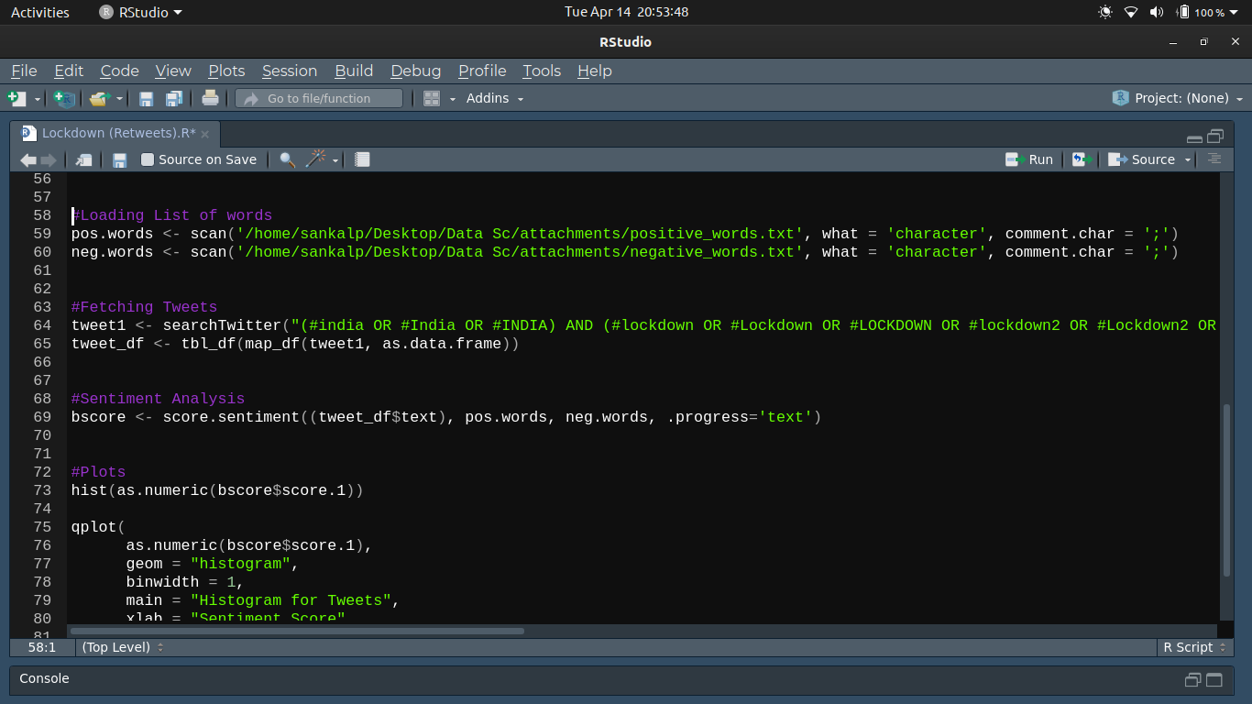
Approach – Loading list of words and Fetching Tweets (Contd.)
Pic 6 – Showing the code used to fetch tweets and load the list of words

Slide 23
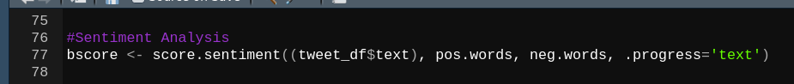
Approach – Sentiment Analysis
We call the function score.sentiment that filters out tweets and assigns score to each tweet and store the returning object in ‘bscore’. ^{(Pic 7)}
Pic 7 – Showing the code that calls the function score.sentiment

Slide 24
Approach – Sentiment Analysis (Contd.)
To filter out the tweets that we import using our app and to score the tweets according to the sentiment they belong to, we use the user-defined function ‘score.sentiment’. ^{(Pic 8)}
We have supplied this function with the list ‘text’ of the data frame consisting of the fetched tweets, the list of positive words, the list of negative words, and .progress which helps display a progress bar in the console.
Inside this function, we have used the laply function of the dplyr package, that, for each element of a list, applies a function then combines the results into an array.

Slide 25
Approach – Sentiment Analysis (Contd.)
The function being applied is also a user-defined annoymous function that removes:-
- punctuation characters
- control characters
- digits
and converts the tweet into lowercase. Then, it extracts all words from a tweet and checks them with all the words present in the postive words and negative words list to calculate the score of the tweet. A score greater than zero implies positive category,
a score lesser than zero implies negative category, and a score of zero implies neutral category.
We convert the results into a data frame and return this data frame. ^{(Pic 8)}

Slide 26
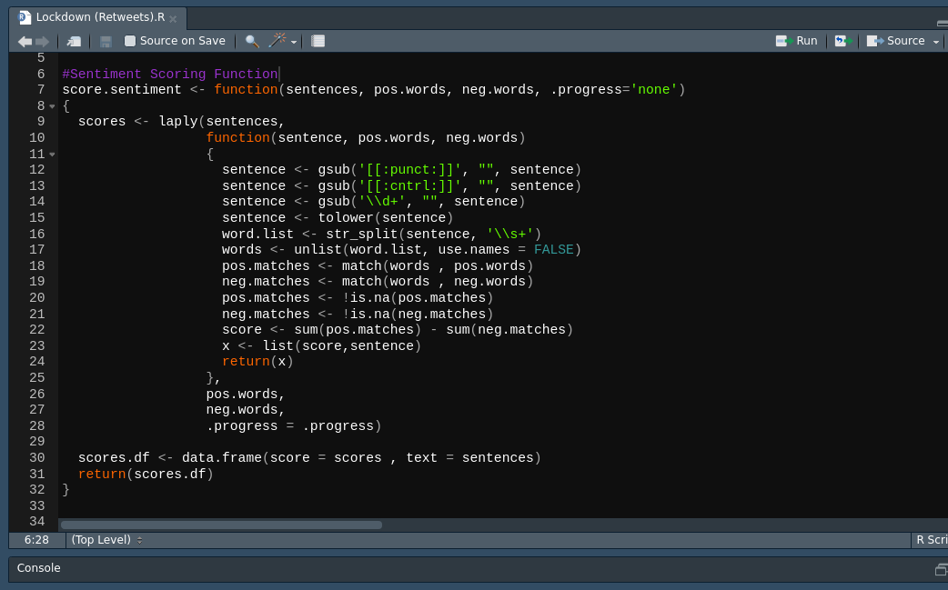
Approach – Sentiment Analysis (Contd.)
Pic 8 – Showing the function score.sentiment()

Slide 27
Approach - Plots
We use the hist() function of the graphics package and the qplot() function of the ggplot2 package to plot our results.

Slide 28
Approach – Plots (Contd.)
Pic 9 – Showing the code for the graphs.

Slide 29
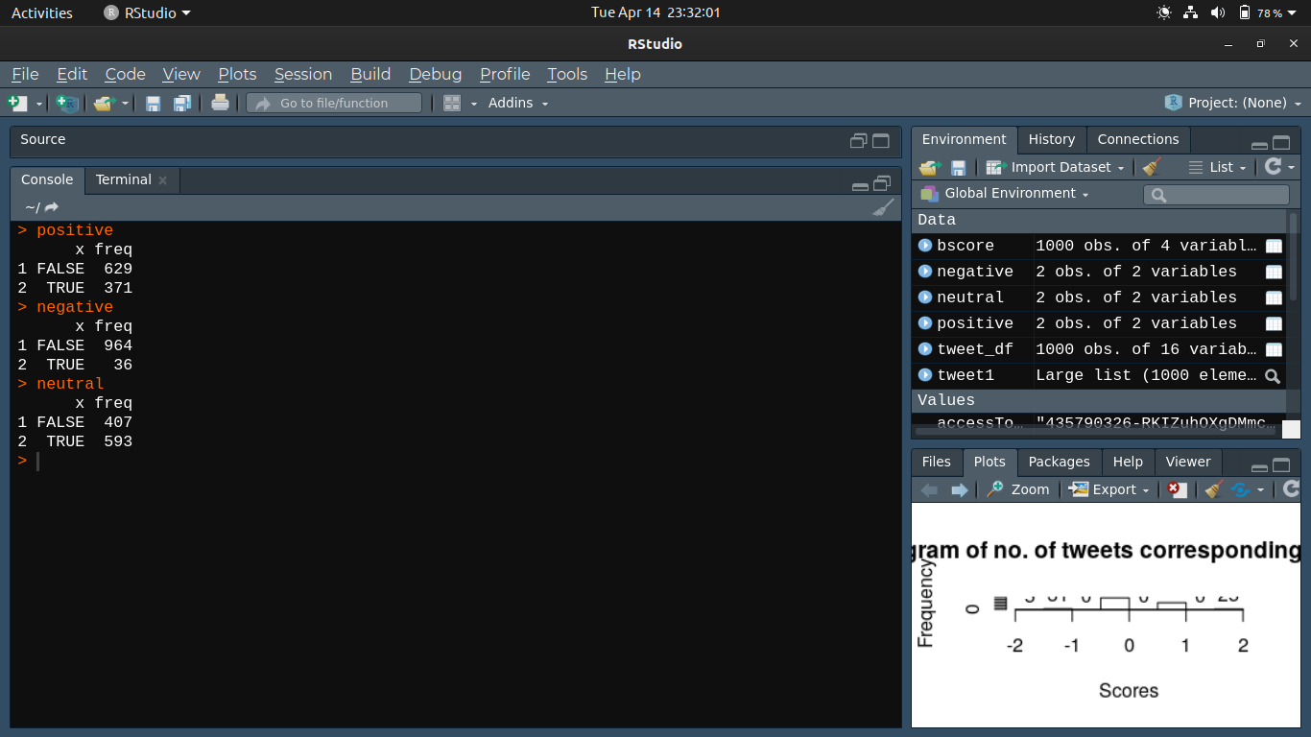
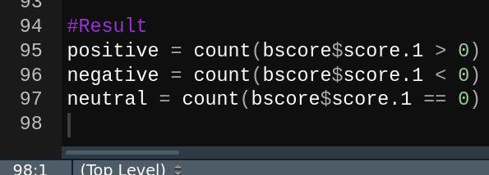
Results
We find out our results from 2 methods:-
1) By arithmetic methods.
Arithmeticly, we calculate the number of positive, negative and neutral tweets by a simple piece of code.
We see that there are 371 positive tweets, 593 neutral tweets and 36 negative tweets.
Pic 10 – code for no. of positive, negative and neutral tweets
Pic 11 – output of code in Pic 10

Slide 30
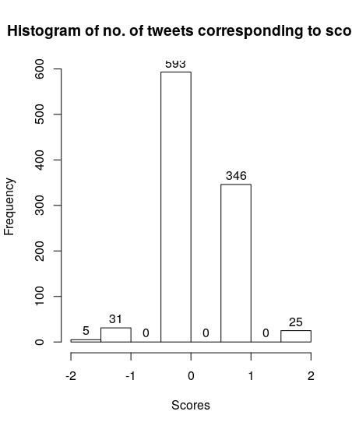
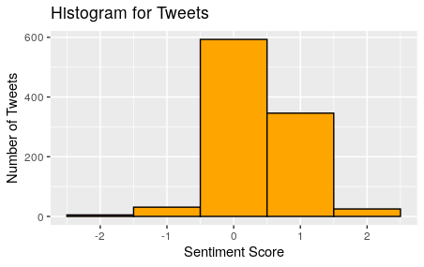
Results (Contd.)
Pic 12 – plot generated by hist() function
Pic 13 – plot generated by qplot() function

Slide 31
Results (Contd.)
2) Graphically from the plots. ^{(Pic 12) (Pic 13)}
It is evident from the plots that there are:- 346+25=371 positive tweets, 31+5=36 negative tweets and 593 netural tweets.
By both methods we see that most of the tweets are neutral in nature, followed by positive and at last negative tweets.

Slide 32
Discussion
For the purpose of our project, we have taken into consideration Retweets which would normally be considered repetitions of the original tweet and avoided. We consider them, because in Sentiment Analysis, even retweets represent the opinions of the individual that retweeted the original tweet, and though the content of the tweet maybe same, but the fact that a different person has a same opinion is what makes it valid in our study.

Slide 33
Discussion (Contd.)
- At the time of study, the maximum number of tweets fall in the neutral category (593 tweets) denoting that most of the people are not bothered by the Nation-wide lockdown.
- The number of positive tweets are 371 denoting that many people feel that the step taken by the Govt. of India is a good one.
- The number of negative tweets are 36 denoting that some people have faced problems because of the step taken by the Govt. of India.
A separate study can be performed to identify the problems faced by these people.

Slide 34
Conclusion
In this project, a methodology is proposed which will determine the dominated opinion in a scenario. This project was done on 1000 tweets taken from twitter as sentiments of the topic. For this methodology a user-defined function was used for performing lexical analysis on the data which resulted in 3 types of opinion i.e. positive, negative and neutral for each tweet. These opinions are then visualized graphically according to their sentiment score value and thus gave insights into the user opinion on the Nation-wide Lockdown in place in India. This methodology can be helpful for various types of stakeholders and can help them in making better marketing strategies, providing better services, making better policies for the public, etc., based on the interactions of user on social networking sites.

Slide 35
References
[1] Stuart J. Russell, Peter Norvig (2010) Artificial Intelligence: A Modern Approach, Third Edition, Prentice Hall ISBN 9780136042594.
[2] Mehryar Mohri, Afshin Rostamizadeh, Ameet Talwalkar (2012) Foundations of Machine Learning, The MIT Press ISBN 9780262018258.
[3] https://en.wikipedia.org/wiki/Lexical_analysis
[4] https://www.cs.uic.edu/~liub/FBS/sentiment-analysis.html

