Slide 1
Orange Army
Class: IS664, Database Programming
Project By:
Pranitha Nukala Roydon Quadros
Rohit Rao
Sankalp Redgaonkar
Tejal Sawant

Slide 2
Outline of the Presentation:
Introduction
Entity Relationship (ER) Modeling
Orphaned Row
Approaches to Phase-1
Creating Database and tables
ER Diagrams
Conclusion
Highlights of Phase-2

Slide 3
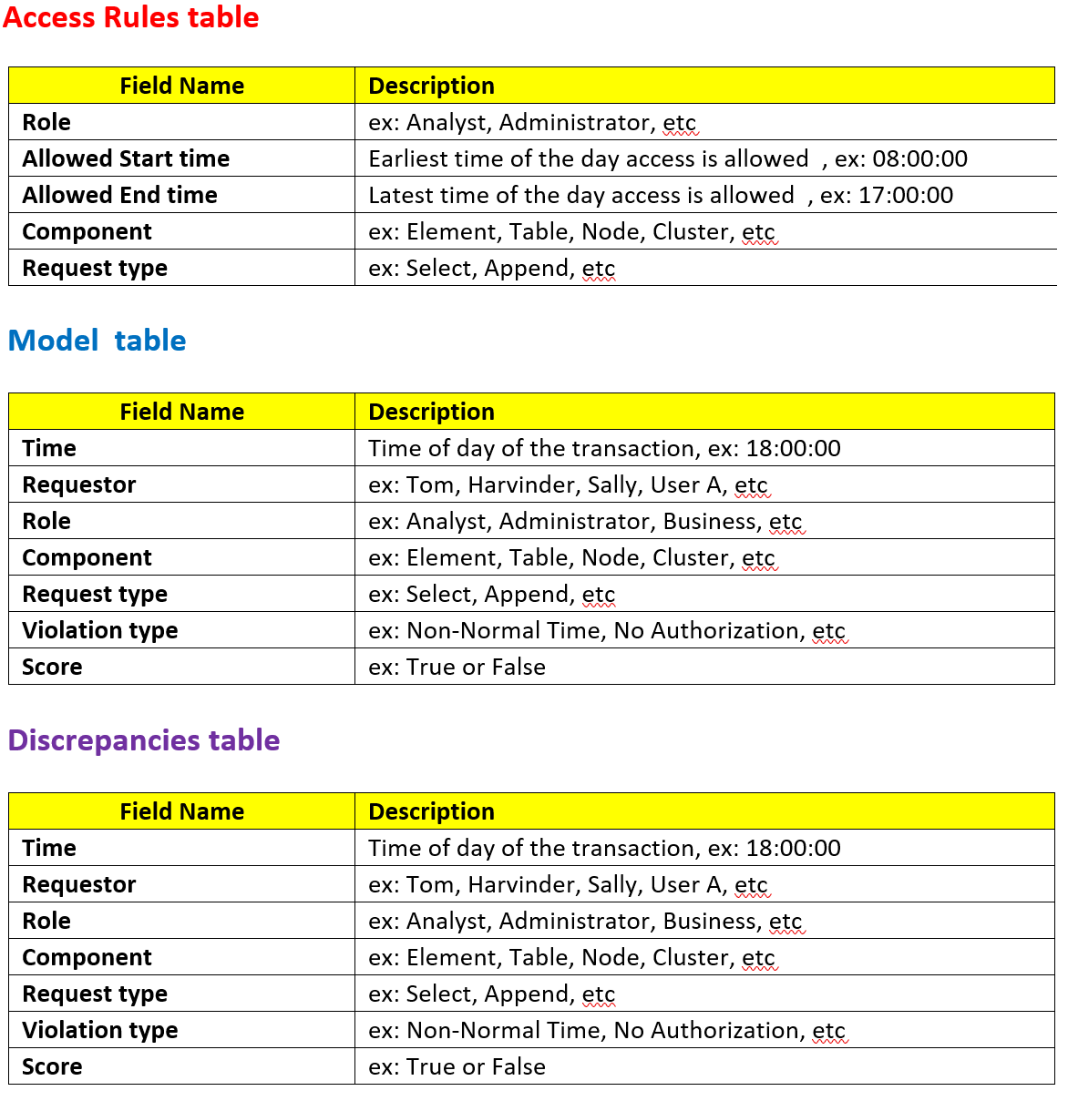

Slide 4
Entity Relationship Modeling:
What is ER Modeling
It is a graphical approach to database design using Entity/Relationship to represent real world objects.
Why is ER diagram used
It is a communication tool which is understood by technical as well non-technical users.
The graphical representation is a simplified version of database creation.

Slide 5
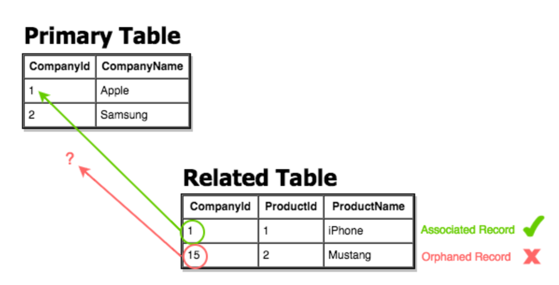
Orphaned Row
What is Orphaned Row?
An orphaned record is a record whose foreign key value references a non-existent primary key value.
How does it work?
If we delete record number 15 in a primary table, but there’s still a related table with the value of 15, we end up with an orphaned record.

Slide 6
Approaches to Phase- 1
Approach 1:
Primary key
Error due to data redundancy.
Composite key
Data loading error due to referential integrity.
Approach 2 :
Inserting a new column
Why we chose approach 2?
Issues we might face in phase 2

Slide 7
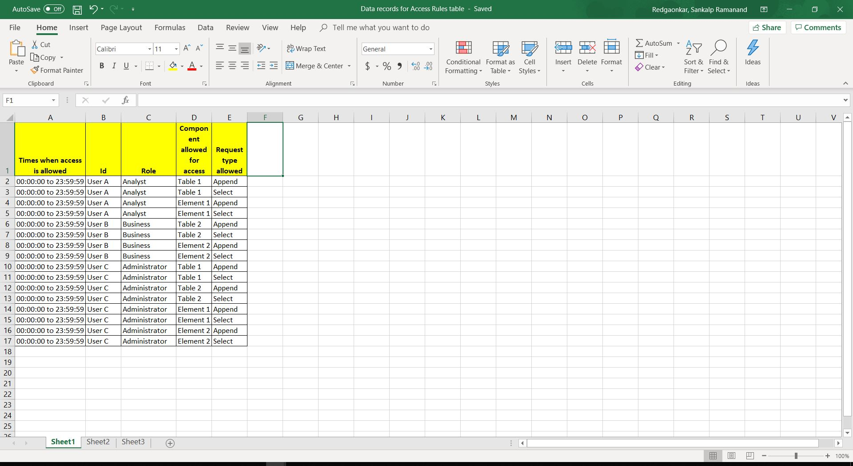
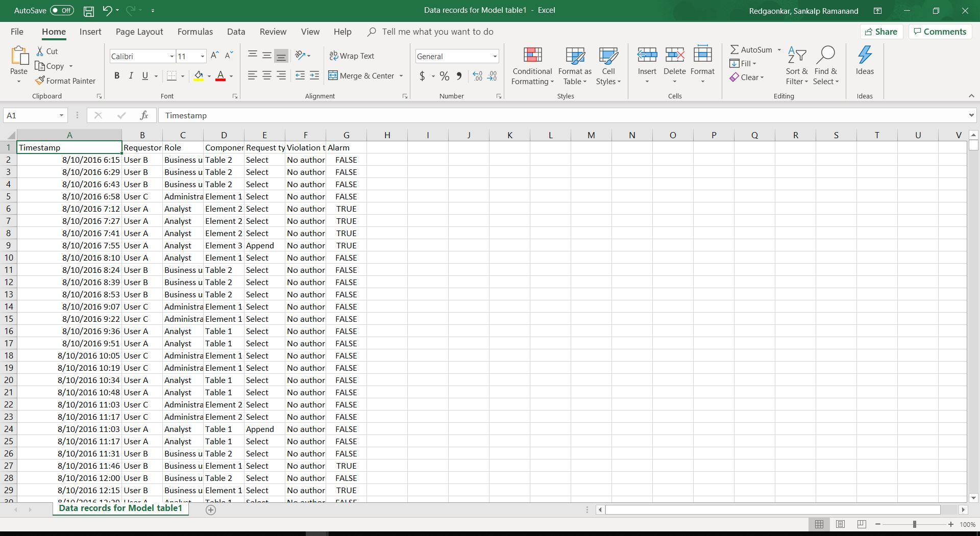
Access rule table and Model Table

Slide 8
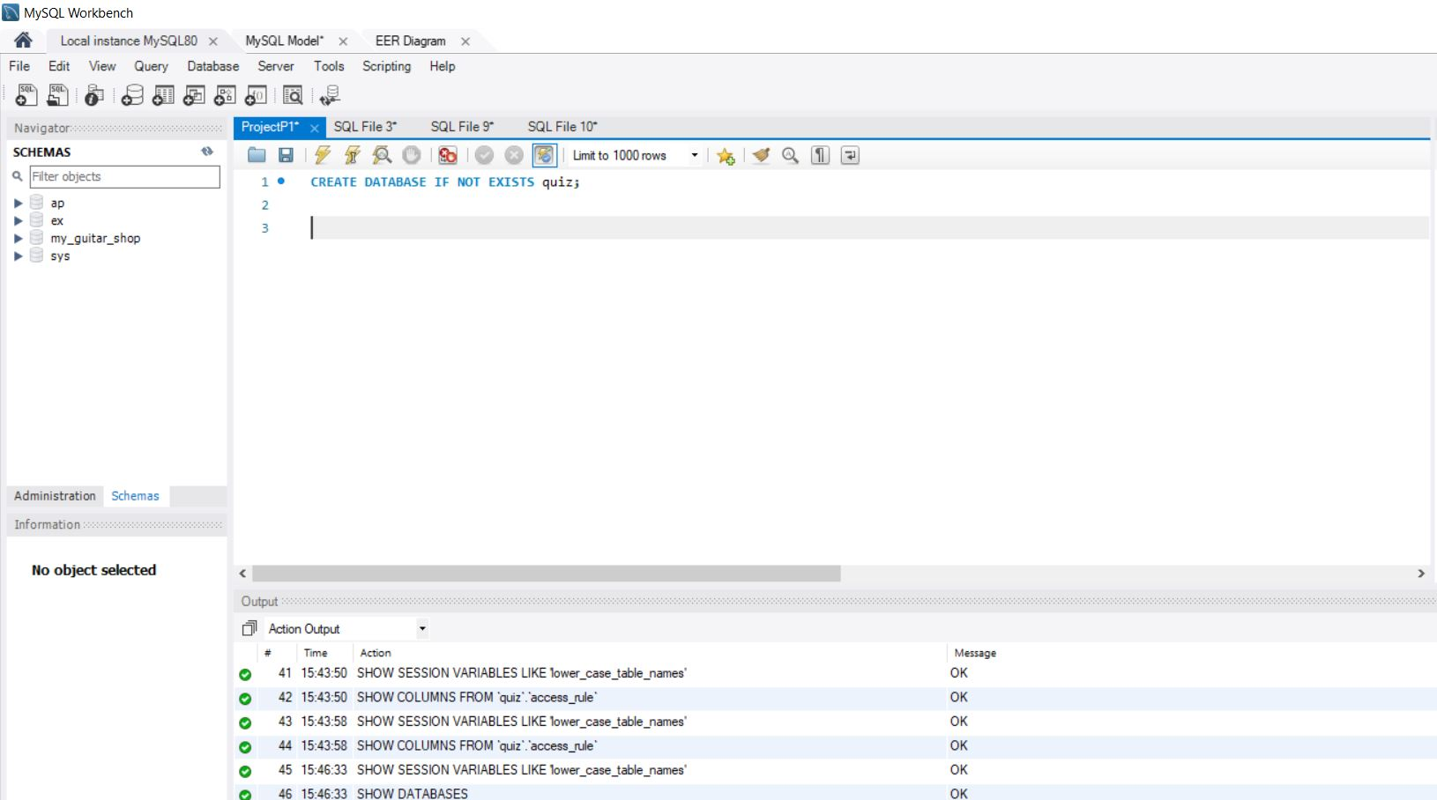
Creating Database

Slide 9
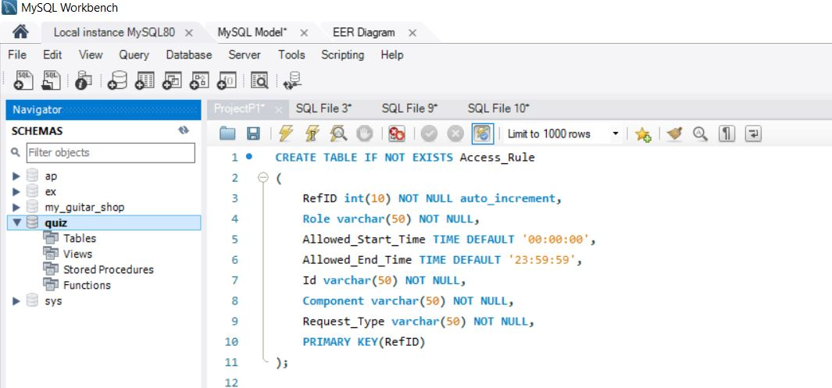
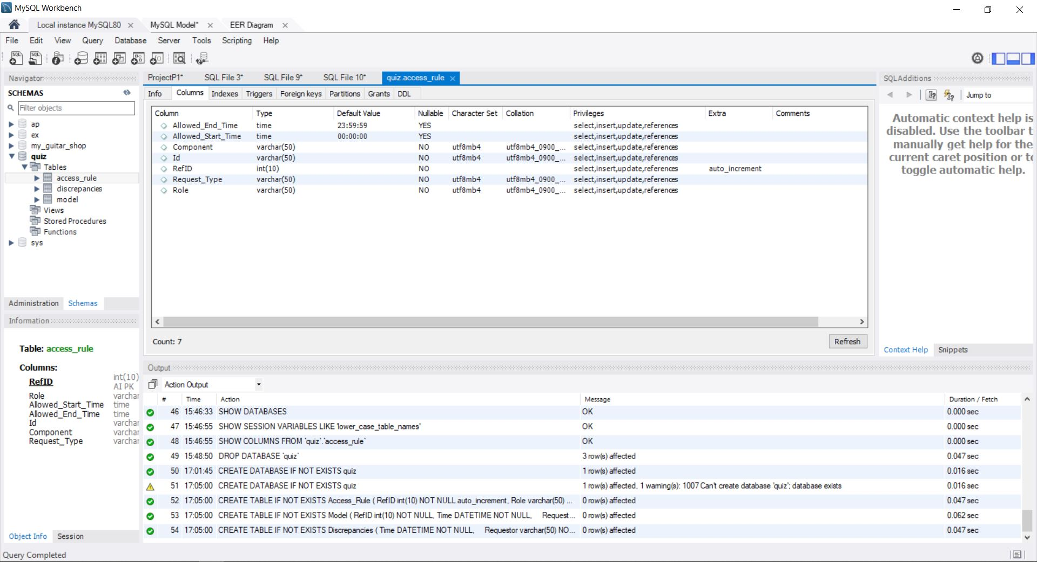
Creating Access_Rules table

Slide 10
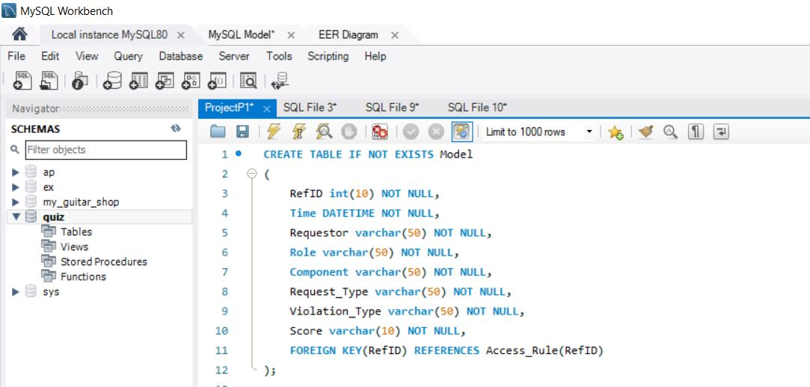
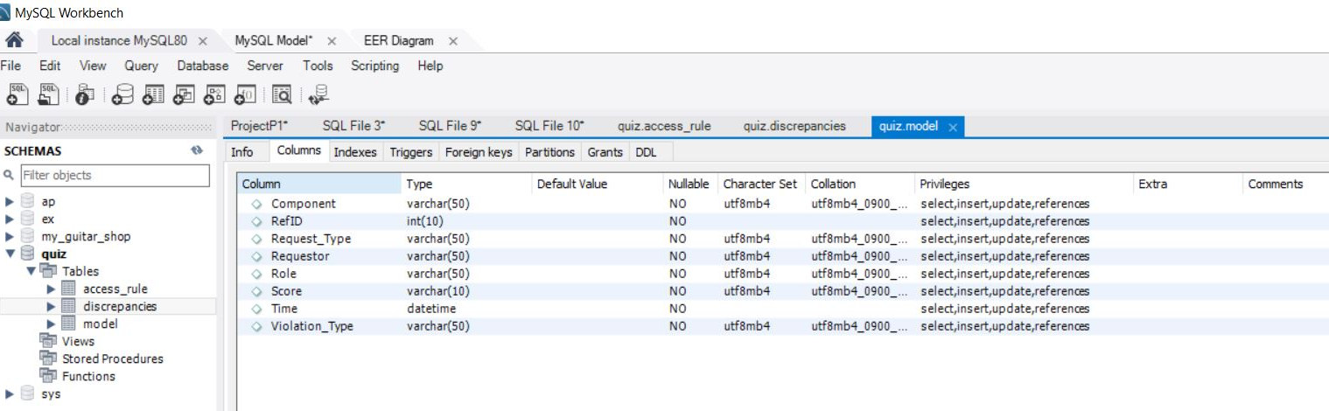
Creating Model Table

Slide 11
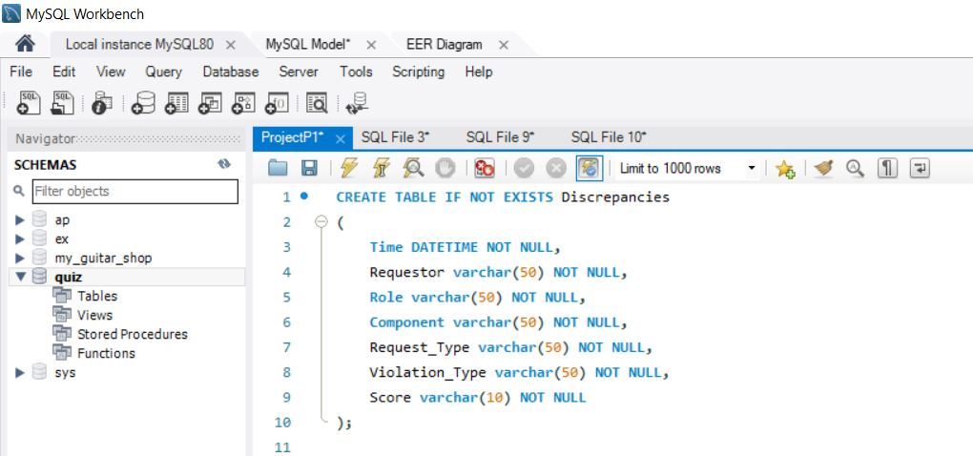
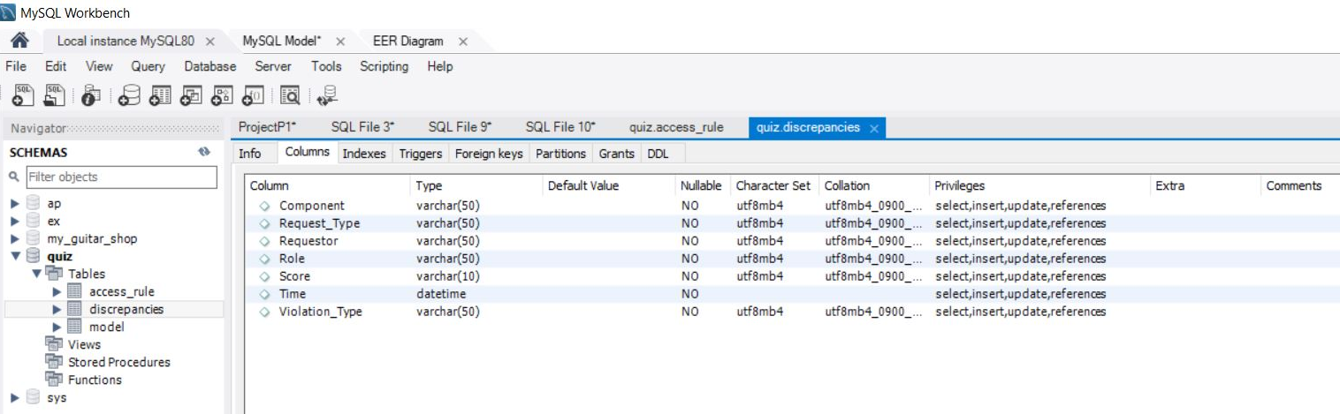
Creating Discrepancies table

Slide 12
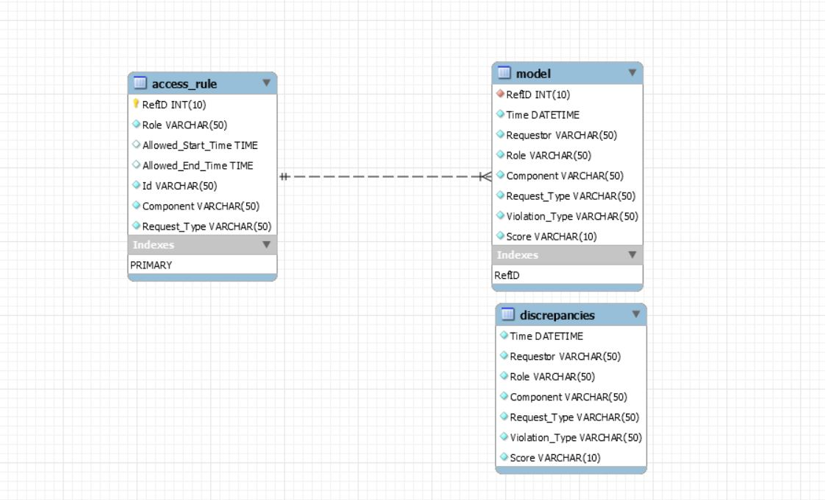
ER-Diagram:

Slide 13
Conclusions:
From the ER Diagram observations, we found a strong relationship between the tables.
We observed one to many relation.
Phase 1: Creating schema named ‘Quiz’ with tables and ER diagram:
From the dataset given to us, we can see that we cannot have a primary key in our access rules table as we have repeating values in all the variables.
Also, we can make a composite key in access rules table using variables Role, Component Accessed and Request Type. But this gives an issue when we try to load the data into model table due to orphaned rows.
So, we go with the approach of adding a new auto incremented variable in the access rules table and making it as a primary key and using the same variable as foreign key in model table.
As we can see from the generated EER Model, we have created primary key in access rule table named “RedID” which is referenced in model table as foreign key.
From the problem statement of phase 2, we think that we do not need any key for discrepancies table, we can treat that table as an empty box in which we just have to add items.

Slide 14
Highlights of phase 2
From the dataset given to us, we might face few issues:
Date Format: The format given in our dataset for model table is “mm/dd/yyyy” where in SQL we need “yyyy/mm/dd”. So, we will have to change that format and load the data.
Values in variable(column) “Role” in access rules table is “Business” where in model table it is “Business User”. So, here we can change those values in access rules table, or we can use “LIKE” function while comparing both the tables.
Approach to compare the tables can be tried using “Cursors” to move from one row to another.
One approach can be, we can match each pertinent variable and as soon as we find that any variable is not matching, we will stop there and insert that row into discrepancies table using subquery.
Other approach can be, we will match each variable in both the tables and fetch their respective primary keys from access rule table and then mark the rows which do not match with row id as 0. And later we can put all these rows with id 0 in discrepancies table.

Slide 15
THANK YOU!

