Slide 1

IS 613 : DATABASE MANAGEMENT SYSTEM
Members: Dhiraj Lulla Ronak Laungani Sankalp Redgaonkar Radhika GOSWAMI Aishwarya CHODAPANEEDI Mayuri Khade

Slide 2
Introduction:
SmartPark is a new venture initiated by the Smart team, which focuses on a very common problem that New Yorkers suffer from : PARKING
Why SmartPark?
Business Objectives
Application Working

Slide 3
Why SmartPark?
The Smart team realizes that many car owners in NYC either spend a fortune for a parking lot or deal with moving their car most of the time. The Smart team thinks that many New Yorkers will sign up for this service and turn out high ROI. This venture will be eventually carried forward to other metropolitan cities upon successful execution of its first phase in NYC.
Business Objectives
To allow the customers to store all their information like email, mailing address and their car model in their account;
To allow the customers to search for a nearby available parking spot location;
Easy to use application that is user friendly;
To allow the customers to setup their payment online;
To allow customers to discuss parking spots;
To allow customers to be notified with the parking spot regulations.

Slide 4
Application Working
When New Yorkers are looking for a parking spot, they can request the application to find one for them. If there is a spot available, the application will return an exact location for the spot (which street/avenue, which side of the street, how far down the block). If there isn't one available, they can request that the attempt be tried every 2 minutes to see if a spot has become available. If they move or if they get a new car, they will need to update their profile.

Slide 5
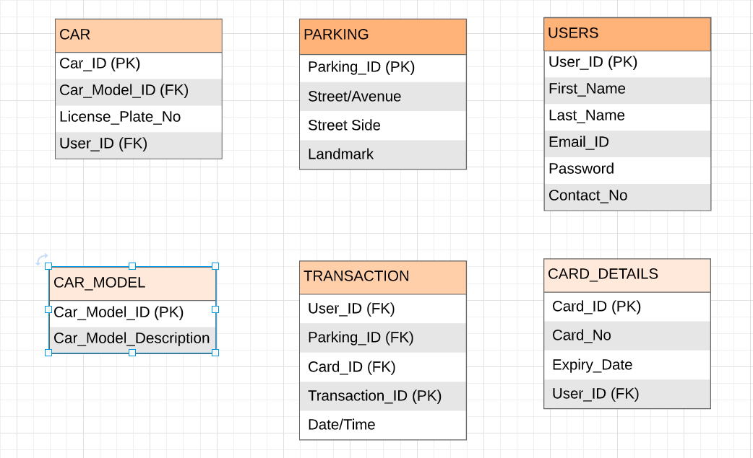
Entities and Attributes:

Slide 6
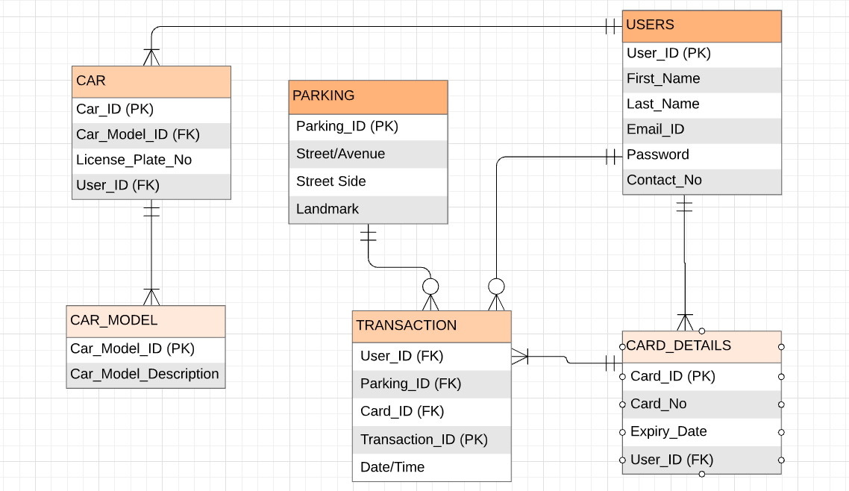
ER Diagram:

Slide 7
Relations:
USERS(User_ID, First_Name, Last_Name, Email_ID, Password, Contact_No)
CARD_DETAILS(Card_ID, Card_No, Expiry_Date, User_ID(FK))
TRANSACTION(Transaction_ID, User_ID(FK), Parking_ID(FK), Card_ID(FK), Date/Time)
PARKING(Parking_ID, Street/Avenue, Street Side, Landmark)
CAR(Car_ID, Car_Model_ID(FK), License_Plate_No, User_ID(FK))
CAR_MODEL(Car_Model_ID, Car_Model_Description)

Slide 8
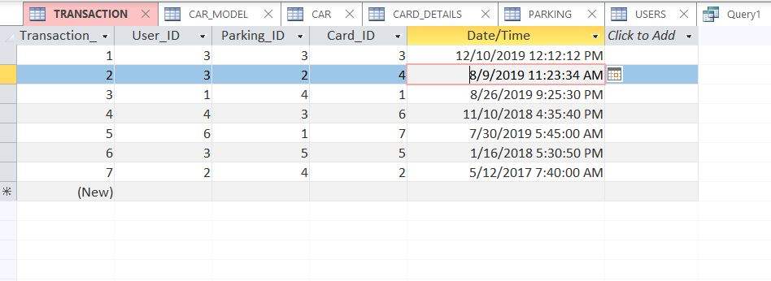
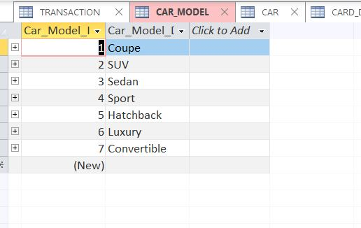
TABLES:
Transaction Table
Car Model Table

Slide 9
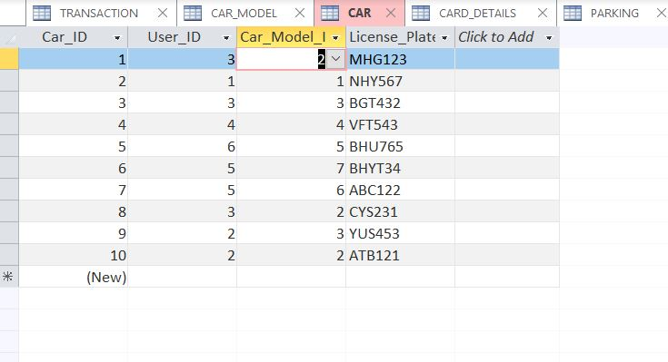
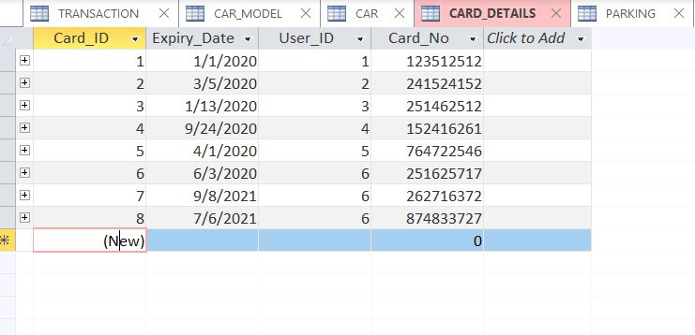
Car table
Card Details Table

Slide 10
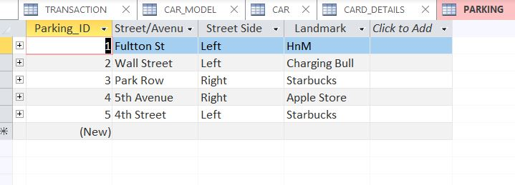
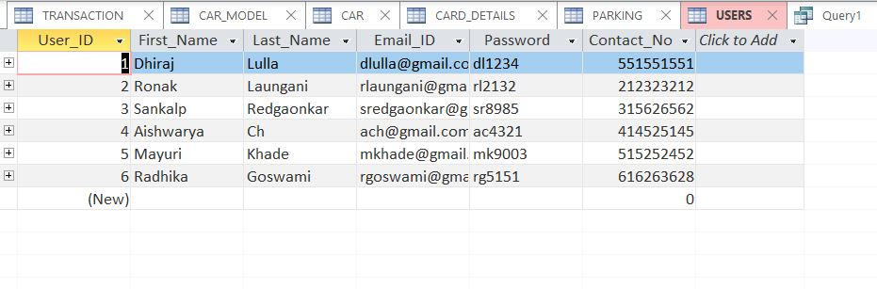
Parking table
Users table

Slide 11
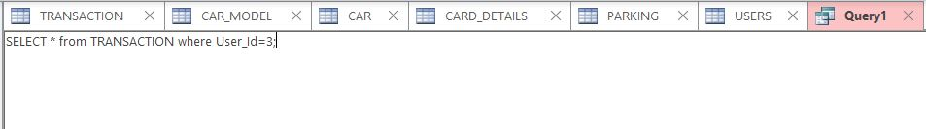
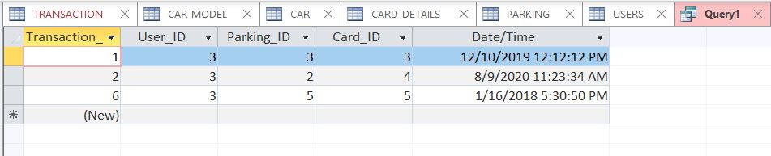
Queries:
Query 1:
Output 1:

Slide 12
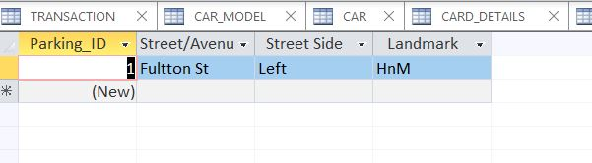
Query 2:
Output 2:

Slide 13
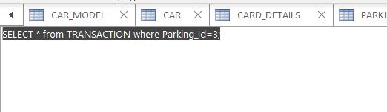
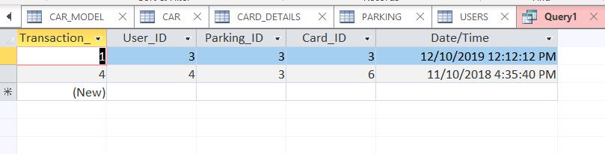
Query 3:
Output 3:

Slide 14
Thank You!

