Slide 1




Michael Keatinge

Slide 2


Slide 3



The 2017 Annual Economic Report
A comprehensive overview of the latest information available on the structure and economic performance of EU Member States (MS) fishing fleets.

Slide 4
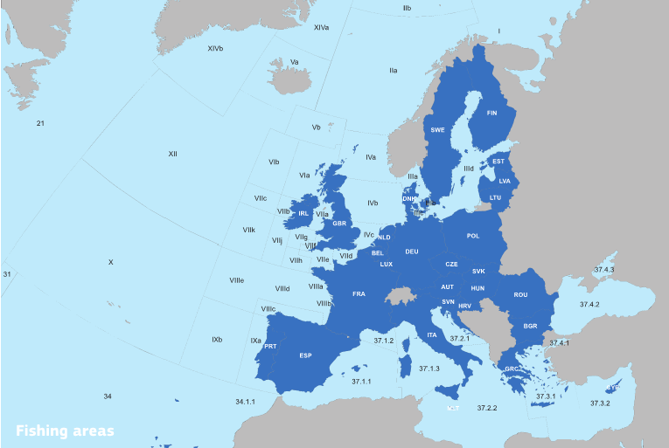

Slide 5
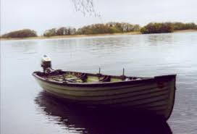
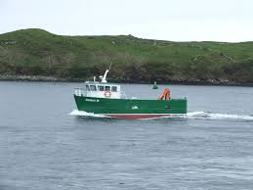
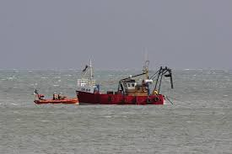
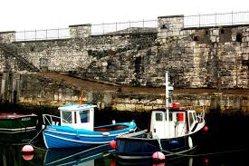
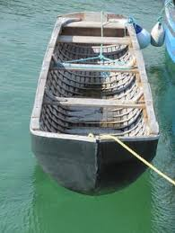
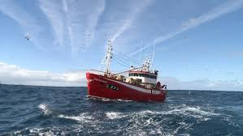
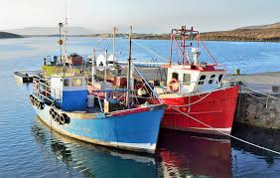

Slide 6
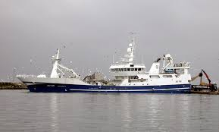
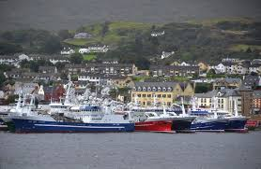
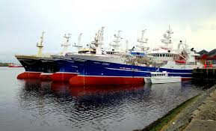
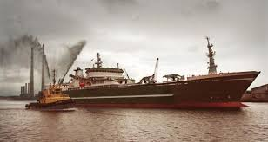

Slide 7

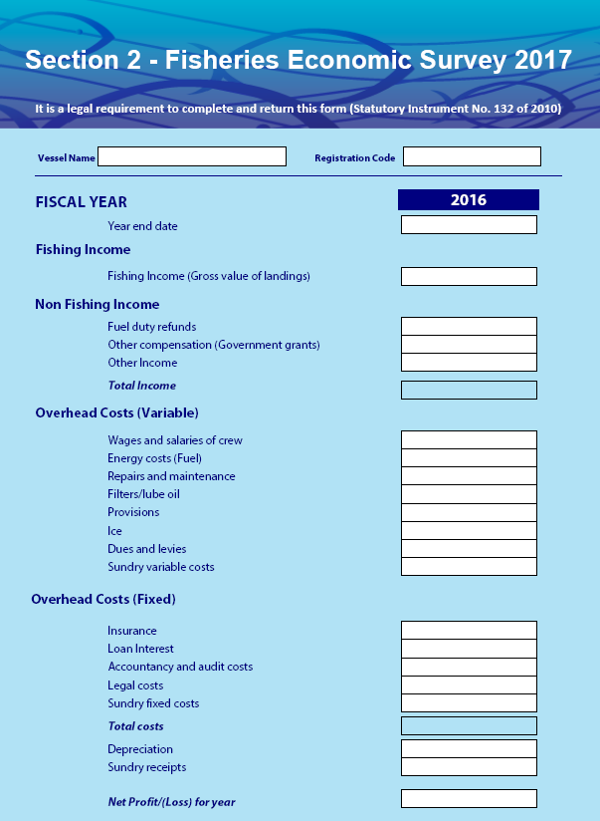

Slide 8

Summary of the Main Findings
Covers the period 2008-2017
Fishing capacity,
Effort,
Employment,
Landings,
Income
Costs
Projected values for 2016
Forecast estimates for 2017.

Slide 9
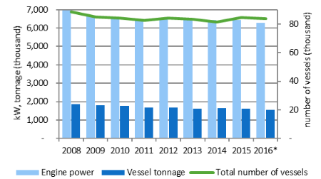
Fleet Capacity and Structure
84,420 Vessels
1.62 million GT
6.44 million kW
  20,444 Inactive
  63,976 Active

Slide 10
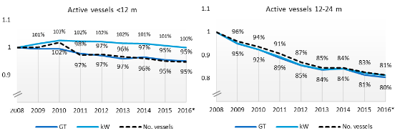
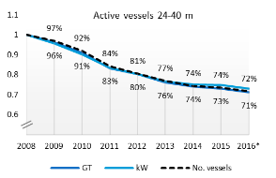
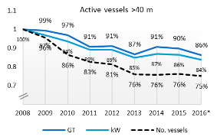
Active Fleet Capacity and Structure over time

Slide 11
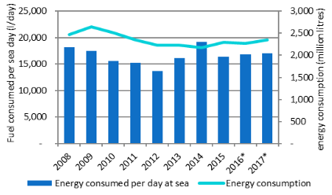
Fuel Consumption
2.3 million tonnes of fuel
Spain 709 ‘000 tonnes (30%)
Italy 378 ‘000 tonnes (16%)
France 317 ‘000 tonnes (14%)
Fuel consumption rose 6%
Since 2009
Fuel consumption declined
Fuel intensity (Lit/t fish) declined
Fuel efficiency (1- €fuel/€fish) up 15%

Slide 12
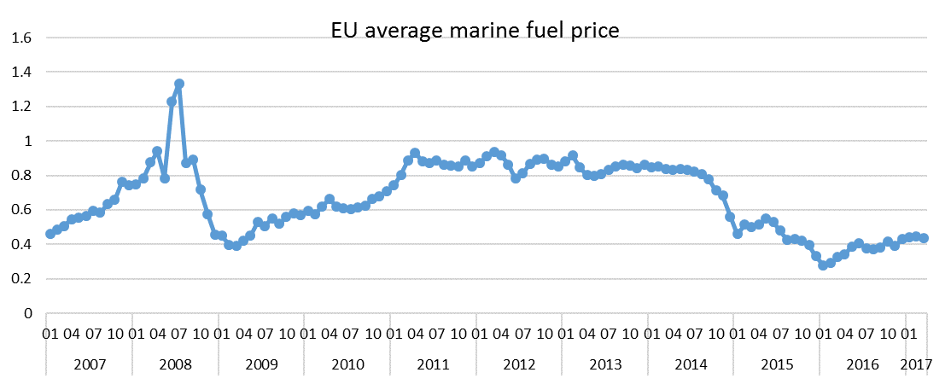


Slide 13
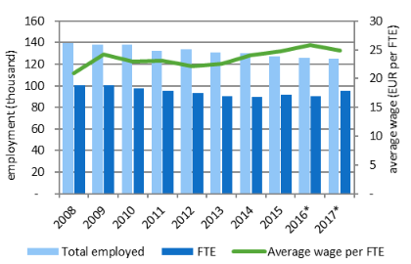
Employment
152,720 Fishers
114,863 FTEs
6 Member States 82% of total
Spain 21%
Italy 17%
Greece 17%
Portugal 11%
France 9%
UK 8%

Slide 14
Average Wage
€24,800 per FTE
Increased 19% since 2008
Varies widely by country, type of vessel, segment.
Belgium €74,900
Denmark €72,800
Malta €4,300
Bulgaria €3,900
Cyprus €1,400

Slide 15
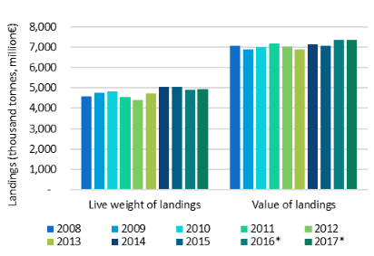
Landings
5 million tonnes of seafood
Increased 10% since 2008
Value has changed little
Spain 26% Value 18% wt
France 16% € 10% wt
UK 15% € 14% wt
Italy 13% € 4% wt
Denmark 6% € 17% wt

Slide 16
Total costs in 2015 relative to 2014
 |  | 2014 | 2015 | Change
Revenue |  | €7,248 | €7,270 | 0.3%
Labour Costs |  | €1,891 | €2,034 | 7%
Unpaid Labour value |  | €260 | €231 | -11%
Fuel Costs |  | €1,348 | €1,097 | -19%
Repair Costs |  | €577 | €643 | 11%
Other Variable Costs |  | €987 | €1,076 | 9%
Non-variable Costs |  | €600 | €542 | -10%
Total |  | €5,663 | €5,623 | -1%
Gross Profit |  | €1,585 | €1,647 | 4%

Slide 17

Costs in 2015

Slide 18


Performance Indicators
Revenue increased to €7.27 billion
Total variable costs down slightly
19% drop in cost of Fuel major factor
Gross Profit up 4% to €1.65 billion
Gross Value Added up 4% to €3.9 billion
Net Profit up 4% to €798 million

Slide 19
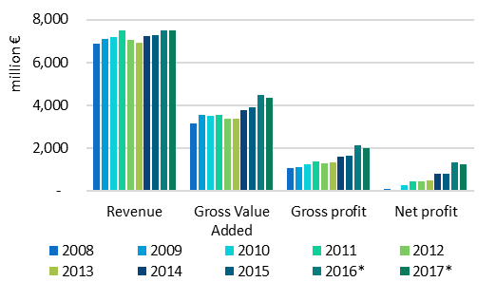

Slide 20
Performance Indicators
Revenue increased to €7.27 billion
Total variable costs down slightly
19% drop in cost of Fuel major factor
Gross Profit up 4% to €1.65 billion
Gross Value Added up 5% to €3.9 billion
Net Profit up 4% to €798 million
GVA to Revenue 54% (+4%)
Gross Margin 23% (+4%)
Net Margin 11% (+3%)

Slide 21
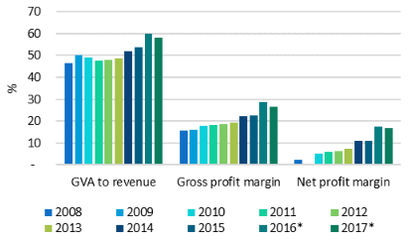

Slide 22
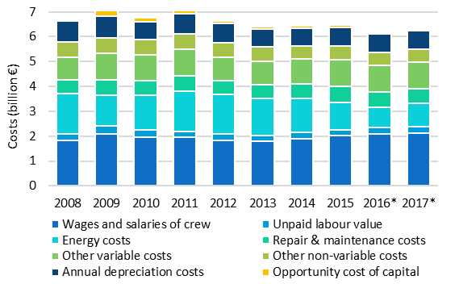

Slide 23
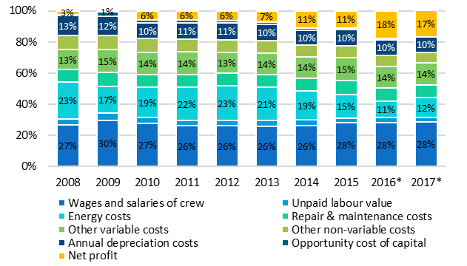

Slide 24
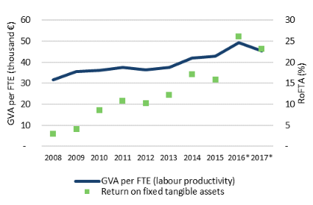
Productivity
Labour Productivity
€42,800 (GVA/FTE)
Increased 1.7% on 2014
Capital Productivity
RoFTA 15.9%
Declined 7% on 2014

Slide 25
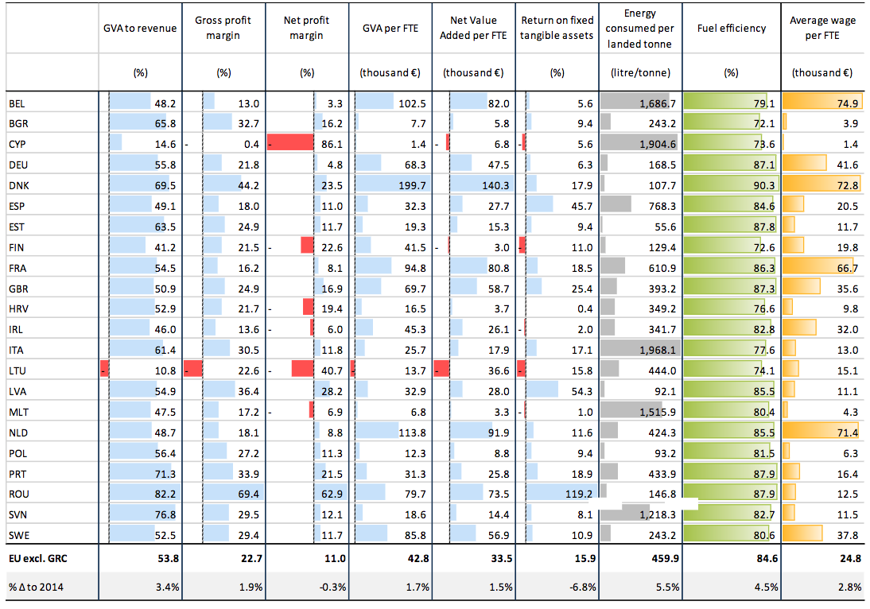

Slide 26
Main Performance Indicators by segment
 |  |  | Small Scale Fleet |  | Large Scale Fleet |  | Distant Water Fleet
 |  | Units | 2014 | Change | 2014 | Change | 2014 | Change
Days at sea |  | '000 days | 2,704 | -0.3% | 2,047 | -2.6% | 74 | 5.1%
Energy Consumption |  | M Lit | 157 | 7.5% | 1,690 | 1.7% | 479 | 21.8%
Live weight of landings |  | '000 tonnes | 284 | -1.3% | 4,080 | 2.4% | 695 | -10.9%
Value of landings |  | M € | 830 | 1.8% | 5,237 | 5.0% | 1,015 | -25.3%
GVA to Revenue |  | % | 65.2 | 3.3% | 56.2 | 7.8% | 31.2 | -27.6%
Gross Value Added |  | M € | 617 | 6.5% | 2,954 | 10.7% | 331 | -36.7%
GVA per FTE (Labour Productivity) |  | '000 € | 21.4 | 5.0% | 54.7 | 9.6% | 42.4 | -41.3%
Gross Profit |  | M € | 214 | 28.2% | 1,290 | 16.3% | 133 | -61.1%
Gross Profit Margin |  | % | 22.6 | 23.9% | 24.6 | 13.2% | 12.6 | -55.5%
Net Profit |  | M € | 92.1 | 98.0% | 628.7 | 35.4% | 54.3 | -80.0%
Net Profit Margin |  | % | 10.1 | 96.3% | 12.2 | 31.1% | 5.7 | -77.9%

Slide 27
Assessment for 2016 - 2017
2016
Landed weight down 3.4%
Landed value up 3.6%
Operating cost down 4.8%
Capital costs down 2.5%
GVA to revenue up 11%
Gross profit up 27%
Net profit up 61%
2017
Landed weight up 1%
Landed value unchanged
Operating cost up 1%
Capital costs down 2%
GVA to revenue down 3%
Gross profit down 7%
Net profit down 5%

Slide 28
Reference Number | Vessel ID | Year | Segment | Size Category | Segment-Size Unique | Capacity (GT) | Length | Capacity Index | Size Index | Total Number of vessels in Segment | Total Active Vessels in Segment | Total Engine Power (kW) for Segment-Size | Total Capacity (GT) for Segment-Size | Average Length for Segment
1221 | 9 | 2014 | TM | 40-70 | TM/40-70/2014 | 676.2 | 38.4 | 6.5 | 3.6 | 21 | 21 | 42,520 | 22,102 | 52.3
491 | 196 | 2011 | TM | 40-70 | TM/40-70/2011 | 1,469.0 | 62.7 | 7.3 | 4.1 | 21 | 19 | 44,094 | 27,473 | 55.4
1134 | 713 | 2014 | TM | 24-40 | TM/24-40/2014 | 305.9 | 24.6 | 5.7 | 3.2 | 14 | 12 | 9,396 | 4,339 | 29.5
462 | 197 | 2011 | TM | 40-70 | TM/40-70/2011 | 1,469.0 | 60.7 | 7.3 | 4.1 | 21 | 19 | 44,094 | 27,473 | 55.4
954 | 196 | 2013 | TM | 40-70 | TM/40-70/2013 | 1,469.0 | 62.7 | 7.3 | 4.1 | 21 | 21 | 42,520 | 22,102 | 52.3
646 | 197 | 2012 | TM | 40-70 | TM/40-70/2012 | 1,469.0 | 60.7 | 7.3 | 4.1 | 21 | 21 | 42,511 | 22,091 | 52.1
692 | 196 | 2012 | TM | 40-70 | TM/40-70/2012 | 1,469.0 | 62.7 | 7.3 | 4.1 | 21 | 21 | 42,511 | 22,091 | 52.1
1371 | 196 | 2015 | TM | 40-70 | TM/40-70/2015 | 1,469.0 | 62.7 | 7.3 | 4.1 | 21 | 21 | 42,520 | 22,112 | 52.3
625 | 391 | 2012 | TM | 40-70 | TM/40-70/2012 | 1,137.8 | 51.7 | 7.0 | 3.9 | 21 | 21 | 42,511 | 22,091 | 52.1

Slide 29
Employment |  | Income
1 | 2 | 1 | 2
Total Jobs | FTE | Fishing Income | Non Fishing Income | Total Income
 |  | €3,419,079 | €5,145,391 | €8,564,470
13.0 | 2.1 | €7,526,964 | €81,287 | €7,608,251
 |  | €2,020,169 | €3,529,859 | €5,550,028
12.0 | 12.0 | €7,526,963 | €111,549 | €7,638,512
 |  | €7,117,396 |  | €7,117,396
13.0 | 13.0 | €6,496,244 | €114,179 | €6,610,423
13.0 | 13.0 | €6,496,242 | €175,764 | €6,672,006
 |  | €5,901,775 | €170,148 | €6,071,923
10.0 | 10.0 | €7,936,321 | €3,564 | €7,939,885
 |  | €6,103,712 | €119,106 | €6,222,818

Slide 30
EXPENDITURE
Overhead Costs (Variable)
1 | 2 | 3 | 4 | 5 | 6 | 7 | 8
Wages | Energy Costs (Fuel) | Repairs & Maintenance | Filters/Lube Oil | Provisions | Ice | Dues & Levies | Sundry Variable Costs | Total Variable Costs
€621,924 | €313,824 | €136,110 |  | €17,583 |  | €40,157 | €631,153 | €1,760,751
€1,522,161 | €710,386 | €326,222 |  | €30,444 |  | €69,798 | €5,646 | €2,664,657
€394,610 | €194,806 | €127,594 |  | €25,033 |  | €35,368 | €440,821 | €1,218,232
€1,583,305 | €727,470 | €631,393 |  | €30,913 |  | €69,124 | €1,768 | €3,043,973
€1,328,104 | €1,202,971 | €593,183 | €0 | €32,772 | €0 | €70,879 | €29,483 | €3,257,392
€1,367,021 | €799,931 | €530,378 |  | €32,118 |  | €63,052 | €0 | €2,792,500
€1,143,943 | €857,323 | €724,792 | €0 | €33,935 | €0 | €97,045 | €0 | €2,857,038

Slide 31
GROSS PROFIT | Depreciation | Sundry receipts | Net Profit / (Loss)
€6,671,874 | €703,092 |  | €5,968,782
€4,635,091 | €520,737 |  | €4,114,354
€4,281,076 | €474,446 |  | €3,806,630
€4,163,086 | €529,076 |  | €3,634,010
€3,540,924 | €563,430 |  | €2,977,494
€3,408,092 | €527,331 |  | €2,880,761
€3,334,421 | €518,609 |  | €2,815,812
€2,976,606 | €524,825 |  | €2,451,781
€2,738,205 | €240,185 | €646,222 | €3,144,242
€2,638,126 | €608,432 | €0 | €2,029,694
€2,628,542 | €560,614 | €399,990 | €2,467,918
€2,578,571 | €1,062,000 | €43,114 | €1,559,685
€2,548,044 | €1,367,789 |  | €1,180,255
€2,517,248 | €557,568 |  | €1,959,680

Slide 32
EXPENDITURE
Overhead Costs (Fixed)
1 | 2 | 3 | 4 | 5
Insurance | Loan Interest | Accountancy | Legal Fees | Sundry fixed costs | Total Fixed Costs | TOTAL COSTS
€60,000 | €59,195 | €11,000 | €1,650 | €0 | €131,845 | €1,892,596
€116,845 | €24,980 | €18,500 | €5,000 | €143,178 | €308,503 | €2,973,160
€20,347 | €13,373 | €17,000 |  | €0 | €50,720 | €1,268,952
€103,359 | €71,204 | €18,500 | €5,000 | €233,390 | €431,453 | €3,475,426
€118,923 | €0 | €19,000 | €0 | €181,157 | €319,080 | €3,576,472
€103,363 | €43,125 | €19,000 |  | €244,343 | €409,831 | €3,202,331
€104,608 | €4,464 | €19,000 | €126,214 | €473,368 | €727,654 | €3,584,692

Slide 35
Reference Number | Vessel ID | Year | Segment | Size Category | Segment-Size Unique | Capacity (GT) | Length | Capacity Index | Size Index | Total Number of vessels in Segment | Total Active Vessels in Segment | Total Engine Power (kW) for Segment-Size | Total Capacity (GT) for Segment-Size | Average Length for Segment
1221 | 9 | 2014 | TM | 40-70 | TM/40-70/2014 | 676.2 | 38.4 | 6.5 | 3.6 | 21 | 21 | 42,520 | 22,102 | 52.3
491 | 196 | 2011 | TM | 40-70 | TM/40-70/2011 | 1,469.0 | 62.7 | 7.3 | 4.1 | 21 | 19 | 44,094 | 27,473 | 55.4
1134 | 713 | 2014 | TM | 24-40 | TM/24-40/2014 | 305.9 | 24.6 | 5.7 | 3.2 | 14 | 12 | 9,396 | 4,339 | 29.5
462 | 197 | 2011 | TM | 40-70 | TM/40-70/2011 | 1,469.0 | 60.7 | 7.3 | 4.1 | 21 | 19 | 44,094 | 27,473 | 55.4
954 | 196 | 2013 | TM | 40-70 | TM/40-70/2013 | 1,469.0 | 62.7 | 7.3 | 4.1 | 21 | 21 | 42,520 | 22,102 | 52.3
646 | 197 | 2012 | TM | 40-70 | TM/40-70/2012 | 1,469.0 | 60.7 | 7.3 | 4.1 | 21 | 21 | 42,511 | 22,091 | 52.1
692 | 196 | 2012 | TM | 40-70 | TM/40-70/2012 | 1,469.0 | 62.7 | 7.3 | 4.1 | 21 | 21 | 42,511 | 22,091 | 52.1
1371 | 196 | 2015 | TM | 40-70 | TM/40-70/2015 | 1,469.0 | 62.7 | 7.3 | 4.1 | 21 | 21 | 42,520 | 22,112 | 52.3
625 | 391 | 2012 | TM | 40-70 | TM/40-70/2012 | 1,137.8 | 51.7 | 7.0 | 3.9 | 21 | 21 | 42,511 | 22,091 | 52.1

