Slide 1
Data Analytics
Model Evaluation – other approaches

Slide 2
Scenario
Large data base
Developed a search algorithm
Returned a list of n items sorted by some measure of “similarity”
Evaluate how good the search is
Each item can be classified as relevant or irrelevant
Know the number of relevant items in the database

Slide 3
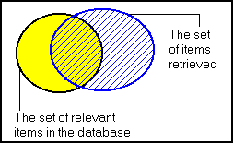
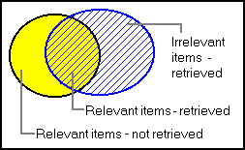
Precision and recall

Slide 4
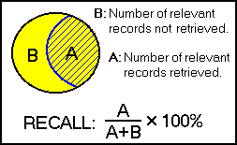
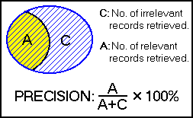
Precision and Recall
RECALL is the ratio of the number of relevant records retrieved to the total number of relevant records in the database.
PRECISION is the ratio of the number of relevant records retrieved to the total number of irrelevant and relevant records retrieved.

Slide 5
Another way of looking at it
 |  | Algorithm
 |  | Relevant | Irrelevant
Truth | Relevant | TP | FN
 | Irrelevant | FP | TN
TP+FP = number of items retrieved at a particular split
Recall = Sensitivity

Slide 6
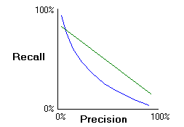
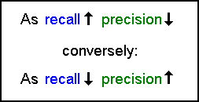
Relationship

Slide 7
Comments
Categorising items as relevant or irrelevant
Determining the number of relevant items in the database
Recall measures how well a search system finds what you want, and precision measures how well it weeds out what you don’t want

Slide 8
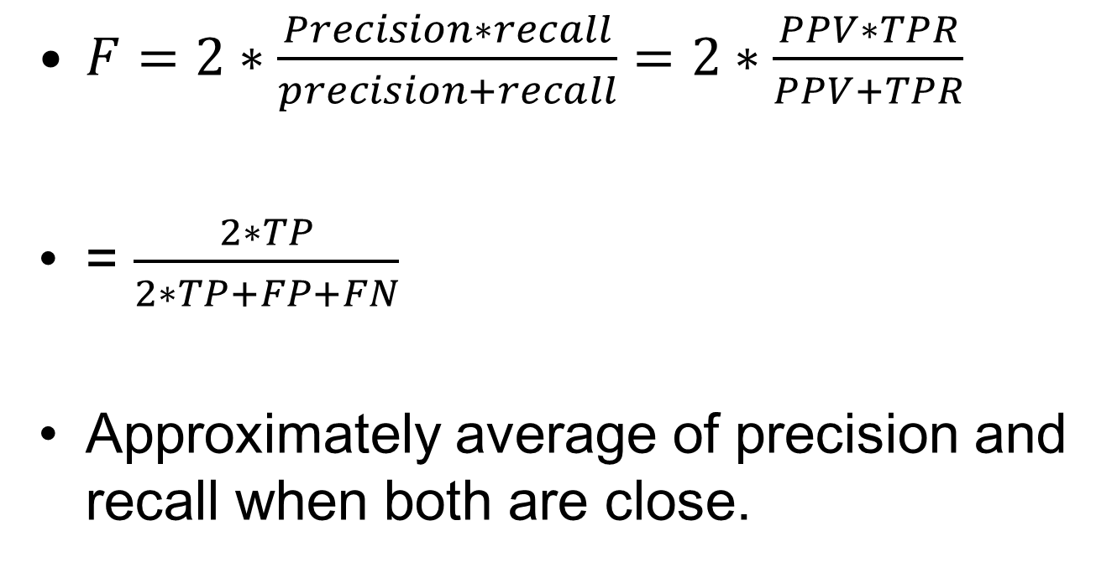
Combine Precision and Recall
$F=2∗\frac{Precision∗recall}{precision+recall}=2∗\frac{PPV∗TPR}{PPV+TPR}$
= $\frac{2∗TP}{2∗TP+FP+FN}$
Approximately average of precision and recall when both are close.

Slide 9
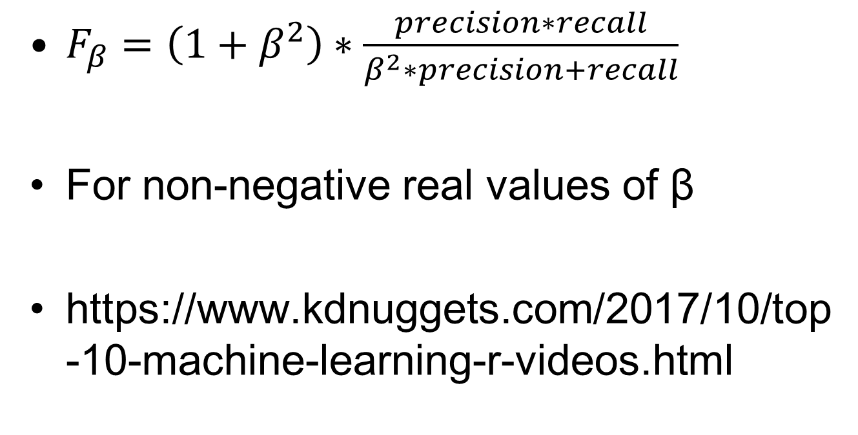
General F_{β}
$F_{β}=\left(1+β^{2}\right)∗\frac{precision∗recall}{β^{2}∗precision+recall}$
For non-negative real values of β
https://www.kdnuggets.com/2017/10/top-10-machine-learning-r-videos.html

Slide 10
Another Approach
Two outcomes for a total of N= 3333 cases
No. of Yes = 483
Run Model – logistic regression or tree
Produce predicted values – test set – p_{i}
Sort the data by p_{i} from highest to lowest
Divide the data into 10 parts – deciles

Slide 11
Model figures
Decile | Churn
 | No | Yes | total
1 | 56 | 278 | 334
2 | 281 | 52 | 333
3 | 306 | 27 | 333
4 | 318 | 16 | 334
5 | 310 | 23 | 333
6 | 314 | 19 | 333
7 | 315 | 19 | 334
8 | 318 | 15 | 333
9 | 316 | 17 | 333
10 | 316 | 17 | 333
total | 2850 | 483 | 3333

Slide 12
Random Data
Decile | Churn
 | No | Yes | total
1 |  |  | 334
2 |  |  | 333
3 |  |  | 333
4 |  |  | 334
5 |  |  | 333
6 |  |  | 333
7 |  |  | 334
8 |  |  | 333
9 |  |  | 333
10 |  |  | 333
total | 2850 | 483 | 3333

Slide 13
Best outcome
Decile | Churn
 | No | Yes | total
1 |  |  | 334
2 |  |  | 333
3 |  |  | 333
4 |  |  | 334
5 |  |  | 333
6 |  |  | 333
7 |  |  | 334
8 |  |  | 333
9 |  |  | 333
10 |  |  | 333
total | 2850 | 483 | 3333

Slide 14
Random Data
Decile | Churn
 | No | Yes | total
1 | 286 | 48.3 | 334
2 | 285 | 48.3 | 333
3 | 285 | 48.3 | 333
4 | 286 | 48.3 | 334
5 | 285 | 48.3 | 333
6 | 285 | 48.3 | 333
7 | 286 | 48.3 | 334
8 | 285 | 48.3 | 333
9 | 285 | 48.3 | 333
10 | 285 | 48.3 | 333
total | 2850 | 483 | 3333

Slide 15
Best outcome
Decile | Churn
 | No | Yes | total
1 | 0 | 334 | 334
2 | 184 | 149 | 333
3 | 333 | 0 | 333
4 | 334 | 0 | 334
5 | 333 | 0 | 333
6 | 333 | 0 | 333
7 | 334 | 0 | 334
8 | 333 | 0 | 333
9 | 333 | 0 | 333
10 | 333 | 0 | 333
total | 2850 | 483 | 3333

Slide 16
Cumulative Approach - Model
Decile | Churn
 | No | Yes | total
1 | 56 | 278 | 334
2 | 337 | 330 | 667
3 | 643 | 357 | 1000
4 | 961 | 373 | 1334
5 | 1271 | 396 | 1667
6 | 1585 | 415 | 2000
7 | 1900 | 434 | 2334
8 | 2218 | 449 | 2667
9 | 2534 | 466 | 3000
10 | 2850 | 483 | 3333
total | 2850 | 483 | 3333

Slide 17
Some definitions
From Cumulative table
% Captured Response – column %’s for Yes or Recall in R (also called Gain Charts)
% Respondents – Row %’s for Yes or Precision in R
Lift – another function
= $\frac{\% Captured response}{\% Random capture}$

Slide 18
Cumulative Table
Decile | No | Yes | total | % Respondents | % Captured response | % random Capture | Lift
1 | 56 | 278 | 334 | 83 | 58 | 10 | 5.76
2 | 337 | 330 | 667 | 49 | 68 | 20 | 3.42
3 | 643 | 357 | 1000 | 36 | 74 | 30 | 2.46
4 | 961 | 373 | 1334 | 28 | 77 | 40 | 1.93
5 | 1271 | 396 | 1667 | 24 | 82 | 50 | 1.64
6 | 1585 | 415 | 2000 | 21 | 86 | 60 | 1.43
7 | 1900 | 434 | 2334 | 19 | 90 | 70 | 1.28
8 | 2218 | 449 | 2667 | 17 | 93 | 80 | 1.16
9 | 2534 | 466 | 3000 | 16 | 96 | 90 | 1.07
10 | 2850 | 483 | 3333 | 14 | 100 | 100 | 1.00
total | 2850 | 483 | 3333

Slide 19
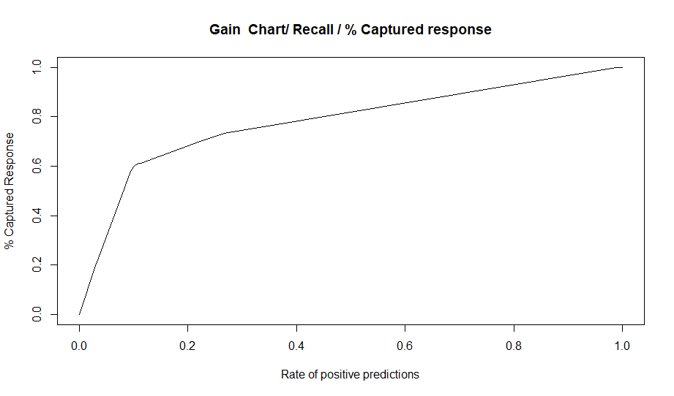

Slide 20
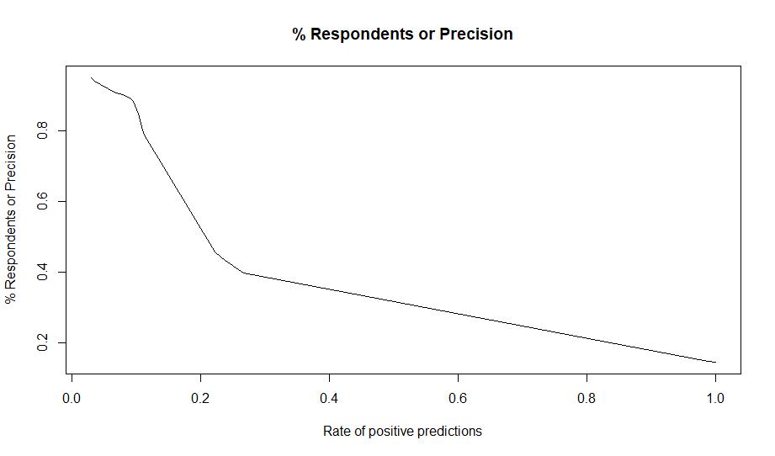

Slide 21
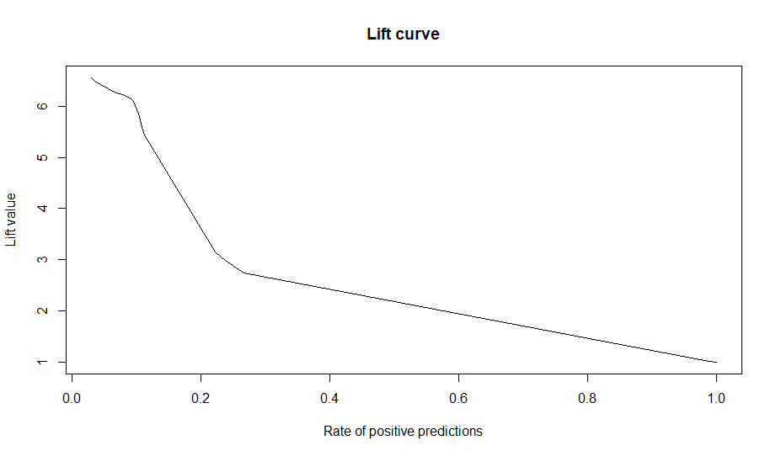

Slide 22
Interpretation of Lift
The Cumulative Lift of 3.42 for top two deciles, means that when selecting 20% of the records based on the model, one can expect 3.42 times the total number of targets (events) found by randomly selecting 20%-of-records without a model.

Slide 23
X-axis different definitions
Deciles - me and SAS
R rpp rate of positive predictions
Rattle Case load= rpp*100

Slide 24
R version
Cutoff | Precision | Recall | Rpp
Inf | NaN | 0.00 | 0.00
0.95 | 0.95 | 0.20 | 0.03
0.88 | 0.94 | 0.23 | 0.04
0.87 | 0.91 | 0.41 | 0.07
0.86 | 0.90 | 0.52 | 0.08
0.83 | 0.89 | 0.56 | 0.09
0.74 | 0.88 | 0.59 | 0.10
0.35 | 0.85 | 0.60 | 0.10
0.16 | 0.80 | 0.61 | 0.11
0.13 | 0.79 | 0.61 | 0.11
0.12 | 0.46 | 0.70 | 0.22
0.11 | 0.43 | 0.71 | 0.24
0.10 | 0.40 | 0.73 | 0.27
0.05 | 0.15 | 1.00 | 0.99
0.00 | 0.14 | 1.00 | 1.00

Slide 25
So what?
Confusion matrix
Misclassification cost
ROC
Precision
Lift
Accuracy
Recall
Cutoff

Slide 26
Which evaluation tool to use?
Purpose of study
What do we want to optimise?
Classification tool
Want a rule
if x > y then do something
IF X <= Y THEN DO SOMETHING ELSE
Rank our cases and take the top few

