Slide 1
Data Analytics Classification and Regression Trees

Slide 2
Classification & Regression Trees
Supervised learning
Target variable –
Categorical for Classification Trees
Continuous for Regression trees
Observations on other variables

Slide 3
And more...
Goal: To predict or classify a person
Construct a rule to apply in the future
To see what variables are important/related to the target variable
What does this remind you of?

Slide 4
Heart Attacks
215 patients,
37 died within a month
100 variables screened
Most expensive care for patients in greatest danger
Target variable: Die within a month

Slide 5
Classification Tree

Slide 6
Classification tree
Upside down tree
Root node – all patients
Two branches defined by a question
Terminal nodes
Classification
All cases fall into one terminal node.

Slide 7
New Cases
Sinus = 1, Age =59,BP = 75
Sinus = 1, Age =65,BP=100
Sinus =0, Age=85, BP=120
Sinus =0, Age=60, BP=90

Slide 8
Iris Data
Three types of Iris – Setosa, Versicolor and Viginica
Measures on petal length and petal width
Derive a rule for classification purposes based on these variables

Slide 9
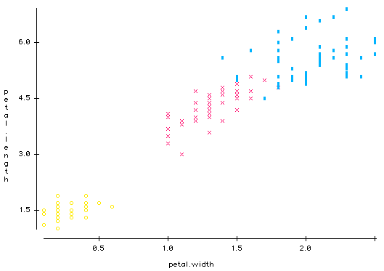
Iris Data

Slide 10
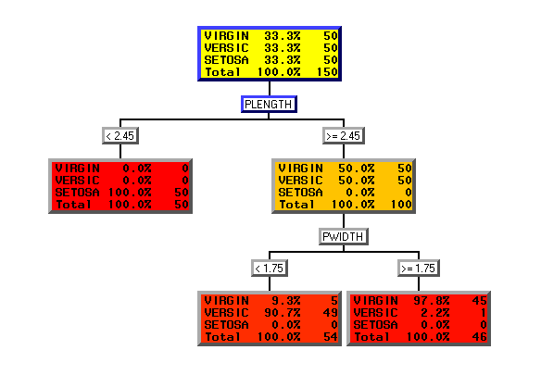
Classification Tree

Slide 11
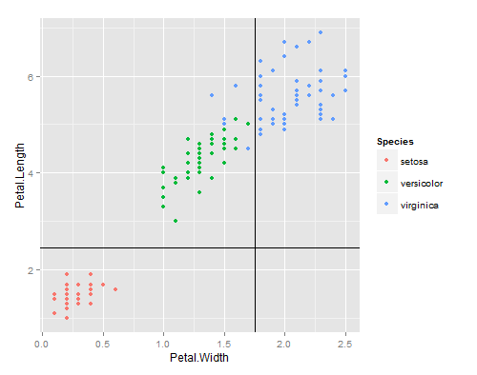

Slide 12
What are the issues here

Slide 13
Coding of outcome variable
Focus on two category outcome variable
Yes vs No, Dead vs Alive, Success vs Failure
One of them will be defined as an event
Make sure you know which.
Depends on coding
Can recode to 0/1

Slide 14
Splits for continuous variables
At each node independently
Examines all possible splits
Looks at each value for each variable
Is it a good split?
Which is the best split?
Importance of screening
How are outliers treated?

Slide 15
Splits for categorical variables
Considers all possible splits
Example 3 regions – A,B,C
Left Right
A B,C
B A,C
C A,B
n values - 2^{n-1}-1 possible splits

Slide 16
What is a good split?

Slide 17
How do we evaluate splits?
Many ways of doing this
Look at concept of impurity function
A node which contains only one class is perfectly pure
Equal proportion of every class is least pure
Need a measure to distinguish these two cases

Slide 18
Prior probabilities
Chance that a case will be presented to a tree
Expert knowledge
Data
Assume priors
Rare cases

Slide 19
Some Notation
N_{j}= Number in class j overall
N(t)= the total number of cases in node t
N_{j}(t)=no. of class j cases in node t
Prop of class j cases in node t = N_{j}(t)/ N(t)
π(j) = prior probabilities

Slide 20
Some formulae
Prob. that a case will be both in class j and fall into node t
Prob. of case falling into class j given that a case is in node t
Prob. that any case falls into Node t=

Slide 21
Common Impurity functions
c=number of categories in target variable

Slide 22
How we can use this to choose split
We look at the “impurity” of parent node t : i(t)
Each split at any node gives us 2 children t_{L} and t_{R}
We measure the impurity of the two children
i(t)-p_{L}*i(t_{L})-p_{R}*i(t_{R})
Where p_{L}=prob of going left
And p_{R}=prob. of going right
And what do we do then????

Slide 23
Choosing nodes
Δ(t,s)=i(t)-p_{L}*i(t_{L})-p_{R}*i(t_{R})
Smaller values for i(t_{L}) and i(t_{R}) the better
p_{L}+p_{R}=1
5,000 splits at a particular node t
Evaluate for each one
i(t) will be the same for each split
Choose split with largest Δ(t,s)
R calls this improvement
R multiplies Δ(t,s) by N – total no. of cases

Slide 24
Entropy and gini for 2 classes

Slide 25
B
A
Use gini to calculate the decrease in impurity for each of these splits

Slide 26
Calculate the Δ(t,s) for each split

