Slide 1
Data Analytics Classification and Regression Trees

Slide 2
Case A
i(t)=2*.5*.5=.5
p_{L}i(t_{L})=.5*2*.75*.25=.19
p_{R}i(t_{R})=.5*2*.75*.25=.19
Δ(t,s)=.5-.19-.19=.12
Case B
i(t)=2*.5*.5=.5
p_{L}i(t_{L})=.75*2*.67*.33=.33
p_{R}i(t_{R})=.25*2*0*1=0
Δ(t,s)=.5-.33-0=.17

Slide 3
Classification Tree

Slide 4
Class Assignment Rule
Assign a class to every terminal node
Calculate p(i|t) for each class i
Let j* equivalent to the max of p(i|t)
Assign the node to class j*
Class probability trees

Slide 5
Some Notation
N_{j}= Number in class j overall
N(t)= the total number of cases in node t
N_{j}(t)=no. of class j cases in node t
Prop of class j cases in node t = N_{j}(t)/ N(t)
π(j) = prior probabilities
Prob. that a case will be both in class j and fall into node t

Slide 6
Calculate p(i|t),p(i,t) and p(t) use equal priors and data as priors

Slide 7
Using data as priors

Slide 8
Data as priors π_{A}=.9 π_{B}=.1

Slide 9
Assignment of Nodes
Assign Node 1 to A
Assign Node 2 to A

Slide 10
When do we stop growing trees?
Two different approaches
Bottom up
Classical CART – grow a very big tree – maximal tree
Prunes branches
Top down
Stops growing when there are no more useful splits

Slide 11
Classical CART approach
Need to look at concept of misclassification at
Node level
Tree level

Slide 12
Evaluate a tree- Misclassification Rate
Confusion Matrix
Predicted
Observed
Dead
Alive
Dead
28
9
Alive
20
158

Slide 13
Node misclassification
Define r(t): prob. of misclassification at node t
=1 -max(p(i|t))
R(t) = r(t)*p(t)
Where p(t) probability of being in node(t)
For the tree we can write

Slide 14
Very small tree T_{t}

Slide 15
Using previous tree calculations with data as priors
Node 0: r(t₀)=.10
R(t ₀) = r(t₀)*p(t₀)=.10*1 = .10
Node 1: r(t₁) = 1-.97=.03
R(t ₁) = r(t₁)*p(t₁)=.03*.31=.0093
Node 2: r(t₂) = 1-.87=.13
R(t ₂) = r(t₂)*p(t₂)=.13*.69=.0897
R(T _{t})=.0093+.0897=.099

Slide 16
Cost complexity pruning
Two stage process
Stage 1 Develop a nested sequence for evaluation
Stage 2 Choose final tree
Start by growing a very large tree
Prune branches from large tree
Which branches and in what sequence?

Slide 17
Cost Complexity Pruning
Grow maximal tree – largest tree possible
R_{α}=cost +complexity measure of the tree T
Define cost as the misclassification rate=R(T)
Complexity measure: function of no. of terminal nodes
R_{α}=R(T)+ α*|T| where |T|= no. of terminal nodes
α penalty placed on complexity

Slide 18
Cost Complexity
For a single node t: R(t)_{α}=R(t)+ α
For a subtree T_{t:} R(T_{t} )_{α}=R(T_{t})+ α|T_{t}|
Now what happens when α increases
Both R(t)_{α} and R(T_{t} )_{α} increase but
R(T_{t} )_{α} increases faster
Value of α when R(t)_{α} = R(T_{t} )_{α}
Price paid for complexity – adding on to tree

Slide 19
Cost Complexity
Bigger values for α implies it is a better branch
Smaller values correspond to weaker branches

Slide 20
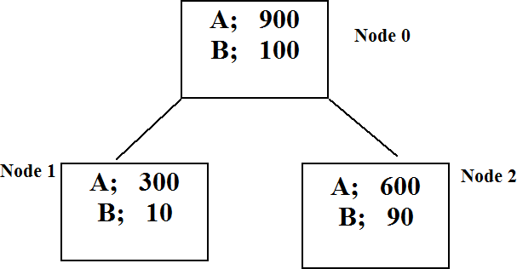
Simplest case

Slide 21
Root node R(t₀)_{α}=R(t₀)+ α
For two node tree R(T_{t})_{α}=R(T_{t})+ 2α

Slide 22
So what do we do?
Calculate a value α for each node -
Prune the tree with the lowest value of α – weakest link
Recalculate again
You continue pruning weakest node to get a sequence of subtrees T₁,T₂, … T_{root}
Then what do we do?

Slide 23
R language
is called cp – complexity parameter
It is calculated in the same way but is divided by the r(0) – misclassification rate for the root node
We will look at output in Lab.

Slide 24
Cost Complexity
We calculate this value for every branch in the tree.
Delete weakest link –maybe more than 1 branch
Recalculate α if necessary
This gives us a sequence of subtrees
How are we going to decide which to choose?

Slide 25
Misclassification Rate vs number of Nodes

Slide 26
So how do we choose the tree
For each tree obtain n estimates of the misclassification rate using crossvalidation
This gives us an estimate of misclassification rate + std error
What do you think is going to happen here?

Slide 27
What does it look like

Slide 28
How do we decide on tree?
Use complexity measure – set stopping size
Use crossvalidation results
Choose tree with minimum misclassification(± SD) or close to minimum in previous graph

Slide 29
Some R output
 | CP | nsplit | rel error | xerror | xstd
1 | 0.383 | 0 | 1.000 | 1.001 | 0.005
2 | 0.117 | 1 | 0.617 | 0.618 | 0.018
3 | 0.030 | 2 | 0.499 | 0.505 | 0.019
4 | 0.029 | 3 | 0.469 | 0.494 | 0.018
5 | 0.024 | 4 | 0.440 | 0.459 | 0.016
6 | 0.010 | 5 | 0.416 | 0.430 | 0.016
7 | 0.010 | 6 | 0.406 | 0.427 | 0.016

Slide 30
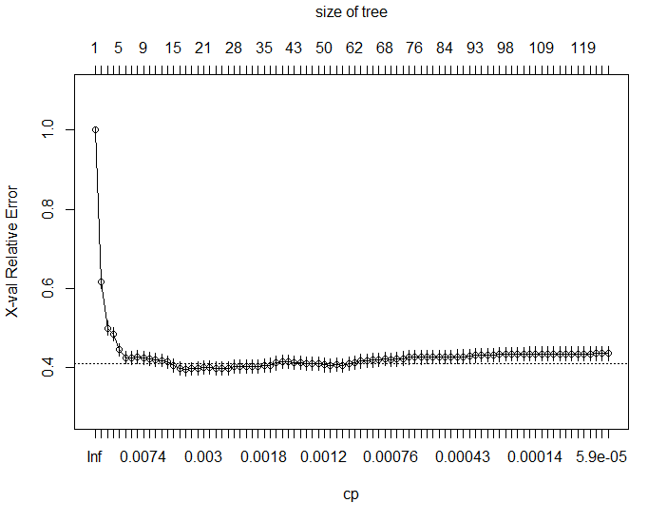

Slide 31
