Slide 1
Literature Presentation
Sankalp Mrutyunjaya, Alan Xu, Mahija Mogalipuvvu, Christopher Ahn

Slide 2
Research Paper: ATF4-dependent fructolysis fuels growth of glioblastoma multiforme

Slide 3
Hypothesis and Methodology
Types of Omics: Proteomics and Genomics
Hypothesis: Glucose deprivation affects fructose consumption
Methods: treated the GBM cell lines including U87, LN229, and A172, genetically characterized primary GBM cells TJ46, as well as GBM stem cell line GSC23 with glucose-deprived media for 18 hours. The researchers then titrated the extracellular glucose concentration needed to activate fructose metabolism by treating the U87 and LN229 cells with media containing different glucose concentrations. To investigate the role of ATF4-dependent fructolysis in GBM growth, we intracranially injected luciferase-expressing U87 cells without or with ATF4 KO or ATF4 binding-deficiency in the promoters of SLC2A5 or ALDOB into athymic nude mice. To investigate the therapeutic potential of pharmacological blockage of fructose utilization in vivo, we intracranially injected the luciferase-expressing TJ46 and GSC23 cells into athymic nude mice.

Slide 4
Findings
Treatment of U87 and LN229 cells with the PERK inhibitor GSK2656157 or the GCN2 inhibitor A-92 partially blocked glucose-deprivation-induced mRNA and protein expression of SLC2A5 and ALDOB.
The data strongly suggest that glucose deprivation induces expression of fructolytic genes depending on PERK-eIF2α and GCN2-eIF2α, but not AMPK signaling pathways.
ATF4 is required for glucose deprivation-induced fructolysis
ATF4 binds to promoters of fructolytic genes to activate fructolysis upon glucose deprivation
ATF4-dependent fructolysis rescues proliferation and colony formation of GBM cells under glucose-deprived condition
ATF4-dependent fructolysis is required to maintain GBM growth
Pharmacological blockage of fructose utilization suppresses proliferation and colony formation of GBM cells under glucose-deprived condition
Pharmacological blockage of fructose utilization shows therapeutic potential
The expression levels of ATF4, GLUT5, and ALDOB positively correlate with each other in GBM specimens and indicate a poor prognosis in GBM patients

Slide 5
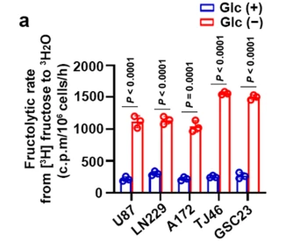
Figure 1a.
glucose deprivation promotes fructolysis
shows the fructolytic or fructose metabolic rate of GBM cells that were deprived of glucose for 18 hours
fructolytic rate measured through conversion of D-[5-3H] fructose to 3H2O
appropriate method to display data

Slide 6
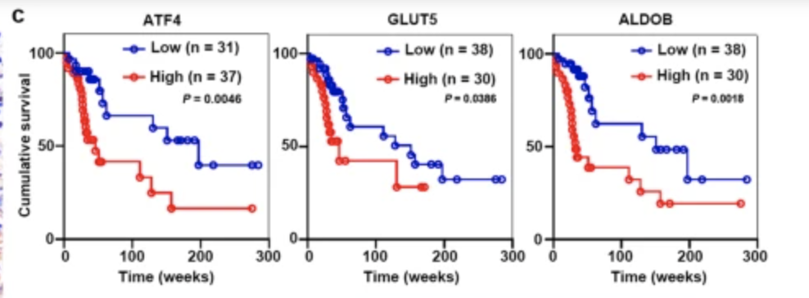
Figure 6c.
data being used comes from 68 patients with glioblastoma multiforme w/ antibodies
compares the survival time of patients with low levels vs. high levels of ATF4, GLUT5, and ALDOB
appropriate method as it plots survival over time while also taking into account the expression levels of ATF4, GLUT5 and ALDOB

Slide 7
Review Paper: Circulating biomarkers in patients with glioblastoma

Slide 8
Current Approach to Glioblastoma Treatment
Diagnosis
Neuroimaging followed by a biopsy (usually a tissue biopsy) to diagnose, grade, and characterize the tumor
Certain tumors are inaccessible or cause side effects upon removal
Treatment
Usually surgery followed by chemotherapy and/or radiation
Prognosis
MRI scans
Difficulty differentiating between tumor progression and post-radiation effects (pseudoprogression)
Most common technique to advise treatment options and surgery

Slide 9
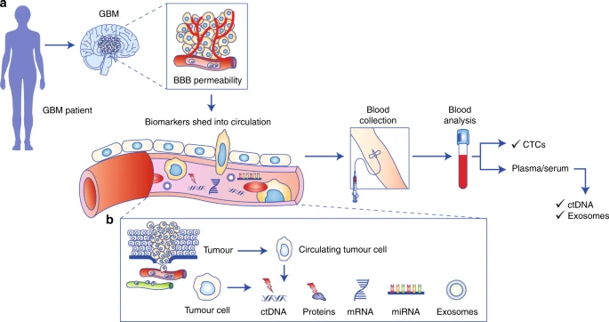
Liquid Biopsies
Samples from the blood, urine, or saliva
Tumors shed contents into circulation
Majority of biomarkers have a short half-life
Assumes contents can pass through the blood brain barrier (BBB)
BBB is a tight junction
Integrity determined by various proteins (claudin 3,5,12, etc.)
GBM induces a proangiogenic environment -> “leaky” BBB
Hypoxia induced by GBM also seems to promote the proliferation brain microvascular endothelial cells -> “leakly” BBB
“Leakiness” is clinically supported by the penetration of gadolinium through BBB under MRI scans
Sheds the possibility of performing liquid biopsies with systemic circulating fluids

Slide 10
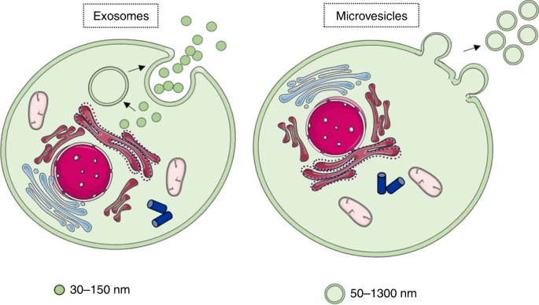
Markers
Circulating Tumor Cells (CTCs)
Very rare in glioblastoma due to the BBB and low survival rate of metastasis
Isolation is done by using specific protein markers to filter out the CTCs in the blood sample
Ex: EpCAM, an epithelial cell adhesion marker
Small sample size, but using CTCs as a biomarker seems to have promising applications
Circulating Tumor Nucleic Acids or Cell-free DNA (cfDNA)
Suggested that main source is from apoptotic tumor cells that release RNA and DNA
Need to know the tumor variations in the genome
Ex: miR-21, associated with lower survival
Potentially lncRNA
Extracellular Vesicles (EV)
Historically thought to be signs of apoptosis
Recently recognized as a tool for cell-to-cell communication
Detected by using cell surface markers (Ex. integrins)
Contents inside of EVs are usually maintained
Exosomes and Microvesicles

Slide 11
References
Chen, C., Zhang, Z., Liu, C., Wang, B., Liu, P., Fang, S., Yang, F., You, Y., & Li, X. (2022). Atf4-dependent fructolysis fuels growth of glioblastoma multiforme. Nature Communications, 13(1). https://doi.org/10.1038/s41467-022-33859-9
Müller Bark, J., Kulasinghe, A., Chua, B., Day, B. W., & Punyadeera, C. (2019). Circulating biomarkers in patients with glioblastoma. British Journal of Cancer, 122(3), 295–305. https://doi.org/10.1038/s41416-019-0603-6

