Slide 1

Dr. MGR Educational and Research Institute Chennai
Department of Electrical and Electronics Engineering
Phase one
Integrated AI Based Electricity Price Forecasting and Energy Management
Batch Members: SANJAY E 211091101014 AAKASH K 211091101001 PRASANTH S 211091101602 ADITHIYAN R 211091101603
Guided by,
Sivanand R
Integrated AI Based Electricity Price Forecasting and Energy Management

Slide 2
CONTENT
Abstract
Introduction
Literature survey
Objective
Proposed system
Block diagram
Circuit diagram
Results and discussion
Reference

Slide 3
ABSTRACT
In the realm of Industrial Internet of Things (IoT) systems, efficient Energy management and accurate price forecasting are paramount for operational optimization and cost efficiency. This study introduces a novel multi-task learning framework that simultaneously addresses these two critical aspects, leveraging cloud-based architectures to enhance scalability and performance. By integrating price forecasting with resource management tasks within a single learning model, our approach exploits the inherent correlations between these tasks to improve the accuracy and reliability of predictions and decisions. Also calculating bill and Power theft identification

Slide 4
INTRODUCTION
Cloud computing is gaining popularity as a storage platform, allowing organizations to reduce hardware and procurement expenses The exponential growth in data consumption necessitates more data centre requirements, which consume significant electricity. Data centers are responsible for 2% of the total energy consumption worldwide. The adoption of distributed computing with virtualization has the potential to significantly enhance productivity, although its usage is still limited. Energy markets exhibit high volatility, with prices surging by a factor of 10 within a mere 60 minutes.

Slide 5
LITERATURE SURVEY
Paper Title and Year | Methods Used | Merits | Demerits
IoT-Based Data Logger for Weather Monitoring Using Arduino-Based Wireless Sensor Networks with Remote Graphical Application and Alerts Jamal Mabrouki, Mourade Azrour, Driss Dhiba, Yousef Farhaoui, and Souad El Hajjaji. 2021 | IoT technology, embedded system, electronic devices, sensors, wireless technology Humidity and temperature sensor experiment with DHT22 sensor | IoT enables remote monitoring of climate parameters like temperature and humidity. Traditional tools for measuring environmental parameters have been replaced by IoT. | It highlights the importance of remote monitoring and data visualization. The system captures climate parameters like temperature, humidity, and gases.
A Load Balancing Algorithm for the Data Centres to Optimize Cloud Computing Applications Dalia Abdulkareem Shafiq, Noor Zaman Jhanjhi, Azween Abdullah And Mohammed A. Alzain 2021 | To optimize resources and improve Load Balancing. Dynamic Task Scheduling algorithm considering Deadline and Completion time. | Optimize resources improves load balancing in cloud computing applications achieves 78% resources utilization and Good performance execution time | Load unbalancing due to improper task-resource mpping in IAAS clouds. Challenges in meeting SLA due to high makespan time

Slide 6
OBJECTIVE
To carry out automatic peak clipping of the nodes during a particular period for achieving effective DSM
Automatic bill generation and power theft detection
To manage the demand for electricity, peak clipping can help to optimize the use of energy resources and reduce wastage. This can help to reduce overall energy consumption and improve energy efficiency
By managing the supply and demand of electricity in real-time, smart grids can improve the stability and reliability of the grid .

Slide 7
PROPOSED SYSTEM
Peak clipping is a technique used by power distribution companies to reduce peak loads by limiting the amount of power consumed during peak periods. This technique involves controlling the power consumption of individual customers during peak periods to avoid overloading the power distribution network. The central controller uses data analytics techniques to identify peak demand periods and control algorithms to reduce power consumption during those periods. The control signals are transmitted to the distribution substation, which reduces the power supply to the customers. The transformer steps down the reduced voltage to the customer premises, resulting in reduced power consumption during peak demand periods.

Slide 8
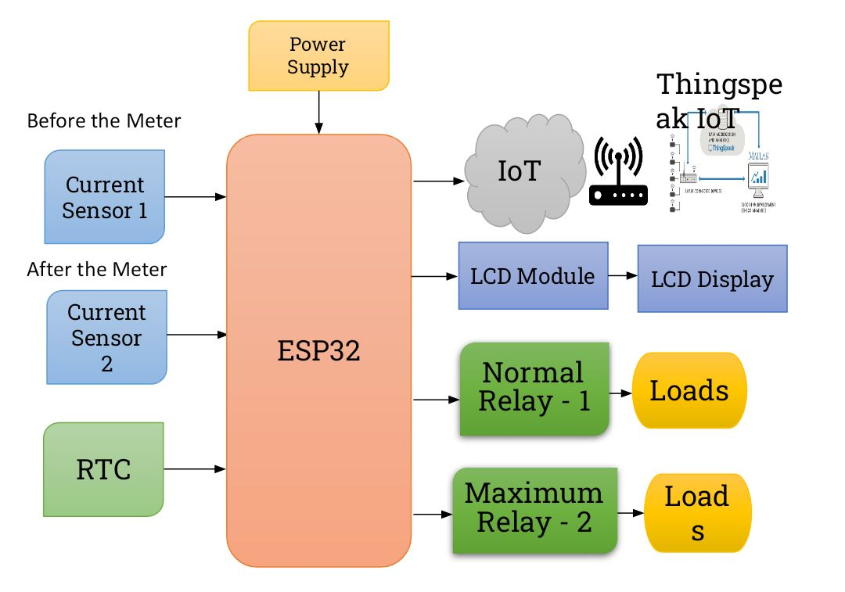
Block diagram

Slide 9
BLOCK DIAGRAM DESCRIPTION
During peak hours, for maintaining the power supply and demand ratio, the heavy loads in both nodes are operated alternatively on a load-scheduling basis. For a particular period, node 1 is in ON condition at the same time node 2 is in OFF condition. When the scheduled period is going to finish then alert message will send to the node 1 customer before a minute of power supply shut down. After that, node 2 will get a power supply and node 1 is in OFF condition by performing an automatic peak clipping method based on a pre-defined timing program loaded in the controller. Then EB can monitor and analyse the node’s status whether it is in active state or inactive state using the Thingspeak cloud webpage designed based on the values received from the current sensor.

Slide 10
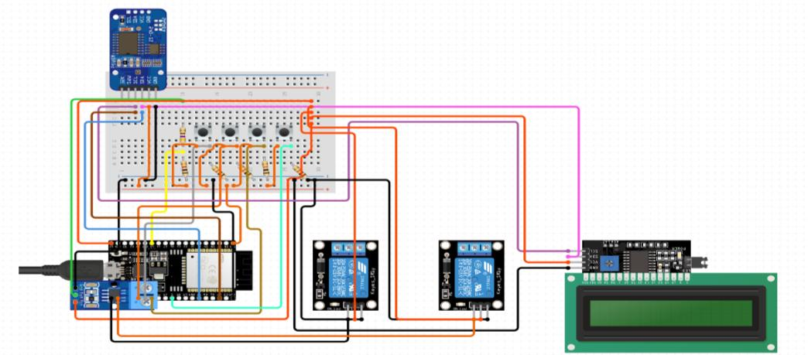
Circuit diagram

Slide 11
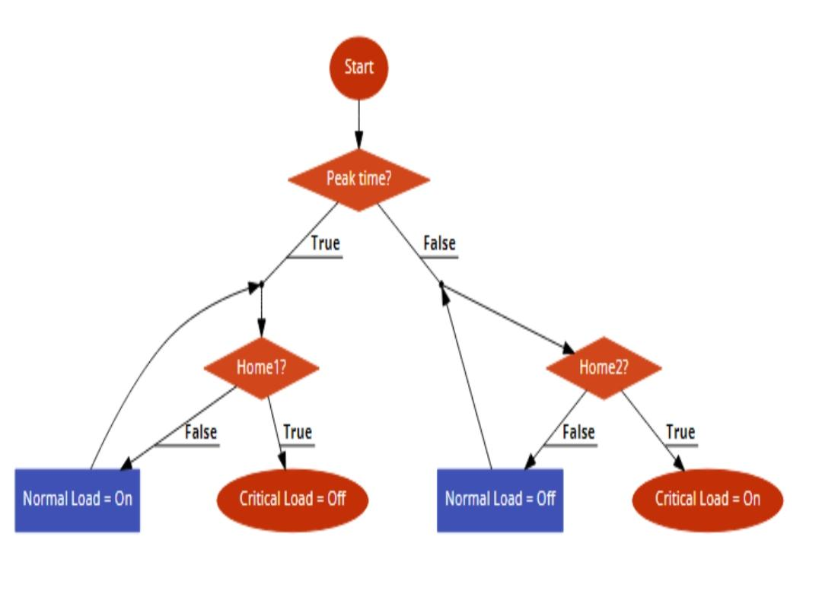
Flow chart

Slide 12
MQTT Cloud
MQTT is a machine-to-machine (M2M)/”Internet of Things” connectivity protocol designed as an extremely lightweight publish/subscribe messaging transport. It is useful for connections with remote locations where a small code footprint is required and/or network bandwidth is at a premium. MQTT facilitates reliable, efficient, and secure data transmission between IoT devices and the cloud (including ThingSpeak). It ensures that data from sensors and actuaries are delivered in real-time, allowing for timely decisions and actions.

Slide 13
Thingspeak Cloud for AI
ThingSpeak is an IoT analytics platform service that allows for the aggregation, visualization, and analysis of live data streams in the cloud. Users can create visualizations of processed data directly in ThingSpeak, making it easier to monitor and understand the current state of resources and price levels in real-time.

Slide 14
LSTM Algorithm
Long Short-Term Memory (LSTM) networks are a type of recurrent neural network (RNN) well-suited for sequence prediction problems. LSTMs are capable of learning long-term dependencies in data, which is critical in scenarios where the relevance of a past event diminishes over time but still impacts the future events. LSTM networks can predict future prices by learning from historical pricing data. The ability to remember long-term patterns is crucial for predicting prices which are influenced by complex factors evolving over time.

Slide 15
Results and Discussion
A power supply is an electrical device that offers electric power to an electrical load such as laptop computer, server, or other electronic devices. The main function of a power supply is to convert electric current from a source to the correct voltage, current, and frequency to power the load. It could be AC to DC or DC to DC. Consequently, power supplies are sometimes regarded as electric power converters. Some power supplies are standalone and separated from equipment to be external power supplies and others inside the device to be the internal power supplies..

Slide 16
REFERENCES
[1] M. Uppal, D. Gupta, N. Goyal, A. L. Imoize, A. Kumar, S. Ojo, and J. Choi, ‘‘A real-time data monitoring framework for predictive maintenance based on the Internet of Things,’’ Complexity, vol. 2023, Mar. 2023, Art. No. 9991029. [2] N. Talpur, S. J. Abdulkadir, H. Alhussian, M. H. Hasan, N. Aziz, and A. Bamhdi, ‘‘Deep neuro-fuzzy system application trends, challenges, and future perspectives: A systematic survey,’’ Artif. Intell. Rev., vol. 56, no. 2, pp. 865–913, Feb. 2023. [3] J. F. Torres, D. Hadjout, A. Sebaa, F. Martínez-Álvarez, and A. Troncoso, ‘‘Deep learning for time series forecasting: A survey,’’ Big Data, vol. 9, no. 1, pp. 3–21, Feb. 2021. [4] T. Wang, Y. Lu, J. Wang, H.-N. Dai, X. Zheng, and W. Jia, ‘‘EIHDP: Edge-intelligent hierarchical dynamic pricing based on cloud-edge-client collaboration for IoT systems,’’ IEEE Trans. Comput., vol. 70, no. 8, pp. 1285–1298, Aug. 2021. [5] S. Mishra and A. K. Tyagi, ‘‘The role of machine learning techniques inInternet of Things-based cloud applications,’’ in Artificial Intelligence Based Internet of Things Systems.

