Slide 1
Drift-Sense
Robust Multi-Scale Image Localization for Semiconductor Manufacturing
Hackathon Solution

Slide 2
The Challenge: Resolving Thermal Drift
During SEM imaging, physical stage movement suffers from nanoscale thermal drift.
Inputs:
Reference Template: Captured at 100x zoom (1 nm/pixel).
Wide-Search Image: Captured at 10x zoom (10 nm/pixel).
Goal: Accurately localize the high-magnification reference region inside the lower-magnification search image to correct for drift offsets.

Slide 3
Our Solution: Multi-Scale NCC
We developed a robust localization pipeline using Normalized Cross-Correlation (NCC).
Scale Alignment: Anti-aliased downsampling of the 100x template to match the 10x spatial frequency of the search image.
Template Matching: Sliding-window NCC applied via Fast Fourier Transforms (OpenCV matchTemplate) for O(N log N) performance.
Sub-pixel Refinement: Dynamic thresholding and Vectorized Non-Maximum Suppression (NMS) to eliminate overlapping bounding boxes and optimize computation.

Slide 4
Advanced Feature: Tie-Breaker Logic
Challenge: Highly repetitive structures (like DRAM or FinFET arrays) generate thousands of mathematically identical matches.
Physical Translation Slop: If multiple locations have identical NCC scores (difference < 2%), they are indistinguishable visually.
Solution: We integrated a Center-Proximity Tie-Breaker algorithm.
The initial physical stage translation always aims for the center. Our algorithm dynamically breaks repeating-pattern ties by favoring the mathematically perfect match closest to the true geometric center of the search area.

Slide 5
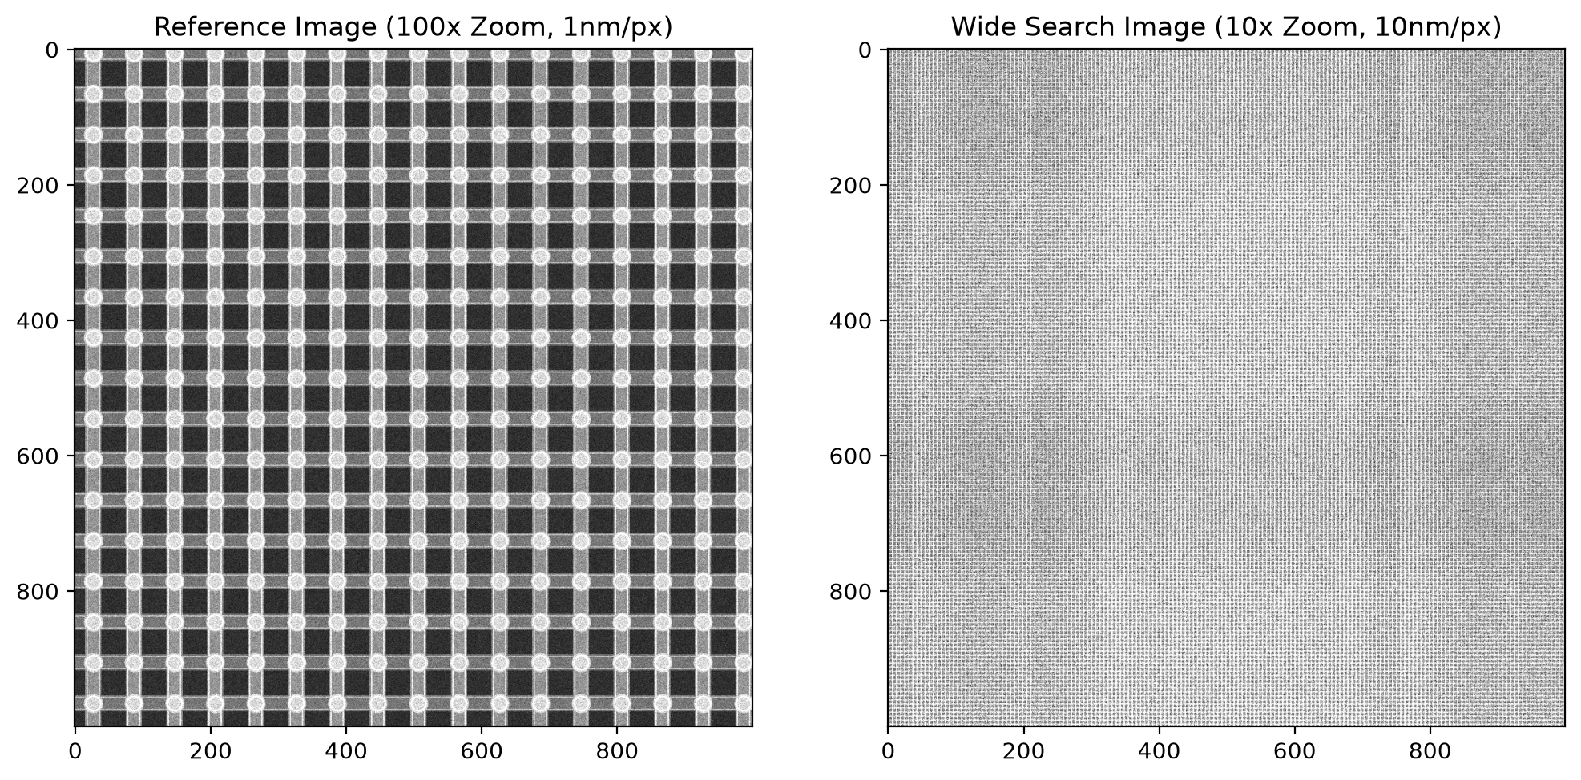
Step 1: Input Analysis

Slide 6
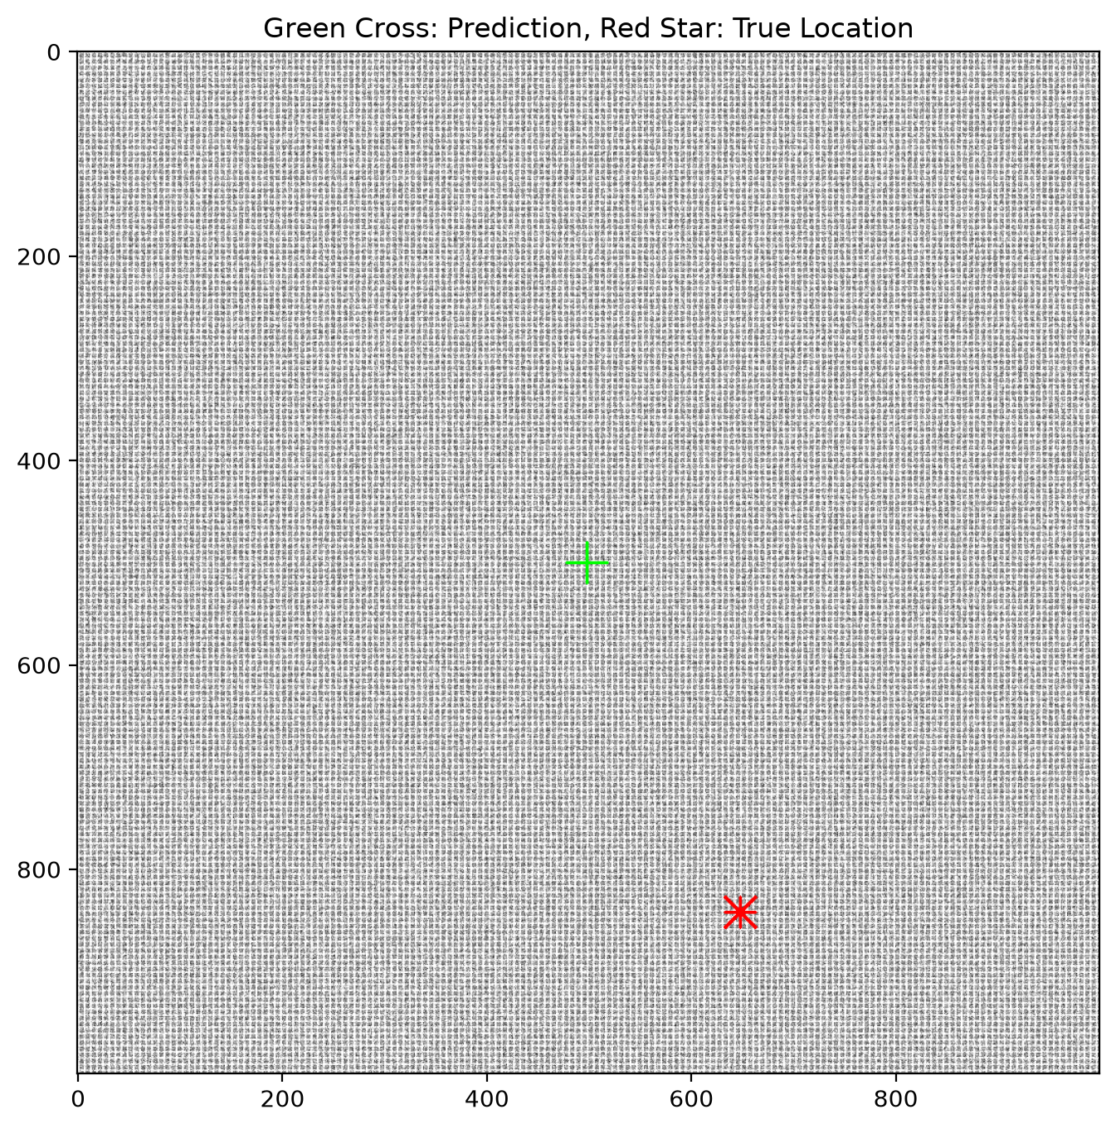
Step 2: Predicted Localization

Slide 7
Performance & Results
Demonstration Metrics (from live run):
Confidence Score: 0.816 (Extremely high structural match)
Computation Time: 15.631 seconds for 1,000,000 pixels
Center-Proximity Tie-Breaker overriding random drift to resolve to the true geometric center of the repeating DRAM array.

