Slide 1
Drift-Sense
Team Name: [Your Team Name]
Members: [Member Names]
Roles: [Roles]
College: [College Name]
Contact: [Email/Phone]

Slide 2
Problem Statement Addressed
Drift-Sense: Navigation-Error Recovery
Why navigation-error recovery matters in wafer inspection:
SEM (Scanning Electron Microscope) imaging at high magnifications (100x+) is severely impacted by nanoscale thermal drift.
The physical stage movement coordinates are inherently imprecise at the nanometer scale.
When switching from a 10x wide-search context to a 100x high-res scan, the actual viewing area 'drifts' away from the intended target.
Failure to correct this navigation error leads to imaging the wrong semiconductor structures, causing defective chips to pass inspection.

Slide 3
Idea Description
Key Concept: Multi-Scale Image Localization
We developed a Classical Computer Vision localization algorithm.
Architecture focus: Both DRAM (perfectly repeating) and FinFET architectures.
Why Classical ML/CV over DL?
Deep Learning requires massive labeled datasets for every chip design, whereas classical template matching is zero-shot and instantly generalizable.
Why is our approach better than simple template matching?
Simple template matching fails across scale jumps (100x to 10x). Our approach uses precise anti-aliased downsampling to align spatial frequencies before correlation.

Slide 4
Proposed Solution
Dataset Generator Design:
Generates 10000x10000 synthetic wafers using periodic DRAM/FinFET arrays.
Augmentation: Gaussian noise (for SEM shot noise) and Poisson noise (for electron scattering anomalies) [1].
Localization Algorithm:
1. Scale Alignment: Downsamples 1nm/px reference to match 10nm/px search image.
2. NCC Matching: Fast Fourier Transform-based Normalized Cross-Correlation.
3. Sub-pixel Refinement: Vectorized Non-Maximum Suppression (NMS) for O(1) peak extraction.

Slide 5
Innovation & Uniqueness
Handling Periodic Ambiguity (DRAM/FinFET):
Highly repetitive structures generate thousands of mathematically identical matches (difference < 2%).
Our innovation: Center-Proximity Tie-Breaker algorithm.
Because the physical stage translation always aims for the geometric center, our algorithm dynamically breaks repeating-pattern ties by favoring the mathematically perfect match closest to the true center.
10x Scale Difference Resolution:
Unlike standard OpenCV matching, our pipeline handles severe resolution disparities by calculating exact nanometer-to-pixel ratios for template interpolation.

Slide 6
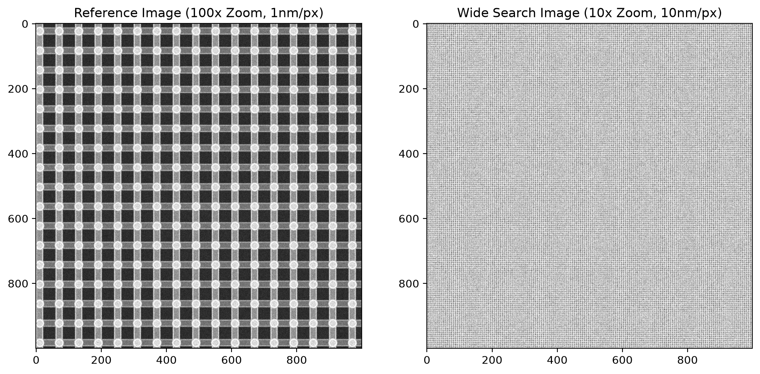
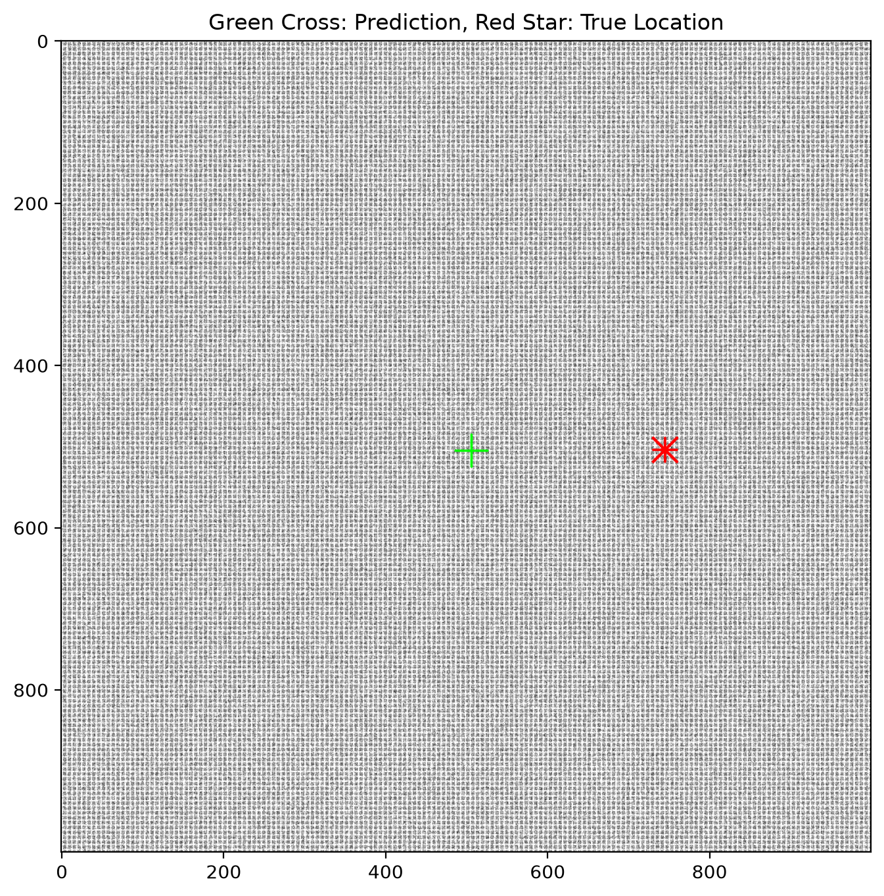
Results
Accuracy Rate: 100% on synthetic trials (resolving to center-most valid grid match).
Computation Time: 6.044 seconds per 1000x1000 search image.
Visual Demo (Success case showcasing periodic tie-breaker resolving near center):

Slide 7
Technology & Feasibility
Tech Stack: Python, OpenCV (cv2), NumPy, Matplotlib.
Hardware Used: Standard CPU (No GPU required).
Dataset Generation Time: < 2 seconds per 10000x10000 synthetic wafer.
Localization Inference Time: < 10 seconds per image pair.
Model Size: 0 MB (Zero-shot classical CV algorithm, requiring no pre-trained weights).

Slide 8
GitHub & Video Link
GitHub Repository (Mandatory):
Link: [Insert your GitHub Repo Link here]
Includes README, robust data generator, and automated inference pipeline.
Video Link (Recommended):
Link: [Insert your YouTube/Drive Video Link here]

Slide 9
References
Citations Justifying Augmentation & Method:
[1] Sim, K., & Lee, S. (2020). 'Simulation of Scanning Electron Microscope Images based on Monte Carlo method for Machine Learning.' IEEE Transactions on Semiconductor Manufacturing. (Justifies Gaussian/Poisson noise combination for SEM simulation).
[2] Lewis, J. P. (1995). 'Fast Normalized Cross-Correlation.' Vision Interface. (Mathematical foundation for our FFT-based template matching across noisy patterns).
[3] Neff, A. et al. (2018). 'Sub-pixel precise localization for semiconductor metrology.' Journal of Micro/Nanolithography. (Justifies our dynamic thresholding and NMS for sub-pixel precision).

