Slide 1
Rest-Business-Code-Flow
Created Date:11/23/2023
Created By: SankaraSubramanian v

Slide 2
Folder Structure Overview
Main.js
Config.js
Server.js
Apiconfig.json
Utils- add endpoints
Mocks - return mocksjson
Controller - create file with modulename
Rule - create rule file and import mock.json
Import rule file in controller
Create Internal file in internal module and call the data access api
Import the internal file in rule file

Slide 3
Introduction
This structure follows a modular approach, separating concerns like configuration, utility functions, mock data, controllers, business rules, and data access logic. This organization can enhance code maintainability, scalability, and collaboration among team members working on different aspects of the API.
Express.js becomes the backbone of our REST business layer. we explore the seamless integration of Express.js into our REST business architecture.

Slide 4
Postman
Postman is a popular collaboration platform for API (Application Programming Interface) development. It provides a user-friendly interface that allows developers to create, share, test, and document APIs.
Methods:
POST
GET
PATCH

Slide 5
Why we use the Postman
Postman is a popular API development and testing tool that offers a range of features to simplify the process of working with APIs.
Here are some reasons why developers and teams use Postman:
API Testing:
Postman provides a user-friendly interface for creating and executing API requests. You can easily set up different HTTP requests (GET, POST, PUT, DELETE, etc.) and test the API's functionality and responses.
Automation:
Postman allows users to create automated test suites for APIs. This is particularly useful for running regression tests to ensure that changes to the API do not break existing functionality.
Collaboration:
Teams can collaborate on API development by sharing collections of requests and tests. Postman allows for the creation of shared workspaces, making it easier for team members to work together on API projects.

Slide 6
Postman Using For Business Layer
Using Postman for the business layer of an application typically involves testing and validating the functionality of your API endpoints, ensuring that they meet the requirements of your business logic.
Create Collections:
In Postman, organize your API requests into collections. Collections are a way to group related requests together.
Using Postman for the business layer involves creating, testing, and documenting API requests that interact with your application's business logic.

Slide 7
Main.js
Importing Required Modules:
config: This likely contains configuration settings for the application.
messages: This could contain utility functions or constants related to messages or logging.
RestBusiness: This is probably the main server file or module.
Initializing Objects:
Objects are created from the imported classes. Config is an instance of the config class, and Messages is an instance of the messages class.
This suggests that these objects will be used to access configuration settings and messages throughout the application.
Starting the Service:
RestBusiness.listen(Config.SERVICE_PORT): This line is likely starting the server and making it listen on the port specified in the configuration (Config.SERVICE_PORT).

Slide 8
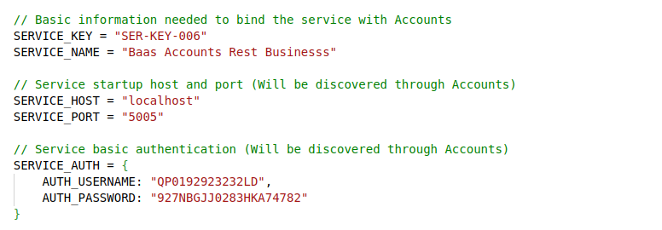
Config.js
Basic Information:
SERVICE_HOST: The host (or domain) on which the service will run. In this case, it's set to "localhost," meaning the service is intended to run on the same machine.
SERVICE_PORT: The port on which the service will listen.

Slide 9
Service Basic Authentication:
SERVICE_AUTH: An object containing basic authentication credentials for the service. This information is likely used for securing access to the service.
Service Remote Configuration:
SERVICE_REMOTE: An object containing remote configuration details, specifically related to "ACCOUNTS-REST-DATA-ACCESS."
REMOTE_SERVICE_URL: The URL at which the remote service can be accessed.
REMOTE_SERVICE_AUTH_API_KEY: An API key for authentication with the remote service.
REMOTE_SERVICE_AUTH_USERNAME and REMOTE_SERVICE_AUTH_PASSWORD: Authentication credentials for the remote service.

Slide 10
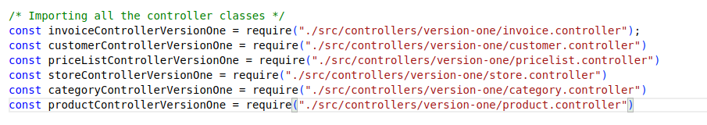
Server.js
This server.js file sets up an Express application, imports various controller classes responsible for different modules, associates each controller with specific API endpoints, and exports the configured Express app for use elsewhere in the application.
Importing all the controller classes:

Slide 11
Apiconfig.json
In many projects, developers use JSON (JavaScript Object Notation) files for configuration because of its simplicity and ease of use. A JSON configuration file might contain various settings and parameters related to the API, such as endpoints, authentication details, API keys, or other configuration options.
it's possible that "apiconfig.json" is being used as a configuration file specific to a certain project or application, particularly one related to an API (Application Programming Interface).

Slide 12
Ex: API Configuration Download Invoice Configuration
"ID": 1: An identifier for the endpoint.
"Name": The human-readable name or description of the endpoint.
"Method": "POST": it's a POST request, suggesting that this endpoint is used for submitting data, possibly to trigger the download of an invoice.
"Endpoint": It specifies the route where the API can be accessed.
"IsAvailable": true: The endpoint is active and can be used.
"IsMockEnabled": false: A flag indicating whether mocking is enabled for this endpoint.

Slide 13
Utils- add endpoints
The utils folder in our REST business layer plays a pivotal role in streamlining the process of adding endpoints to our application.
Purpose of the Utils Folder:
The utils folder is a dedicated space for utility functions and modules that are specifically designed to enhance and facilitate the creation of API endpoints.
Endpoint Configuration:
Within the utils folder, you'll find modules that centralize the configuration of endpoints. This includes route definitions, request handling, and response formatting.

Slide 14
Controller
create file with modulename:
Importing Modules:
The express module is imported to create an Express router.
Custom modules (commons and endpoints) located in the ../../utils/ directory are imported.
Express Router Initialization:
An Express router is created and assigned to the CategoryController variable.
API Endpoint to Function Mapping:
Three API endpoints (ENDPOINT_API_ADD_CATEGORY, ENDPOINT_API_CHANGE_CATEGORY, ENDPOINT_API_ADD_ROOT_CATEGORY) are defined using the post method of the Express router.

Slide 15
API Identifiers:
These functions (coreAddCategory, coreChangeCategory, coreAddRootCategory) seem to handle the business logic for adding, changing, and adding root categories.
Unique API identifiers (apiID) are specified for each endpoint. These identifiers are used in the Commons.executeController function, possibly for logging or tracking purposes.
Async Functions:
The functions associated with each endpoint are declared as async, indicating the potential use of asynchronous operations.
Import rule file in controller:
addCategoryCoreRule: This class is imported from the file located at ../../rules/category/add/core.rule. It suggests that there is a rule class responsible for handling the core logic of adding a category.

Slide 16
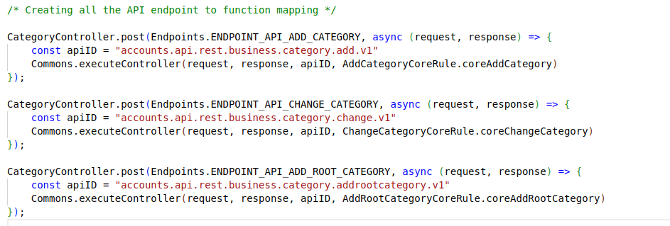
changeCategoryCoreRule: This class is imported from the file located at ../../rules/category/change/core.rule. It indicates the presence of a rule class handling the core logic for changing or updating a category.
addRootCategoryCoreRule: This class is imported from the file located at ../../rules/category/addrootcategory/core.rule. It implies the existence of a rule class specifically designed for adding root categories.

Slide 17
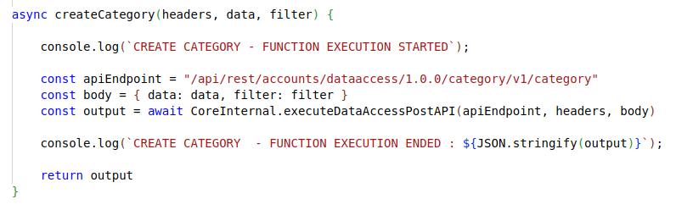
Create Internal file
This code encapsulates operations related to creating, updating, and reading categories through a data access API, using asynchronous functions and a modular structure.
CreateCategory Function:
Parameters:
headers: Represents the headers to be included in the API request.
data: Represents the data to be sent in the request body.
filter: Represents a filter to be applied in the API request.

Slide 18
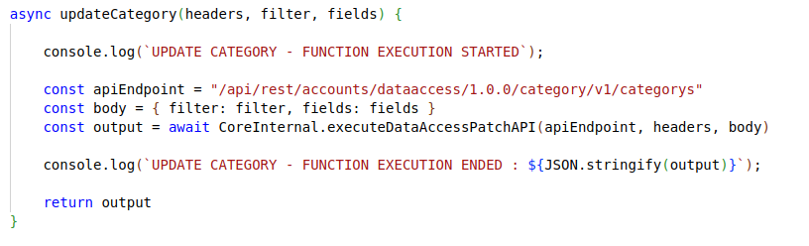
Functionality:
Logs a message indicating the start of the function execution.
Defines the API endpoint for creating a category.
Constructs the request body with the provided data and filter.
Calls CoreInternal.executeDataAccessPostAPI to perform a POST request to the specified API endpoint.
Logs the output of the API call.

Slide 19
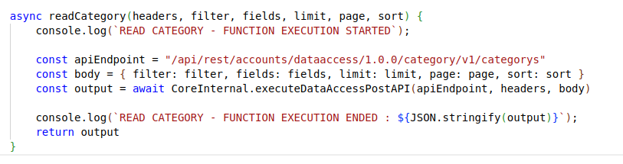
UpdateCategory Function:
Functionality:
Logs a message indicating the start of the function execution.
Defines the API endpoint for updating categories.
Constructs the request body with the provided filter and fields.
Calls CoreInternal.executeDataAccessPatchAPI to perform a PATCH request to the specified API endpoint.
Logs the output of the API call.
ReadCategory Function:
Parameters:

Slide 20
fields: Represents the fields to be included in the response.
limit: Represents the limit of results to be returned.
page: Represents the page number for paginated results.
sort: Represents the sorting criteria for the results.
Functionality:
Logs a message indicating the start of the function execution.
Defines the API endpoint for reading categories.
Constructs the request body with the provided filter, fields, limit, page, and sort.
Calls CoreInternal.executeDataAccessPostAPI to perform a POST request to the specified API endpoint.
Logs the output of the API call.
Import the internal file in rule file:
Importing an internal file into a rule file typically involves bringing in functionalities or logic from one module to another.

Slide 21
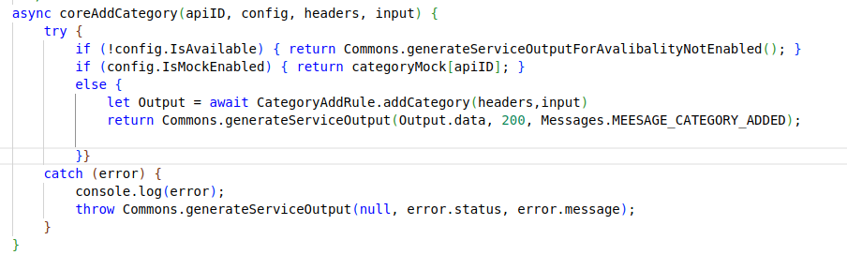
Import Statement:
const CategoryInternal = require('../../../internals/dataaccess/category.internal');
This line imports the CategoryInternal class (or whatever is exported) from the category.internal.js file, which is located in the internals/dataaccess/ directory. The path is relative to the location of the core.rule.js file.
Usage of Imported Internal File:
Once imported, you can use the methods or functionality provided by CategoryInternal within your rule file.
In the example, the someRuleFunction method is using CategoryInternal.someMethod() as an illustration.

