Slide 1

Sonarqube
Optimizing Code Analysis with SonarQube
by V. Sankara Subramanian

Slide 2
Introduction
What is SonarQube?
SonarQube is an open-source platform for continuous inspection of code quality, security, and performance.
Its primary purpose is to assist software development teams in delivering high-quality, reliable, and secure code.
Key Features :
Code Quality Analysis
Code Security Analysis
Code Duplication Checks
Code Coverage
Continuous Inspection

Slide 3
Why SonarQube?
Improve Code Quality: Identify and fix code issues early in the development process.
Enhance Security: Detect and address security vulnerabilities.
Reduce Technical Debt: Tackle code duplication and complexity.
Ensure Compliance: Enforce coding standards and best practices.
Collaboration: Promote collaboration and shared code quality goals.

Slide 4
How SonarQube Works
Developers write code.
Code is submitted for analysis.
SonarQube inspects the code.
It checks for various factors, including code quality, security vulnerabilities, code duplication, and more.
Reports on code quality, security, and other metrics are generated.
Developers receive feedback to make improvements.

Slide 5
Optimizing Code Analysis
Optimizing code analysis time is crucial for maintaining a productive and efficient software development process. Here are some strategies to help you improve the speed of code analysis.
Limit Analysis Scope:
Narrow down the analysis scope to specific projects, modules, or directories within your codebase. Exclude files or components that are not essential for the current analysis, reducing the workload.
Use Code Analysis Profiles:
Create and use different code analysis profiles for different stages of development. For example, you may have a stricter set of rules for the main branch and a more permissive set for feature branches.

Slide 6
Use Local Analysis:
Installing SonarScanner on your local machine can enhance your code analysis process and reduce the time required for analysis.
Enable local analysis for developers' workstations. This way, developers can catch issues early and reduce the number of issues reported during a full analysis.
Prerequisites:
Download and Install SonarScanner:
Visit the official SonarScanner download page (https://docs.sonarqube.org/latest/analysis/scan/sonarscanner/) and download the appropriate version for your operating system (e.g., Windows, macOS, Linux).

Slide 7
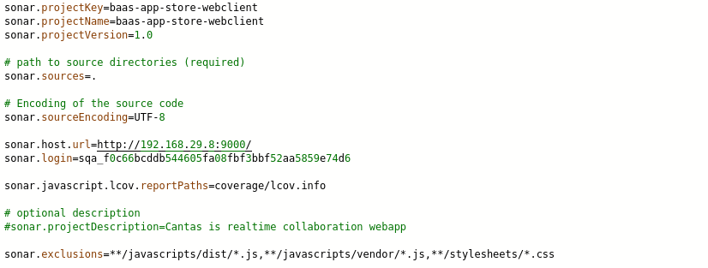
Configuration:
Configure your SonarScanner by creating or modifying the sonar-scanner.properties file. This file typically contains information about your SonarQube server or SonarCloud account, project key, and authentication details.

Slide 8
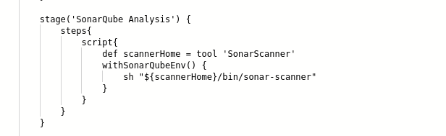
Analyze Code:
Run the SonarScanner on your codebase by executing the sonar-scanner command from your project's root directory.
The scanner will analyze your code and send the results to your SonarQube server or SonarCloud account.

Slide 9
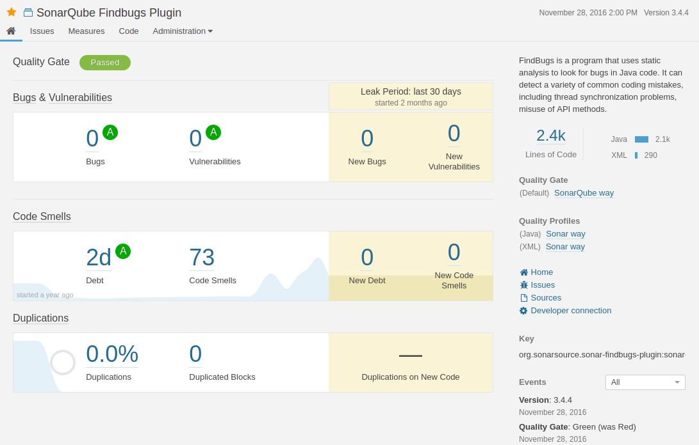
View Reports:
Once the analysis is complete, you can log in to your SonarQube server or SonarCloud account to view the analysis reports, code quality metrics, and any issues found in your code.

Slide 10
Conclusion
Conclude by reiterating the significance of SonarQube in maintaining code quality throughout the development process.
In conclusion, installing SonarScanner on your local machine is a valuable step in optimizing code analysis. It empowers developers to perform real-time quality checks and addresses issues promptly, ultimately leading to more efficient and higher-quality software development.

