Slide 1
Drones and GIS Ethical Considerations
Sankara Narayana Katabathina
Colorado State University Global
Course Code: CSC502
Dr Shaher Daoud
07/06/2025

Slide 2
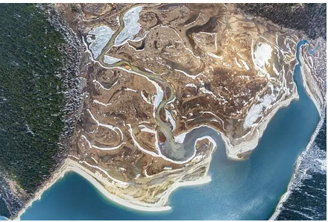
Drones and GIS
Figure 1
Aerial photo of mountain range during daytime
Drones are integrated with GIS to gather, analyze, and visualize geospatial data.
Applications include agriculture, disaster response, and urban planning.
Drones enhance data accuracy and frequency, offering real-time spatial insights.
GIS integration allows for efficient tracking, monitoring, and modeling of environments.

Slide 3
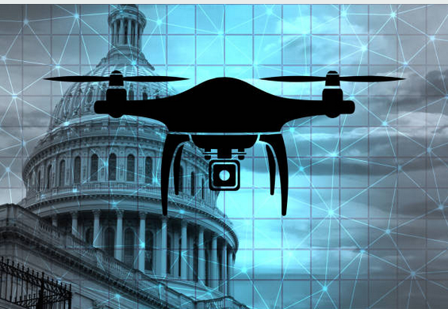
Privacy and Surveillance Concerns
Data captured may include individuals without their knowledge or consent.
Drones can record video or take images over public and private spaces.
Individuals may be identifiable in drone footage even without intentional targeting.
Raises legal and ethical questions about "reasonable expectation of privacy"
Persistent aerial monitoring can feel invasive and affect public trust.
Repeated drone flights over residential areas can cause discomfort or fear.
Communities may perceive surveillance as a tool for control or targeting.
Public opposition often grows when surveillance lacks transparency.
Lack of uniform global standards makes enforcement inconsistent.
Some countries have strict regulations, while others have virtually none.
Enforcement depends on local capabilities and political will.
This patchwork of laws allows potential misuse to go unpunished in many regions.
Figure 2
Drone Surveillance at private places
[use this space to place an image that best captures the main idea of point #1]

Slide 4
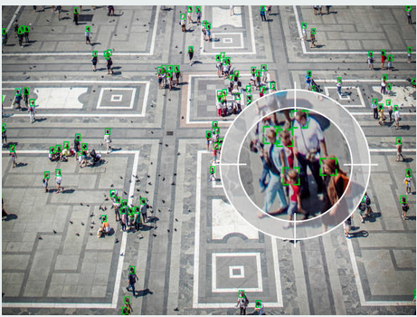
Data Ownership and Consent
Ambiguity in data rights and intellectual property.
It's often unclear whether data belongs to the drone operator, platform provider, or the subject.
Disputes can arise over usage rights, especially in commercial or governmental projects.
No universal legal framework to resolve cross border data claims.
Lack of informed consent in public and private spaces.
People are rarely informed when drones are collecting data above them.
In rural and marginalized areas, data collection often occurs without engagement.
This undermines ethical standards for transparency and respect.
Commercial use of collected data raises ethical dilemmas.
Drone data may be sold or repurposed for marketing, surveillance, or profiling.
Individuals rarely have access to or control over data that concerns them.
Monetization of personal or community data occurs without equitable benefit-sharing.
Figure 3
Drones capturing People information without their knowledge
[use this space to place an image that best captures the main idea of point #2]

Slide 5
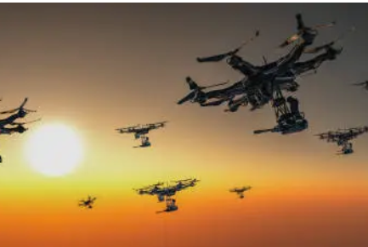
Security and Misuse Risks
Susceptibility to Cyberattacks
Drones operate on GPS signals and remote communication, both of which are vulnerable to spoofing and jamming.
Hackers can take control of drones to alter flight paths or redirect them for illicit activities.
Sensitive GIS data stored onboard or streamed in real time can be intercepted and exploited, especially when drones are used in urban or militarized zones.
Weaponization and Illicit Use
Non state actors have demonstrated the ability to weaponize commercially available drones for surveillance, disruption, or attacks.
In civil contexts, drones have been used to harass individuals, invade secure areas, or deliver contraband (e.g., into prisons).
This weaponization undermines public confidence in drone technology and creates urgency for proactive regulations.
Figure 4
Drones usage in defence
[use this space to place an image that best captures the main idea of point #1]

Slide 6
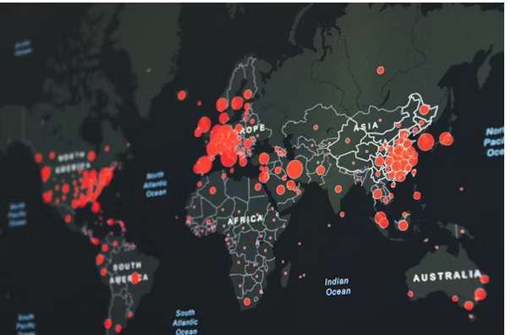
Bias and Ethical GIS Practices
Data Selection and Interpretation Bias
GIS systems are only as objective as the data inputs and choices made by analysts.
Selecting certain variables or scales may inadvertently prioritize dominant narratives or overlook marginalized communities.
For example, mapping "high crime zones" using biased law enforcement data can justify over-policing in minority neighborhoods.
Algorithmic and Model-Based Inequities
GIS models may embed assumptions that favor certain populations or land uses.
Automated decision tools used in zoning or environmental monitoring may perpetuate systemic disparities.
Drones that collect uniform data may not capture localized cultural or social nuance, leading to oversimplified conclusions.
Risks in Predictive Policing and Urban Surveillance
When used for surveillance or urban planning, GIS can reinforce racial and socioeconomic stereotypes.
Predictive policing systems that rely on historic arrest data risk legitimizing historical discrimination.
Ethical GIS practice requires critical review of how data are collected, categorized, and applied in policy.
Figure 5
mapping data can reflect or obscure regional inequalities
[use this space to place an image that best captures the main idea of point #2]

Slide 7
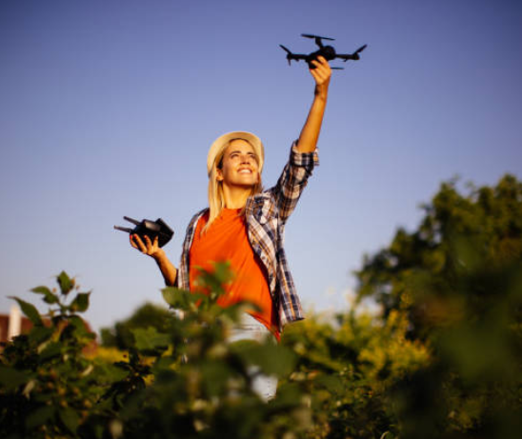

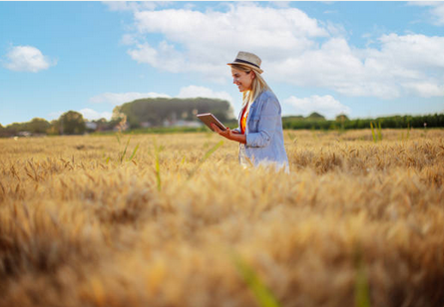

Recommendations and Best Practices
Establish clear regulatory frameworks
Create national and international laws that govern drone usage, including airspace permissions, data retention, and privacy protections.
Ensure legislation keeps pace with technological advances to close current regulatory gaps.
Promote global cooperation to standardize ethical drone operations across borders.
Implement data governance and consent protocols
Require explicit consent when collecting geospatial data from individuals or communities.
Develop local data stewardship policies that grant communities access, control, and knowledge over drone-collected data.
Mandate disclosure of data usage plans before drone deployment.
Prioritize ethical training and interdisciplinary education
Equip GIS professionals, drone pilots, and data scientists with ethics training that covers consent, cultural sensitivity, and bias detection.
Incorporate real-world case studies into professional certifications and university curricula.
Encourage collaboration between technologists, ethicists, and community representatives.
Promote participatory GIS practices
Include stakeholders especially Indigenous, rural, and underrepresented populations in the planning and analysis stages.
Use co-creation models to build trust and ensure the data serves the needs of the communities involved.
Avoid extractive mapping practices that benefit only external parties.
Strengthen data security and transparency
Encrypt drone communications and store data in secure, access-controlled environments.
Maintain transparent audit logs and metadata that track how, when, and why data was collected.
Regularly assess data systems for vulnerabilities and apply security patches promptly.
Figure 4
Drone and GIS technology in an agricultural field, demonstrating ethical and responsible data collection
[use this space to place an image that best captures the main idea of point #1]

Slide 8
References
Patrick Lin, Keith Abney, and George A. Bekey, Editors. Robot Ethics: the Ethical and Social Implications of Robotic: https://csuglobal.idm.oclc.org/login?url=https://search.ebscohost.com/login.aspx?direct=true&AuthType=ip,uid&db=nlebk&AN=414238&site=eds-live
ANDERSON, JENNIFER, The Age of Surveillance Capitalism: The Fight for a Human Future at the New Frontier of Power.: https://csuglobal.idm.oclc.org/login?url=https://search.ebscohost.com/login.aspx?direct=true&AuthType=ip,uid&db=asn&AN=147355278&site=eds-live
Steven E. Franklin, New York, McGraw-Hill, 2010. Remote Sensing for Biodiversity and Wildlife Management: Synthesis and Applications: https://csuglobal.idm.oclc.org/login?url=https://search.ebscohost.com/login.aspx?direct=true&AuthType=ip,uid&db=asn&AN=61305861&site=eds-live
MORDELL, DEVON. Critical questions for big data: https://csuglobal.idm.oclc.org/login?url=https://search.ebscohost.com/login.aspx?direct=true&AuthType=ip,uid&db=asn&AN=137140406&site=eds-live
Roger Clarke, Understanding the drone epidemic: https://www.sciencedirect.com/science/article/abs/pii/S0267364914000545?via%3Dihub

