Slide 1

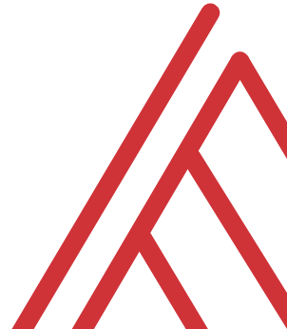
Advancing into Analytics: From Excel to R and Python

Slide 2
Learning objectives
Situate Excel in the data analytics stack
Chart a clear learning path from Excel to R and Python
Demonstrate tangible use cases for combining these tools

Slide 3
Unofficial learning objectives
Having fun with data & computers

Slide 4
What is the data analytics stack?

Slide 5
Spare no tools…
Insert your O’Reilly-drawn data analytics stack image here

Slide 6
What is Excel good for?
Good at…
Visual calculations
End-user interactivity
Rapid prototyping
Not so much…
Storing data
Mobilizing data
Implementing advanced analysis

Slide 7
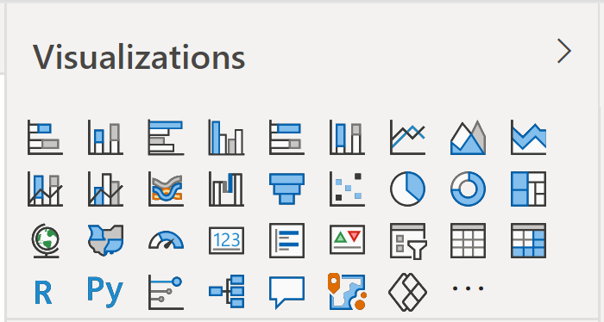
Don’t take my word for it…
Insert Power BI visuals here

Slide 8

Don’t take my word for it…
https://docs.microsoft.com/en-us/archive/blogs/wikininjas/tnwiki-article-spotlight-consuming-azure-storages-python-sdk-using-ptvs

Slide 9
The dialects of data
Adding, removing, calculating columns
Sorting and filtering
Aggregating and joining
Pivoting and reshaping

Slide 10
Welcome to the R Project for Statistical Computing

Slide 11


R + RStudio
The code base
The interface

Slide 12
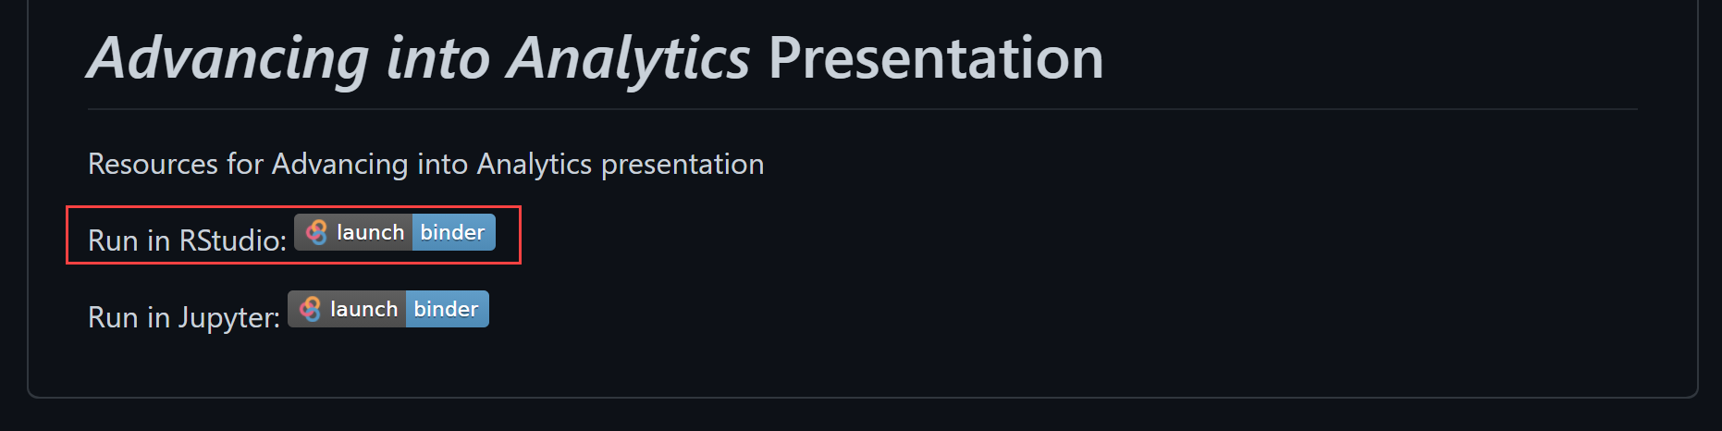
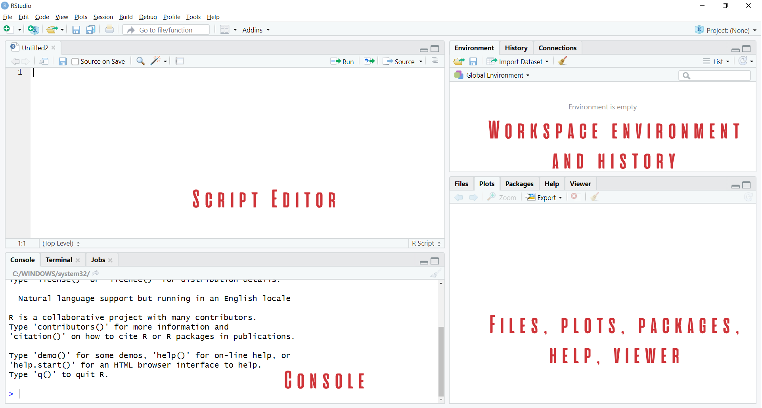

Demo
Navigate RStudio, beginning with 1+1

Slide 13

The dialects of data
Group by origin
Find average for each group
Sort the results
“Get me the average price for each cut, sorted from high to low.”

Slide 14

Packages: “There’s an App for that!”
Install the package
Open the package

Slide 15
Demo
Speaking the language of data with the tidyverse
Load and explore diamonds dataset
Write a “sentence” in dplyr:
“Get me the average price for each cut, sorted from high to low.”
File: diamonds.r

Slide 16
Questions?

Slide 17
Prancing into Python

Slide 18



Python+ Anaconda + Jupyter
The (open) source code
The distribution of code & apps
The browser-based app

Slide 19

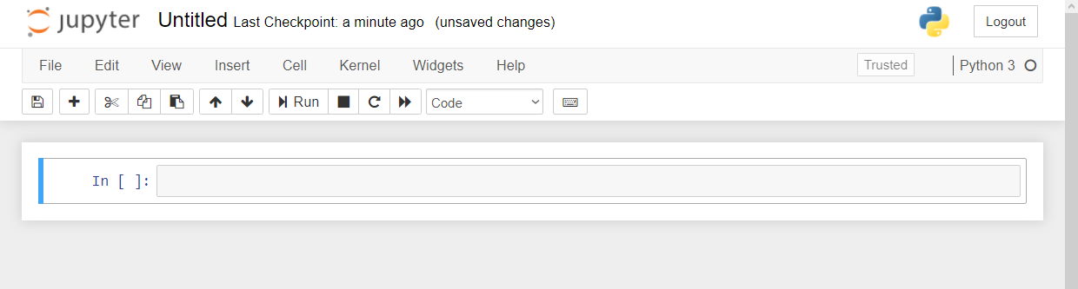
Demo
Navigate Jupyter, starting with 1 + 1
File: Open a new .ipynb notebook
Notebook name
Menu bar
Toolbar
Code cell

Slide 20
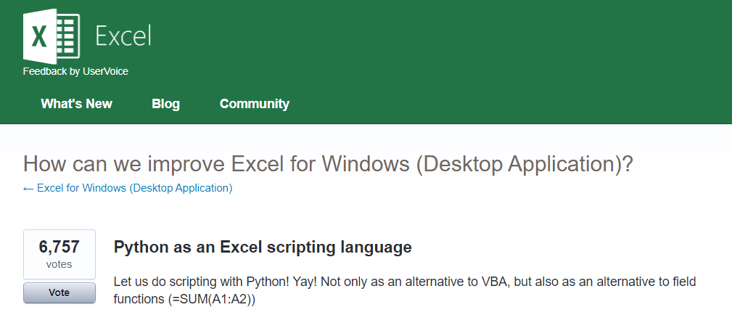



Python for Excel
More: http://www.python-excel.org
https://excel.uservoice.com/forums/304921-excel-for-windows-desktop-application/suggestions/10549005-python-as-an-excel-scripting-language

Slide 21
Demo
Export & format a dataset to Excel
Working with modules in Python
Working with tabular data in Python
“Python-Powered Excel”
File: python-powered-excel.ipynb

Slide 22
Questions?

Slide 23
The data world is your oyster shell

Slide 24
Demo
Export an R regression to Excel
Decoupling of platforms and applications
The magic of ggplot2 visualizations
File: r-powered-excel.ipynb

Slide 25
Questions?

Slide 26
Conclusion/Resources

Slide 27
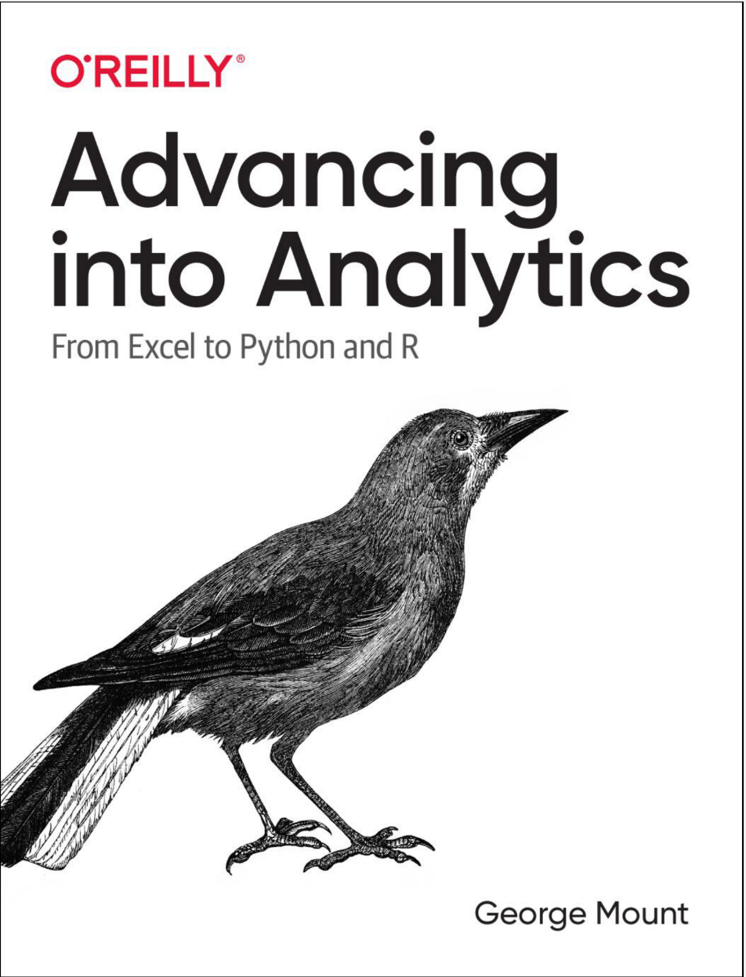
Buy my book
http://georgejmount.com/book/
Learning objective: By the end of this book, you should be able to conduct exploratory data analysis and
hypothesis testing using a programming language.

Slide 28
After you’ve bought my book
R for Data Science by Hadley Wickham and Garrett Grolemund
Python for Data Analysis, 2nd Edition by Wes McKinney
Python for Excel by Felix Zumstein

Slide 29
Get in touch
george@stringfestanalytics.com
stringfestanalytics.com/book
linkedin.com/in/gjmount

