Slide 1
RM Pre-Meeting
Intelligence Brief
Agentic AI for Relationship Managers · M&T Bank AI Hackathon 2026
Powered by Claude Sonnet + Plaid Sandbox · Java / Spring Boot
Focus: Deliver High-Value Use Cases · Agent-Based AI · Operationalize GenAI

Slide 2
The Problem: Meeting Prep is Manual, Slow, and Error-Prone
"Before every client meeting, I spend 10–15 minutes opening core-banking screens, checking CRM notes, scanning recent transactions, and hoping I remember what I promised last time."
10 min
6 ×/day
220 days
220 hrs
manual prep
per meeting
average client
meetings
working days
per year
lost per RM
per year
Where it breaks down:
The RM walks in underprepared.
The client notices.
Data scattered across core-banking, CRM, and investment platforms
Open promises from last meeting buried in unstructured notes
No flag when a CD is about to mature or a large outflow just hit
Generic prep — nothing tailored to what actually changed

Slide 3
Our Solution: One Click → One-Page Brief, Ready in Seconds
What the RM gets:
The Design That Makes It Bank-Grade
📸 Snapshot
Name, segment, tenure, total relationship value
"What is true" is deterministic Java.
"How to say it" is the LLM.
The model is never trusted with arithmetic, dates, or comparisons.
📊 Changed Since Last Meeting
What actually moved — balances, inflows, outflows
⚠️ Watch-Outs
✓ No invented numbers
Severity-rated alerts: overdraft risk, maxed credit, dormancy
💡 Opportunities
✓ Every claim has an auditable citation
Maturing CDs, underutilised savings, cross-sell signals
✓ One right-sized model call per brief
🗣️ Talking Points
Three scripted, data-grounded conversation starters
~4¢ LLM cost per brief
vs ~$12.50 RM time saved
📝 Last Interaction
Meeting notes + open promises pulled from CRM

Slide 4
How It Works: 4-Phase Agentic Pipeline
1
2
3
4
🔧
📊
🤖
📡
GATHER
DELTA
SYNTHESIZE
STREAM
6 read-only tools
Pure Java
1 Claude Sonnet call
SSE events
CRM → Postgres
ZERO LLM tokens
Prose from ChangeReport
Live agent feed
→
→
→
Plaid Sandbox API
Accounts, outflows,
Citation validator
Brief JSON
(eager or LLM-driven)
maturity, dormancy
strips hallucinations
Clickable citations
Single HTTP request (SSE stream) · GET /briefs/{clientId}/stream

Slide 5
The Differentiator: Deterministic Delta + Constrained Synthesis
❌ Typical LLM Approach
✅ Our Approach
• LLM reads raw data and computes deltas itself
• Java computes all deltas — zero LLM tokens
• Model may hallucinate balances or dates
• ChangeReport is the single source of truth
• No way to audit where a number came from
• Claude writes prose ONLY from that report
VS
• One bad inference poisons the brief
• Citation validator strips any unresolvable ID
• Cost scales with reasoning complexity
• One Sonnet call = predictable cost (~4¢)
Same architecture that prevents hallucinations also minimises token cost.

Slide 6
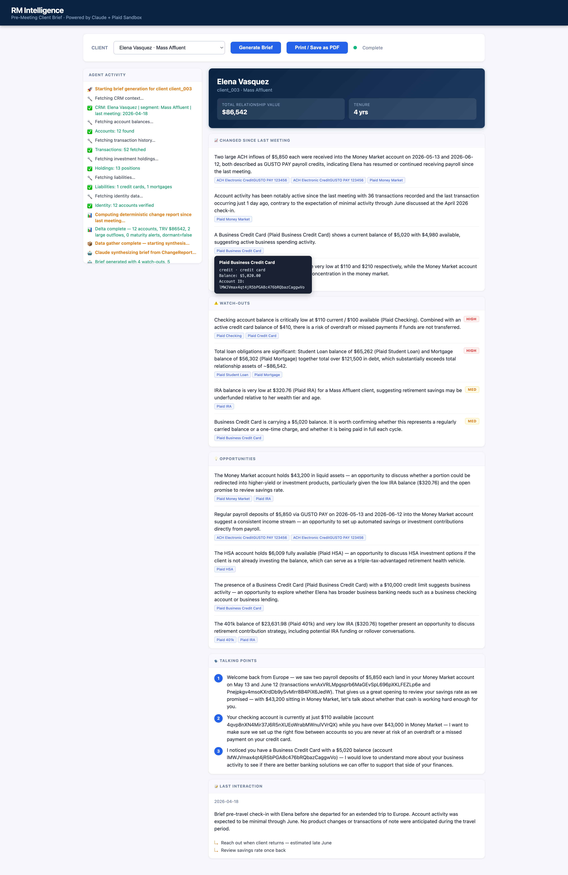
Demo: Robert Harrington · Mass Affluent Hero Client
http://localhost:8080 · GET /briefs/client_002/stream · SSE live feed

Slide 7
Citations: Every Claim Is Auditable
🗄️
⚙️
🤖
🔍
✅
Plaid API
returns data
Java builds
ChangeReport
Claude writes
prose + cites IDs
Validator checks
every citation
Brief delivered
with real IDs
✅ Citation resolves
🔴 Citation doesn't resolve
Chip is clickable
→ shows account name, balance, account ID
→ RM can verify the source instantly
Chip is rendered red and stripped
→ hallucinated ID visible to reviewer
→ never silently reaches the RM
"Plaid Money Market · depository · $43,200"
Caught by SynthesisService.validateCitations()
before the brief is returned

Slide 8
Business Case: 300× ROI on Every Brief
~4¢
$12.50
300×
$820K
LLM cost
per brief
RM time value
reclaimed
return on
each brief
50-RM pilot
annual value
Assumptions
Per-Brief Cost Breakdown
• 10 min manual prep per meeting
Gather (6 tools)
Java — $0.00
• $75 / hr RM fully-loaded cost
Delta computation
Java — $0.00
• 6 meetings × 220 days = 1,320 briefs / RM / yr
Synthesis input ~5k tokens
$0.015
• 50-RM pilot scope
Synthesis output ~1.5k tokens
$0.023
Total
~$0.04
Break-even: < 1 month at pilot scale · ~$53/RM/yr model cost vs $16,500/RM/yr time value

Slide 9
Tech Stack & Agentic Design
☕ API
Java 21 · Spring Boot 4.0 · Maven
Why It's Agentic
Tool-calling loop
🤖 LLM
Claude Sonnet 4.6 · anthropic-java 2.41
Claude plans & sequences 6 tool calls in LLM-driven mode (eager-tool-calls=false)
🏦 Financial
Plaid Sandbox · plaid-java 35.0
Observable pipeline
Every phase emits SSE events — live agent feed in the UI
🗄️ Data
PostgreSQL 16 · Flyway migrations
Validated output
Claude's output is checked against ground-truth IDs before use
📡 Streaming
SSE (Server-Sent Events) · virtual threads
Configurable modes
Deterministic (default) or full LLM orchestration — one flag in application.yml
🖥️ UI
Single static HTML/JS file — no build step

Slide 10
Path to Production
Wks 1–3
FDX / Production Plaid integration
~$50K one-time
8 wks · 2 engineers
Replace Sandbox with real bank data
Wks 4–5
AuthN / AuthZ / audit logging
~$50K one-time
8 wks · 2 engineers
RM login, role scoping, full audit trail
Wks 6–7
Productionise SSE + UI + observability
~$50K one-time
8 wks · 2 engineers
Metrics, error handling, pilot UX
Wk 8
Pilot UAT with 50 RMs
~$50K one-time
8 wks · 2 engineers
Feedback loop, threshold tuning
The POC is end-to-end working today. Plaid Sandbox → FDX is the primary integration swap.

Slide 11
One design decision.
Two wins.
🏦 Bank-grade trust
💰 Minimal token cost
Deterministic deltas + citation validation = no hallucinations in the brief
One right-sized Claude call per brief — 4¢ in, $12.50 in RM time out
Data: synthetic · Plaid Sandbox only · No customer PII · AI-assistance disclosed in docs/model-usage.md

